Slide 1
Secondary consideartions

Slide 2
Frontiers in Computational Genomics
Brief Research Reports
Tools or algorithms which provide meaningful insights into biology from the analysis of genomic data
It has a 3.258 impact factor
https://www.frontiersin.org/journals/all/sections/computational-genomics#about

Slide 3
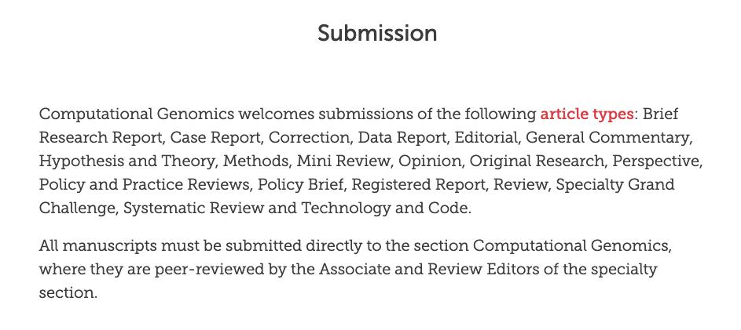

Slide 4
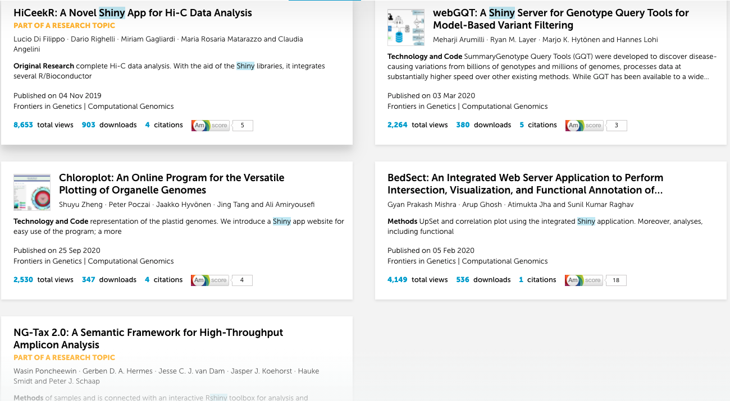
https://www.frontiersin.org/search/section/computational-genomics?query=r+shiny&tab=top-results&origin=
https%3A%2F%2Fwww.frontiersin.org%2Fjournals%2Fall%2Fsections%2Fcomputational-genomics%23about

Slide 5
Frontiers in genetics
Original research article (https://doi.org/10.3389/fgene.2019.01079)
Technology and code (https://doi.org/10.3389/fgene.2020.00152)
Technology and code (https://doi.org/10.3389/fgene.2020.576124)
Method article (https://doi.org/10.3389/fgene.2020.00003)
Method article (https://doi.org/10.3389/fgene.2019.01366)

Slide 6
Frontier in Genetics – computational genomics
Technology and code
Tools or algorithms which provide meaningful insights into biology from the analysis of genomic data
It has a 3.258 impact factor
https://www.frontiersin.org/journals/all/sections/computational-genomics#about

Slide 7
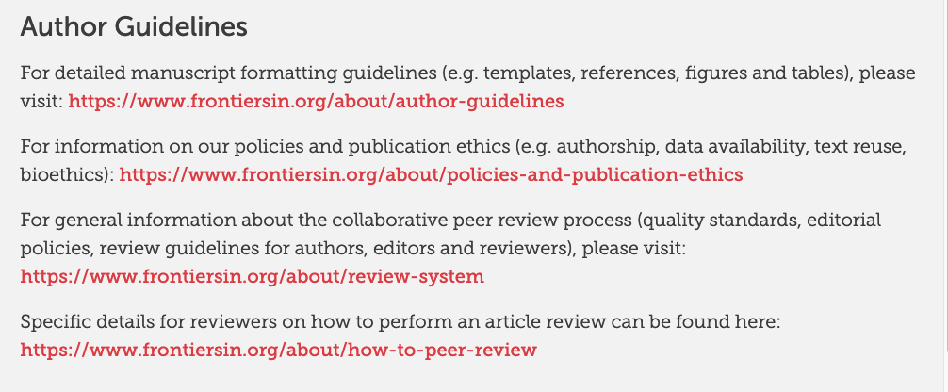

Slide 8
Technology and code
SoftwareApplication/SoftwareSourceCode and Dataset related specifications. Technology & Code articles should have the following format: 1) Abstract, 2) Introduction, 3) Method (including any code description), 4) Results (including examples of use and limitations), 5) Discussion (including scalability and limitations). The following information must also be included: project link (e.g. sourceforge, github), operating system (e.g. Windows, Linux, platform independent), programming language (e.g. Python), any restrictions for non-academic use (e.g. licence needed).

