Slide 1
Secondary consideartions

Slide 2
BMC research note
Abstract: 200 words
Introduction, main text and limitation together: 2000 words
Declarations: must have
Software: public repository
Figure table limitation: 3
https://bmcresnotes.biomedcentral.com/submission-guidelines/preparing-your-manuscript/research-note

Slide 3


Slide 4
BMC genomics -- software article
Impact factor: 3.75
The Abstract should not exceed 350 words
3 – 10 key words
Lists the following:
Project name: e.g. My bioinformatics project
Project home page: e.g. http://sourceforge.net/projects/mged
Operating system(s): e.g. Platform independent
Programming language: e.g. Java
Other requirements: e.g. Java 1.3.1 or higher, Tomcat 4.0 or higher
License: e.g. GNU GPL, FreeBSD etc.
Any restrictions to use by non-academics: e.g. licence needed
https://bmcgenomics.biomedcentral.com/submission-guidelines/preparing-your-manuscript/software-article
Software articles should describe a tool likely to be of broad utility that represents a significant advance over previously published software

Slide 5
PeerJ – life & environment
Bioinformatics tool
One preprint: National Institute of Mental Health and Neuro Sciences
Impact: 2.38
Citation average: 8.5
https://peerj.com/about/author-instructions/

Slide 6
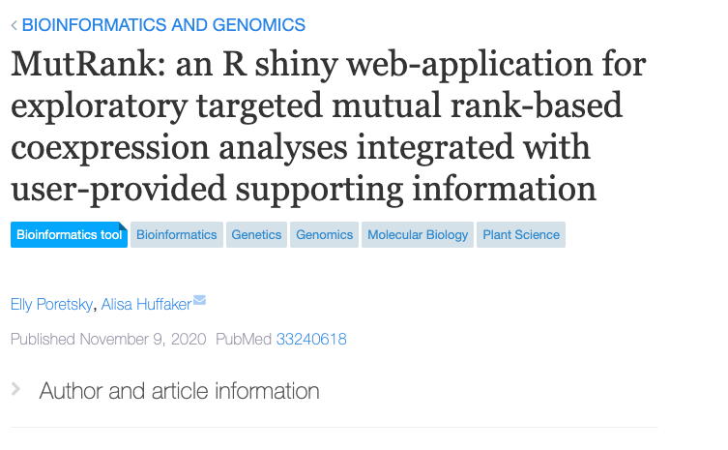

Slide 7
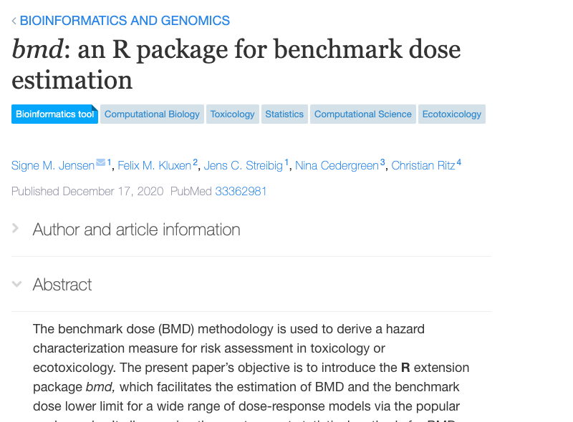

Slide 8
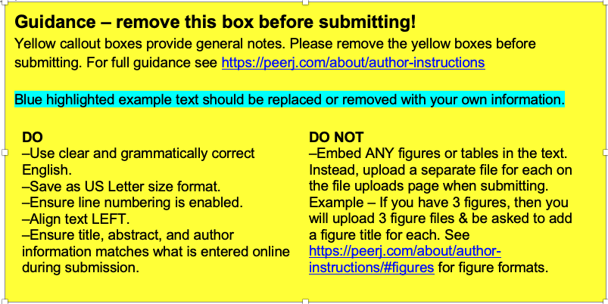

Slide 9
Frontiers in Computational Genomics
Brief Research Reports
Tools or algorithms which provide meaningful insights into biology from the analysis of genomic data
It has a 3.258 impact factor
https://www.frontiersin.org/journals/all/sections/computational-genomics#about

Slide 10
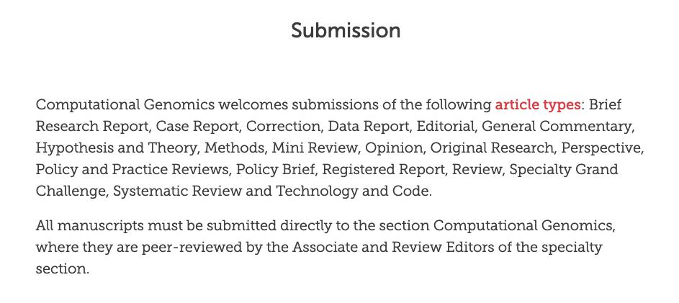

Slide 11
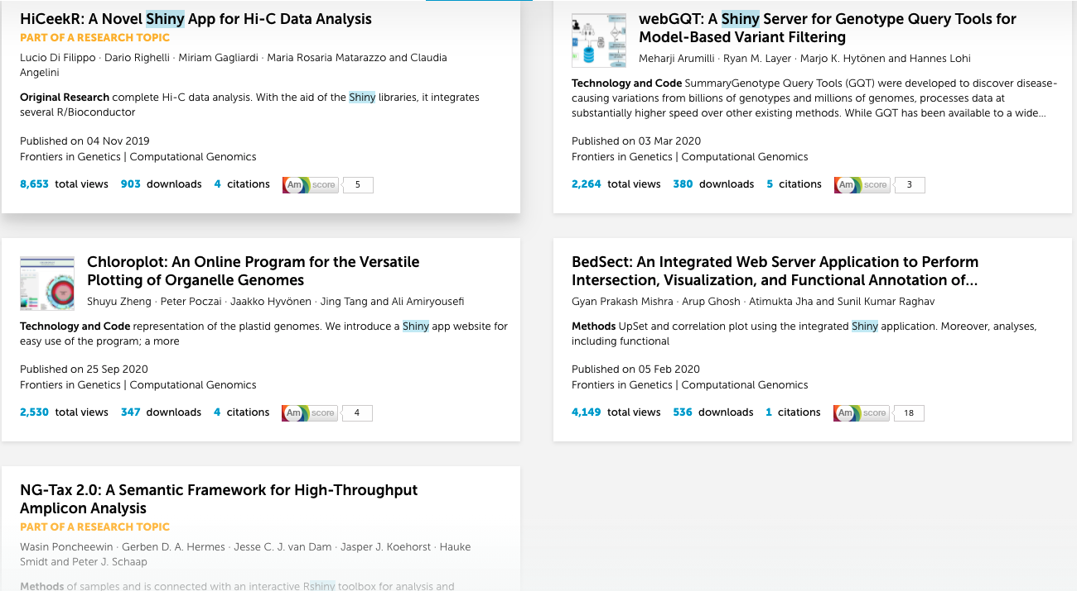
https://www.frontiersin.org/search/section/computational-genomics?query=r+shiny&tab=top-results&origin=
https%3A%2F%2Fwww.frontiersin.org%2Fjournals%2Fall%2Fsections%2Fcomputational-genomics%23about

Slide 12
Frontiers in genetics
Original research article (https://doi.org/10.3389/fgene.2019.01079)
Technology and code (https://doi.org/10.3389/fgene.2020.00152)
Technology and code (https://doi.org/10.3389/fgene.2020.576124)
Method article (https://doi.org/10.3389/fgene.2020.00003)
Method article (https://doi.org/10.3389/fgene.2019.01366)

Slide 13
Brief research report
4000 words
4 figures/tables
Authors are required to pay a fee (B-type article) to publish a Brief Research Report
Should have the following format: 1) Abstract, 2) Introduction, 3) Method, 4) Results, 5) Discussion. Supplementary material may be included with Brief Research Reports.

Slide 14
Broad areas of bioinformatics – BMC Bioinfo
Analysis and modelling of complex systems Comparative genomics Data visualization Imaging, and image analysis Knowledge-based analysis Machine learning and artificial intelligence in bioinformatics Networks analysis Novel computational methods for the analysis of biological systems Proteomics Sequence analysis Structural analysis Transcriptome analysis
https://bmcbioinformatics.biomedcentral.com/

