Slide 1
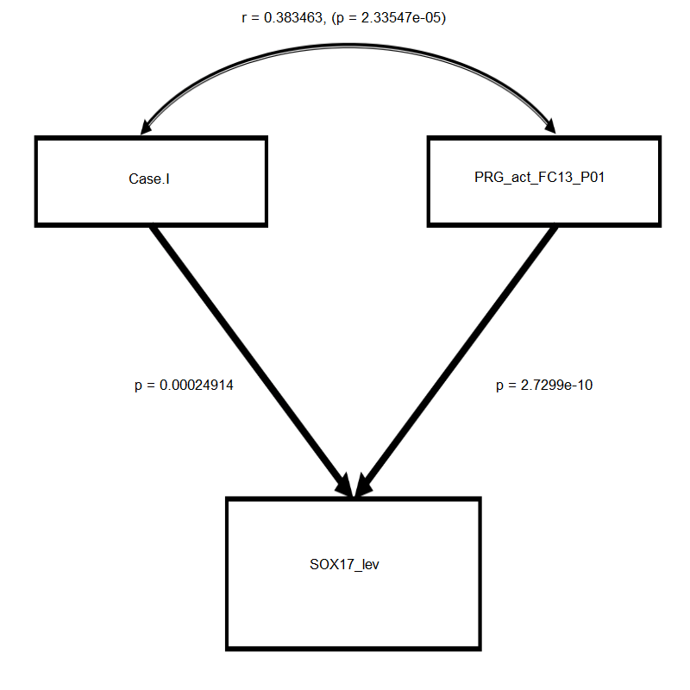
r = 0.38
p = 2.33 X 10⁻⁵
GATA2 direct
PGR
p =
2.49 X 10⁻⁴
p =
2.73 X 10⁻¹⁰
SOX17
Comparative Fit Index | 1.00
Tucker-Lewis Index | 1.00
Standardized Root Mean Square Residual | < 0.001
Root Mean Square Error of Approximation | < 0.001

