Slide 1
GATA2 significant gene List
GATA2 significant gene List
All genes except GATA2&PGR (list)
+ SOX17
Random exclude N genes
A downstream target gene list (N)
Exclude downstream target genes
Shrunk significant gene List
Shrunk significant gene List
Add back to
the shrunk list
Random draw (N)
genes
Calculate the
activity with
the Signature
Analysis App
Restore back to the original number of genes
GATA2
PGR
GATA2
PGR
γ₁₁
γ₂₁
γ₁₁
ξ₁
γ₂₁
ξ₁
[SOX17]
[SOX17]
Calculate the activity with the Signature Analysis App
ξ₂
ξ₂
Notes:
Figure S1A two-fold bootstrap strategies. On the left hand, we coin the name “elimination without replacement”; whereas the one on the right, “elimination with replacement”.

Slide 2
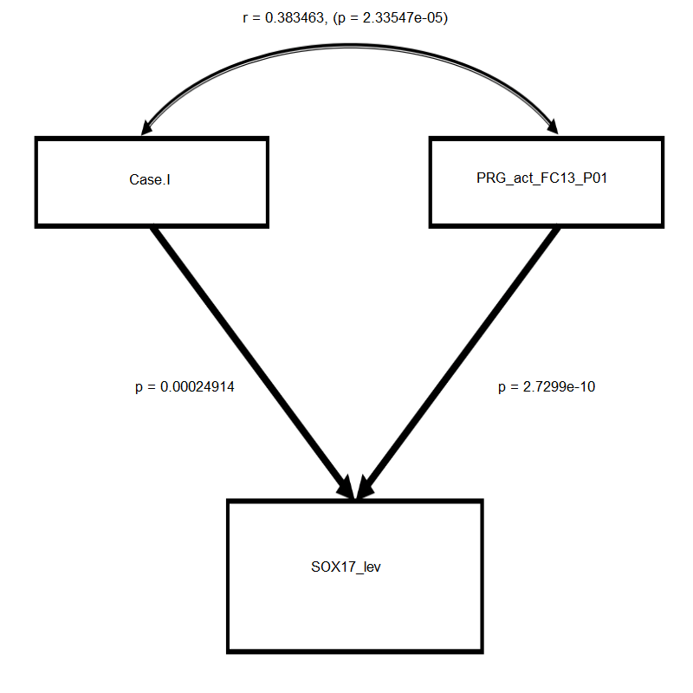
r = 0.38
p = 2.33 X 10⁻⁵
GATA2 direct
PGR
p =
2.49 X 10⁻⁴
p =
2.73 X 10⁻¹⁰
SOX17
Comparative Fit Index | 1.00
Tucker-Lewis Index | 1.00
Standardized Root Mean Square Residual | < 0.001
Root Mean Square Error of Approximation | < 0.001

