Slide 1
ToxPipe Evaluation

Slide 2
Pipeline
Each stage is evaluated using Promptfoo with “prompts with answers” created by experts.
Different assertions are tested
“Contains”: If the expected response is within the model response, as-it-is.
“Similarity”: If the expected response is similar to the model response (a similarity threshold is used)
Each response is marked with “Pass” or “Fail” mark after evaluation
Promptfoo output is visualized and analyzed by experts
Assertions are validated (using Promptfoo provided reasons)
Model responses are compared (using similarity plots)
The evaluation can be updated by experts (not implemented yet)

Slide 3
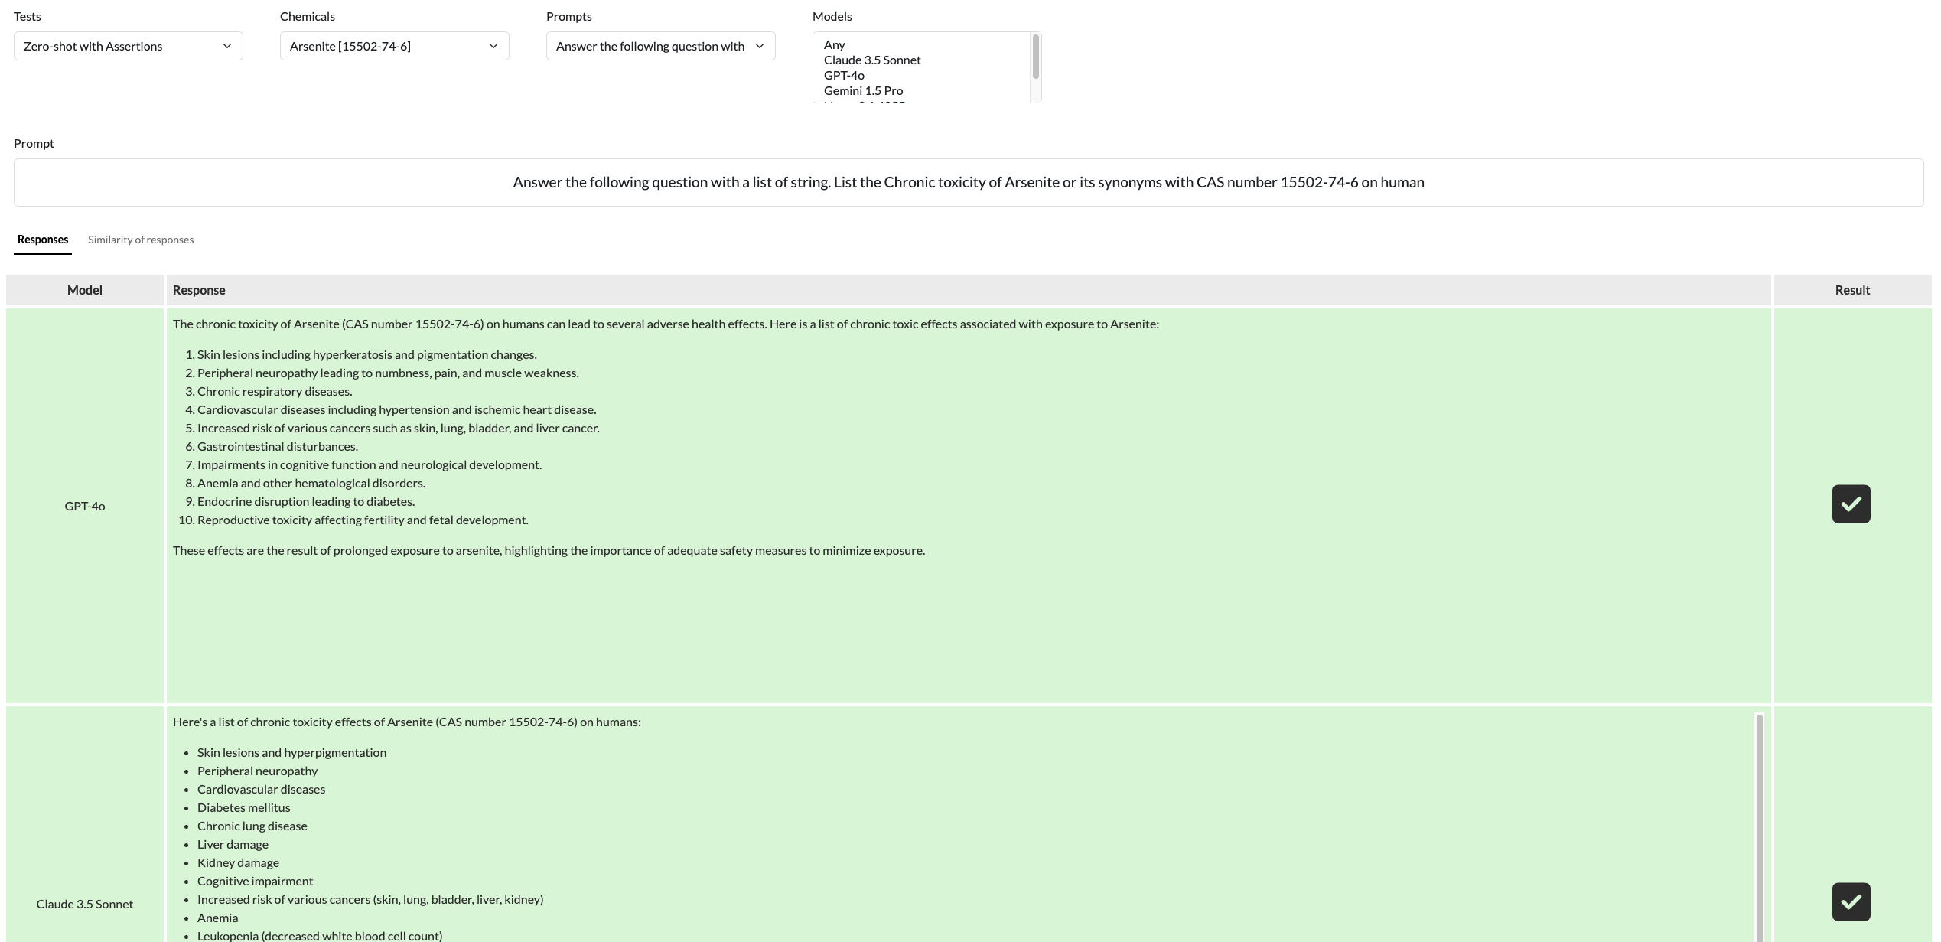
Evaluation of ToxPipe Stages: Validate model response

Slide 4
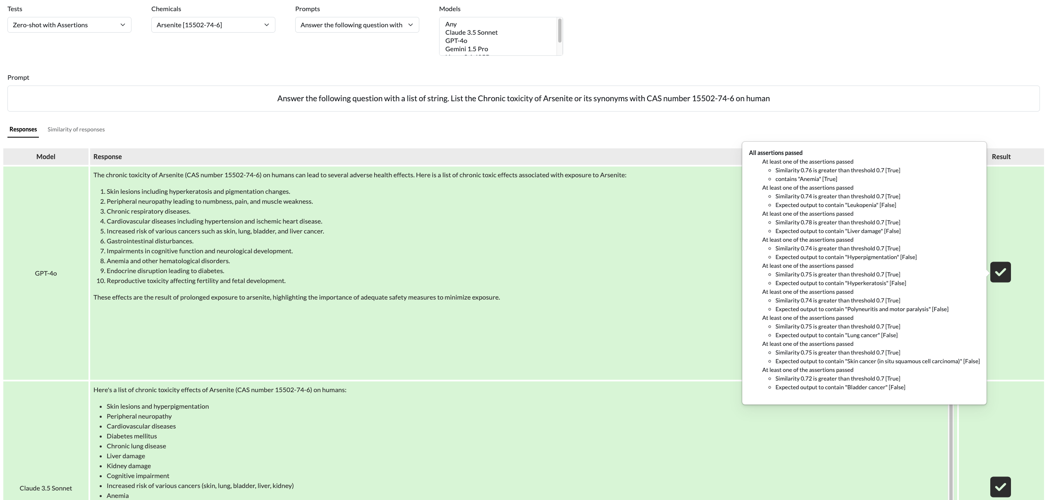
Evaluation of ToxPipe Stages: Validate model response

Slide 5
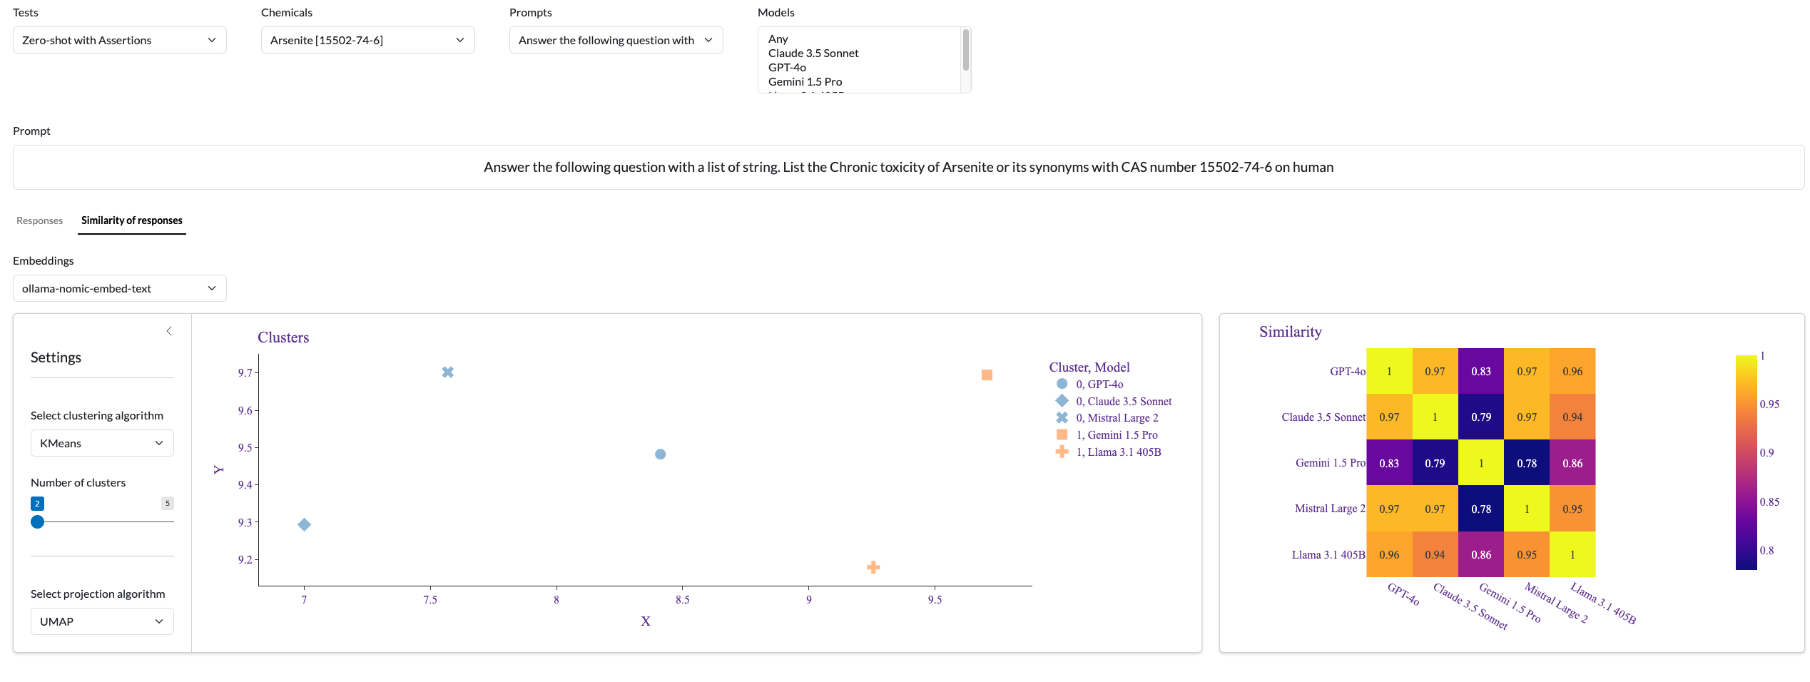
Evaluation of Toxpipe Stages: Compare model responses

