Slide 1

NIEM-UML-3
Concepts, changes & status
OMG Government Domain Task Force
Sept. 2013
Cory Casanave

Slide 2
Status
NIEM-3
NIEM 3.0 is in a "candidate release" status; final release expected mid-October
Finalization of the NIEM Naming and Design Rules (NDR) v3.0, Model Package Description (MPD) Specification v3.0 and NIEM Conformance v3.0 is underway
Refinement of the NDR and MPD Specification could occur as the final release nears
Content consistency issues have been identified and remediated
NIEM-UML-3
Has “tracked” NIEM-3 and made assumptions about progress
There is an updated NIEM-UML-3 specification: Alpha 1.1
This has been done as a project – not an OMG process, the intent is to open it up for community review soon

Slide 3
Where are the changes?
NIEM-UML PIM
Changes
NIEM-UML MPD
NIEM-UML PSM
NIEM-UML QVT Mappings
NIEM-UML Reference Models

Slide 4
Unified Reference & Content
NIEM-2
UML “AggregationKind” (The symbol at the end of an association) corresponded with the “content” Vs. “Reference” distinction in NIEM-2
NIEM-3
No longer makes this distinction in the schema and uses “structures:ref” for reference, an instance level distinction. Schematron may be used for constraints.
Since both UML and NIEM modelers are used to specifying aggregation, some support should be provided
NIEM-UML-3
There are three options presented for NIEM-UML-3. For Alpha-1 UML aggregation will have no impact, it is a comment (note that in UML, aggregation kind always has some value).
We expect this to be a discussion point

Slide 5



Reference/Content Example (Alpha 1.1 Option)
These all mean the same thing

Slide 6
NIEM-3 Augmentations
NIEM-2
Augmentations augment a class by use of an property in a subclass
NIEM-3
No subclass is required, augmentations augment a class by use of a substitution group head
NIEM-UML-3
There is one option presented for the PIM

Slide 7
NIEM-3 Augmentation Rules
A type marked as <<AugmetnationType>> would implicitly be able to augment any <<ObjectType>> or <<AssociationType>>.
The set of classes an <<AugmentationType>> may augment (the substitution head) may be specified using <<Augments>>, which would map to the definition of the substitution group. If no <<Augments>> is specified, the global augmentation group head would be used.
Inheriting an <<AugmentationType> will have the effect of generating a Schematron constraint that exactly one instance of the augmentation will augment each instance of the inheriting class.
An <<AugmentationType>> may also be marked as a <<PropertyHolder>>. This would have the effect of defining each of the contained properties as being individually substitutable for the subject substitution group head.
All object and association types defined in UML will generate an augmentation point (A PSM option could be added to suppress this, but always producing it is in keeping with the recommendation).
Each augmentation would also generate a single property referencing the augmentation, these properties would be hidden from the PIM and use the standard naming convention. If additional reference properties are allowed (Pending resolution of recommended NDR rule #15), each such property will be included in a single <<PropertyHolder>> for the namespace. Note we suggest that only one property be allowed per augmentation and that it must use the naming convention.

Slide 8

Example 1 - Unrestricted
Unrestricted Augmentation, may augment anything
<xs:element name=«my:TelephoneNumberAugmentation" type=« my:TelephoneNumberAugmentationType" substitutionGroup=« structures:ObjectTypeAugmentationPoint

Slide 9
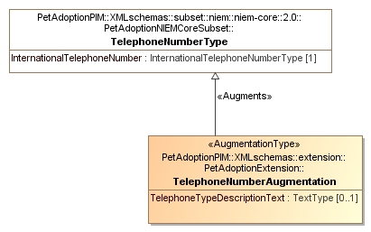
Example 2 - Restricted
Restricted Augmentation of TelephoneNumber
<xs:element name=«my:TelephoneNumberAugmentation" type=« my:TelephoneNumberAugmentationType" substitutionGroup=«nc:TelephoneNumberAugmentationPoint »

Slide 10
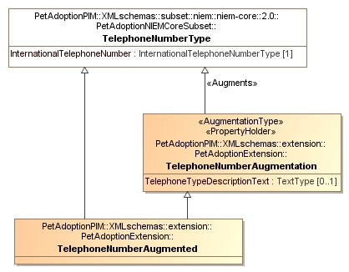
Example 3:Required Augmentation
TelephoneNumberAugmented MUST have augmentation
Additional constraint expressed in Schematron:
Each PetAdoptionPIM TelephoneNumberAugmented must have
exactly one TelephoneNumberAugmentation

Slide 11
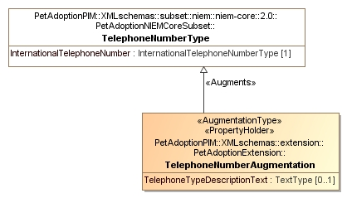
Example 4: Properties as Augmentations
TelephoneTypeDescriptionText is the augmentation
Note property holder
<xs:element name=«my:TelephoneTypeDescriptionText" type=« nc:TextType" substitutionGroup=« nc:TelephoneNumberAugmentationPoint>>

Slide 12
Constraint Schema
Current capability (as of FTF)
PIM subset schema may reference subtype in extension schema (Please see FTF issue 18251)
There is no other support for constraint schema
This will generate a constraint schema
New capability
Type extension as well as OCL constraints will generate schematron as well as a constraint schema
No change to constraint schema

Slide 13
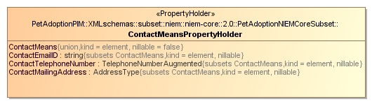
Constraint Schema Example
Subset model property type MAY reference a subtype of the original property type
Note subtype
Generates:
Subset schema with original type
Constraint schema and schematron restricting ContectTelephoneNumber to TelephoneNumberAugmented

Slide 14
Business Rules
Current capability
Undefined
New capability
OCL constraints will generate schematron
Example TBD

Slide 15
Local Vocabulary
New capability
A “local vocabulary” may be defined and referenced from any NIEM schema
Potential representation
The local vocabulary is defined as stereotype of enumeration where each enumeration literal is a vocabulary term. The enumeration literal’s UML name corresponds with the domain specific abbreviation, the “UML Specification” corresponds with the expansion of the abbreviation and the UML Documentation corresponds to the NIEM definition. The NIEM sourceURI may also be set by applying the “Source” stereotype to the enumeration literal.

Slide 16

Local Vocabulary Example
Definition of local vocabulary

Slide 17
MPD Changes
Changes
New schema
Oasis catalog
NIEM-UML
Currently handled by QVT transforms, no model changes
MPD changes are expected in later versions of NIEM 3
May require some changes to the MPD profile

Slide 18
“Simplified Annotations”
There are substantial changes
i:ConformantIndicator must be changed to @appinfo:externalImportIndicator attribute. Rule for its use has also changed as now we are indicating use of external imports.
s:ComplexObjectType must be changed to structures:ObjectType.
s:ComplexObjectType must be changed to structures:ObjectType. (XML Schema Representation)
s:ComplexObjectType must be changed to structures:AssociationType.
Any references to i:AppliesTo will be removed or replaced.
Any references to s:MetaData will be removed or replaced.
Any references to appinfo:ReferenceTarget will be removed or replaced.
Any references to structures:ReferenceType will be removed or replaced.
Any references to namespace http://niem.gov/niem/structures/2.0 will be replaced.
Any references to namespace http://niem.gov/niem/appinfo/2.0 will be replaced.
Any references to structures:Augmentation will be removed or replaced.
Any references to structures:ComplexObjectType will be removed or replaced.
Any references to appinfo:Base will be removed or replaced.
Any references to structures:Association will be removed or replaced.
Any references to structures:SequenceId will be removed or replaced.
Any references to structures:sequenceID will be removed.
More…
All such changes are taken care of by the QVT transforms

Slide 19
New reference models
NIEM-3 contains substantially changed reference models
All reference models have been transformed into NIEM-3-UML
Conversion of some reference model types from niem-2 to niem-3 is being explored.

Slide 20
NIEM-UML-3 Alpha 1.1
Packaged like NIEM-UML
Updates the specification document
Updates all machine readable files
Example models with provisioned NIEM-3 IEPDs (first known examples of NIEM 3)
NIEM-PMO working on public review strategy
Current artifacts are in MDZIP format, not strict OMG-XMI – Strict XMI to be produced for submission to OMG
Updated Magicdraw plugin available separately
Next steps:
Open up the process
RFC or RTF

Slide 21
File(s) |  | Contains
NIEMUML3-Alpha1 |  | This file, summarizing NIEM-UML-3, Alpha-1
Documents/NIEM-UML-3-Draft.docx |  | The OMG NIEM-UML specification updated to include NIEM-UML-3 changes, with change tracking. Note that not all changes have been made as some technical sections require substantial effort and will be revised on finalization
Models/NIEM-UML-Profile.mdzip |  | Magicdraw version of the NIEM-UML profile updated for NIEM-3. Note that changes at this level are not substantial
ConopsExamples.pptx |  | Examples of new NIEM-3 concepts in UML
Under Models/NIEM UML Machine Readable Files
mpd2pim.qvto mpd2pimOasis.qvto NIEMglobals.qvto NIEMmpdartifact2model.qvto NIEMmpdmodel2artifact.qvto NIEMpim2psm.qvto NIEMpim2Schematro.qvto NIEMplatformBinding.qvto NIEMpsm2xsd.qvto NIEMpim2psm.qvto pimSubsetReference.qvto pimSubsetReferenceN20.qvto |  |  | QVT supporting NIEM-UML-3 mappings
XmlPrimitiveTypes.mdzip |  |  | XML types used by NIEM.
Under Models/NIEM UML Machine Readable Files/NIEM-Reference
NIEM-Reference*.mdzip |  | 49 NIEM-3 Reference schema converted to NIEM-UML-3
Under Models/NIEM UML Machine Readable Files/Nonnormative
*.ecore |  | Meta models in “Eclipse ecore format required to support transformations
Under Models/Examples
*.mpd | 11 Legacy NIEM-2 models transformed to NIEM-3 to serve as examples and test cases. Note that, to the best of our knowledge, these are the first examples of NIEM-3 IEPDs.

