Slide 1

NIEM Schema / IEPD Registry Way Ahead Discussion
29 October 2018 NBAC Face-to-Face Arlington, VA
Ms. Heather D. Grace
Joint Staff J6, DDC5I, Data & Services
757-836-8070
Heather.d.grace2.civ@mail.mil
Mr Chuck Chipman
Georgia Tech Research Institute
757-836-8085
charles.chipman@gtri.gatech.edu

Slide 2
Background
What is a registry? (https://hortonworks.com/tutorial/schema-registry-in-trucking-iot-on-hdf/section/1/)
Schema Registry provides a centralized repository for schemas and metadata, allowing services to flexibly interact and exchange data with each other without the challenge of managing and sharing schemas between them.
Schema Registry has support for multiple underlying schema representations (xmL, Avro, JSON, etc.) and is able to store a schema’s corresponding serializer and deserializer.
NIEM repo / registry background (-pre GitHub –pre Horton –preX)
Several exist – Domain(s) / COI(s) - centric (DoJ, HHS, DHS,..) (.csv/RDBMS/Oracle)
No commit – variability at network / software modernization efforts degraded orchestrated agreement on meta, deployment – staging, and use (vendor specific)
Strong community desire to share schema for discovery / reuse

Slide 3
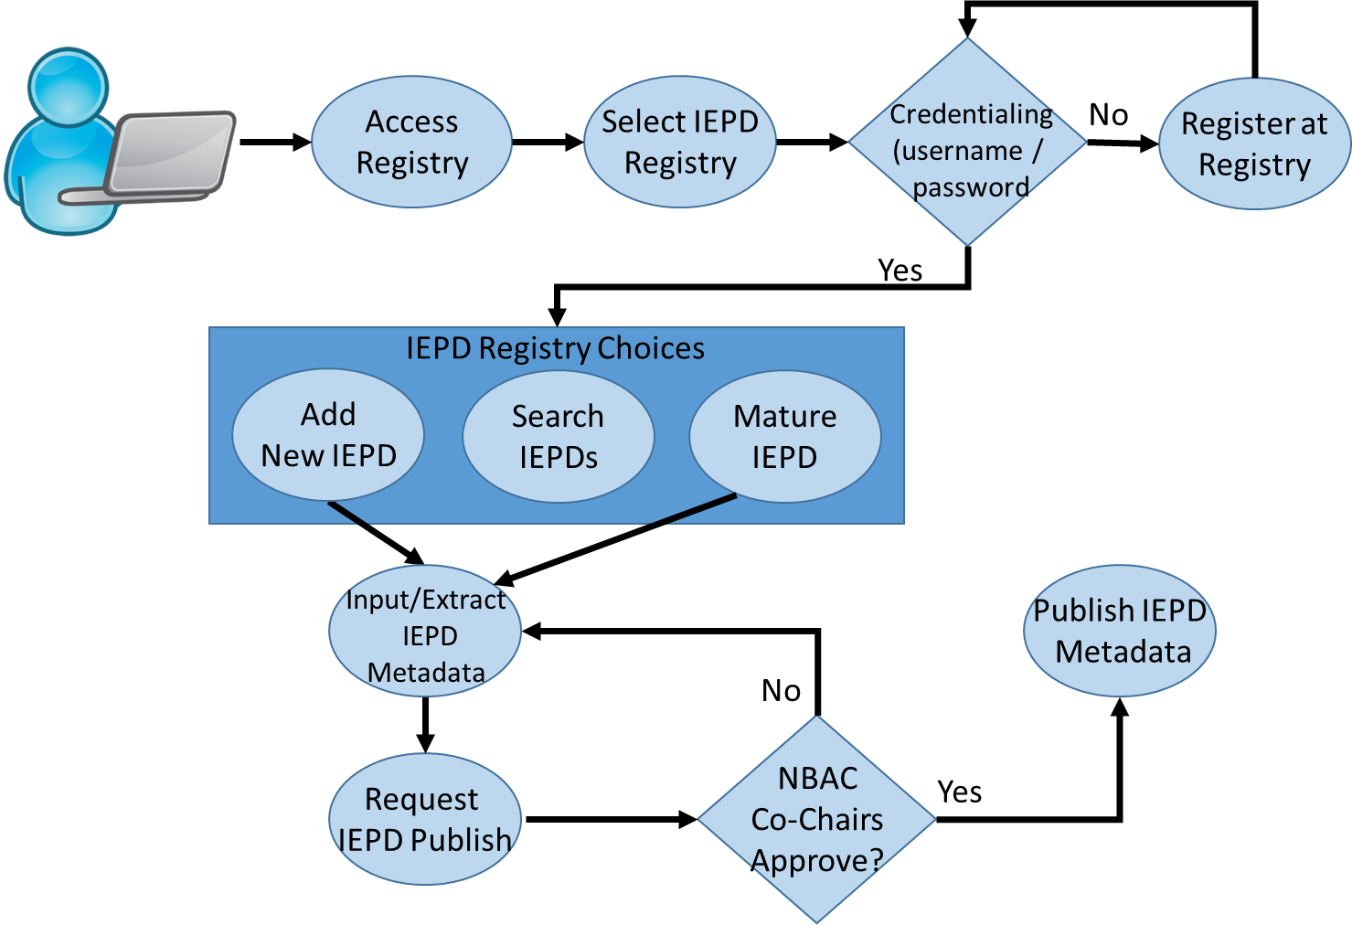
Proposed Model – Design Thinking
Activities to date
Feedback collected via interviews and meetings
Current capabilities (Hadoop DM Eco, NIEM DM, Geo DM, ICITE)
Explored alternatives (BUILD, ADOPT / BUY)
What we gathered so far (requirements)
Adopt data format(s) with rules that allow schema evolution
Discovery/search/filtering
Self-service – publish
Add, delete, mature, archive
Federate, ingest
Access control/monitoring
*
*
Notes:
* Indicates issues we need to address:
Do we need to control access to the registry? If yes, how, and is there a cost? If no, then it needs to be read only to prevent garbage from being posted.
Do we need NBAC co-chair approval before adding something to the registry? Maybe only PMO staff post products and/or update the registry, and the producer sends a product to the PMO staff for review?

Slide 4
Demo
GitHub Registry Demonstration

Slide 5
Next Steps
Define minimal viable product (MVP)
Explore Domain data management / data infrastructure deployments; consider both when defining functional/tech requirements
Pool community resources based on priority requirements
Design, Release (LUA), Test (UAT), Deploy

Slide 6
BACKUP

Slide 7
Registry Sites <Attempts>
tools.niem.gov
Pros: existing registry, requires account to add content
Cons: manual entry of discovery metadata; hasn’t been maintained in years/buggy
DOJ IEPD Clearinghouse/NISS
Pros: existing registry
Cons: hasn’t been maintained in years
APAN.org
Pros: existing sites for NBAC, EM, and MilOps; access controls
Cons: must have APAN account (no guests); SharePoint limitations; limited search
GitHub
Pros: already hosts NIEM content; access controls
Cons: learning curve for managers; requires user accounts to add content; limited search (browser)

