Slide 1
NTAC 2018 Face-to-face Update
Dr. Scott Renner, Mike Hulme
NTAC Co-chairs

Slide 2
2018 NTAC Activities Focus
New technical specifications http://niem.github.io/reference/
NIEM Naming and Design Rules 4.0 (November 2017) – updated for NIEM 4.0
NIEM Code List Specification 4.0 (November 2017)
Support for JSON http://niem.github.io/json/

Slide 3
New NIEM Naming and Design Rules 4.0
Supports NIEM 4.x releases
Lots of little changes to make NIEM easier to use niem.github.io/niem-releases/v4.0-technical-changes/
NDR 4.0 specification https://reference.niem.gov/niem/specification/naming-and-design-rules/4.0/niem-ndr-4.0.html

Slide 4
New NIEM Code List Specification 4.0
Additional machine-readable formats for code lists:
Spreadsheet CSVs (comma-separated values)
Genericode (OASIS) XML formats
Design-time or run-time binding of code lists elements to a specific code list file
Specify bindings design-time via schema annotations to require designated code lists
Specify bindings run-time via instance message attributes to allow for dynamic code lists
XML catalog support for resolving code list identifiers (URIs) to actual code lists (CSV or Genericode files) within an IEPD
Rules for matching values in messages to values in corresponding code lists
This enables validation and adds multi-column code table support
http://niem.github.io/reference/specifications/code-lists/

Slide 5
NIEM and JSON
Adopting JSON (JavaScript Object Notation) as a second standard format for representing data based on the NIEM data model
Guidance pages available at http://niem.github.io/json/
An easy introduction to the purpose of NIEM
The reasons to use NIEM with JSON data
The developer knowledge needed to put NIEM JSON into practice
They are intended for:
Developers who know JSON but know nothing of NIEM or XML
Developers familiar with NIEM XML who need a JSON version of a data exchange
Data scientists wanting to understand or provide JSON data sources
Managers wondering if NIEM JSON is right for their project

Slide 6
NIEM and JSON Resources
A NIEM-JSON tutorial
Walks the reader through a small example of implementing an information exchange using NIEM-JSON
Begins with a small set of data requirements, constructs a NIEM information exchange model, expresses data for that model as JSON, constructs a JSON schema for that data
NIEM and JSON Frequently Asked Questions
Explains what NIEM and JSON each are and do and why they are useful together
A NIEM-JSON Reference Guide
Provides normative and non-normative guidance on how NIEM and JSON are used, including lots of examples

Slide 7
Other current NTAC activities
A simplified way to specify information exchanges (IEPDs) as an alternative to the existing Model Package Description (MPD) Specification
Can specify information exchanges using JSON instead of (or in addition to) XML
With or without JSON Schema
A NIEM JSON technical specification that supports NIEM conformance using JSON instead of XML
Improved tool support for NIEM XML and NIEM JSON
OpenAPI JSON example to support use of NIEM JSON in a popular API specification

Slide 8
Open activities
Internationalization: need objectives and requirements
Tool strategy
Movement, SSGT
Additional services
JSON
NIEM Interface Specification (MPD spec replacement)
NIEM 5 technical topics
NIEM conformant JSON
Continued work
Conformance Specification

Slide 9
Internationalization Considerations
Internationalization vs. localization
Languages and associated character sets
US-ASCII, single-byte, multi-byte, character sets
Instance property values
Language tags (via xml:lang)
NIEM data model – currently US English
Property (element and attribute) names
Definitions
NIEM reference XML schemas reflect data model
Things to avoid
Copies of NIEM in different languages
Requirement for translation of NIEM into different languages prior to publication of NIEM releases

Slide 10
NIEM Tool Strategy
What do we want from a tool architecture for NIEM, in the long term?
Open source & user-installable
Accreditation in DOD and other environments
Modular to support incremental improvements
Support a self-service model
Provide capabilities that satisfy the needs of the community and that aren't available from other tools
Current Tools
SSGT
Movement
Contesa / NIEM Conformance tool
Code list generation tool

Slide 11
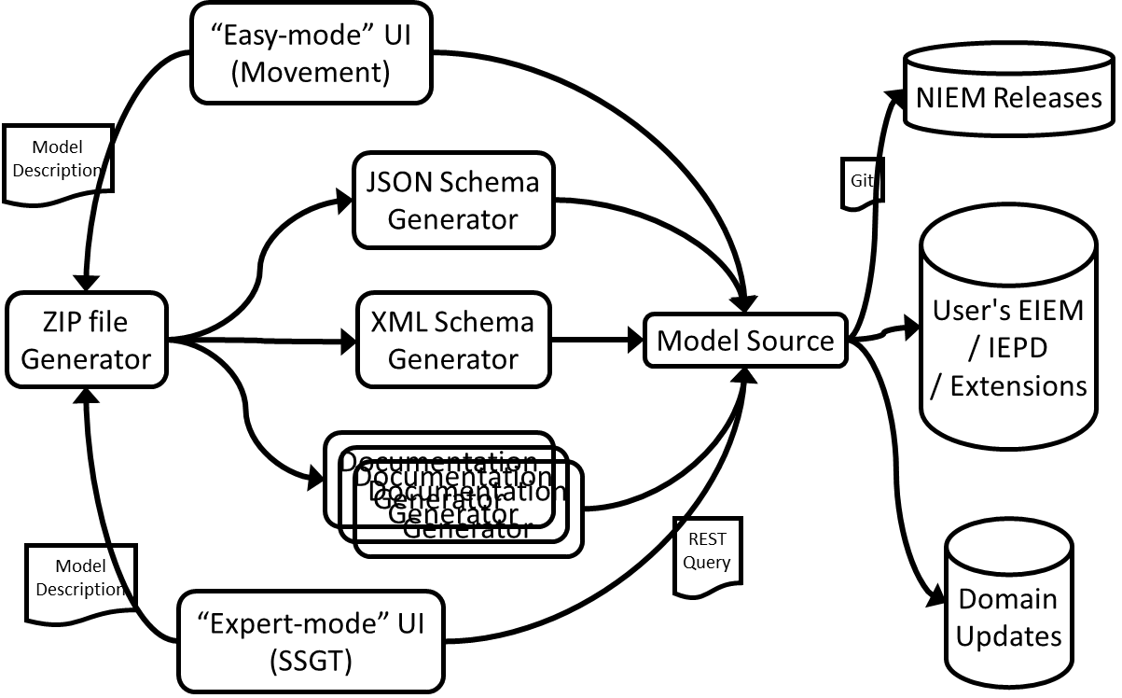
NIEM Tool Target Concept

