Slide 1

Military Operations (MilOps) Domain Update
Domain Steward & Stakeholders: Mr. Stuart Whitehead, Mr. Ryan Schultz, Mr. Rodney McCoy, Mr. Ralph O’Connell
Description
Highlights & Activities: Describe your NIEM domain accomplishments and data activities Best Practices: Describe what is working well in supporting your domain success Challenges & Recommendations: Specify what NIEM can do to better support your domain objectives
Highlights & Current Activities
Best Practices
Challenges & Recommendations
Provide technical and collaborative support to Army, Navy, Air Force, Marine Corps, and DoD agencies (details follow)
Quarterly MilOps Configuration Control Board (CCB) Stakeholder Engagement virtual collaboration
Provide virtual machine software loads to promote reuse
Automated support for end-to-end IEPD development and implementation tools/support
On call technical support for IEPD development and implementation
Provide funding to resource NIEM implementation
Improve IEPD reuse (discovery and retrieval)
Identify all systems using NIEM to promote marketing/adoption
Improve understanding of NIEM reference schema to promote marketing/adoption

Slide 2
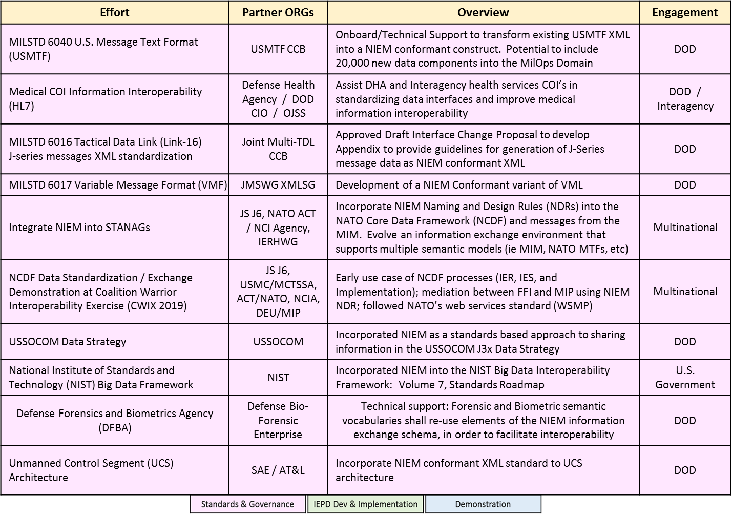
MilOps Domain Update

Slide 3
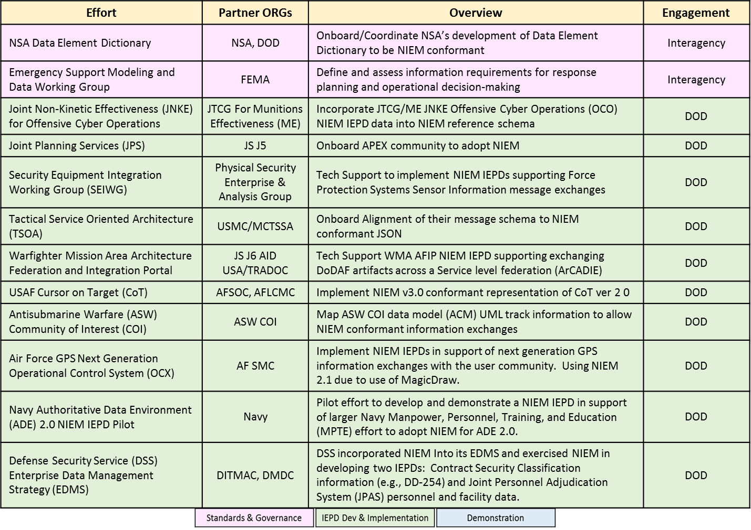
MilOps Domain Update

Slide 4
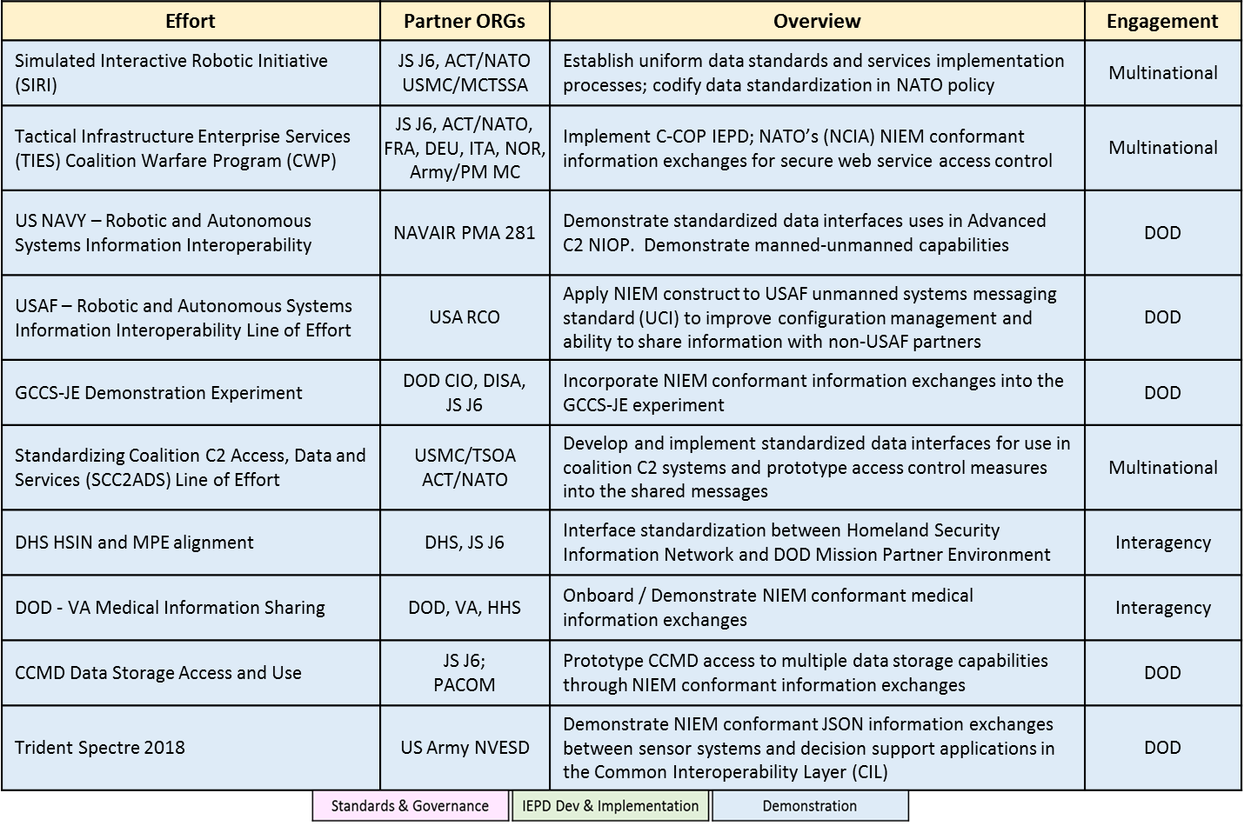
MilOps Domain Update

