Slide 1

Release Updates
4.1 Recap 4.2 and 5.0 Plans

Slide 2
4.1 Release – Recap
NIEM 4.1 released this summer (July)
Domains with new or updated content:
Biometrics
Emergency Management
Human Services
Justice
Military Operations
Core Supplement 4.0.1
GENC update
Tools updated:
Movement
Schema Subset Generator Tool (SSGT)
Migration Tool
https://github.com/NIEM/NIEM-Releases

Slide 3
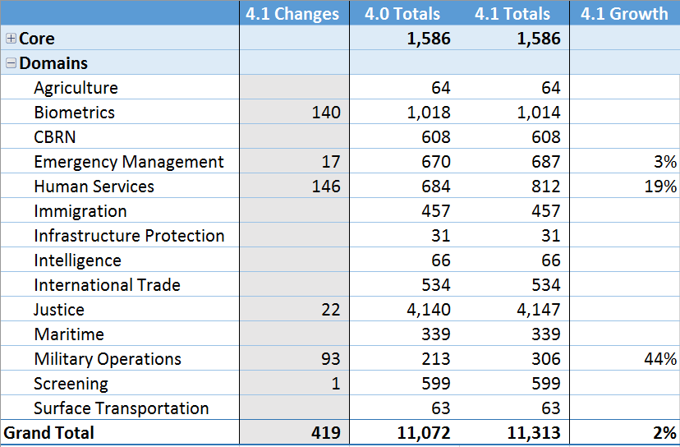
4.1 Release – Property Stats

Slide 4
4.2 Release – Plans
Current status:
Content preparation by domains / NIEM community
Minor release overview:
Domains may update content as needed
Core and its imports are locked until the next major release (5.0)
Core Supplements may be published as an interim solution
Changes go into a new, separate namespace
Architecture is locked
Only additive changes that do not affect 4.0-based schemas permitted
https://github.com/NIEM/NIEM-Releases/wiki/Upcoming-Release

Slide 5
4.2 Release – Projected Schedule and Changes
Projected schedule:
Alpha 1 January 2019
Beta 1 March 2019
RC 1 May 2019
Release Summer 2019
Expected changes:
Biometrics update
Emergency Management update
MilOps update
Justice code table updates
International Tiger Team updates
Harmonization and issue resolutions
New Census domain (?) Others (?)
https://github.com/NIEM/NIEM-Releases/wiki/Upcoming-Release

Slide 6
4.2 Release – Content Submissions
Major changes:
NIEM-conformant XML schema
start with most recently published schema (4.1 release)
check conformance in ConTesA - https://tools.niem.gov/contesa
Change Request spreadsheet
enables a detailed change log
Minor changes:
Submit detailed description
Submit changes to:
niem-comments@lists.gatech.edu or
Issue tracker for NIEM releases repo on GitHub https://github.com/NIEM/NIEM-Releases/issues
https://github.com/NIEM/NIEM-Releases/wiki/Upcoming-Release

Slide 7
5.0 Release – Plans
Major release
Content changes to Core and domains
Architectural changes
Core Supplements integrated into Core
Projected schedule:
Alpha 1 January 2020
Beta 1 March 2020
RC 1 May 2020
Release Summer 2020
Restart the Content Subcommittee following the 4.2 release (summer 2019)
Review changes for Core
Harmonization across Core and the domains
Start discussing potential architectural changes for 5.0 now
NTAC needs time to review and update the NDR
Need time to update tools and training

Slide 8
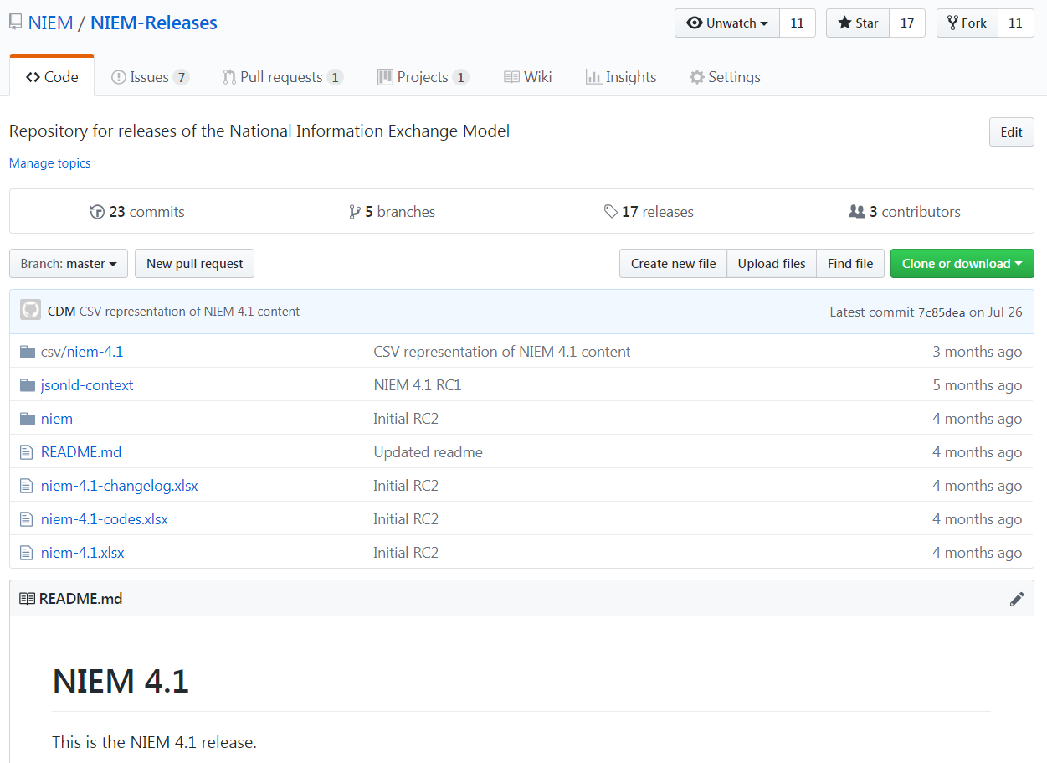
NIEM Releases – GitHub Walkthrough
https://github.com/NIEM/NIEM-Releases or search for "niem release github"

