Slide 1
2022 Face to Face: NTAC outbrief
Notes:
Hello and welcome to an overview of how NIEM, the State Local Tribal and Territorial, and the Cybercrime Support Network will assist you to solve your data interoperability concerns while concurrently implementing the NIEM Cyber Domain.

Slide 2
OUTLINE
What we did on our summer vacation (up to 15-17 August)
Our plan for next year

Slide 3
this year
NIEM Open process
NIEM message specification guide
Architecture improvements, NDR update
Common Message Format (CMF) and metamodel

Slide 4
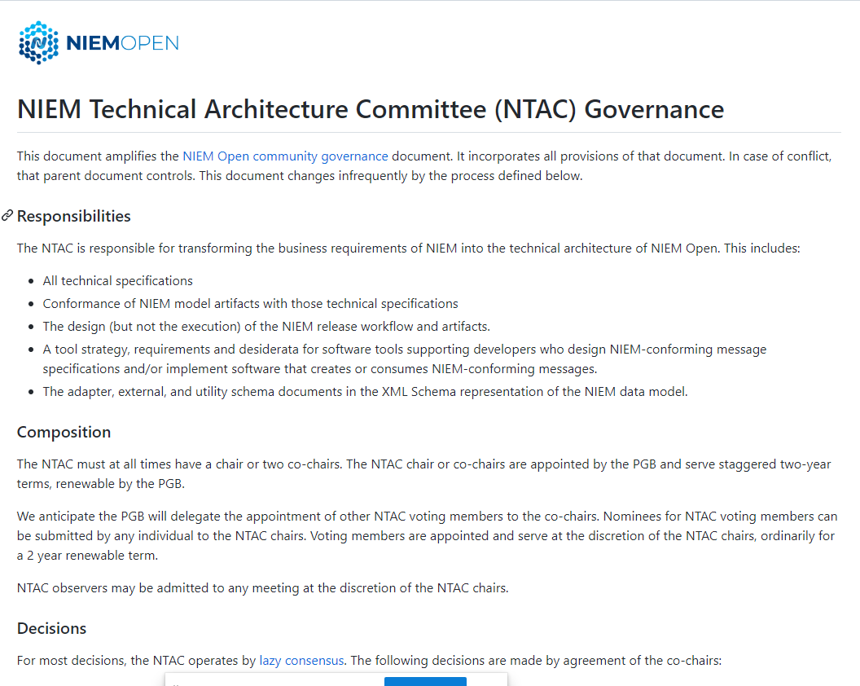
nieM Open process for ntac
Our requests to PGB
Co-chairs appointed by PGB
Voting members appointed by co-chairs
Pemission to open new repos
Recommendations for repo Maintainers
Draft NTAC governance complete
Lazy consensus
Minimal voting requirements
Detailed operations document forthcoming
Work with OASIS to merge our existing review process with OASIS rules

Slide 5
architecture improvements, NDr changes
Metadata simplification
Inline metadata objects now possible for simple cases
Referencing still supported for complicated cases
Clarified metadata scope rules – what objects are modified?
Treat metadata objects more like other objects – augmentations allowed
Adapters and external standards
Where are they still needed? How should they work?
Roles and representations
Can role properties (e.g. RoleOfPerson) be simplified?
Code lists – should we require unique enumerations?
Support for component documentation in languages other than English
Several other topics for a future presentation to NBAC

Slide 6
Message Specification Guide
Three features in the new guide
One message class, or several
One message syntax (XML, JSON), or several
Canonical properties (nc:PersonSurName) or simple (lname)
Convention over configuration
Simple specifications are easy, complicated are possible
Tool support!
Follow the guidance and get software build automation
Not a specification
A kinder, gentler guide for developers
No conformance target for message specification (until demanded)

Slide 7
Common Message Format (CMF) and Metamodel
We will support both XML and JSON as message syntax in NIEM 6.0
We will support both XSD and CMF as model languages in NIEM 6.0
Existing tool support
Conversion from NIEM XSD to CMF
Conversion from CMF to NIEM XSD
Planned tool support (next year)
Generate constraint XSD from CMF
Generate JSON-LD context and JSON Schema from CMF

Slide 8
NTAC: Coming soon to a theater near you
Needed by NIEM 6.0 alpha model release (≈April 2023)
Metadata revisions to NDR
Updated schematron rules in NDR
Update utiltity schema documents (structures, etc.)
New namespace URIs for NIEM model
Perhaps http://niem.open-oasis.org, not http://release.niem.gov
Needed by NIEM 6.0 release candidate (≈October 2023)
All NDR updates
Planned tool support
Message specification guide
Other technical specification updates (conformance, etc.)
Needed after NIEM 6.0 release candidate
Process and package format to move a release to an OASIS Standard

