Slide 1

Military Operations (MilOps) Domain Update
DoD CIO <10/2018> & Joint Staff J6, DDC5I, Data & Services – Joint Warfighter, Mission Partners (C/S/A; Intra-,State, Local, Tribal) International)
High-Level Details:
Highlights & Activities: Transition PMO <DHS to DoD>; program review and solicitation for support; Model Mgmt (UML Profile Update <OMG Standard>, migration from “lead developer” design & implementation - to “lead integrator” <model Mgmt: discover, transform, load> <open source>; Enterprise Data Management – Governance <Community, DoD Enterprise – DoD CIO & JS J6> Best Practices: Collaboration, Agile Deployment, Demonstration/Exercises Recommendations: Educate, Energize, Evolve – Shared Commitment(s): dev/governance/deployment.
Highlights & Current Activities
Best Practices
Challenges & Recommendations
NIEM <PMO> transition from DHS to DoD <MO>.
NIEM 4.1 Update – 44% growth
DoD Policy, “Consider NIEM” – Strategy & Planning, Roadmap (Congressionally Mandated), Implementation – Active Engagement (USAF, USN. USMC, USA, NGB, MPE) – Joint C2
NATO / International Adoption – STANAG(s), NCDF, FMN
UML Transform –Profile Update (OMG); RFC – March Pub <eta>
DoD / Intel / MPE - Analytics (Big Data, MDM), Visualization, Access (ICAM, Biometrics)
Outreach / Communication –GitHub, Niem.gov, Social Media
Feedback and avenues for action – CPI
Acquisition / IT Procurement - (IDIQ <MAC> to General Services Administration IT Schedule 70 contract(s).)
Training – GitHub, ….niem.io
Deployment – Market adjustments <Data Infrastructure / Modernization> - Practices: Agile, Implementation: Hortonworks (MS, AWS, IBM)
Information Management (non-material)
Data Governance (SLA / MOU-A) – (Interoperability – Integration / Implementation – Enterprise)
Implementation - Conforms vs. Complies; Schema Registry (Discover/ Reuse)
Training: Data Prep (UML Schema Registry, Deployment, Monitoring (Cyber / AI / ML), Storage (on-Premise / Remote)
Collaboration / SA – Monthly MilOps WG Updates (Synch & Harmonization)
Demonstrations / Exercises (BQ, CWIX, ….), others ?
$$$

Slide 2
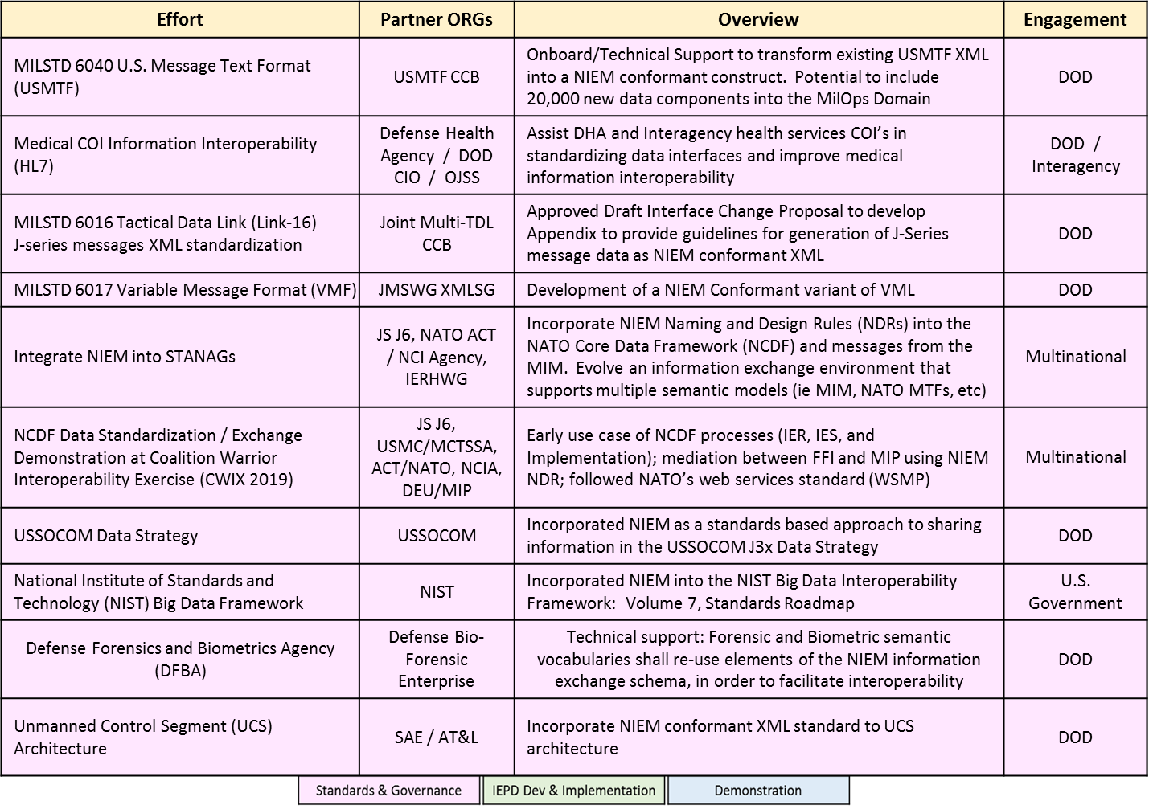
MilOps Domain Update

Slide 3
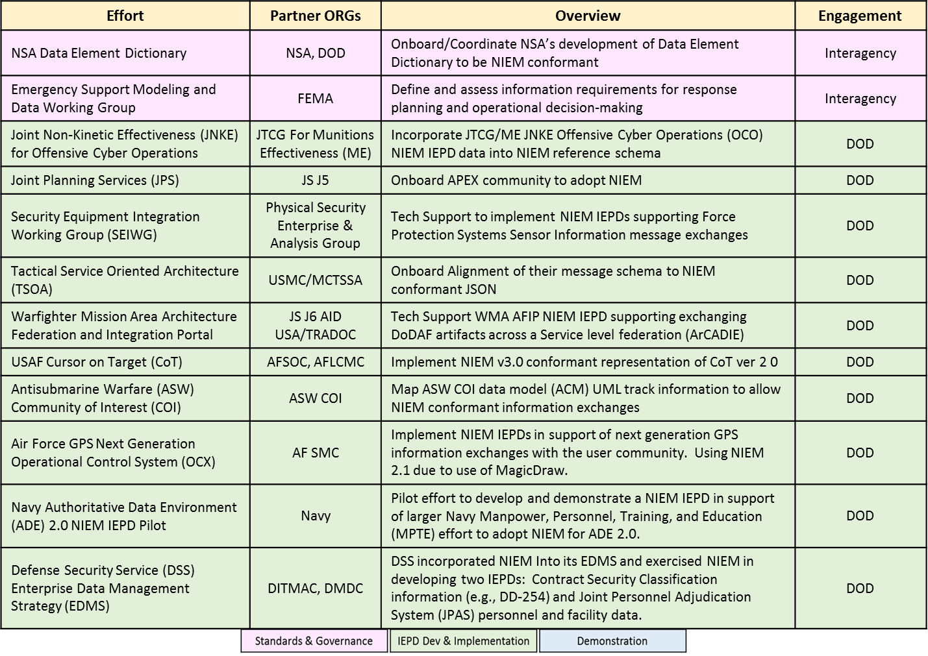
MilOps Domain Update

Slide 4
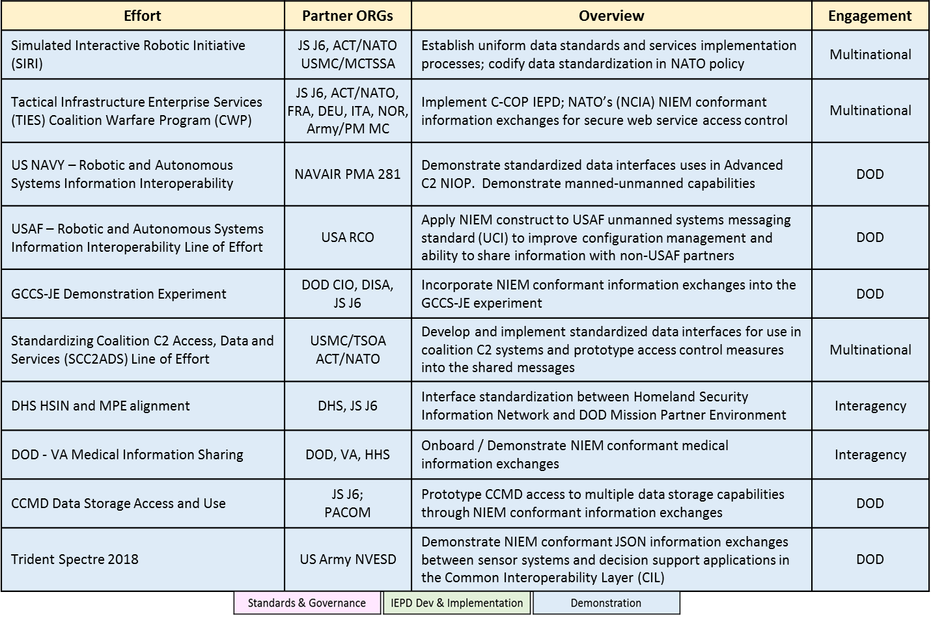
MilOps Domain Update

