Slide 1
ESB Modernization
Prepared by: OIT
As of May 23, 2016

Slide 2
ESB Modernization Goals
Move to AWS
Move Microservice Architecture
Zero or minimum impact to stakeholders

Slide 3
Decentralized Architecture
The first of these proposed solutions places the responsibility on individual components within the enterprise and outside the enterprise. For instance; existing platforms such as ELIS, EDMS, or VIS can provide microservice hooks that provide the microservices the platform exposes. In this case, other services will reach out and touch each of the alternative service provides directly for any services provided. Applying the same logic: internal systems like CPMS, ELIS and VIS will provide microservice hooks to external systems like CCD, IDENT, NGI, ADIS, etc., to external systems to reach out and touch each of our external systems for the functionalities they need. This also includes any interconnections between USCIS-internal systems.

Slide 4
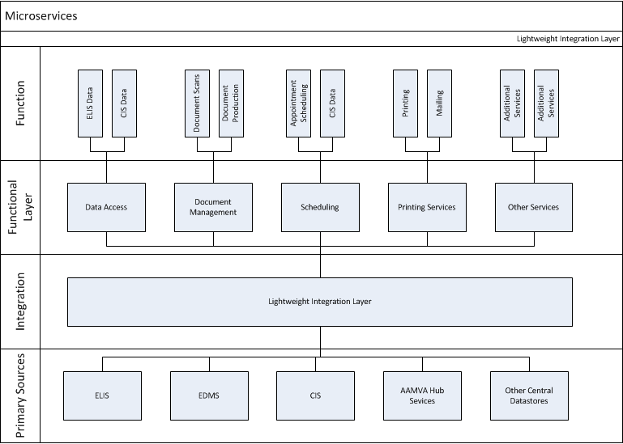
Thin Integration Layer
The second proposed solution uses a thin integration layer model to disintermediate access. This is a hybrid solution that adapts the MSA while keeping a new integration layer. The integration layer would be the central point of integration and access used by systems across the enterprise. It would provide consolidated access and also provide internal logic to add additional features not available on an individual host system. In addition, the integration layer provides a gateway between APIs from the client-server perspective, and adds an additional layer of decoupling. Additional decoupling allows for modernization or retooling of one side or the other without placing the existing interface at risk. In this instance external systems, which is our service consumer and service provider will not have to make any changes at their end.

Slide 5
Decentralized Architecture Migration Outline
migration strategy is conceptually simpler, though the more complex of the two. It relies on the introduction of microservices through the ongoing modernization of the individual component systems. Accordingly, the complexity of migration is buried within the modernization of other projects. As new microservices are deployed to AWS, we can decommission existing functionality on the ESB following validation. At the end of the process, when all services have modernized and migrated, the ESB in DC can be retired.
For each service, the high-level roadmap to migration takes the following steps:
1. Transition service to AWS as part of service migration strategy
2. Add microservices-based interface to service
3. Transition other applications away from ESB to direct microservices connection
4. Decommission related ESB services

Slide 6
Thin Integration Layer Migration Outline
In option 2, the modernization strategy is explicit and provided for directly.
1. Deploy a thin integration layer into an AWS cloud-based solution
2. Expose the current service endpoints as RESTFul JSON interface
3. Deploy the services as a containerize microservice
4. Convert “client” applications to use the MSA-based services
5. Decommission replaced integration layer service
6. Repeat steps 2-5 for other USCIS-provided services
The option 2 modernization strategy is a straightforward application of the upgrade cycle which keeps the existing service in place until a new service is ready and tested.

Slide 7
Decentralized Architecture Pros/Cons
Advantages
Each of the two main options presents positives and negatives. Option 1, where the ESB is removed and each system provides its own microservices interface, has several advantages by streamlining the environment.
Microservices can be introduced by the application when its interface is ready
Eliminates a single point of failure
Disadvantages
Some services, such as authentication for microservices, must be re-implemented for each application providing microservices
Turns all applications into central brokers – this means that we will be building mini BUS within each system
Changes in API must be reflected in all consumers
Major changes are required for internal and external systems
External systems may not adapt to the changes quickly and USCIS may still be maintaining the ESB components for a long time
ESB has a lot of functionalities, going with this option by converting all functionalities into micorservices might take a long time

Slide 8
Thin Integration Layers Pros/Cons
Advantages
As a single aggregation point, larger data pools are available to queries
Presents a single point of entry for non-USCIS access to data
Can provide translation services from JSON/JMS/XML-RPC and other query languages
External systems will not have to make any major changes but we will still be modernized internally with MSA
Disadvantages
Single point of entry and exit for many USCIS services with HA in place
Increases response time across applications
Additional cost of integration between client and server
Together, the advantages and disadvantages of the different approaches should be weighed and evaluated to ensure USCIS follows the solution that best serves the agency.

Slide 9
Benefits and Risks
The proposed architecture and migration strategy provides a number of benefits to USCIS:
Provides a scalable solution built on the AWS platform
Simplifies the DHS infrastructure by consolidating services and reduces the overlap of supported for query through legacy systems
Provides a scaffolding to integrate quickly integrate other source systems
Solution will use open standards for data exchange, authentication, and interfaces
Solution will support continuous integration and continuous deployment for lean development
System will create a single system to access person data across the enterprise
However, like any strategy, there are risks associated with the transitions. These include:
Creation of API endpoints for each source system to support decoupling. To fully realize the MSA vision, each source system must support an endpoint to view and/or update data.
As with any modernization project, there is risk that the new system could introduce new problems that do not exist with the as-is system.
Distributed systems are generally more difficult to program and debug
Consistency cannot be guaranteed among multiple data sources
Stakeholders and consumers of USCIS data and services will need to adapt and make changes to their systems as necessary and this may take time

Slide 10
Tools
Service Registry
Eureka–Service registries fill the gap of dynamic service discovery
As new services are introduced to the architecture, configuration at the service level will allow the service to register itself with the service registry.
Real-time monitoring and Resiliency
Hystrix—Provides real-time monitoring of the system at the component level
Counters the additional burden created by more components, often paired with Eureka
Load Balancing
Ribbon - A client side IPC library that is battle-tested in cloud. It provides the following features.
Fault tolerance
Multiple protocol (HTTP, TCP, UDP) support in an asynchronous and reactive model
Caching and batching
Data Storage
PostgreSQL—Standard SQL database, provided Amazon RDS and with no licensing cost
Dynamo DB—NoSQL database, provided Amazon AWS
Provides unstructured data storage for systems where data is not inherently relational
Container Orchestration
Docker—Industry standard containerization framework
Deployable with multiple orchestration platforms, such as Docker Swarm, Kubernetes, Universal Control Plane, Amazon EC2 Container Service, and OpenShift
Cloud Foundry—Open source cloud PaaS
Hosts applications in propriety container format, Warden
Targeted self-contained solution for full-stack deployment/integration
TIBCO Tools (TIBCO tools will be used till full MSA is in place)
BW6.3, BWCE

