Slide 1

NATIONAL INFORMATION EXCHANGE MODEL
“Proposed”
HOUSING DOMAIN UPDATE
October 2018
Presented by: Russell Varnado
Notes:
This presentation introduces the proposed National Information Exchange Model Housing Domain (HSG). In the interest of time, since many of the individuals in the audience are already familiar with many of the concepts, this presentation is brief. Therefore, if there are any questions please feel free to ask me at any time. I have done a significant amount of research on this topic should be able to answer most questions.

Slide 2

Adoption and Use of the NATIONAL INFORMATION EXCHANGE MODEL (NIEM)
In Fiscal Year (FY) 2010, the Office of Management and Budget (OMB) provided guidance to all Federal Agencies to evaluate the adoption and use of NIEM as the basis for developing reference information exchanges to support specification and implementation of reusable cross-boundary services. (Office of Management and Budget (OMB) 25 Point Implementation Plan to Reform Federal Information Technology Management, Dec 9, 2010)
Alert Interactive Voice Response System (CAIVRS) contains data exchanges with many agencies, and is used by HUD approved lenders, several participating Federal lending agencies, and lenders acting on the Government's behalf to prescreen applicants for federally guaranteed loans against a shared interagency database of delinquent Federal borrowers
CAIVRS contains many data exchanges; one core high volume information exchange is the web-based prototype for Citizen Access to CAIVRS and the user authentication method to support the prototype
Stakeholders
HUD
Department of Agriculture
Department of Justice
Department Veterans Affairs
Department of Education
Financial Institutions

Slide 3
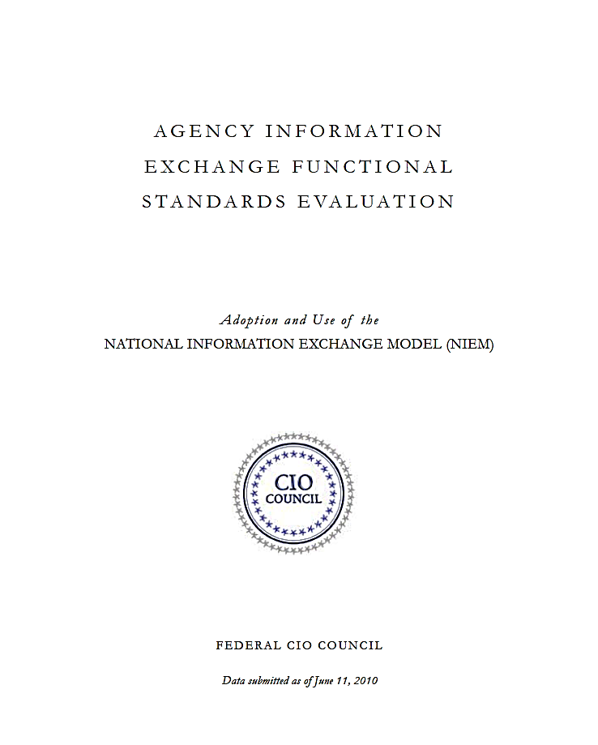
Progress ON Federal NIEM Adoption
Success of NIEM within the Departments’ of Justice, Homeland Security, and Health and Human Services propelled growth of NIEM across the Federal Government
Agency | Use of NIEM
Department of Agriculture | Committed to Use
Department of Defense | Committed to Use
Department of Education | Committed to Use
Department of Energy | Committed to Use
Department of Health and Human Services | Committed to Use
Department of Homeland Security | Committed to Use
Department of Housing and Urban Development | Committed to Use
Department of Justice | Committed to Use
Department of Labor | Committed to Use
Department of State | Committed to Use
Department of the Interior | Committed to Use
Department of the Treasury | Committed to Use
Department of Transportation | Committed to Use
Department of Veterans Affairs | Committed to Use
Environmental Protection Agency | Further Evaluation Required
General Services Administration | Committed to Use
National Aeronautics and Space Administration | Further Evaluation Required
National Archives and Records Administration | Committed Use
National Science Foundation | Committed to Use
Nuclear Regulatory Commission | Further Evaluation Required
Office of the Director of National Intelligence | Committed Use
Social Security Administration | Further Evaluation Required
Geospatial Line of Business | Further Evaluation Required
Grants Management Line of Business | Committed Use
Financial Management Line of Business | Committed Use
Human Resources Line of Business | Committed Use
Committed to Use | Further Evaluation Required - | Will Not Use

Slide 4
HUD’s Data Exchange Layer target Enterprise Architecture – Volume 1 of 2, November 2012
The DRM Data Exchange layer defines the packages of information that are communicated or passed between business processes. These data flows are referred to as “Information Exchange Packages”.
There is no Data Exchange layer for the HUD DRM at this time. This effort will identify areas where data exchange standards could be adopted to facilitate data exchanges and increase data reuse and understanding. Current known data exchange standards in use at HUD consist of the following:
Mortgage Industry Standards Maintenance Organization (MISMO). MISMO provides extensible mark-up language (XML) data exchange standards for both residential and commercial property transactions in USA market. HUD’s Housing segment uses MISMO in its loan management processes.
Multifamily Information and Transactions Standard (MITS). MITS is an industry-wide effort by the apartment sector to develop common data standards and (XML) protocol to facilitate data exchanges. The HUD disaster support system, National Housing Locator System (NHLS) uses the MITS data exchange standard to collect detail information about rental housing units in order to respond to the public’s need for housing when displace by a disaster.
Homeless Management Information System (HMIS). Homeless Management Information System (HMIS). HMIS is a set of data standards to support the exchange of data from homelessness prevention programs systems across the country.
National Information Exchange Model (NIEM)
The key use of NIEM is to provide the processes and support to develop cross-boundary data exchange standards that could be reused across Federal, State and Local governments. A cross-boundary information exchange is one that crosses a bureau or agency boundary, including information sharing with international, State, local, tribal, industry, or non-governmental organization partners.
HUD is currently evaluating the possible adoption of NIEM for defining, building and maintaining data
exchanges. The cost of adopting NIEM versus the benefits are being considered before a decision will be made if HUD will fully, partially or not adopt NIEM as a data exchange standard.

Slide 5
Current Status
Housing Domain was proposed (FY 2016)
No investment commitment was supported by Chief Information officer
Numerous other “alternative” HUD enterprise-wide information exchange standards and processes have been examined and implemented with varying degrees of success.
No current strategy or plan to design, implement or enable automated information sharing via the NIEM.

Slide 6
Proposed NIEM ‘HOUSING’ Domain
Questions and Answers

