Slide 1

Framing the NBAC F2F Strategic Planning
To formulate the NIEM Community FY 19 Action Plan

Slide 2
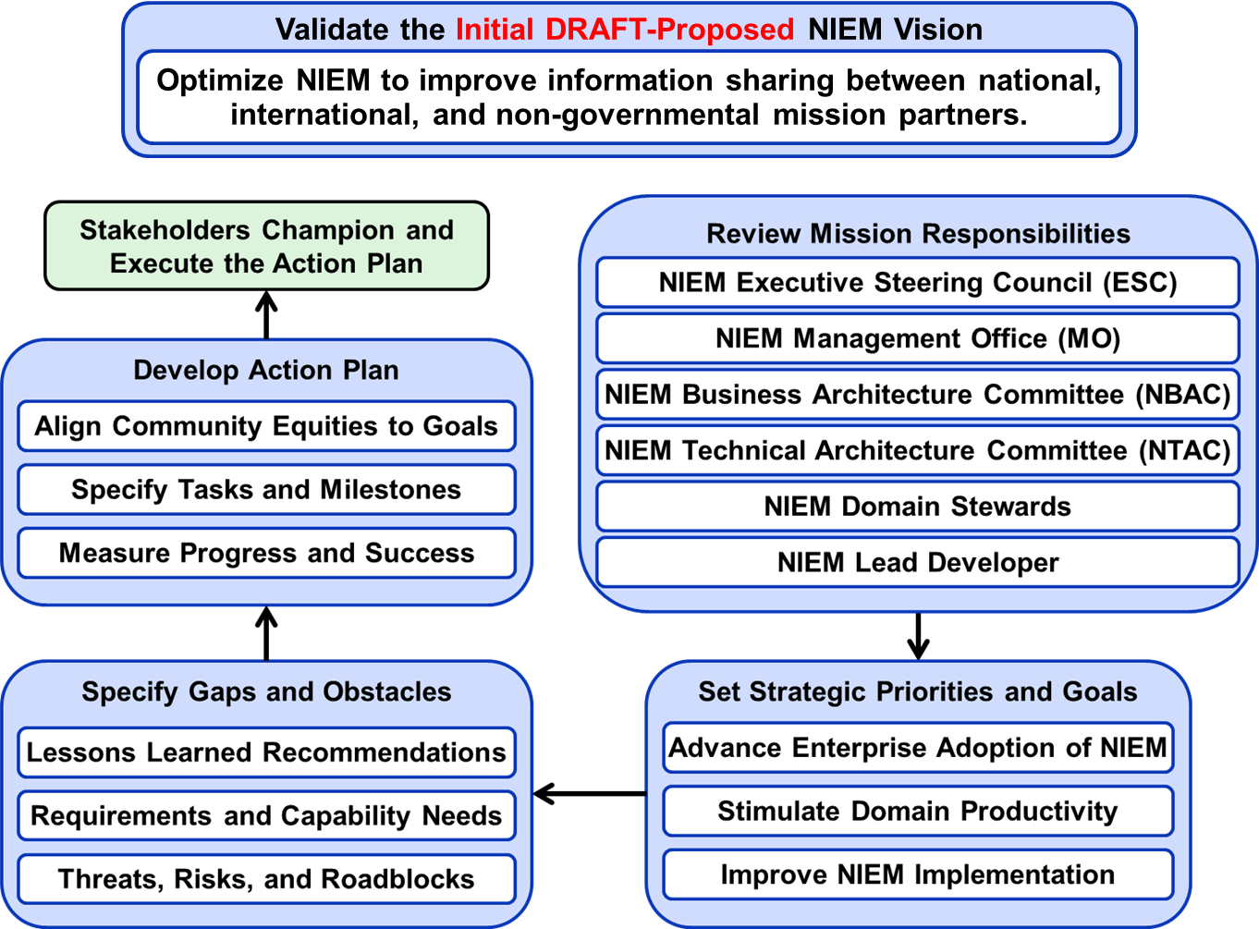
Proposed NIEM Annual Strategic Planning Overview
Strategic planning is an organization's process of defining its strategy, or direction, and making decisions on allocating its resources to pursue this strategy. It may also extend to control mechanisms for guiding the implementation of the strategy.
DRAFT NIEM Vision and Annual Strategic Planning Process are provided to stimulate community stakeholder discussion to incorporate recommendations for improving NIEM

Slide 3
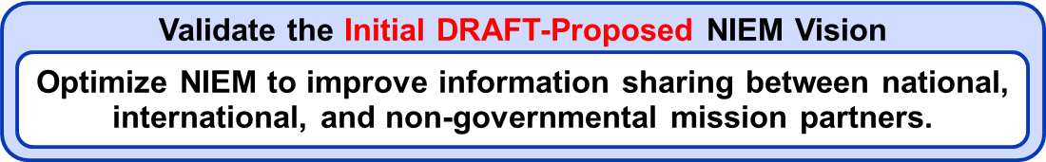
Vision Statement is
a declaration of an organization's objectives, intended to guide its internal decision-making.
(Desired End-State) A one-sentence statement describing the clear and inspirational long-term desired change resulting from an organization or program's work.
identifies what a company would like to achieve or accomplish.
"Your vision statement is where your company is going – it's all about your future.“
"A vision is aspiration.”
"A vision statement is essentially an articulation of your hopes and dreams for the future, what kind of a mark you want to make on the world with your business, and how you see that business developing into the future.“
"You are setting the direction of your company, staking out an identity, and sharing it with your partners and employees in a simple and powerful fashion.“
“The vision should drive our Strategic Priorities and Goals,”
Can we improve the NIEM Vison?

Slide 4
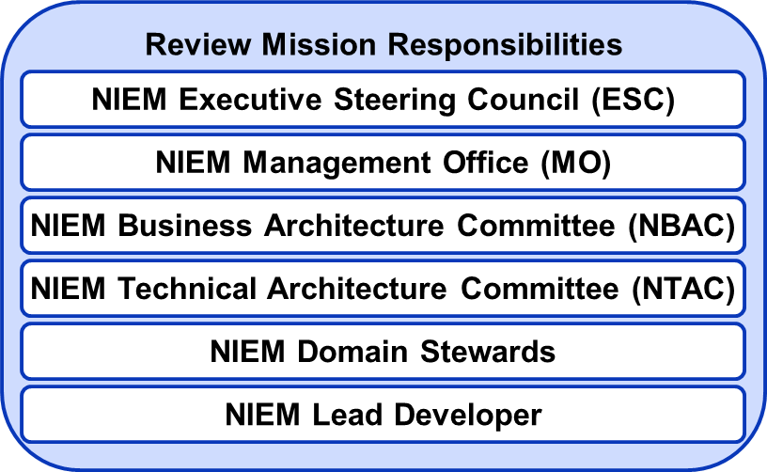
NIEM ESC & PMO Mission Responsibilities
NIEM Executive Steering Council (ESC)
The ESC serves as NIEM’s decision-making body regarding membership, funding requirements, program or technical direction, personnel appointments, and other organizational decisions as required for supporting NIEM management.
The primary sponsors of NIEM are Chief Information Officers (CIOs) of the U.S. Department of Homeland Security (DHS), U.S. Department of Justice (DOJ), and U.S. Health and Human Services (HHS), and as such, are members of the ESC. Advisory members and invited guests of the ESC include but are not limited to the following.
The Global Justice Information Sharing Initiative (Global), The National Association of State Chief Information Officers (NASCIO), The Executive Office of the President Office of Management and Budget (OMB) Federal Enterprise Architecture (FEA) through the Chief Architect, The Office of the Director of National Intelligence (ODNI) through the Program Manager of the Information Sharing Environment (PM-ISE), and Chief Information Officers of the U.S. Department of Defense and CrimTrac, Government of Australia
NIEM Program Management Office (PMO)
The PMO executes the ESC’s vision for NIEM while managing the Program’s day-to-day operations, encouraging adoption and use of NIEM, and overseeing all working group and committee activities. The NIEM PMO coordinates with Communities of Interest (COIs), principal stakeholders, and other information-sharing initiatives to promote collaboration and interest in NIEM priorities.

Slide 5
NBAC & NTAC Mission Responsibilities
NIEM Business Architecture Committee (NBAC)
As specified in its Charter, the mission of the NBAC is to set the business architecture​ and requirements of NIEM, manage NIEM Core, and facilitate the processes for the regulation and support of NIEM domains. The NBAC focuses on the following areas:
Business Architecture: The NBAC oversees and validates the construction, maintenance, and use of the business architecture framework for NIEM.
NIEM Core: The NBAC provides management and oversight of the NIEM Core—the central part of the NIEM data model that’s commonly understood across all domains.
Community: The NBAC serves as the forum for the admission of new domains and interactions between domains, and coordinates action to maintain the NIEM community.
NIEM Technical Architecture Committee (NTAC)
As outlined in its Charter, the primary mission of the NTAC is to define​ and support the technical architecture that governs NIEM. In addition, the NTAC:
Documents and maintains NIEM’s technical specifications.
Provides robust, effective development of the NIEM core structure and complementary processes to support and enable users to efficiently develop, use, and reuse data definitions and information exchange specifications.
Delivers and maintains a tool strategy that meets stakeholder requirements in support of information exchange across organizations

Slide 6
Domain Stewards & Lead Developer Mission Responsibilities
NIEM Domain Stewards
As specified in its Charter, the mission of the NBAC is to set the business architecture​ and requirements of NIEM, manage NIEM Core, and facilitate the processes for the regulation and support of NIEM domains. The NBAC focuses on the following areas:
Business Architecture: The NBAC oversees and validates the construction, maintenance, and use of the business architecture framework for NIEM.
NIEM Core: The NBAC provides management and oversight of the NIEM Core—the central part of the NIEM data model that’s commonly understood across all domains.
Community: The NBAC serves as the forum for the admission of new domains and interactions between domains, and coordinates action to maintain the NIEM community.
NIEM Lead Developer
The mission of the lead developer is to manage and maintain the NIEM data model and technical architecture. This involves but is not limited to: generate releases, draft and maintain NIEM technical specifications, maintain NIEM reference tools, and provide NIEM support. The lead developer serves at the discretion of the NIEM executive director.
Data Model Management: in conjunction with the NBAC, facilitates the release process, issue resolution, and harmonization; and publishes the NIEM release schedule.
Technical Specifications: in conjunction with the NTAC, drafts and maintains NIEM technical specifications and guidance supporting the NIEM technical architecture.
Reference Tools: SSGT (NIEM XML subsets) and ConTesA (XML conformance).
NIEM Support: technical support, training, and general NIEM support.

Slide 7
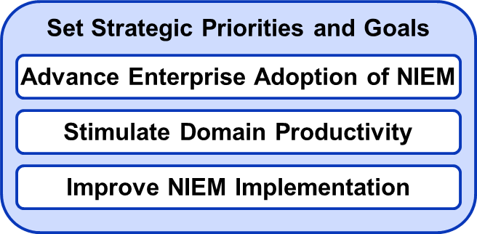
Set Strategic Priorities and Goals
Are these Strategic Priorities correct and complete?
Advance Enterprise Adoption of NIEM
Stimulate Domain Productivity
Improve NIEM Implementation
For each Strategic Priority, we need to specify the Goals, Gaps and Obstacles
Advance Enterprise Adoption of NIEM: Goals
Stimulate Domain Productivity: Goals
Improve NIEM Implementation: Goals
Highlight benefits of NIEM
Senior Leaders Champion NIEM
Onboard New Domains
Obtain International Adopters
Domain Stewards recruit community stakeholders
Reinvigorate idle Domains
Provide financial resources
Automated tools for end-to-end IEPD development
Provide solutions to capability needs
Extend Domain best practices
Synergize NBAC and NTAC
Provide training resources
Provide tool resources
Streamline IEPD reuse
Incorporate new technology
Provide financial resources
Focus on solving real world information sharing problems
Automated tools to generate API software from developed IEPDs
Establish NIEM development environment
Provide on-site technical support
Provide financial resources

Slide 8
Advance Enterprise Adoption of NIEM Collaborative Brainstorming Goals
Highlight benefits of NIEM
Compelling message
Senior Leaders Champion NIEM
Identify Decision Makers
Strategic Communications
Onboard New Domains
Statistics
Housing
Public Safety Canada
Cyber
Obtain International Adopters
Domain Stewards recruit community stakeholders
Reinvigorate idle Domains
Provide financial resources
Other?

Slide 9
Stimulate Domain Productivity Collaborative Brainstorming Goals
Automated tools for end-to-end IEPD development
Provide solutions to capability needs
Extend Domain best practices
Synergize NBAC and NTAC
Reference Schema Content
Technical Specifications
Provide training resources
Provide tool resources
Streamline IEPD reuse
Incorporate new technology
Provide financial resources
Other?

Slide 10
Improve NIEM Implementation Collaborative Brainstorming Goals
Focus on solving real world information sharing problems
a
Automated tools to generate API software from developed IEPDs
a
Establish NIEM development environment
a
Provide on-site technical support
a
Provide financial resources
a
Other?

Slide 11
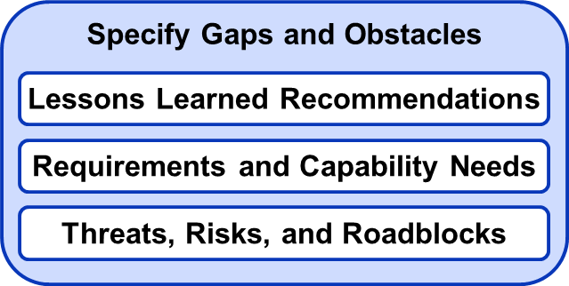
Specify Gaps and Obstacles (1/3) Lessons Learned Recommendations
NIEM sustainability and adoption is a challenge. The program has relied extensively on the community to sustain it, which is the right goal, but certain aspects have been neglected as a result (like training and tooling). An over-emphasis on community may have inhibited stronger leadership from domain stewards, the PMO, and the executive leadership. While the federal CIOs should not be steering the ship exclusively, we do need much stronger participation and leadership from federal IT executives to drive adoption and incorporation into agency level planning and as a means of interfacing with state and local agencies.
At the program (PMO) level, we need to see continued government-wide momentum and leadership pushing NIEM as a solution.
NIEM usability and utility for maximum number of use cases should be the priority, which will drive adoption and long-term sustainability.
Automated support for end-to-end IEPD development and implementation tools/support
We need a community-wide data sharing architecture, so that NIEM fits more universally into existing software development lifecycles. Either develop a small but deeply knowledgeable set of experts using a more rigorous training approach, or the model and tools need to be simplified to reduce the learning curve. Online training coupled with scheduled instructor availability. On call technical support.

Slide 12
Specify Gaps and Obstacles (2/3) Lessons Learned Recommendations
NIEM is very comprehensive, big; need a mechanism to explore the model in a visual way other than a spreadsheet to enable a quicker understanding of what NIEM covers. Give them something to look at, understand in 10 minutes, to stimulate pursuit. The elevator speech to sell NIEM. The big spreadsheet and XSDs scare people off.
NIEM should be positioned as a data model that accommodates cross-domain exchanges in general, even if those domains are not currently modeled in NIEM. The issue is that communities have existing data models, and little incentive to change or add another. This argument is difficult to resolve unless NIEM is repositioned as a translator across existing data models in addition to serving as a data model for those domains who choose to use it in that way. May require rethinking the domain structure and concepts, but is critical to ensure the long-term viability.
Training seems to have been de-emphasized over the years, moving from classroom-based, to proctored, to simple video-based instruction. While cost effective and on-demand, online training does not seem adequate given the complexity of using NIEM in practice. Either the target should be developing a small but deeply knowledgeable set of experts using a more rigorous training approach, or the model and tools need to be significantly simplified to reduce the learning curve to using NIEM-conformant data exchanges. Online training coupled with scheduled instructor availability would help here. On call technical support for IEPD development and implementation

Slide 13
Specify Gaps and Obstacles (3/3) Lessons Learned Recommendations
Need a NIEM compelling message on why to adopt and implement. Start with a hook, cost savings, return on investment, compelling examples. Stakeholders are diverse with varied information sharing needs.
Develop compelling message for Canadian executive leadership. Should emphasize sharing information, interoperability (operational benefit) vice NIEM; NIEM is an enabler
Identify all systems using NIEM to promote marketing/adoption
Refine Internationalization information exchange requirements and develop possible courses of action
People don’t understand NIEM, thinking it is a standard.
Provide funding to resource NIEM implementation
Improve IEPD reuse (discovery and retrieval)
Improve understanding of NIEM reference schema to promote marketing/adoption
Requirements and Capability Needs
Threats, Risks, and Roadblocks
Other?

Slide 14
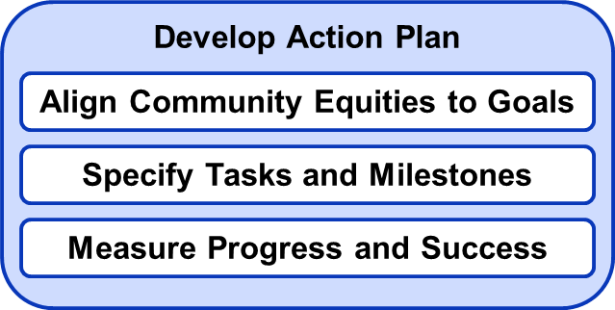
Advance Enterprise Adoption of NIEM Develop Action Plan
Highlight benefits of NIEM
Compelling message
Senior Leaders Champion NIEM
Identify Decision Makers
Strategic Communications
Onboard New Domains
Statistics
Housing
Public Safety Canada
Cyber
Obtain International Adopters
Domain Stewards recruit community stakeholders
Reinvigorate idle Domains
Provide financial resources
Other?

Slide 15
Stimulate Domain Productivity Develop Action Plan
Automated tools for end-to-end IEPD development
Provide solutions to capability needs
Extend Domain best practices
Synergize NBAC and NTAC
Reference Schema Content
Technical Specifications
Provide training resources
Provide tool resources
Streamline IEPD reuse
Incorporate new technology
Provide financial resources
Other?

Slide 16
Improve NIEM Implementation Develop Action Plan
Focus on solving real world information sharing problems
a
Automated tools to generate API software from developed IEPDs
a
Establish NIEM development environment
a
Provide on-site technical support
a
Provide financial resources
a
Other?

Slide 17
Obtain Resources to Implement NIEM
Needs Work
Define the Operational Problem
Design the Solution
Management & Outreach
North American Emergency Management: The United States, Canada, and Mexico first responders share information to provide humanitarian assistance, disaster relief, and public safety after a complex catastrophe
Develop use case – operational activities
Identify mission partner organizations and points of contact
Prioritize information needs (providers and consumers)
Establish Measures of Effectiveness (MOEs) and Measures of Performance (MOPs)
Specify reuse opportunities and capability gaps
Develop implementation plan of action
Estimate cost and in-kind funding
Develop Proposal
Executive Coordination
Calculate cost benefit
Obtain implementation resources
Demonstrate success

Slide 18
NIEM Implementation Approach
Needs Work
Define the Operational Context: North American Emergency Management: The United States, Canada, and Mexico first responders share information to provide humanitarian assistance, disaster relief, and public safety after a complex catastrophe (use case – operational activities)
Identify mission partner organizations and points of contact
Prioritize information needs (providers and consumers)
Specify reuse opportunities and capability gaps
Establish Measures of Effectiveness (MOEs) and Measures of Performance (MOPs)
Develop implementation plan of action
Calculate cost benefit
Obtain grant resources
Demonstrate success

