Slide 1
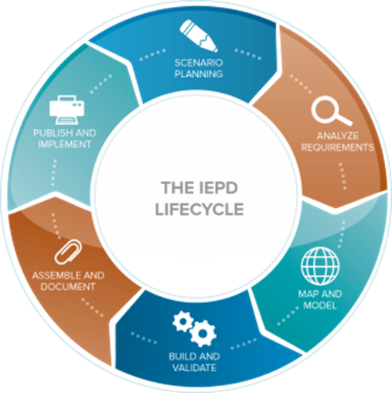
Where are we today ?
Scenario Planning
UML Modeling Tools
Visio
MS Office
Excel
Word
PowerPoint
Publish & Implement
XML
UML
JSON
ZIP File
IEPD Lifecycle
Analyze Requirements
UML Modeling Tools
Visio
MS Office
Excel
Word
PowerPoint
ReQtest, Qualtrics Core, Confluence …..
Assemble and Document
UML Modeling Tools
Visio
MS Office
Excel
Word
Powerpoint
Zip Tools
Build and Validate
SSGT
Code List Generation Tool
NIEM Conformance Tool (ConTesA)
Migration Tool
Map and Model
Mapping Spreadsheet
Schema Subset Generation Tool (SSGT)
Movement
Legend
NIEM Custom Tools
Generic / Commercial Tools

Slide 2
VISION
Automated support for IEPD production and implementation.
Easy to use.
Self-service model.
Open source & user-installable.
Supports XML, JSON & UML .
Accredited in diverse environments to facilitate tool creation.
Modular to support incremental improvements & agile development.
Accommodates third party tool hosting (e.g. Sparx EA, Magic Draw Cameo plugin and Wayfarer)
Tools to solve stakeholder problems
Flexible and adaptable NIEM tools for a Multi- Partner Environment

Slide 3
IEPD LIFECYCLE GAPS
Scenario Planning Tools
Analyze Requirements Tools
Search, browsing and content selection
Easy and Expert Modes
Automated Mapping Tool
Subset & Extension Content Generation
Code List Implementation
IEPD Validation
Assembly of Exchange Package Documentation
Publish and Implement Tools

Slide 4
Phase 1: extend Core Services
Archive
JSON Schema Generator
JSON Schema
Easy – Mode UI
(Movement)
Model
Description
UML Generator
UML
Expert – Mode UI
(SSGT)
XML Schema Generator
XML Schema
Documentation Generator
Documentation
Model Source
NIEM Releases
Notes:
Long-term: vision / roadmap
Could be other tools that use these same services
Ecosystem
Marketplace of providers
2 kinds of tools:
1. self-contained / locally-installable
2. Using services in a build process
3. web app using web services
Show how to connect in new things:
Generator services
Search services
Applications calling APIs
Locally installed components
Can add ingestion / model source of other kinds of artifacts:
UML
STIX
EDXL
Spreadsheets
Less training required – support production of artifacts the developers/users are familiar with.
could add search module
inputs
data definitions
XML Schemas
Spreadsheets
Databases
selections
extensions
rules
outputs
schemas
diagrams
spreadsheets
zip files with stuff in it

Slide 5
Phase One objectives
Enhance the current IEPD development tool to allow the creation of:
JSON
UML
XML

Slide 6
Phase 2: Incorporate IEPD Metadata
Archive
JSON Schema Generator
JSON Schema
Easy – Mode UI
(Movement)
Model
Description
UML Generator
UML
Expert – Mode UI
(SSGT)
XML Schema Generator
XML Schema
Model Source
Documentation Generator
Documentation
NIEM Releases
SQL Generator
Relational Schema
Users' EIEM / IEPDs / Extensions
Domain Updates
Notes:
Long-term: vision / roadmap
Could be other tools that use these same services
Ecosystem
Marketplace of providers
2 kinds of tools:
1. self-contained / locally-installable
2. Using services in a build process
3. web app using web services
Show how to connect in new things:
Generator services
Search services
Applications calling APIs
Locally installed components
Can add ingestion / model source of other kinds of artifacts:
UML
STIX
EDXL
Spreadsheets
Less training required – support production of artifacts the developers/users are familiar with.
could add search module
inputs
data definitions
XML Schemas
Spreadsheets
Databases
selections
extensions
rules
outputs
schemas
diagrams
spreadsheets
zip files with stuff in it

Slide 7
Phase two objectives
Deconstruct the current NIEM tool model in preparation of phase three.
Document tool code
Update code library to open source
Identify IEPD development models
Create code models
Create IEPD creation wizard
Update IEPD training
Convert all data ingest to binary format
Create input forms and templates

Slide 8
Phase 3: Comprehensive tool
Archive
JSON Schema Generator
JSON Schema
Easy – Mode UI
(Movement)
Model
Description
UML Generator
UML
Expert – Mode UI
(SSGT)
XML Schema Generator
XML Schema
Model Source
Documentation Generator
Documentation
NIEM Releases
SQL Generator
Relational Schema
Users' EIEM / IEPDs / Extensions
Domain Updates
Metadata Management
Notes:
Long-term: vision / roadmap
Capture all IEPD creation metadata for re-use
Use metadata to populate MO dashboards
Integrate metadata into NIEM data lake

Slide 9
Phase Three Objectives
Create user friendly IEPD creation interface that allows customers to:
Create IEPDs without leaving the interface.
Leverage metadata to populate NIEM MO dashboards.
Create user profile capability to capture all user input for reuse.
Integrate IEPD creation data with IEPD registry data.

Slide 10
Overall Tools Strategy Objectives
Enables accessible, efficient & agile Mission Partner Information Sharing
Expands support beyond XML to JSON and UML (more exchange formats)
Improves accessibility to the novice but expands expert capabilities
Shortens development & deployment by automating manual processes
Improves interoperability through standardization & conformance

