Slide 1
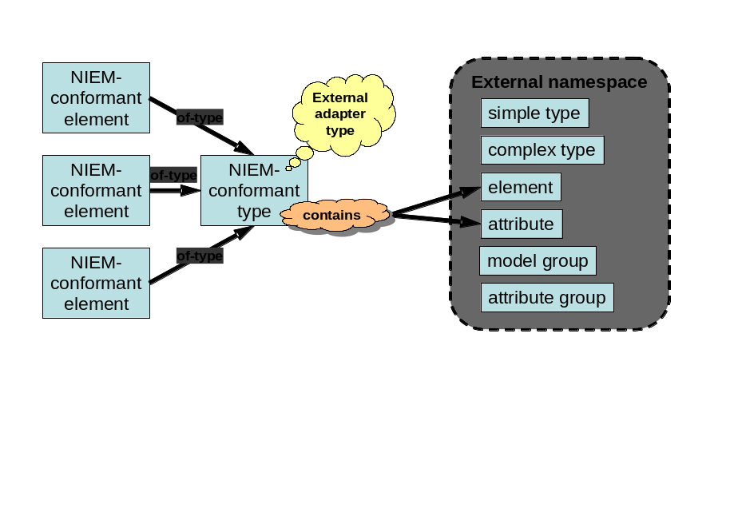

Slide 2
C2Core-conformant element
External namespace
External adapter type
simple type
of-type
complex type
C2Core-conformant element
C2Core-conformant type
of-type
element
contains
attribute
of-type
model group
C2Core-conformant element
attribute group

