Slide 1
NIEM Health 101: An Introduction to Health Information Exchange
Cait Ryan
Brian Handspicker

Slide 2
NIEM Health Guidance Documents
NIEM Health 101: An Introduction to Health Information Exchange
NIEM Health 102: An Introduction to Security and Privacy of Protected Healthcare Information
NIEM Health 201: Architecting NIEM Health IEPDs using Health Information Models
NIEM Health Element Inventory
Notes:
The Federal Health Architecture (FHA), an Office of Management and Budget (OMB) e-Gov Line of business, has published a series of National Information Exchange Model (NIEM) guidance documents for the NIEM Health Community of Interest (NH-COI) and NIEM stakeholders at large.
This presentation is the first in the series - NIEM Health 101: An Introduction to Health Information Exchange. This document should be used in conjunction with the follow-up NIEM Health 102: An Introduction to Security and Privacy of Protected Healthcare Information
and NIEM Health 201: Architecting NIEM Health IEPDs using Health Information Models guidance document and www.fhims.org.

Slide 3
NIEM Health 101
This presentation outline:
NIEM Health Guidance Documents
NIEM Health Challenge
Health IT (HIT) Landscape and HIT Standards
What is NIEM
What is FHIM
NIEM Health Community-of-Interest (CoI) Strategy
Notes:
NIEM Health 101, the first of the NIEM guidance documents, provides a brief overview of the current health IT landscape, related reference exchange and terminology standards, the Federal Health Information Model (FHIM). By the end of this guidance document you should better understand:
NIEM Health Challenge
Health IT (HIT) Landscape and HIT Standards
What is NIEM
What is FHIM
NIEM Health Community-of-Interest (CoI) Strategy

Slide 4
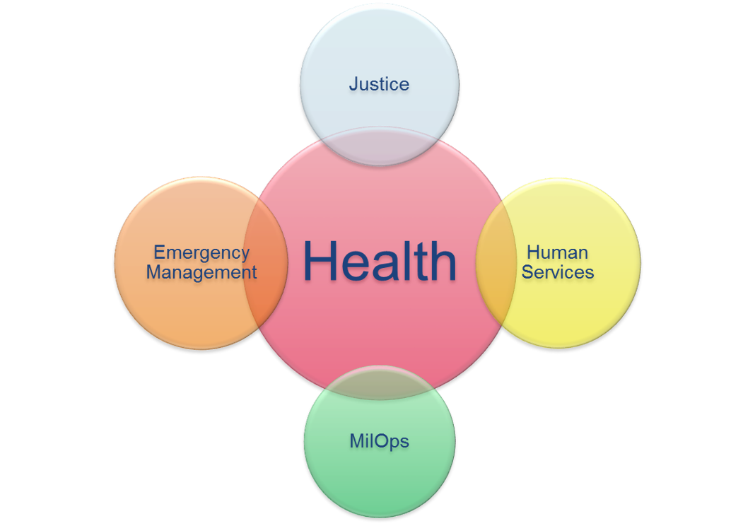
NIEM Health Challenge
Notes:
As NIEM's adoption continues to grow, non-clinical domains that utilize health data elements for information exchange will require clinical informatics subject matter expertise to successfully navigate through the complexities of the HIT/HIE environment. Furthermore, operational HIT/HIE safeguards must be in place to ensure that the exchange of health information is always legal, secure, and private. The real world challenge is to harmonize across all information exchange standards and to build a compelling business case, through the Federal Health Information Model (FHIM) that defines standardized terminology and the mapping of data relationships, both key to the efficient exchange of healthcare information.

Slide 5
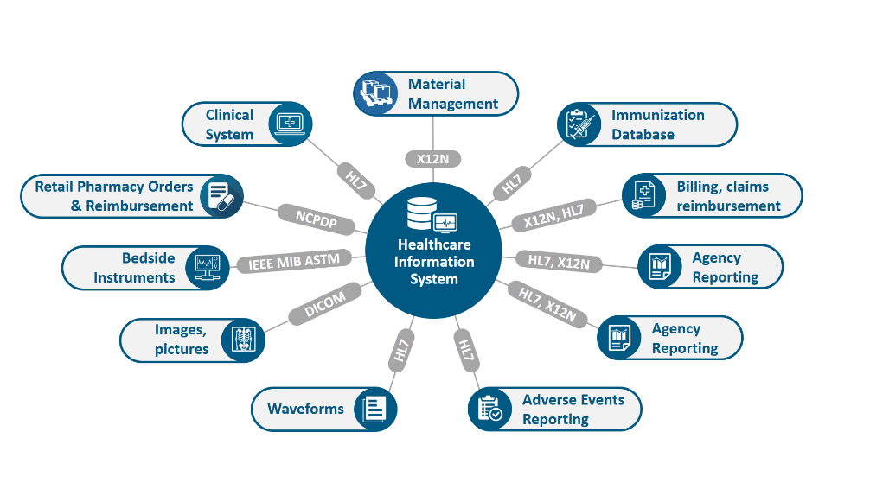
Health IT Landscape
Notes:
The Healthcare Information Management Systems Society (HIMSS) summarizes today’s Health IT (HIT) landscape as a sophisticated, heterogeneous environment comprised of a wide assortment of health care settings, stakeholders, and information systems, specifically for healthcare delivery. The sheer number and diversity of healthcare entities (e.g. providers, payers, researchers, and beneficiaries) presents a considerable information sharing challenge within the healthcare ecosystem. This lack of “interoperability,” is primarily due to an absence of a widely adopted and integrated standardized vocabulary (or shared language). Despite the advent of several interoperability standards development organizations (SDO), the assortment of interoperability standards are not “harmonized,” resulting in gaps, overlaps, and duplication. Furthermore, competing standards hinder further development and progress of the standardized exchange and use of protected health information (PHI).
The 21st Century Cures Act (Cures Act) defines interoperability in the context of health information technology (health IT) as health IT that enables the secure exchange of electronic health information with, and use of electronic health information from, other health information technology without special effort on the part of the user; allows for complete access, exchange, and use of all electronically accessible health information for authorized use under applicable State or Federal law; and does not constitute information blocking as defined in section 3022(a).

Slide 6
Health Data Exchange Standards
Acronym | Title | Description
DICOM | Digital Imaging and Communications in Medicine | Defines standards for representing and exchanging medical imaging
HL7v2 | Health Level 7 version 2 | Defines standards for representing and exchanging medical clinical information using EDI
HL7v3 | Health Level 7 version 3 | Adds XML-representation of Clinical Document Architecture (CDA), Consolidated-CDA (C-CDA), Continuity of Care Document (CCD) documents
FHIR | Health Level 7 Fast Healthcare Interoperability Resources | Defines standards for representing and exchanging medical clinical information using RESTful and web services
NCPDP | National Council for Prescription Drug Programs | NCPDP is an accredited standards development organization providing healthcare standards largely to pharmaceutical industry
ELINCS | EHR-Lab Interoperability and Connectivity Specification | Defines standards for representing and exchanging medical laboratory information
Notes:
HIE data exchange standards have evolved through the years to improve messaging and to drive high data quality. These structure and syntax standards include:
• Digital Imaging and Communications in Medicine (DICOM): Imaging
• HL7v2.x: Messaging
• HL7v3: Clinical Document Architecture (CDA), Consolidated-CDA (C-CDA), Continuity of Care Document (CCD) documents
• HL7 Fast Healthcare Interoperability Resources (FHIR): an emerging web services and document standard, currently in trial use
• National Council for Prescription Drug Programs (NCPDP): developed by the American National Standards Institute, NCPDP is an accredited standards development organization providing healthcare solutions, largely to the pharmaceutical industry

Slide 7
Health Vocabulary Standards
Acronym | Title | Description
SNOMED | Systematized Nomenclature of Medicine-Clinical Terms | Nomenclature copyrighted by the College of American Pathologists; includes diseases, clinical findings, etiologies, procedures, and outcomes
ICD-10 | International Classification of Diseases, 10th Edition | Overlaps with SNOMED in diseases, events and findings
LOINC | Logical observation Identifiers Names and Codes | Overlaps with SNOMED in findings and measures
CPT | Current Procedural Terminology | Overlaps with SNOMED in procedures/interventions concepts. Not as granular as LOINC; also used for insurance data exchange.
X12 | Claim Status Codes | Similar to CPT but focused for insurance claims, not specific enough for clinical reporting
UMLS | National Library of Medicine’s Unified Medical Language System ® | Meta vocabulary collection that includes ICD-10, LOINC, CPT, and SNOMED
Notes:
Health vocabulary standards include:
• SNOMED CT (Systematized Nomenclature of Medicine-Clinical Terms)
• RxNorm
• LOINC (Logical Observation Identifiers Names and Codes)
• CPT® (Current Procedural Terminology)
• ICD-10 (International Statistical Classification of Diseases and Related Health Problems 10th revision)
• DSM-5 (The Diagnostic and Statistical Manual of Mental Disorders)
Vocabulary standards were developed to ensure semantic and syntactical consistency with the characteristics and attributes for clinically specific patient medical record information terminologies. Examples of relevant vocabulary standards include, but are not limited to:
• SNOMED CT (Systematized Nomenclature of Medicine-Clinical Terms): developed by the International Health Terminology Standards Development Organization (IHTSDO), it is comprehensive, multilingual clinical healthcare terminology originally intended to record observations for pathologists
• RxNorm: developed by the National Library of Medicine (NLM), it provides normalized names for clinical drugs and links its names to many of the drug vocabularies commonly used in pharmacy management and drug interaction software
• LOINC (Logical Observation Identifiers Names and Codes): developed by Regenstrief, LOINC serves as an international standard for identifying health measurements, observations, and documents and was originally intended for reporting lab results
• CPT® (Current Procedural Terminology): developed by the American Medical Association (AMA) for the purpose of billing outpatient & office procedures
• ICD-10 (International Statistical Classification of Diseases and Related Health Problems 10th revision): a medical classification list developed by the World Health Organization (WHO). It contains codes for diseases, signs and symptoms, abnormal findings, complaints, social circumstances, and external causes of injury or diseases. ICD-10 is commonly used for billing purposes.
• DSM-5 (The Diagnostic and Statistical Manual of Mental Disorders): developed and administered by the American Psychiatric Association (APA), serves as a psychiatric classification and diagnostic reference tool

Slide 8
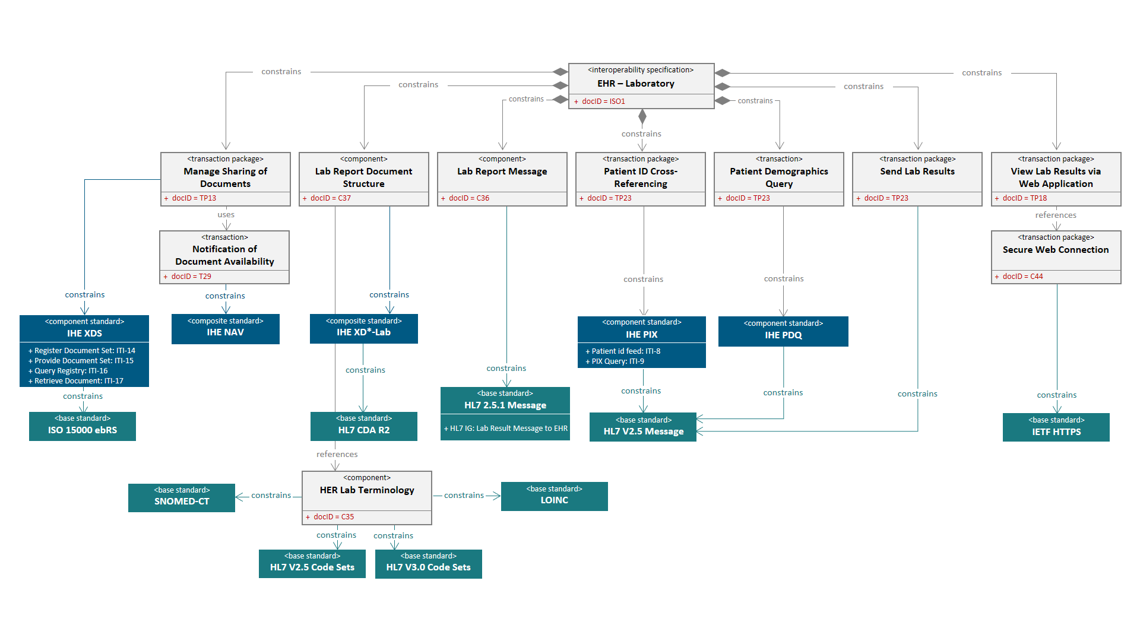
Health IT Sophistication
Notes:
In addition to the standards mentioned above, health information is protected by a number of privacy and security laws that proscribe the type of terminology to utilize as well as the protections around the information being shared.
The combination of a history of multiple healthcare information exchange standards and multiple different specialized healthcare vocabulary standards results in a very sophisticated health IT environment that is challenging for non-healthcare domains to implement directly.

Slide 9
What is NIEM?
The National Information Exchange Model is a common vocabulary that enables efficient information exchange across diverse public and private organizations:
NIEM breaks down interagency stovepipes
NIEM enables agencies to share information that crosses system, agency, and jurisdictional borders
NIEM improves decision-making, agility, and efficiency in satisfying business needs
NIEM supports interoperability and reuse reducing costs
Notes:
The National Information Exchange Model (NIEM) is a common vocabulary that enables efficient information exchange across diverse public and private organizations. NIEM connects communities of people who share a common need to exchange information in order to advance their mission.
As NIEM's adoption continues to grow, non-clinical domains that utilize health data elements for information exchange will require clinical informatics subject matter expertise to successfully navigate through the complexities of the HIT/HIE environment. Furthermore, operational HIT/HIE safeguards must be in place to ensure that the exchange of health information is always legal, secure, and private. The real world challenge is to harmonize across all information exchange standards and to build a compelling business case, through the Federal Health Information Modeling and Standards (FHIMS) program and its corresponding Federal Health Information Model (FHIM) that defines standardized terminology and the mapping of data relationships, both key to the efficient exchange of healthcare information.

Slide 10
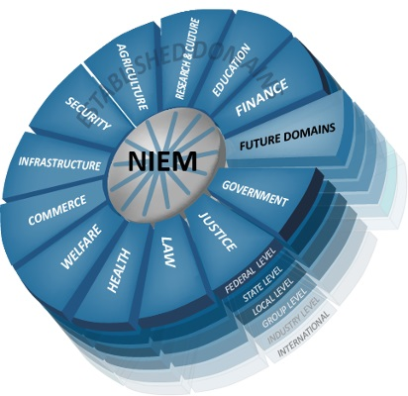
NIEM Domains and Users
Notes:
NIEM has come a long way since it was formally launched in April 2005 by the Chief Information Officers of U.S. Department of Homeland Security and the U.S. Department of Justice based on the Global Justice XML Data Model (GJXDM). As of June 2019 there are over 14 NIEM Domains and emerging Communities of Interest (CoI), including Agriculture, Biometrics, CBRN, Emergency Management, Human Services, Immigration, Infrastructure Protection, Intelligence, International Trade, Justice, Maritime, Military Operations, Screening, and Surface Transportation.
Today all 50 states and over 19 federal agencies are using NIEM. The benefits of NIEM have also extended to Europe, the Americas, Australia, and Asia.

Slide 11
What is FHIMS
Federal Health Interoperability Modeling and Standards (FHIMS) program:
Coordinates with partner agencies including:
Department of Defense (DoD),
Department of Veteran Affairs (VA),
Department of Health and Human Services (HHS),
The Office of the National Coordinator for Health IT (ONC),
The Center for Medicaid and Medicare Services (CMS)
On the development of Electronic Medical/Health Records (EMR/EHR), health information and terminology standards, and the coordination of agency efforts at relevant Standards Development Organizations (SDOs)
Notes:
The FHIM initiative is under Federal Health Interoperability Modeling and Standards (FHIMS) program. FHIMS coordinates with partner agencies, including Department of Defense (DoD), Department of Veteran Affairs (VA), Department of Health and Human Services (HHS), The Office of the National Coordinator for Health IT (ONC), and The Center for Medicaid and Medicare Services (CMS), on the development of Electronic Medical/Health Records (EMR/EHR), health information and terminology standards, and the coordination of agency efforts at relevant SDOs. Many partner agencies are active in SDOs. This enables the FHIMS program to unify agencies into a single voice while limiting redundant SDO participation. For those agencies that do not yet have a presence in a particular SDO, the FHIMS program does provide a mechanism for agencies to delegate issues to another agency.

Slide 12
What is FHIM
Federal Health Information Model (FHIM):
a platform independent model (PIM)
a logical health information model,
supports semantic interoperability
harmonizes information and terminology content across federal partners and SDOs
can standardize data concepts and serve as a repository of such concepts.
FHIM is an implementation-neutral planning and reference tool that can also be used to generate other models
Notes:
Federal Agencies’ experts, including Agency Subject Matter Experts (SMEs), clinicians, and terminologists have developed and now maintain the Federal Health Information Model (FHIM). FHIM encompasses over 85% of the health domain and proscribes to the implementer exactly which terminology should be used for a given exchange, dictated by HIPAA, NCPDP, etc. This allows NIEM Health developers to identify and map key health standard data elements from the FHIM instead of modeling a NIEM Health domain from scratch.
FHIM is a platform independent model (PIM), as well as a logical health information model, that supports semantic interoperability through development of a comprehensive and integrated set of implementation guides. The model harmonizes information and terminology content across federal partners and SDOs and can standardize data concepts and serve as a repository of such concepts. Therefore, FHIM is an implementation-neutral planning and reference tool that can also be used to generate other models.

Slide 13
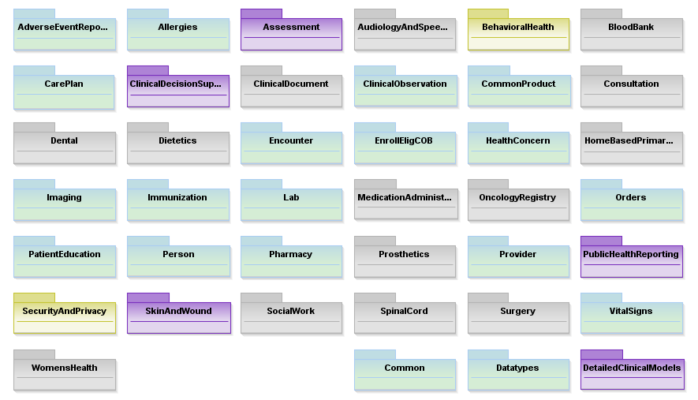
FHIM UML Model
Notes:
Approximately 85% of frequently exchanged healthcare information falls within these 39 domains. As such, FHIM has established itself as a valued source for referencing health information by FHA’s federal partner agencies and FHA has determined it will leverage FHIM rather than ‘recreate the wheel’:
AdverseEventReporting
CommonProduct
Lab
SecurityAndPrivacy
Allergies
Consultation
MedicationAdministration
SocialWork
Assessment
Dental
OncologyRegistry
SpinalCord
AudiologyAndSpecimen
Dietetics
Orders
Surgery
BehavioralHealth
Encounter
PatientEducation
VitalSigns
BloodBank
EnrollEligCOB
Person
WomensHealth
CarePlan
HealthConcern
Pharmacy
Common
ClincialDecisionSupport
HomeBasedPrim
Prosthetics
Datatypes
ClinicalDocument
Imaging
Provider
DetailedClinicalModel
ClinicalObservation
Immunization
PublicHealthReporting

Slide 14
FHIM and NIEM
Federal Health Information Model can be used to:
model NIEM elements and NIEM IEPDs
based on structures and constraints defined in NIEM
compatible with similar structures in Consolidated CDA implementation guides required for meaningful use
FHIM’s biggest value is that it is proscriptive, implementers know exactly which terminologies to use for a given element:
Ensures compliance with federal laws
Promotes interoperability
Notes:
The FHIM and MDHTs can be used to generate NIEM elements and IEPDs, knowing the structures and constraints defined in the IEPDs are compatible with similar structures in Consolidated CDA implementation guides required for meaningful use.
FHIM is modeled in standard Unified Modeling Language (UML) with both structural and terminology concepts, defining code systems, concept domains, and value sets. The Terminology model describes the underlying terminology constructs, including URLs and version numbers, so that software can be automatically generated ensuring that implementations are conformant at run-time. The FHIM utilizes model-to-model transformations (an aspect of Model Driven Architecture (MDA)) to create implementation guides, test harnesses, and other implementable artifacts targeted to various standards (e.g., CDA, FHIR, NIEM). FHIM maintains traceability to underlying standards - especially HL7, NCPDP, and X12 – as well as to S&I Initiatives. FHIM leverages the HL7 Reference Information Model (RIM) as a reference model, but can also leverage other reference models. FHIM derivative models add “interoperability use cases” which provide additional constraints. These derivative models maintain traceability to the use cases and to the HL7 EHR-S Functional Model. The models can be leveraged by organizations for internal use in systems and database development.

Slide 15
FHIM and NIEM Comparison
 | NIEM | FHIM
Purpose | Provides a common vocabulary to enable efficient information exchange across diverse public and private organizations | Supports semantic interoperability and harmonize information requirements from federal partners and multiple standards organizations
Model Type | Conceptual, Information Exchange, XML | Logical, Information, Platform-Neutral, Standard-Neutral, UML
Functionality | XML-based. “Proven” information exchange framework | Semantic-based. Information exchange, traceability, and alignment into industry information models and standards
Standards-Neutral | Yes, each domain steward determines the specific standards they will use | Yes, contents identified in the FHIM may be represented using any technology or standard representation
Platform-Neutral | Yes | Yes
Domains | 14, Each is specific to a Community of Interest (COI) | 41, All are specific to Healthcare
Exchanges | NIEM is about the semantics, not the transportation, of XML messages. Web Services (e.g. WSDL) provides the mechanism for exchanging machine-to-machine NIEM Information Exchange Package Documentation (IEPD) | FHIM does not provide a method for transport of information
Developed By | Federal, State, and Local Agencies | Federal Agencies
Used By | Federal, State, and Local Agencies | Federal Agencies
Notes:
NIEM and FHIM are respectively logical information exchange and information (not data) models. The table below provides a high-level view, of the similarities and differences between NIEM and FHIM.
Within Health IT the functional interoperability between Electronic Health Records (EHR) and Health Information Exchanges (HIE) creates the bridge for inter-connecting the diverse modern health care ecosystem. NIEM can take business and information requirements to create reusable IEPDs to address the needs of heterogeneous health information producers and consumers. The Information Exchange Package Documentation (IEPD) is fundamental to the NIEM architecture, acting as a complete definition of an information exchange. It is composed of a data exchange schemas with business context and usage documentation. Although the IEPD is a data exchange specification that defines data exchange, for the purpose of these guidance documents the IEPD is the functional template that specifies content, structure, format, and packaging.
Like NIEM, FHIM provides a common vocabulary and a well-defined set of model elements to make the federal healthcare system more understandable and healthcare information more readily exchanged. It synthesizes recognized industry standards into a single model and is validated using a “bottom up” approach to its construction by agency representatives. The FHIM assists in identifying shared information needs across two (or more) agencies, building mutual understanding and consensus on data sharing and documents, and automating key aspects of information exchange protocols.
NIEM is comprised of industry specific domains, or COI that are developed and maintained by a specific federal agency. For example, the Human Services domain is owned by HHS and the Military Operations (MilOps) domain is owned by DoD. Both of these domains are built from the NIEM Core components and domain-specific elements.
Unlike NIEM, FHIM domains consist of a singular COI: health. Therefore, FHIM domains are classified into an assortment of healthcare categories, as illustrated below, and can be viewed at: http://fhims.org/.

Slide 16

NIEM Health Community Strategy
NIEM COI Collaboration based on past NIEM-Health Work (No traditional FHA HIT agency involvement required)
Provide high level and detailed guidance with examples on how to traverse from the NIEM Core to required FHIM elements and how elements can be associated at least conceptually if not through notation
High Level FHIM to NIEM Core Mapping/Guidance
Publish within NIEM Community
Identify most commonly needed health elements
Leverage FHIM to access authoritative element value sets and code sets
Guides
Notes:
The NIEM Health Community-of-Interest Strategy is to:
• lead NIEM Health Community discussions to define use-cases, and functional and technical requirements,
• develop high-level FHIM to NIEM mapping and guidance documents, including
o identifying most commonly needed health elements,
o leveraging FHIM to access authoritative element value sets and code sets,
• develop detailed guidance documents with examples on how to traverse from the NIEM Core to required FHIM elements and how elements can be associated at least conceptually if not through notation, and
• review, revise, and socialize NIEM Health guidance documents with the NIEM Health Community-of-Interest.

Slide 17
Conclusion
Functional interoperability, both within and outside information exchanges, is the key to accurate, useful, and secure information exchange networks.
FHIM and NIEM can be leveraged together to increase accuracy and to ease the development of functional interoperability between federal, local, state, and tribal health entities by adopting and integrating the standardized use and exchange of health data amongst various public health entities. See:
NIEM Health 201: Architecting NIEM Health IEPDs using Health Information Models
Notes:
Functional interoperability, both within and outside Health Information Exchanges, is the key to accurate, useful, and secure information exchange networks. Currently, disparate interoperability standards vary between HIT organizations and their stakeholders. Furthermore, the lack of consistent standards adoption impedes HIE interoperability on both a national and regional scale. FHIM can provide a means to harmonize competing standards and produce artifacts that will improve the quality of implementations through model-to-model transformations. Information exchanges have numerous requirements related to standards and terminology. Their diverse data sets and cross-domain relevance require the FHIM logical model to describe the contents of the information exchanges (e.g., HL7, NIEM). FHIM can bridge the existing semantic gap between domains (e.g. HL7, NIEM) to consistently exchange health information, regardless of context, by defining explicit information exchange requirements in a platform independent fashion. Thus, FHIM and NIEM can be leveraged together to increase accuracy and to ease the development of functional interoperability between federal, local, state, and tribal health entities by adopting and integrating the standardized use and exchange of health data amongst various public health entities.
To learn more about NIEM Health IEPD development please read the follow up tutorials to this work:
NIEM Health 102: An Introduction to Security and Privacy of Protected Healthcare Information,
NIEM Health 201: Architecting NIEM Health IEPDs using Health Information Models, and
NIEM Health Element Inventory.

Slide 18
Thank You

