Slide 1
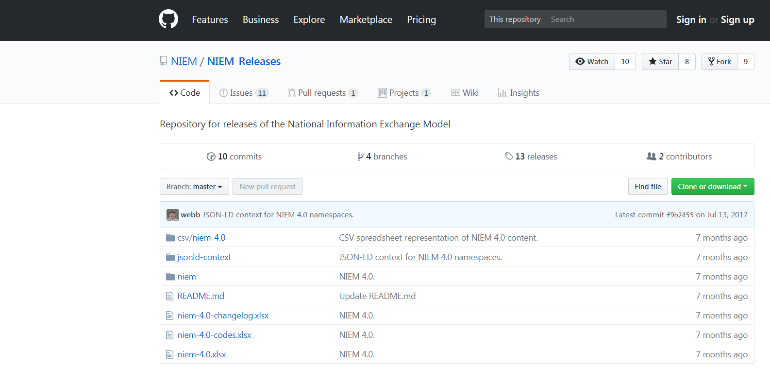
NIEM CSVs
JSON-LD Context
XML Schemas
README
Change log spreadsheet
Code spreadsheet
Model spreadsheet

