Slide 1
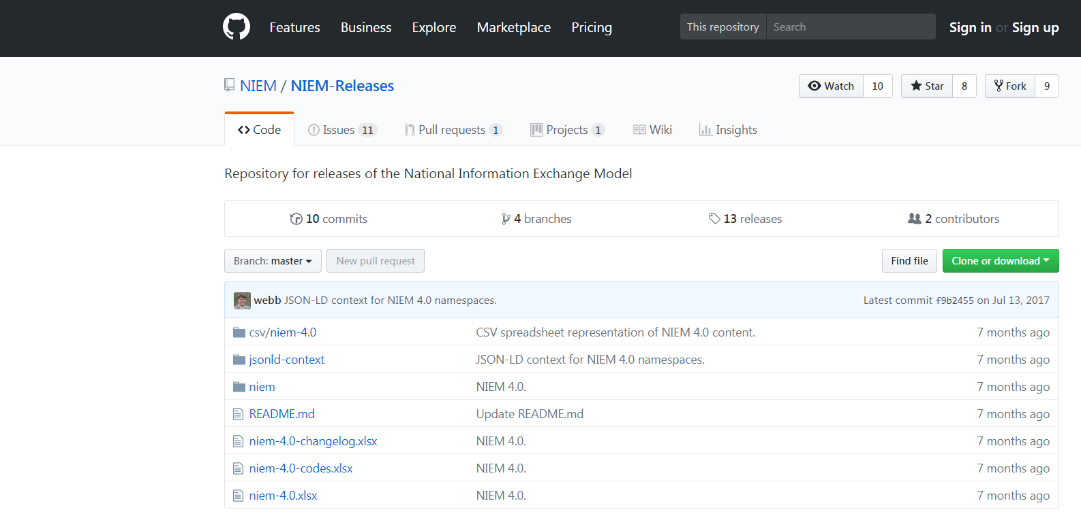
Alternate Formats (CSVs)
JSON-LD Context
XML Schemas
README
Change log spreadsheet
Code spreadsheet
Model spreadsheet

