Slide 1
scVIRGILS – to annotation
Marsan 2023 - FC

Slide 2

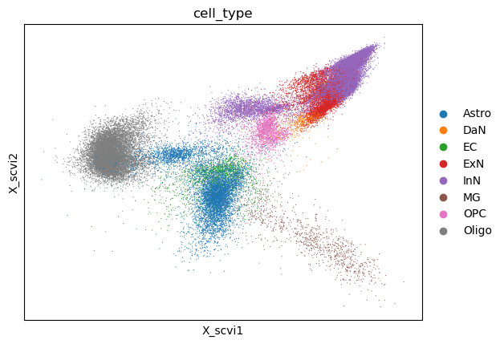
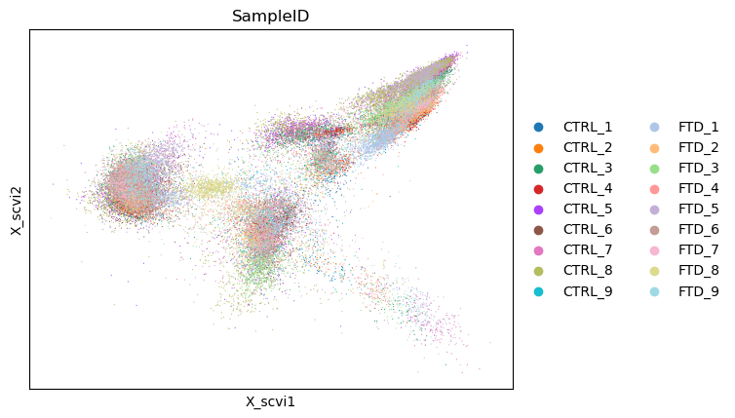

Slide 3
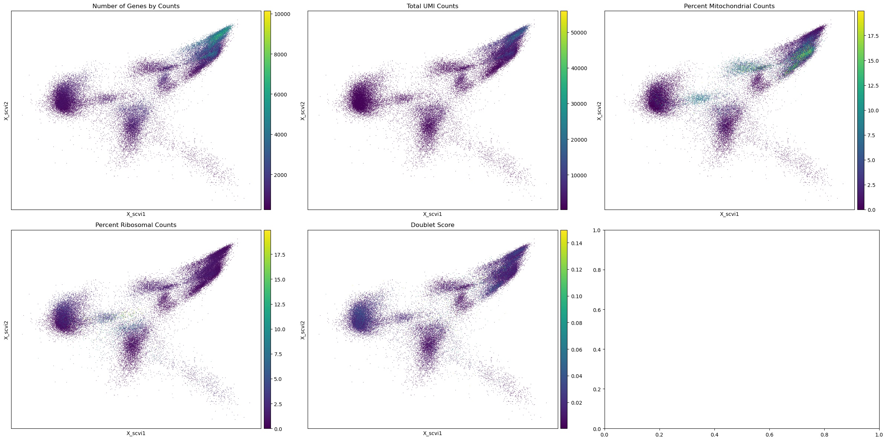

Slide 4


