Slide 1
Aggregation rule depends on the predictive method
Per-method federation protocols evaluated in this work
• Multiple Linear Regression — FedAvg-by-N (weighted mean of coefficients, weights proportional to per-institution training size)
• Lasso — ADMM consensus (Boyd 2011 §8.2): local ridge-style fits plus a coordinator soft-thresholding step
• Random Forest — union of forests: each institution trains a forest; test predictions are averaged across all institutions' forests
• Plain CNN — multi-round FedAvg with synchronisation: every round, each institution warm-starts from a common parameter vector
• Autoencoder + CNN — two-stage: per-institution AE pretraining, then a supervised head on top of the federated encoder
BioIT World 2026 • Federated Lasso supplement

Slide 2
ADMM-Lasso: definition and protocol
Alternating Direction Method of Multipliers applied to Least Absolute Shrinkage and Selection Operator regression
What the algorithm does
Three steps per round
• Splits the L1-penalised regression into a local subproblem at each institution plus one coordinator step
• Local update at each institution: closed-form ridge fit using only that institution's data
• Coordinator update: soft-thresholding applied once per round to the consensus coefficient vector
• Iterates until the per-institution coefficient vectors converge to the consensus
• 1. Local: each institution updates its β_k from its own data and the current consensus vector z
• 2. Coordinator: z is updated as the soft-thresholded average of β_k + u_k across institutions
• 3. Dual: each institution updates u_k = u_k + β_k − z, accumulating drift from consensus
• Network exchange: β_k + u_k up, z down. Subject-level data never leave the institution.
Boyd, Parikh, Chu, Peleato, Eckstein (2011). Distributed Optimization and Statistical Learning via the Alternating Direction Method of Multipliers. Foundations and Trends in Machine Learning 3(1):1–122.
BioIT World 2026 • Federated Lasso supplement

Slide 3
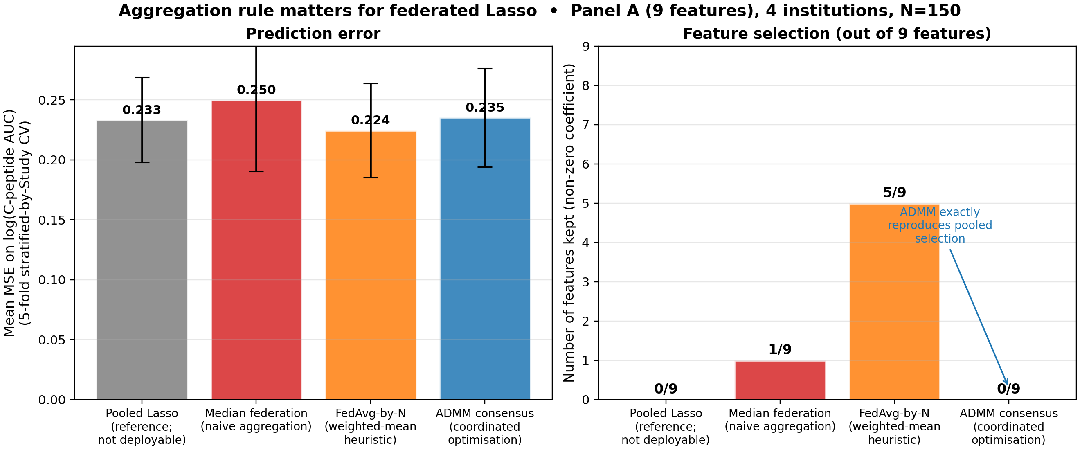
Lasso aggregation rule comparison
Panel A, 9 features, N=150 across 4 institutions, α=0.05, 5-fold stratified-by-Study CV
ADMM-Lasso coefficient agreement with pooled: ||β̂_ADMM − β̂_pooled||_∞ = 0 (Panel A, 95 iterations). Median federation keeps 1/9 features; FedAvg-by-N keeps 5/9; ADMM and pooled both keep 0/9 at this α.
BioIT World 2026 • Federated Lasso supplement

Slide 4
Post-Lasso pipeline: protocol
Federated feature selection followed by per-method refit on the selected support
Steps
• Step 1: ADMM-Lasso runs across institutions; coefficients with magnitude greater than 1e-6 define the selected feature set
• Step 2: MLR (FedAvg-by-N), Lasso (ADMM), and Random Forest (union of forests) are refit on the selected feature set under their respective aggregation rules
• Step 3: 5-fold stratified-by-Study cross-validation; selection and refit occur inside each training fold (no leakage between folds)
• Reference for the post-Lasso refit framework: Belloni & Chernozhukov (2013). Least squares after model selection in high-dimensional sparse models. Bernoulli 19(2):521–547.
Configurations evaluated
• Panel A (9 features) with all 4 institutions and excluding SDY1737
• Panel B (19 features) with all 3 institutions and excluding SDY1737
BioIT World 2026 • Federated Lasso supplement

Slide 5
Sensitivity analysis: Panel B excluding SDY1737
Pre-specified rationale and per-study held-out R²
Rationale
Per-study held-out R² (Panel B, full cohort, ADMM federation)
• Smallest of the three Panel B cohorts (N=16)
• Includes the >30 age stratum, absent from the other studies — flagged in the data loader as a schema mismatch
• Different clinical recruitment: older subjects, longer disease-duration distribution
• Lowest per-study held-out R² under every method tested
• SDY524 (N=72): R² = +0.117
• SDY569 (N=10): R² = +0.321
• SDY1737 (N=16): R² = −0.301
Both configurations (with and without SDY1737) are reported as paired numbers in the results.
BioIT World 2026 • Federated Lasso supplement

Slide 6
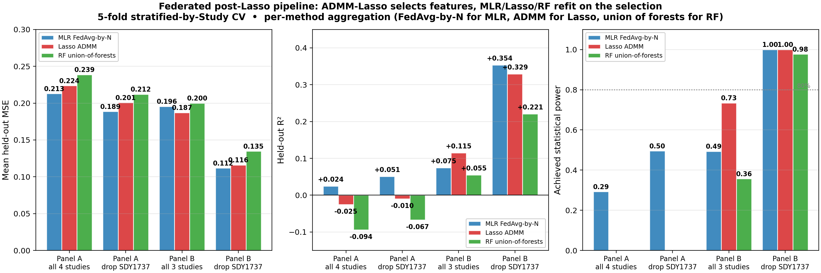
Post-Lasso pipeline: results
MSE, R², and achieved statistical power across 4 configurations × 3 methods
Panel B without SDY1737: MLR FedAvg-by-N MSE=0.112, R²=+0.354, achieved power=1.000. Lasso ADMM MSE=0.116, R²=+0.329, power=1.000. RF union MSE=0.135, R²=+0.221, power=0.977.
BioIT World 2026 • Federated Lasso supplement

Slide 7
Features selected by ADMM-Lasso (Panel B excluding SDY1737, α=0.008)
Coefficients on standardised features; sign indicates direction of association with log(C-peptide AUC)
weight_kg
coefficient = +0.97
Continuous body mass measurement in kilograms
GAD65
coefficient = −0.12
Glutamic acid decarboxylase 65 autoantibody level (standardised)
received_active_treatment
coefficient = +0.08
Indicator: 1 if subject was on hOKT3 anti-CD3 arm of SDY524, 0 otherwise
Sex
coefficient = +0.06
Binary sex indicator (encoding-dependent direction)
Features with coefficient equal to zero: IA2IC, ZNT8, ICA, MIAA, height_cm, BMI, age_years, disease_duration_years, race indicators (4 levels), ethnicity indicators (2 levels), bmi_missing.
BioIT World 2026 • Federated Lasso supplement

Slide 8
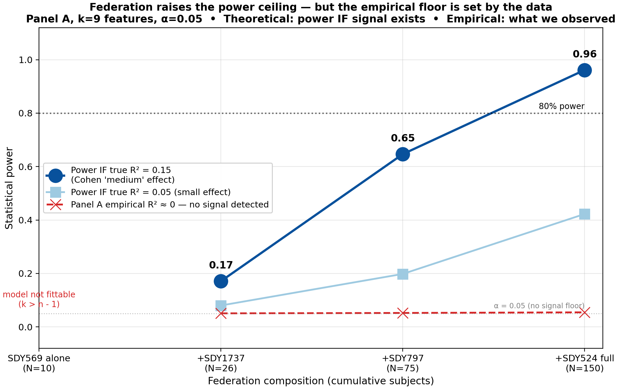
Statistical power vs federation composition
Panel A, 9 features, α=0.05 • Solid: theoretical power at assumed effect sizes • Dashed: power at empirical effect sizes
Power values along the federation path at assumed R²=0.15: cohort size 10 — model not fittable (k > n−1); cohort size 26 — power 0.17; cohort size 75 — power 0.65; cohort size 150 — power 0.96. Empirical Panel A R² ≈ 0: power remains at the α floor across all cohort sizes.
BioIT World 2026 • Federated Lasso supplement

Slide 9
Summary
• Federation across more institutions reduces held-out MSE for interpretable methods on Panel A (per the k-axis comparison in the main deck).
• Multi-round federation continues to reduce MSE for the deep methods until a plateau; the AE+CNN final MSE matches single-round federated Lasso.
• Statistical power scales with cohort size; federation lifts the maximum detectable effect size of the experimental design.
• Aggregation rule depends on the method: FedAvg-by-N for MLR, ADMM for Lasso, union of forests for Random Forest, multi-round FedAvg for CNNs.
• ADMM-Lasso under federation recovers the centralised Lasso solution to machine precision in 95–316 iterations across Panel A and Panel B.
• Post-Lasso pipeline on Panel B excluding SDY1737 with 4 selected features (weight_kg, GAD65, received_active_treatment, Sex): MSE = 0.112, R² = +0.354, achieved power = 1.000.
• Next step: Nextflow port. Each ADMM iteration maps to one Nextflow round; the local update is one process per institution; the coordinator update is one aggregation process.
BioIT World 2026 • Federated Lasso supplement

