Slide 1
The biological question
• Type 1 Diabetes destroys insulin-producing beta cells of the pancreatic islets.
• C-peptide (released one-to-one with insulin during a four-hour meal challenge) is the field-standard quantitative readout of how many functional beta cells remain.
• The five-autoantibody panel (GAD65, IA-2, MIAA / insulin, ICA, ZnT8) is the immune signature of the destruction process.
• Question: can the autoantibody profile that signals destruction predict the beta-cell function that survives it?
If the panel were sufficient, single-institution studies would already have shown it.

Slide 2
Four institutional cohorts, no pooling allowed
• SDY524 (N = 75), SDY569 (N = 10), SDY797 (N = 49), SDY1737 (N = 16).
• Total panel A cohort: 150 subjects across four independent ImmPort studies.
• Each cohort sits behind institutional data-use governance — privacy, IRB, and policy block centralisation.
• Federated learning: each institution trains locally; only model parameters leave the institution; the coordinator aggregates by per-feature median across institutions.
The methodological question is not centralised, but federated.

Slide 3
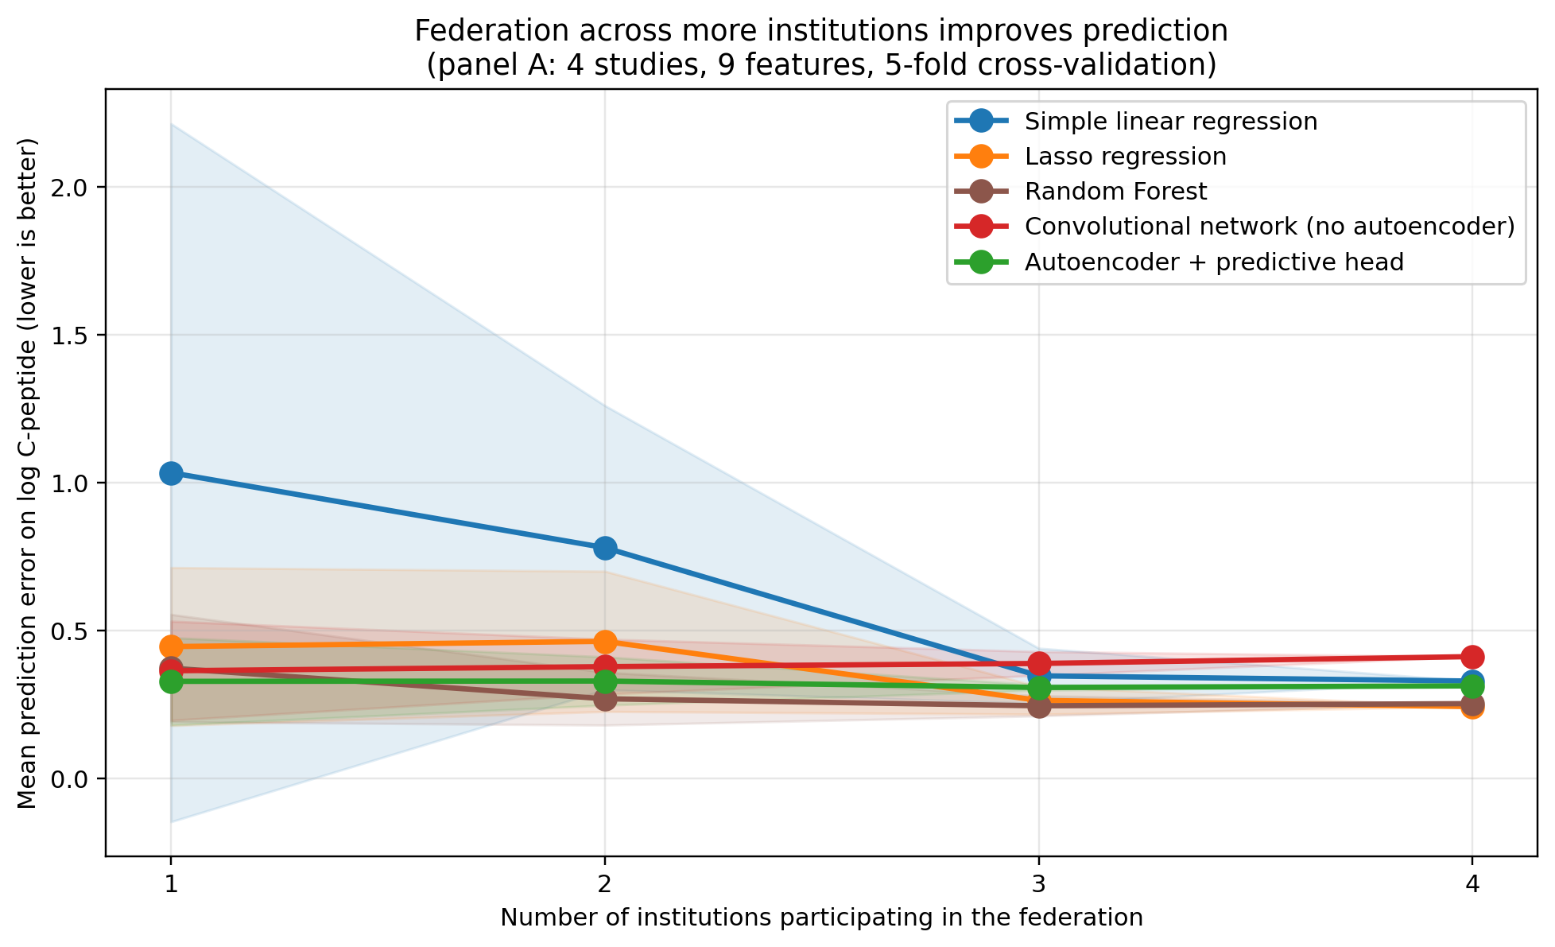
Result 1: more institutions → lower prediction error
• Mean prediction error drops as more institutions participate.
• Simple linear regression: 1.03 (solo) → 0.33 (four-institution federation). A 3× improvement.
• Lasso: 0.45 → 0.24. Random Forest: 0.37 → 0.25.
• Naive convolutional network gets WORSE with federation.
• Autoencoder pretraining is required to make deep learning work under federation.
Interpretable models benefit immediately; deep models need the autoencoder.

Slide 4
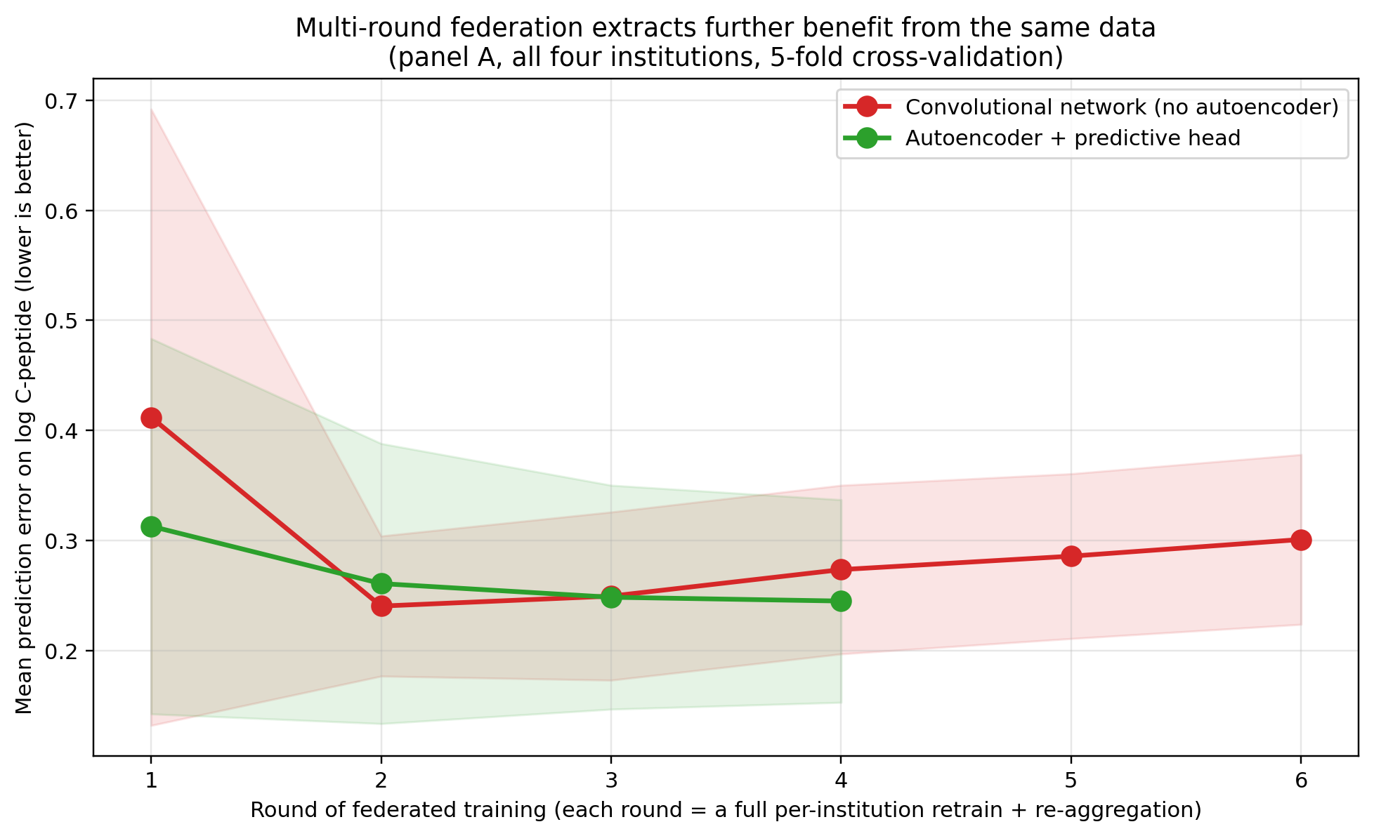
Result 2: multi-round federation extracts further benefit
• Each round: each institution warm-starts from the previous round's aggregated parameters, retrains locally, re-aggregates.
• Autoencoder + head: clean monotonic descent, plateaus at MSE 0.245 by round 4.
• Plain convolutional network: round-2 jump is recovery from random initialisation; rounds 3+ degrade.
• Deep model with autoencoder lands at the same MSE the regularised linear model reaches in one round.
Under proper federation, the deep model has no architectural premium.

Slide 5
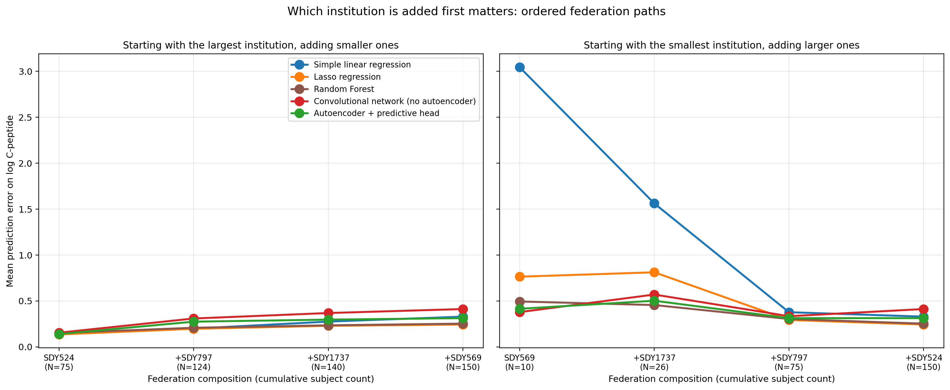
Which institution is added first matters
• Left panel: largest institution first, adding smaller ones in turn.
• Right panel: smallest institution first, adding larger ones.
• Smallest-first path tells the operational story: a small institution joining the federation goes from N = 10 alone to N = 150 federated.
• Statistical power follows: from "cannot fit a 9-feature model" alone to 96 % power at the full cohort.
Small institutions gain most; large institutions still gain from new partners.

Slide 6
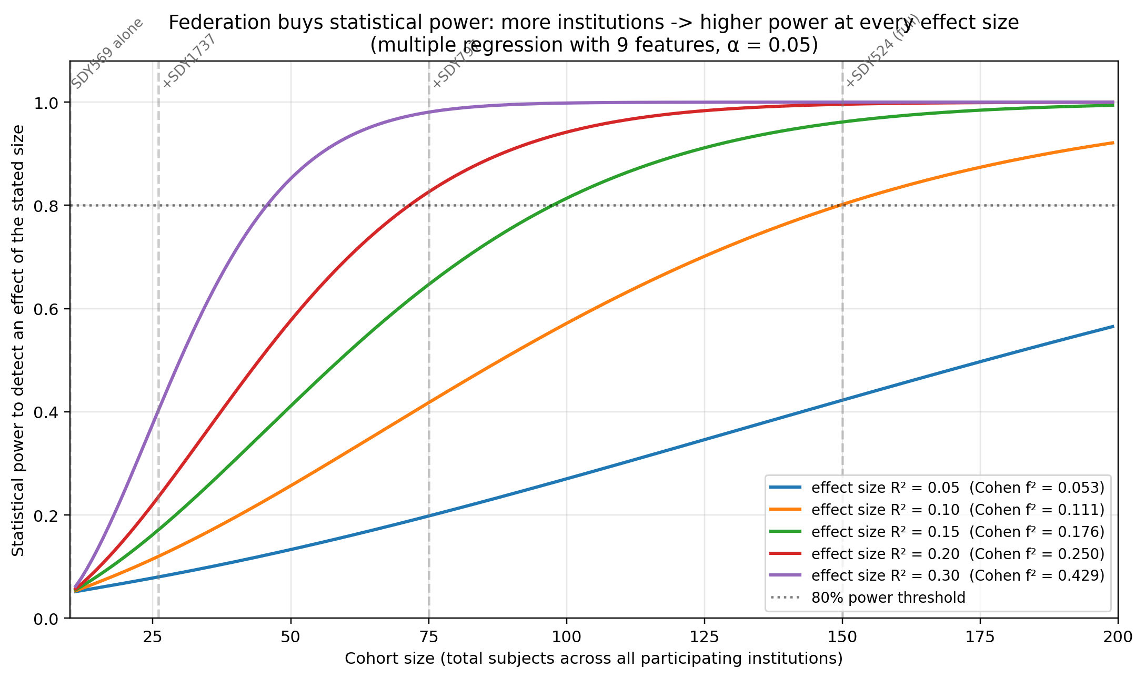
Result 3: federation lifts the statistical-power ceiling
• N = 10 (one small institution, alone)
→ cannot fit a 9-feature model
• N = 26 (two institutions federated)
→ 17 % power
• N = 75 (three institutions federated)
→ 65 % power
• N = 150 (four institutions federated)
→ 96 % power
Statistical power at biological effect size R² = 0.15 (moderate; Cohen's f² ≈ 0.18, α = 0.05)
Federation is the device that delivers cohort size — and statistical power — without moving data.

Slide 7
The biological surprise: autoantibodies alone are not enough
• On the 9-feature autoantibody panel: every model produces a NEGATIVE cross-validation R² — the panel does not predict residual beta-cell function on its own.
• Adding the extended feature panel (body mass index, height, weight, exact age, disease duration, race, ethnicity, treatment cohort): lasso finds a real predictive effect (R² ≈ 0.09).
• Dominant predictive features identified by lasso (selection frequency across bootstrap subsamples):
Weight (kg) — 89 %
Sex — 82 %
Treatment cohort: Pediatric — 72 %
Treatment cohort: Control — 64 %
All five autoantibodies — 27 – 49 % (mostly drop out)
The prediction lives in body composition and treatment context — not in the antibody panel alone.

Slide 8
Three takeaway conclusions
• Federation delivers cohort sizes single sites cannot reach.
Predictive performance improves two- to three-fold for interpretable methods. Statistical power rises from "cannot fit" to detection of biologically plausible effects. No subject data leaves any institution.
• Autoencoder pretraining is what makes deep-learning federation work.
Without it, naive parameter aggregation across independently-trained networks actively degrades the model.
• The autoantibody profile alone is insufficient.
Body composition and treatment context carry the prediction. The translational path forward requires institutions to record body composition alongside antibody panels.

Slide 9
Next step: from Jupyter simulation to federated Nextflow
• This work simulated federation in a single Jupyter notebook. Next step: port the protocol to a Nextflow workflow that runs on the real federated platform across the four institutions.
• Each per-institution training step becomes a Nextflow process; aggregation becomes a single coordinator process; the round loop becomes Nextflow iteration.
• Coordinated optimisation (federated ADMM-lasso) replaces median aggregation for sharper feature selection on small heterogeneous cohorts.
• Deployment target: the Lifebit CloudOS federated platform, in partnership with NLM's OADR initiative.
Scientific idea → Jupyter notebook → Nextflow workflow → federated execution.

