Slide 1
NexusMeds
Amit Saha
2105049
Md. Abrar Jahin
2105055

Slide 2
Core Features
Database
Drug and chemical database
Stores valuable information related to chemicals
- Available for lookup and distribution
Stores necessary information related to medicines and drugs
- Available for lookup and distribution
Manufacturers supply chemicals and drugs to the storage (Quality control is left to them)
- customers and researchers buy from storage

Slide 3
Core Features
Users
Admin approves doctors and researchers and can message customers regarding orders
Doctors can look up and prescribe medicines to their patients
Customers can buy drugs they need, only with doctor-authorized prescriptions
If they don’t have a prescription, they will need to consult a doctor.
If they do, they need to provide details about their prescription
They can give reviews about their assigned doctor
Researchers can look up and buy chemicals to further their research

Slide 4
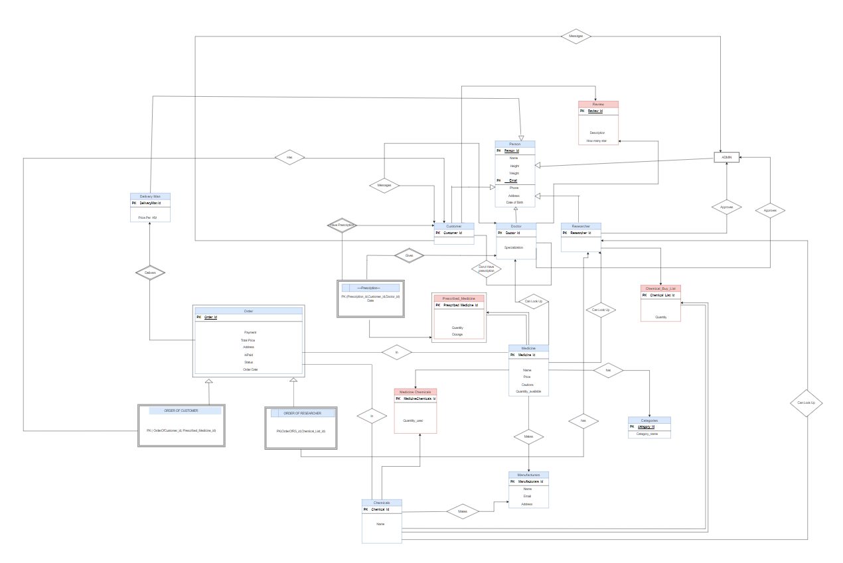
ERD

Slide 5
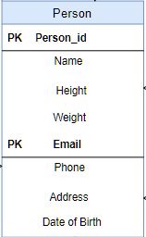
Person(User)
Primary key of the entity. Must be unique as the system will search based on a person’s id.
Basic User Information

Slide 6
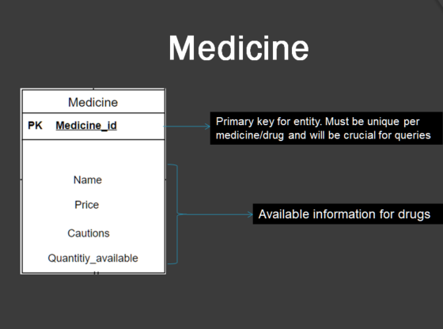
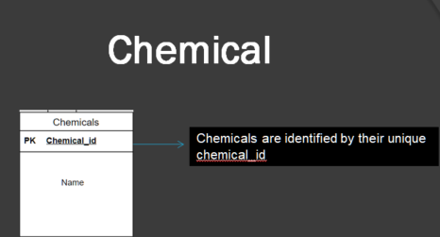
Medicine & Chemicals

Slide 7
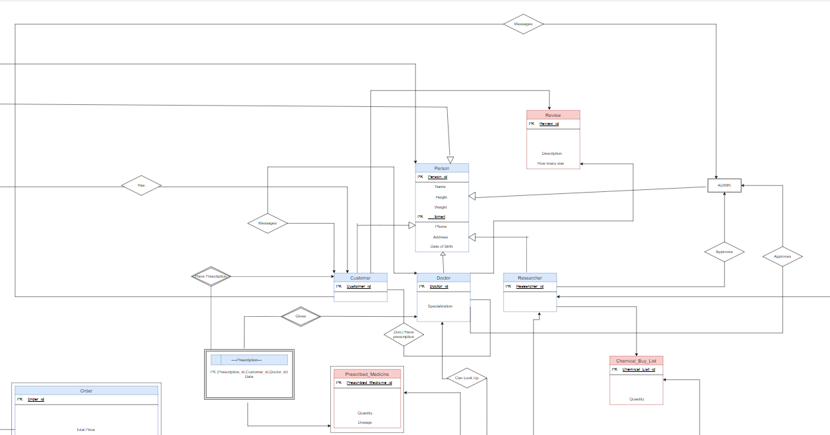
User Relations

Slide 8
User Relations
Admin Interactions

Slide 9
User Relations
Customer-Doctor Relation

Slide 10
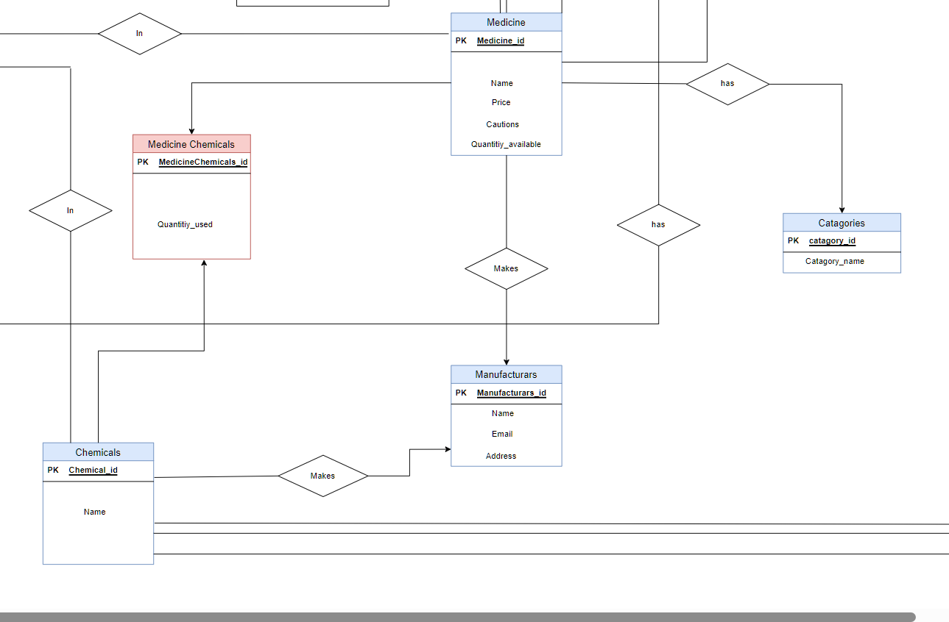
Medicine and Chemical Relations

Slide 11
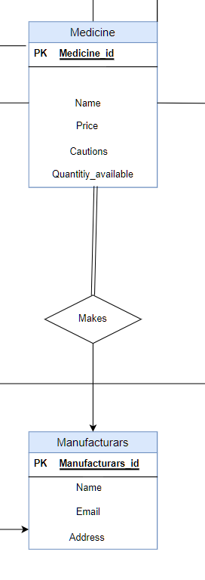
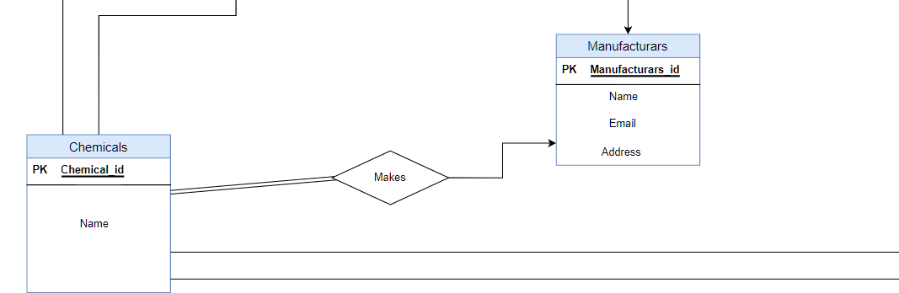
Manufacturers Relations
Manufacturers can produce both medicine and chemicals

Slide 12
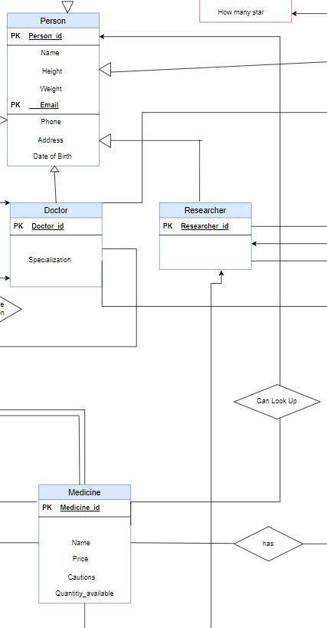
Look-up Relations
Medicine Lookup

Slide 13
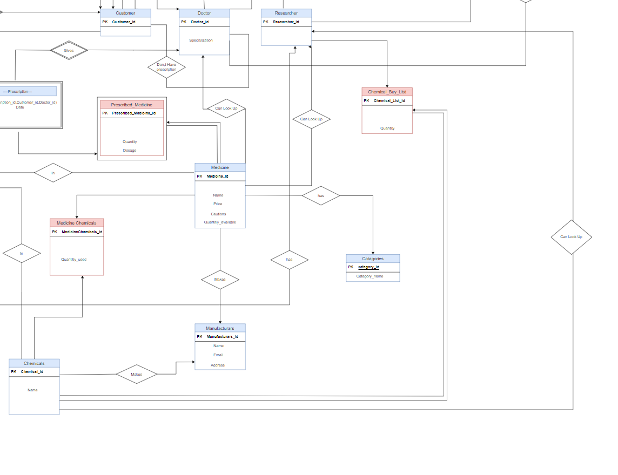
Look-up Relations
Chemical Lookup

Slide 14
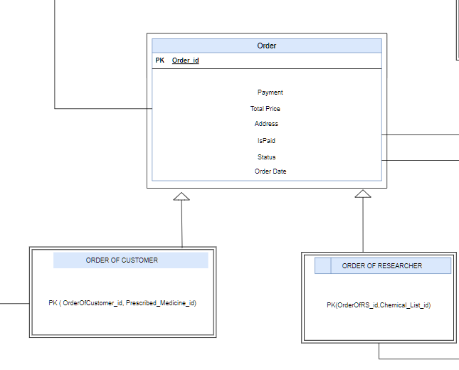
Purchase Relations
Orders can be of two types
Based on the type of purchase

Slide 15
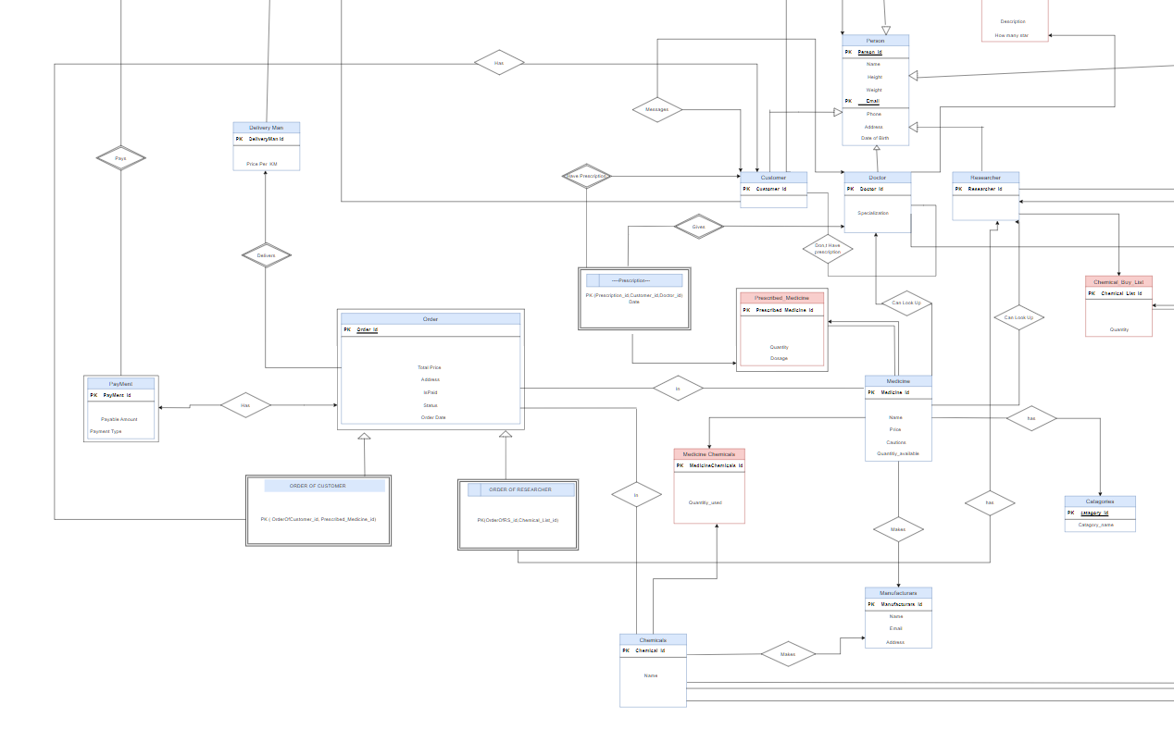
Purchase Relations

Slide 16
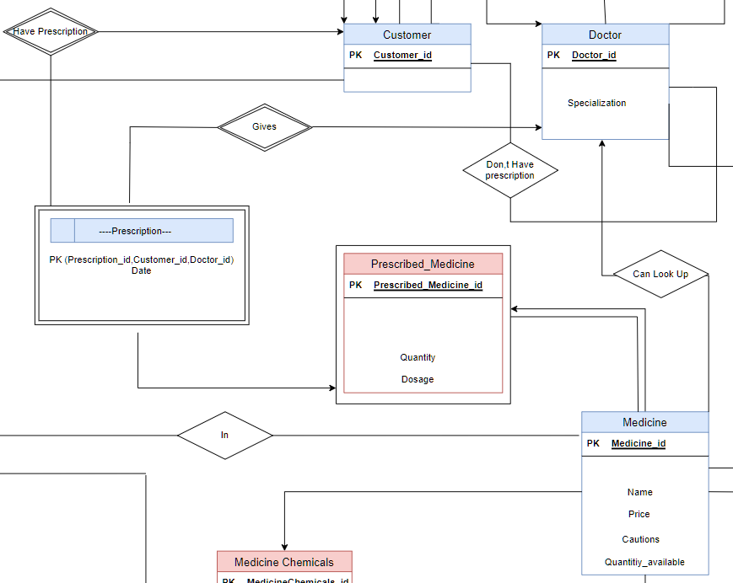
Purchase Relations
Medicine Purchase

Slide 17
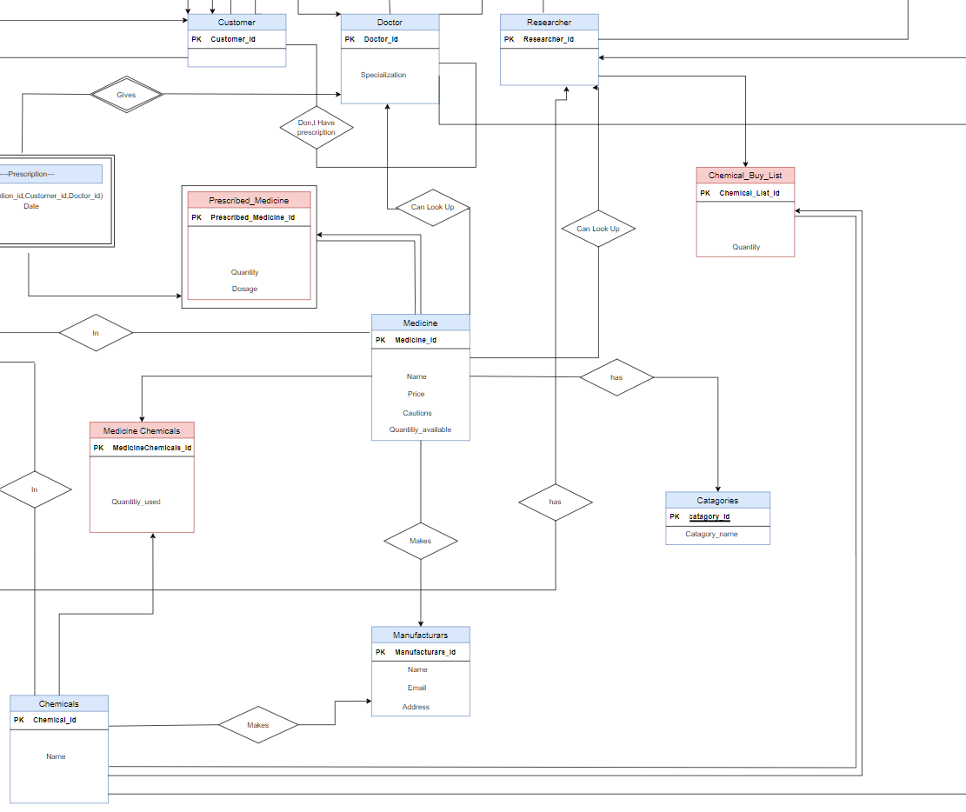
Purchase Relations
Chemical Purchase

Slide 18
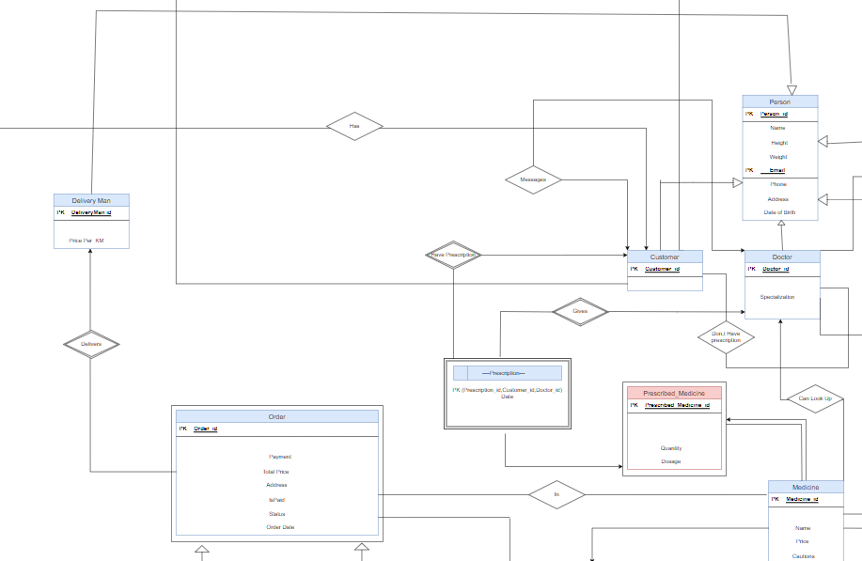
Purchase Relations
Order Delivery

