Slide 1

IPL Prediction Using MERN Stack & Machine Learning
Project by:
BOKKA HITESH REDDY(23BD1A662A)

Slide 2

Key Components & Features
Data Collection
Preprocessing
Our system gathers data from various sources like official IPL websites, news articles, social media, and historical match statistics.
Data is cleaned, transformed, and prepared for analysis, ensuring accuracy and reliability.
Machine Learning Models
Prediction Engine
The model generates predictions for match outcomes based on input parameters and trained data.
Sophisticated machine learning algorithms are trained on the processed data to identify patterns and make predictions.

Slide 3
Technologies Used and Detailed Features
MERN Stack
Machine Learning
MongoDB: NoSQL database for storing and managing diverse data types.
Logistic Regression Algorithm: Predict match outcomes based on historical data and players performance.
Express.js: Fast and efficient web application framework for building API endpoints.
Analyze complex patterns in data to enhance prediction accuracy.
HTML, CSS, Bootstrap: dynamic and user-friendly web interfaces.
Predicts by using IPL match input data provided .
Node.js: Runtime environment for executing JavaScript code on the server side.

Slide 4
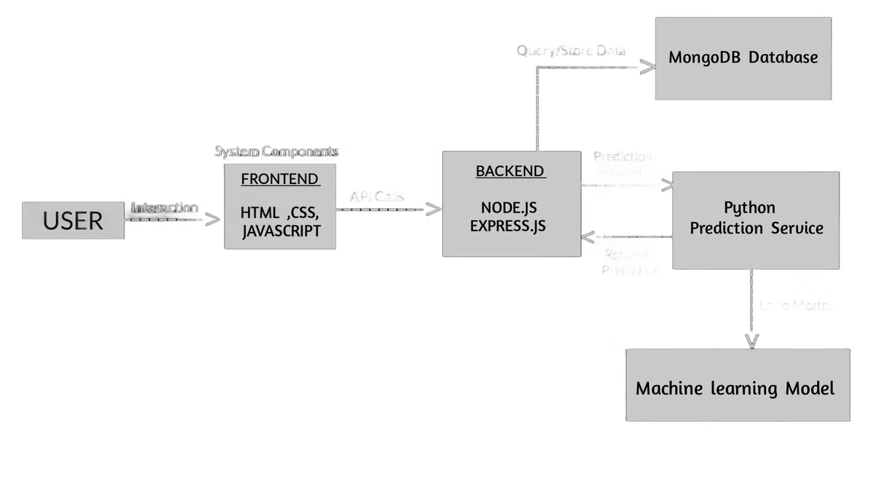
System Architecture Diagram
The system architecture is designed for scalability and efficiency, allowing for future growth and improvement.

Slide 5

Real-Life Use Cases
Fantasy Cricket
Betting Markets
Players can leverage prediction insights to make informed decisions while selecting their fantasy teams, leading to improved performance.
Sports betting platforms can utilize prediction models to provide more accurate odds and enhance user engagement.
Fan Engagement
Provide fans with insightful predictions, enhancing their experience and increasing their interest in the game.

Slide 6
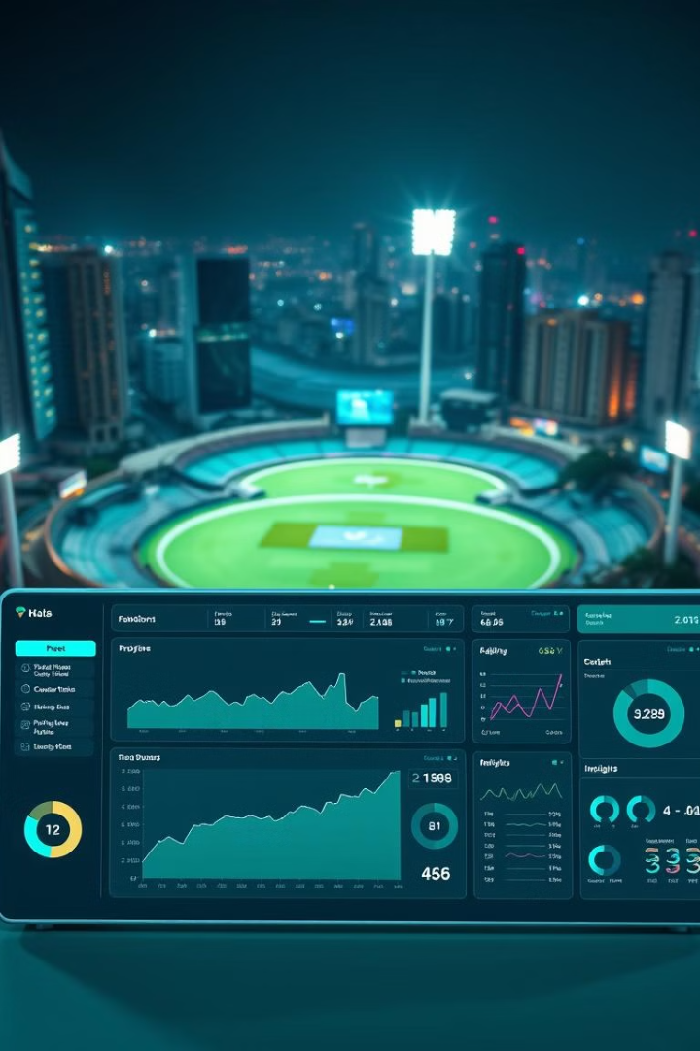



Potential Future Upgrades
Sentiment Analysis
Analyze public sentiment towards teams and players to identify potential shifts in performance.
Real-Time Data Integration
Include real-time match data like player performance and weather conditions to enhance predictions.
Advanced Machine Learning Techniques
Experiment with more sophisticated algorithms to further enhance prediction accuracy.

Slide 7

Conclusion and Key Takeaways
This system combines MERN stack development, machine learning to create a powerful IPL prediction engine, offering valuable insights for fans, players, and industry stakeholders.

