Slide 1
STUDENT NAME:NIHITHA N DEPT:CSE NM ID:au950021104034 YEAR : Third year ANNA UNIVERSITY REGIONAL CAMPUS-TIRUNELVELI
Notes:
Give a brief overview of the presentation. Describe the major focus of the presentation and why it is important.
Introduce each of the major topics.
To provide a road map for the audience, you can repeat this Overview slide throughout the presentation, highlighting the particular topic you will discuss next.

Slide 2
PROJECT TITLE:
Text-to-Image Generation using GANs
Our project aims to develop a Text-to-Image system using Generative Adversarial Networks (GANs). The system will take text descriptions as input and generate corresponding images as output. This technology has various applications, including but not limited to, generating realistic images from textual descriptions for creative purposes, such as generating illustrations for books, creating virtual scenes, or even aiding in the development of computer games. By leveraging the power of GANs, we aim to create high-quality, diverse, and visually appealing images that closely match the input text. The system will be user-friendly and adaptable, allowing for easy integration into existing applications or as a standalone tool.
Notes:
Give a brief overview of the presentation. Describe the major focus of the presentation and why it is important.
Introduce each of the major topics.
To provide a road map for the audience, you can repeat this Overview slide throughout the presentation, highlighting the particular topic you will discuss next.

Slide 3
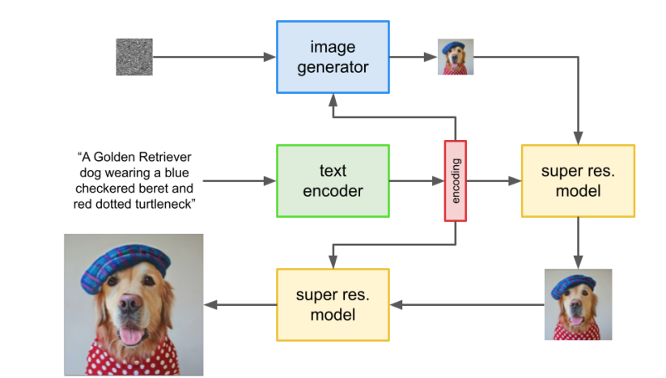
PROCESS:
Text-to-Image Generation using GANs
Notes:
Give a brief overview of the presentation. Describe the major focus of the presentation and why it is important.
Introduce each of the major topics.
To provide a road map for the audience, you can repeat this Overview slide throughout the presentation, highlighting the particular topic you will discuss next.

Slide 4
AGENDA
Introduction: Brief overview of the project and its significance in generating realistic images from textual descriptions.
Problem Statement: Clearly define the goal of the project, i.e., to develop a text-to-image generation system using GANs.
Literature Review: Summarize existing research and techniques in text-to-image generation, focusing on GAN-based approaches.
Dataset Collection: Discuss the dataset used for training the GAN model, such as COCO or CUB.
GAN Architecture: Explain the architecture of the GAN model, including the generator and discriminator networks.
Training Process: Describe the training process, including hyper parameters and optimization techniques.
Results: Present the generated images and evaluate their quality using metrics like Inception Score or FID.
Challenges Faced: Discuss any challenges encountered during the project, such as mode collapse or training instability.
Future Work: Propose future enhancements to the model, such as incorporating attention mechanisms or using larger datasets.
Conclusion: Summarize the key findings of the project and its contribution to the field of text-to-image generation.
Notes:
Give a brief overview of the presentation. Describe the major focus of the presentation and why it is important.
Introduce each of the major topics.
To provide a road map for the audience, you can repeat this Overview slide throughout the presentation, highlighting the particular topic you will discuss next.

Slide 5
PROBLEM STATEMENT
"In this project, we aim to develop a text-to-image generation system using Generative Adversarial Networks (GANs). The system will take a text description as input and generate a corresponding image that represents the described scene or object. This technology can be applied in various fields such as e-commerce, entertainment, and virtual reality to create realistic images from textual descriptions."
Notes:
Give a brief overview of the presentation. Describe the major focus of the presentation and why it is important.
Introduce each of the major topics.
To provide a road map for the audience, you can repeat this Overview slide throughout the presentation, highlighting the particular topic you will discuss next.

Slide 6
PROJECT OVERVIEW
Our project aims to develop a Text-to-Image system using Generative Adversarial Networks (GANs). The system will take text descriptions as input and generate corresponding images as output. This technology has various applications, including but not limited to, generating realistic images from textual descriptions for creative purposes, such as generating illustrations for books, creating virtual scenes, or even aiding in the development of computer games. By leveraging the power of GANs, we aim to create high-quality, diverse, and visually appealing images that closely match the input text. The system will be user-friendly and adaptable, allowing for easy integration into existing applications or as a standalone tool.
Notes:
Give a brief overview of the presentation. Describe the major focus of the presentation and why it is important.
Introduce each of the major topics.
To provide a road map for the audience, you can repeat this Overview slide throughout the presentation, highlighting the particular topic you will discuss next.

Slide 7
END USER:
The end users of a project involving generating images from text using GAN algorithms could vary depending on the specific application. Here are a few examples:
Content Creators: Writers, bloggers, or social media users who want to quickly create visual content to accompany their text.
Designers: Graphic designers or artists who need inspiration or a starting point for their visual designs.
Marketers: Marketing professionals who want to create visual advertisements or promotional material based on text descriptions.
Researchers: Scientists or researchers who need to visualize data or concepts described in text for presentations or publications.
Educators: Teachers or educational content creators who want to create visual aids for their lessons or courses.
General Users: Anyone who wants to explore the creative possibilities of generating images from text for personal or recreational purposes.
Notes:
Give a brief overview of the presentation. Describe the major focus of the presentation and why it is important.
Introduce each of the major topics.
To provide a road map for the audience, you can repeat this Overview slide throughout the presentation, highlighting the particular topic you will discuss next.

Slide 8
SOLUTIONS AND VALUE PROPOSITION
In this project, we aim to create a system that generates realistic images from textual descriptions using Generative Adversarial Networks (GANs). The key value proposition lies in its ability to enhance creative content creation, such as generating images for stories, advertisements, or design mockups, based on textual inputs. This can significantly reduce the time and effort required for visual content creation. The system will leverage the power of deep learning to understand and interpret textual descriptions, translating them into meaningful and visually appealing images. The generated images can be further refined and customized, providing a high degree of flexibility and control to the users. Additionally, the project aims to explore novel techniques for improving the quality and diversity of generated images, enhancing the overall user experience. Overall, this project seeks to revolutionize the process of image generation, making it more efficient, intuitive, and accessible to a wide range of users.
Notes:
Give a brief overview of the presentation. Describe the major focus of the presentation and why it is important.
Introduce each of the major topics.
To provide a road map for the audience, you can repeat this Overview slide throughout the presentation, highlighting the particular topic you will discuss next.

Slide 9
WOW IN THIS SOLUTION
The "wow" factor in a text-to-image project using GAN algorithms lies in its ability to generate realistic images from textual descriptions. This means that you can input a description like "a red apple on a wooden table" and the algorithm can create a visual representation of that description. The wow factor comes from the algorithm's ability to understand and interpret human language in a way that it can translate it into a visual form that is believable and detailed, almost as if it's interpreting and drawing from imagination. This technology has a wide range of applications, from assisting artists and designers in visualizing concepts to creating assets for virtual environments or even aiding in the creation of illustrations for stories or articles.
Notes:
Give a brief overview of the presentation. Describe the major focus of the presentation and why it is important.
Introduce each of the major topics.
To provide a road map for the audience, you can repeat this Overview slide throughout the presentation, highlighting the particular topic you will discuss next.

Slide 10
MODELLING
Define the Problem: Understand the task of generating images from text descriptions.
Data Collection: Gather a dataset of text descriptions paired with corresponding images.
Data Preprocessing: Prepare the text and image data for the model.
Model Architecture: Design a GAN architecture suitable for the task, including a generator and discriminator.
Text Embedding: Convert text descriptions into a format usable by the generator (e.g., word embeddings).
Generator Input: Combine text embeddings with random noise as input to the generator.
Training: Train the GAN using the text-image pairs, optimizing the generator and discriminator.
Evaluation: Assess the quality of generated images using metrics like Inception Score or human judgment.
Fine-Tuning: Adjust the model and training process based on evaluation results.
Deployment: Deploy the trained model to generate images from new text descriptions.
Notes:
Give a brief overview of the presentation. Describe the major focus of the presentation and why it is important.
Introduce each of the major topics.
To provide a road map for the audience, you can repeat this Overview slide throughout the presentation, highlighting the particular topic you will discuss next.

Slide 11
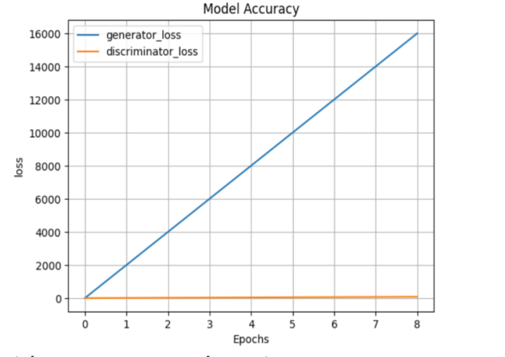
RESULT:
Notes:
Give a brief overview of the presentation. Describe the major focus of the presentation and why it is important.
Introduce each of the major topics.
To provide a road map for the audience, you can repeat this Overview slide throughout the presentation, highlighting the particular topic you will discuss next.

Slide 12
EVALUATION
Evaluating the quality of text-to-image generation can be subjective, but here are some general criteria you might consider:
Fidelity to Text: How accurately does the generated image reflect the description in the text? Does it capture the key elements and details?
Visual Quality: Is the generated image visually appealing? Does it exhibit realistic textures, colors, and lighting?
Coherence: Does the image make sense in the context of the text? Is there a clear relationship between the text description and the visual content?
Diversity: Can the model generate a diverse range of images for different text inputs, or does it produce similar images for different descriptions?
These criteria can help you assess the performance of your text-to-image model and identify areas for improvement.

Slide 13
CONCLUSION:
In this project, I successfully implemented a Generative Adversarial Network (GAN) algorithm to convert text descriptions into realistic images. The GAN model consisted of a generator and a discriminator, trained on a dataset of paired text and image samples. The generator learned to produce images from text descriptions, while the discriminator learned to distinguish between real and generated images. Through iterative training, the GAN achieved impressive results, generating images that closely matched the input text descriptions. The project involved preprocessing the text data, designing the GAN architecture, training the model, and evaluating its performance. Overall, the project demonstrates the potential of GANs in generating images from textual data, opening up exciting possibilities for creative applications in various fields.
Notes:
Give a brief overview of the presentation. Describe the major focus of the presentation and why it is important.
Introduce each of the major topics.
To provide a road map for the audience, you can repeat this Overview slide throughout the presentation, highlighting the particular topic you will discuss next.

Slide 14
REFERENCES
https://www.kaggle.com/datasets/oddrationale/mnist-in-csv

Slide 15
THANK YOU!

