Slide 1
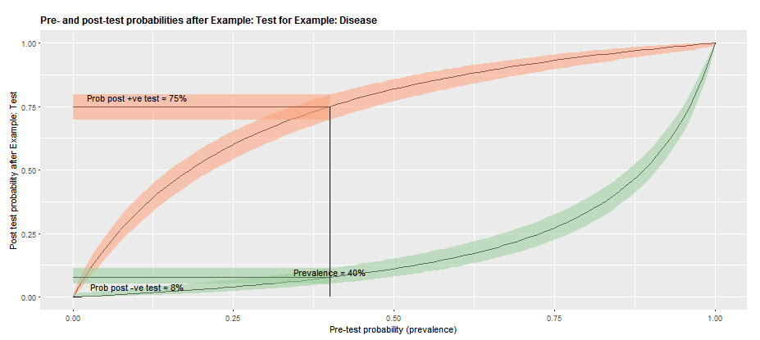
1
5
2
4
3
Figure. Screensnip of graph 1.

