Slide 1

CollegeMart_{.com}
GROUP MEMBERS:
ANAY YADAV
NAVED AHMAD
SURYAKANT
COURSE INSTRUCTOR:
MR. AMIT KUMAR

Slide 2
About the project:
A web portal application to let students/staff of a particular college sell/buy/rent there stuff which they no longer need.
Any student/faculty/staff member of that college/university can register on our web application and upload any product that they want to, and later on remove it if they decide otherwise.
The contact details of the owner will be displayed automatically on the product details page.

Slide 3
Minutes of Meeting with our customers:
As mentioned before, our customers are college students/staff/faculty. They are the ones who’ll essentially be using our web application. Therefore, we met several people during the course of development of our web app.
Here we show one video of the meetings that we’ve had…

Slide 4

Meeting Video:

Slide 5
Nature of the Customer
Our customers are students/staff of a particular college/university whom we want to provide an alternative means to purchase reusable items through our web application, or rent/sell their own product which they no longer need.

Slide 6
Novelty of the Project:
Our project is quite unique in the sense that nothing like this has been implemented like this in colleges/universities.
Some of us might think that it is similar to other web-services like Olx, quickrr etc, but the novelty lies in the fact that this web application is meant to be functional intra-college and not any extensive geographic location, making it concise and specific to it’s purpose.

Slide 7
Sophistication value of the Project:
Sophistication of our product is of a moderate level. We have tried to make this product a bit generic, in terms of the user-interface, making it look like the way other e-commerce websites look.
The look and feel of the whole application is extremely simple and subtle. The control panel of a particular user is slightly complex, it displays all sorts of things like number of orders, number of products, categories of products, money earned etc. making that part slightly sophisticated.

Slide 8
Feedback taken from a user:

Slide 9
Tools and Technologies used:
Part of the project: | Tool and Technology used:
UML Diagrams | Creately
Back-end | Php, MySQL, XAMPP Software (Apache, Filezilla)
Development Framework | Magento Community Edition 1.9.2
Testing | WAPT
Front-end | HTML5, CSS3, JavaScript, jQuery, AJAX, GIMP Software

Slide 10
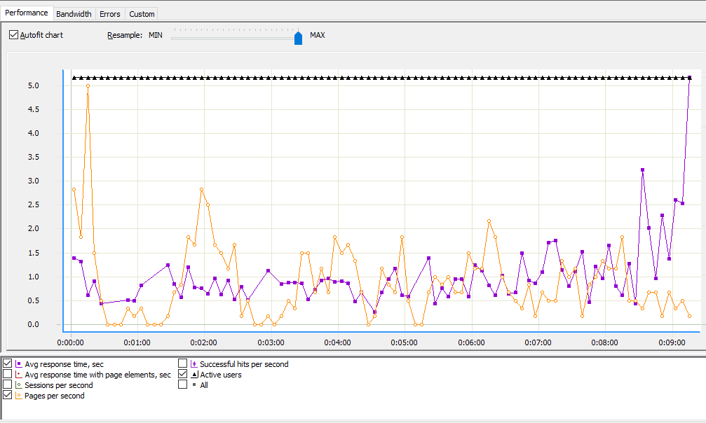
Test Results:

Slide 11
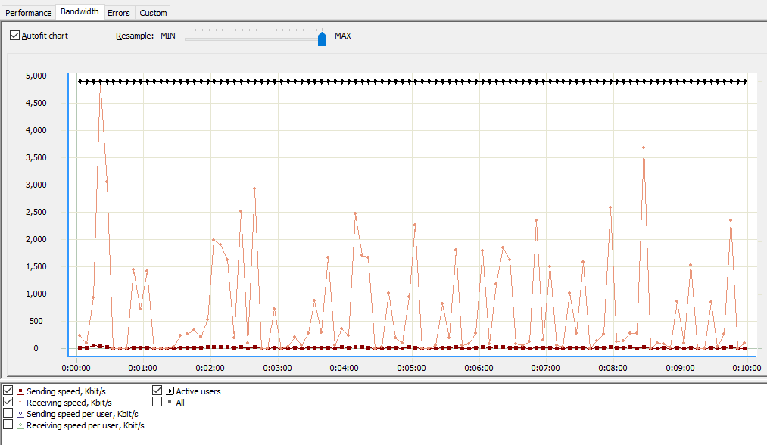

Slide 12
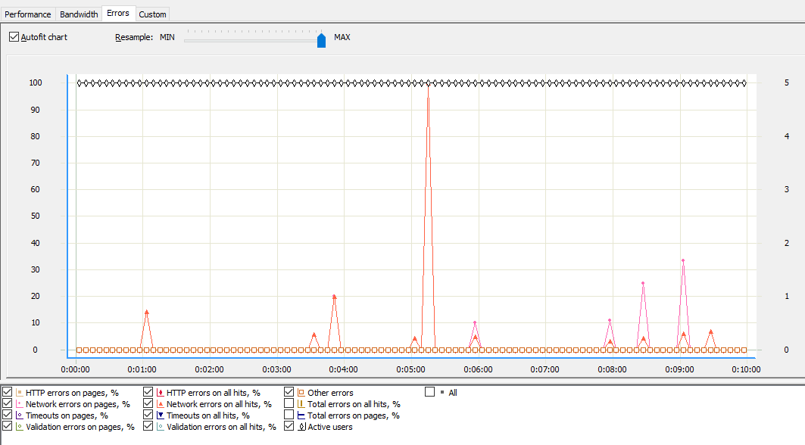

Slide 13
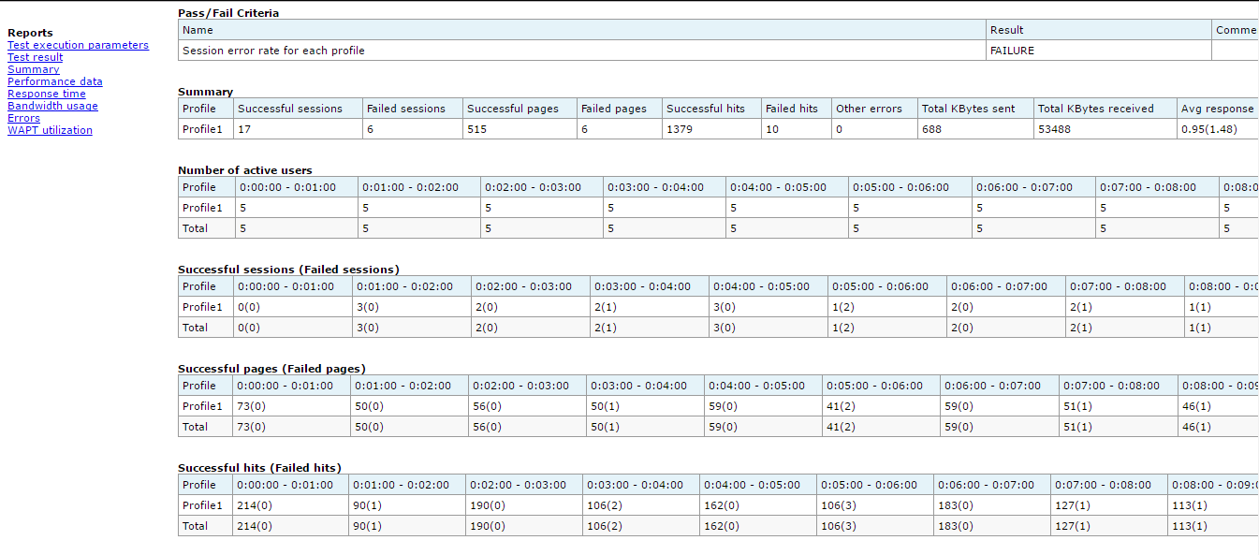

Slide 14
Time for the demo…

Slide 15
Any Questions???

