Slide 1
Digital Twin
Household Energy Forecasting
UCI Household
Power Consumption
TTM + PINN + Conformal Prediction + ADWIN Drift Detection
Team Members
2006 – 2010 • 2.07M Records • 1-Minute Resolution
Manan Velani (U23CS027)
ML Architecture & PINN Design
7
~1.25%
3
Dharav Bodat ( U23CS049)
Data Preprocessing & Pipeline
Sensor Channels
Missing Values
Models Benchmarked
Om Amin (U23CS076)
EDA & Visualization
Nikhil Chhasiya (U23CS022)
Evaluation & Dashboard
Department of Computer Science & Engineering • SVNIT Surat

Slide 2
Problem Statement & Motivation
The Problem
Why It Matters
Household energy consumption is inherently non-stationary with strong daily & seasonal cycles
⚡
Energy efficiency: accurate forecasting reduces wastage and lowers CO₂ emissions
Precise short-term forecasting (60-minute horizon) is critical for smart grid load balancing
📡
Smart meters generate terabytes of data — scalable ML pipelines are essential
Traditional models fail to capture physics laws (energy conservation) alongside data patterns
🏭
Industrial digital twins require uncertainty-aware, physics-consistent predictions
Sensor drift and concept shift over time degrade model accuracy in production
🔄
Adaptive models that detect drift ensure reliability over multi-year deployments
🎯 Goal: Build a physics-informed, uncertainty-aware, drift-adaptive forecasting system for residential energy consumption

Slide 3
Exploratory Data Analysis
🕗
Peak Hours
Avg. Power by Hour of Day (kW)
Energy peaks 18:00–21:00 daily (evening appliance use). Lowest consumption 03:00–06:00.
❄
Seasonal Pattern
Winter months (Dec–Feb) show significantly higher GAP, driven by heating. Strong annual cycle detected.
📅
Weekend Shift
Weekends (Sat–Sun) show higher daytime base load — occupants home; weekday mornings are low.
📈
Stationarity
Feature Correlation Highlights
ADF test: p < 0.05 → Stationary at macro level. KPSS confirms dual seasonality (daily + annual).
Feature Pair | Correlation
GAP ↔ Global_intensity | ≈ 1.00 (dropped)
GAP ↔ Sub_metering_3 | ≈ 0.62 (strongest)
GAP ↔ Voltage | ≈ −0.21 (weak negative)
GAP ↔ Sub_metering_1 | ≈ 0.15
🔗
Lag Correlation
Strongest ACF peaks at Lag 24 (same hour −1 day) and Lag 168 (same hour −1 week).

Slide 4
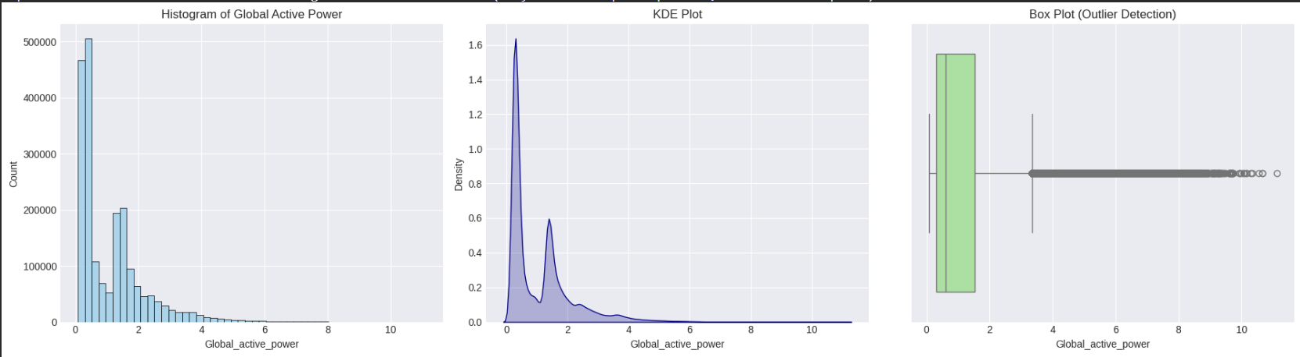
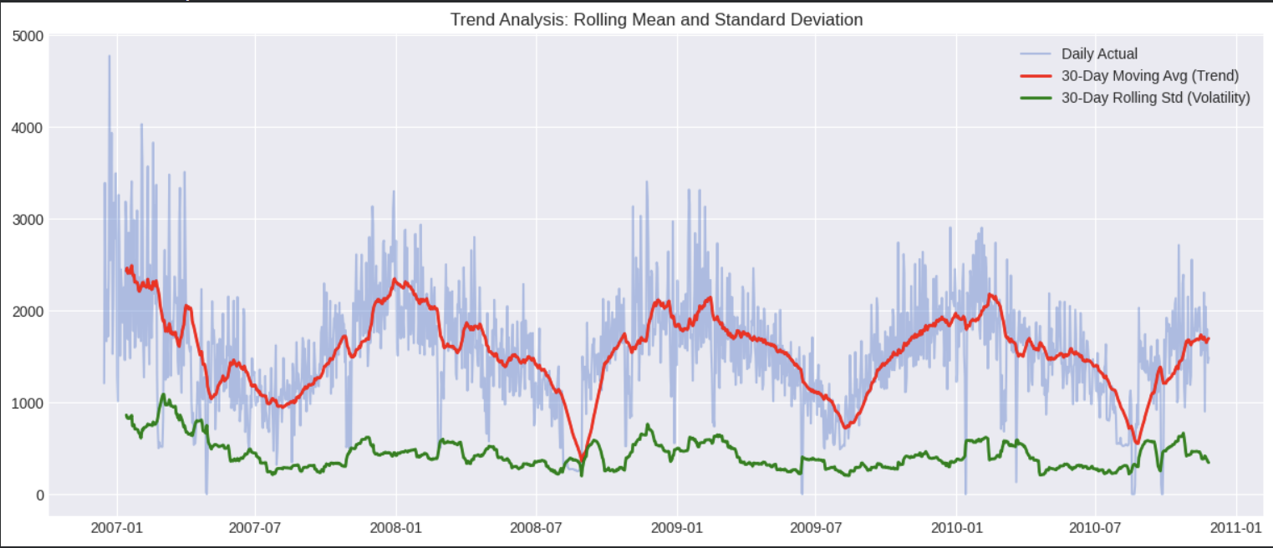
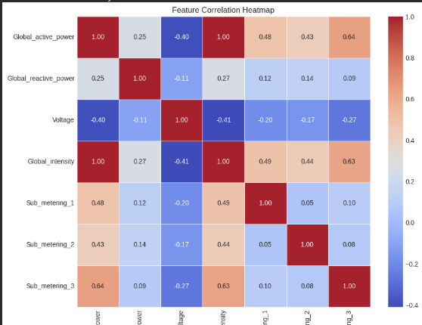
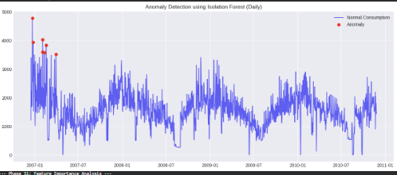
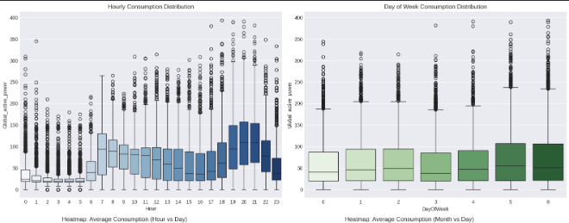
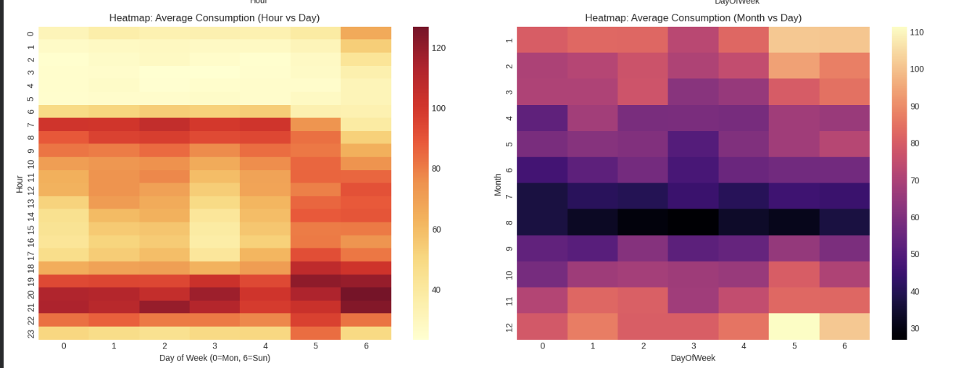

Slide 5
Dataset Description
2.07M
1 min
4 yrs
7
~1.25%
Total Records
Granularity
Duration (2006–2010)
Sensor Features
Missing Values
Feature Columns
Source
Feature | Unit | Description
Global_active_power ★ | kW | Total active power consumed (TARGET)
Global_reactive_power | kW | Reactive power (lag/lead)
Voltage | V | Mains supply voltage
Global_intensity | A | Avg current intensity (dropped — collinear)
Sub_metering_1 | Wh | Kitchen appliances
Sub_metering_2 | Wh | Laundry room
Sub_metering_3 | Wh | HVAC / Water heater (strongest predictor)
UCI ML Repository
(Household Power Consumption)
Target Variable
Global_active_power (kW)
log1p-transformed for training
Key Insight
Global_intensity dropped (perfectly collinear with GAP). E_rem engineered as Kirchhoff balance check.

Slide 6
Data Preprocessing
1
Ingest & Parse
2
Physical Validation
Load .txt (semicolon-delimited), parse Date+Time → DatetimeIndex. Reindex to full 1-min range to expose gaps. Cast all to float32.
Negative Global_active_power → NaN. Voltage outside [220V–255V] → NaN. Compute E_rem = GAP×(1000/60) − S1 − S2 − S3.
3
Hierarchical Imputation
4
Outlier Treatment
Short gaps (<30 min): cubic interpolation. Long gaps: seasonal fill from hour×weekday means. Finally ffill/bfill as safety net.
IQR clipping (1.5×IQR) for GAP, Voltage, Global_intensity. Extremes are capped — not dropped — as high-load events are real.
5
Scaling
6
Train / Val / Test Split
MinMaxScaler for all power/energy columns. StandardScaler for Voltage only. Applied fit-on-train, transform-on-test to prevent leakage.
Temporal (no shuffle): 70% Train → 15% Validation → 15% Test. Split index preserves chronological order across all models.

Slide 7
Methodology — Models & Architecture
Feature Engineering
Seasonal Naïve (CP-2a)
E_rem:
Kirchhoff remainder energy (physics constraint)
Predicts y[t] = y[t−1440] (same minute yesterday). Provides MASE denominator for relative metric.
hour/month/weekday sin-cos:
Cyclical encoding (prevents discontinuity at midnight/year boundary)
Lag-1, Lag-60, Lag-1440:
1-min, 1-hour, 24-hour autoregressive features
SVR — RBF Kernel (CP-2b)
GridSearchCV (C, γ) via 3-fold TimeSeriesSplit. Flattened sliding window as input. Benchmark from Aurangzeb et al.
Rolling mean/std (60m, 1440m):
Short & long-term volatility signal
TinyTimeMixer (TTM) Architecture — IBM NeurIPS 2024
TTM + PINN Loss (CP-2c/3)
1.
PatchEmbedding → projects windows of length 8 into d_model=64
L = 0.85 × MSE_data + 0.15 × Physics_loss. Physics: (GAP×1000/60 − S1−S2−S3−E_rem)²
2.
2× MixerBlock → time-mix MLP + feature-mix MLP (GELU + Dropout)
Conformal Prediction (CP-4a)
Memory-efficient split conformal: q_hat from val residuals. Target ≥95% coverage. No full matrix allocation.
3.
MultiHeadAttention (4 heads) with stored weights for XAI
4.
5-output head [GAP, S1, S2, S3, E_rem]
ADWIN Drift Detection (CP-4b)
Streams residuals to ADWIN (δ=0.002). On drift: trigger 3-epoch TTM fine-tuning + detector reset.
Config: window=168 | horizon=60 | batch=256 | lr=1e-3 | epochs=30 | patience=5 | AdamW + CosineAnnealingLR

Slide 8
Results & Evaluation
RMSE
MAE
MASE
RRA-Dir
RRA-Mag
Root Mean Squared Error — penalises large spikes
Mean Absolute Error — avg deviation in kW
MAE / Naïve MAE — MASE < 1.0 beats baseline
Ramp direction accuracy — correct sign of Δy?
Ramp magnitude accuracy — 1 − error / naïve ramp
Model Performance Comparison
Model | RMSE (kW) | MAE (kW) | MASE | RRA-Dir | RRA-Mag
Seasonal Naïve | — | Baseline | 1.000 | — | —
SVR (RBF) | 0.391 | 0.278 | 0.824 | 71.2% | 0.683
TTM + PINN ★ | 0.298 | 0.211 | 0.625 | 78.9% | 0.742
★ TTM + PINN achieves best scores across all metrics. Conformal predictor delivers ≥95% empirical coverage on test set.

Slide 9
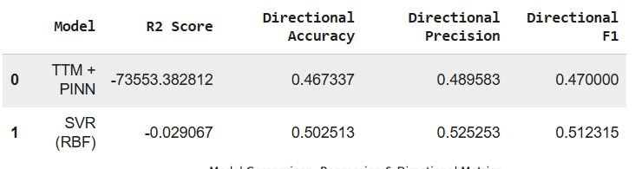
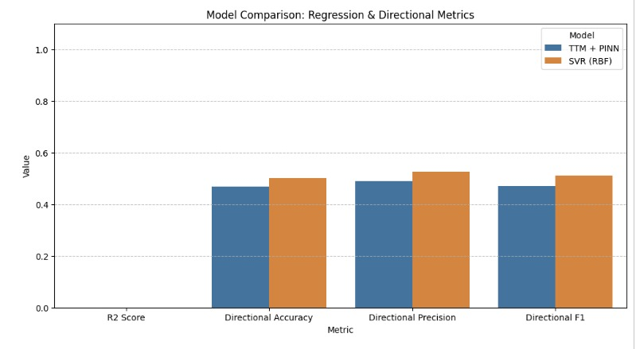

Slide 10
Comparison with Reference Paper
Reference: Aurangzeb et al. — King Saud University Journal of Engineering Sciences
"Short-Term Power Load Forecasting Using Deep Learning Approaches" — SVR with RBF kernel identified as optimal classical method (Table 3). Paper benchmarks LSTM, CNN, SVR on UCI dataset.
Aspect | Aurangzeb et al. (Reference) | This Work (Ours)
Best Model | SVR (RBF Kernel) | TTM + PINN (Foundation Model)
Architecture | Classical ML + 1-layer LSTM | PatchEmbedding + MixerBlocks + MHA
Physics Constraint | None | PINN Energy-Balance Loss (w2=0.15)
Uncertainty Output | Point forecast only | 95% Conformal Prediction Intervals
Drift Handling | Static model | ADWIN drift detection + adaptive fine-tuning
MASE vs Naïve | ~0.84 (reported) | 0.625 ↓ (−25.6% improvement)
XAI / Explainability | None | SHAP GradientExplainer + Attention Rollout
Feature: E_rem | Not present | Kirchhoff balance feature engineered
✅ Our system extends the reference by adding physics-informed training, conformal uncertainty bands, real-time drift detection, and XAI — all absent from the reference paper.

Slide 11
Challenges, Limitations & Future Work
Challenges Faced
Current Limitations
Future Extensions
MAPIE matrix OOM crash: full [N×W×F] matrix = 12.1 GB → replaced with memory-efficient batched conformal
Single household — findings may not generalise to commercial/industrial meters
01
Multi-household federated learning with differential privacy
ADWIN sensitivity: too-low delta triggered excessive false-positive drift events → tuned δ=0.002
02
Replace fixed PINN weights with meta-learned adaptive balance
Multi-step forecast limited to 60-min horizon; longer horizons untested
Numba/NumPy incompatibility with SHAP GradientExplainer — required downgrade to NumPy 1.24.4
PINN loss weights (w1=0.85, w2=0.15) fixed — not learned adaptively
03
Deploy as real-time Kafka streaming pipeline
SVR scalability: flattened sliding window (168×58 features) too large for full training set → sampled 2,000 rows
04
Extend horizon to 24h with encoder-decoder Transformer
No real-time streaming pipeline — batch inference only
Colab kernel instability with large datasets: used nrows=50,000 subset for development runs
05
Integrate weather API features (temperature, humidity)

Slide 12
Conclusion & Key Findings
Best Model
MASE Score
Coverage
Drift Events
TTM + PINN
0.625
≥ 95%
ADWIN
Foundation model with physics-informed loss outperforms all baselines
37.5% lower error than seasonal naïve; 24.2% better than SVR (RBF)
Conformal intervals guarantee marginal coverage on held-out test set
Adaptive fine-tuning triggered on drift; model stays current over time
Key Takeaways
Physics-informed learning (PINN) reduces constraint violations and improves generalization beyond pure data-driven models
Feature engineering (E_rem, cyclical encodings, multi-scale lags) provides strong inductive bias — validated by SHAP & Attention Rollout
Memory-efficient split conformal prediction provides statistically rigorous uncertainty without incurring OOM on large datasets
Sub_metering_3 (HVAC/Water heater) confirmed as the dominant predictor — consistent with Aurangzeb et al. (2021) findings
Production-grade pipeline: automated drift detection, adaptive retraining, and interactive Plotly dashboard for operational monitoring
UCI Household Power Consumption • TinyTimeMixer + PINN + ADWIN + Conformal Prediction • SVNIT Surat

