Slide 1
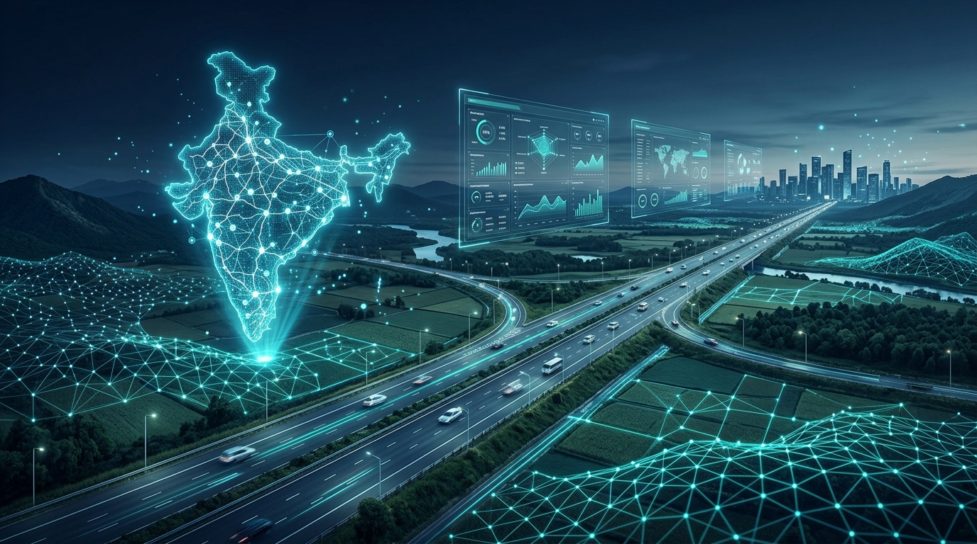
SMART INDIA HACKATHON 2026
BhoomiSetu
AI-Powered Land Acquisition Early Warning System
🧠 Artificial Intelligence
🗺️ GIS Mapping
📊 Decision Intelligence
Team BhoomiSetu

Slide 2
THE CHALLENGE
Land Acquisition Delays Stall
India's Infrastructure Growth
● Land acquisition delays slow highways, railways & industrial corridors
● Compensation disputes & legal cases create uncertainty
● Officials identify risks after delays have already occurred
● No early-warning mechanism for proactive intervention
🏗️
⚖️
⏳
💸
→
→
→
Land
Acquisition
Disputes &
Litigation
Project
Delay
Cost
Overrun

Slide 3
OUR SOLUTION
Predict Risk. Explain Causes. Act Early.
📋
🧠
🔍
🚀
→
→
→
Project Data
AI Prediction
Risk Explanation
Early Action
● Predict delay risk before it becomes critical
● Identify the major factors driving risk
● Monitor all projects from one unified dashboard
● Support proactive administrative decision-making

Slide 4
SYSTEM WORKFLOW
How BhoomiSetu Works
01
02
03
04
Data Collection
→
AI Prediction
→
Explainability
→
Decision Support
Project • Land • Legal
Compensation • Stakeholder
ML model predicts
delay probability
SHAP identifies top
risk-driving factors
Alerts • Dashboard
Recommended Actions
End-to-end pipeline: from raw project data to actionable risk intelligence

Slide 5
AI ENGINE
AI-Powered Risk Prediction
RISK LEVELS
● XGBoost Machine Learning classifier
● 500 decision trees for robust prediction
● 58 engineered features across 5 domains
● Predicts >90 day delay risk
🟢 LOW
< 40% probability
🟡 MODERATE
40 – 59%
REPORTED MODEL EVALUATION METRICS
🟠 HIGH
60 – 79%
91.4%
0.974
🔴 CRITICAL
≥ 80%
Accuracy
ROC-AUC

Slide 6
EXPLAINABLE AI
Why Is the Project at Risk?
SHAP analysis reveals the top factors contributing to delay risk —
not just a score, but an explanation.
ILLUSTRATIVE SAMPLE
72%
Compensation Pending
+0.184
Legal Disputes
+0.142
HIGH RISK
Stage Stagnation
+0.118
DEMO SAMPLE
Stakeholder Friction
+0.091
Acquisition Progress
−0.076
Risk score with factor attribution
for transparent decision-making

Slide 7
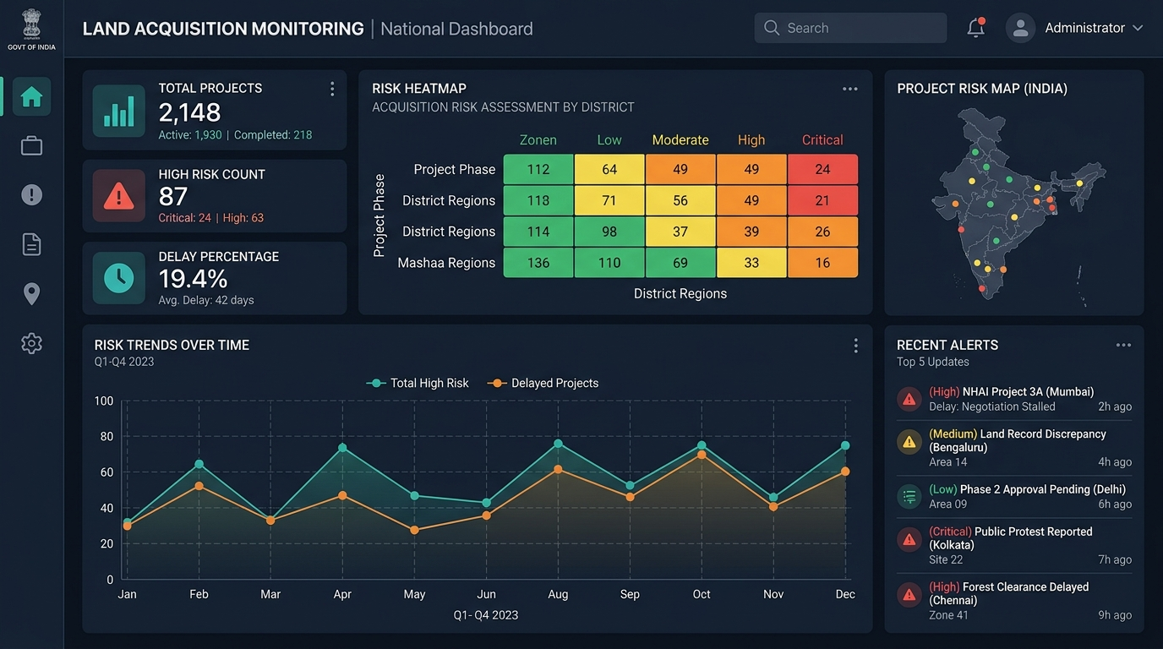
COMMAND CENTER
One Dashboard. Complete Visibility.
ILLUSTRATIVE DEMO DATA — NOT PRODUCTION STATISTICS
TOTAL PROJECTS
LOW RISK
MODERATE
HIGH RISK
CRITICAL
128
66
31
24
7

Slide 8
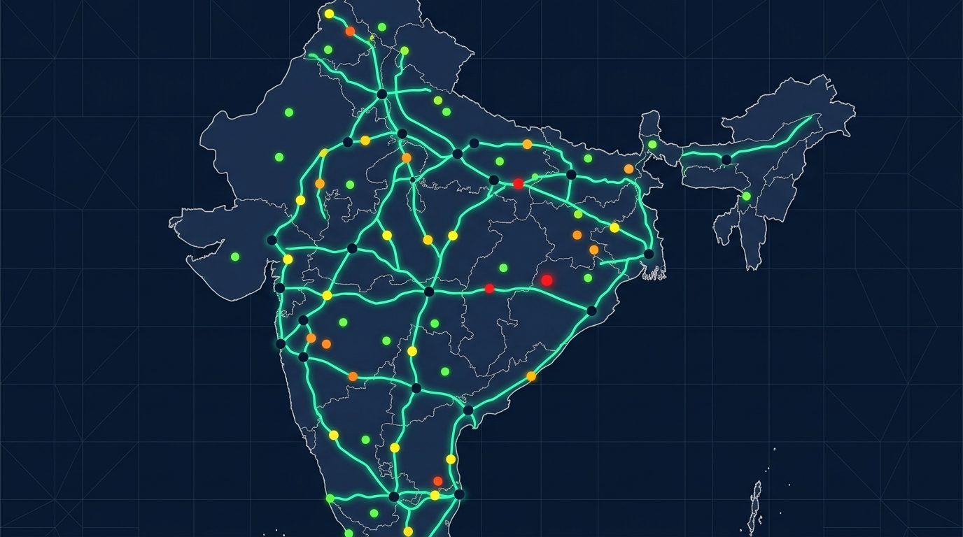
SPATIAL INTELLIGENCE
See Risk on the Map
● Project locations across India
● Infrastructure corridor mapping
● District-level risk concentration
● Spatial conflict detection
Low
Moderate
High
Critical
DEMO VISUALIZATION

Slide 9
PLATFORM CAPABILITIES
Key Features
🧠
AI Early Warning System
🔍
Explainable AI (SHAP)
🗺️
GIS Corridor Mapping
⚖️
Legal & Statutory Tracking
💰
Compensation Fund Tracking
🚨
Automated Risk Alerts
🔄
What-If Simulation
📊
State Benchmarking

Slide 10
ENGINEERING
Technology Stack
🎨 FRONTEND
⚙️ BACKEND
🧠 AI / ML
🚀 DEPLOY
React 19
FastAPI
XGBoost
Docker
TypeScript
Python
Scikit-learn
Render
Vite
SQLAlchemy
SHAP
Vercel
TailwindCSS
PostgreSQL
Pandas
PostGIS
Radix UI
Redis
NumPy
Recharts
Alembic

Slide 11
VALUE PROPOSITION
Expected Impact
❌ Before BhoomiSetu
✅ With BhoomiSetu
Reactive monitoring only
Early risk visibility
Delayed risk identification
Explainable risk factors
Manual investigation
Proactive intervention
No explainability
Data-driven monitoring
Illustrative / Projected — Not Validated Results

Slide 12
ROADMAP
Future Scope
🏛️
📈
🗺️
🚀
Govt. Integration
More Data
Better Analytics
Nationwide Deploy
Integration with government
land records & revenue databases
Incorporate historical project
data across all states
Improved district & state-level
comparative analytics
Deployment across
infrastructure departments

Slide 13
BhoomiSetu
"From Delayed Response to Early Action."
🧠 AI
🗺️ GIS
🔍 Explainability
📊 Decision Intelligence
Thank You
Smart India Hackathon 2026 • Team BhoomiSetu

