Slide 1

Unit-1 | Part-1 (C# Fundamentals) Introduction to .NET Web API
Building RESTful APIs with ASP.NET Core
#2401CS521
Prof. Naimish R. Vadodariya
Computer Science & Engineering Department
Naimish.vadodariya@darshan.ac.in
8866215253

Slide 2

Outline
.NET Overview
C# Overview
Namespace
Console Class Methods
Data Types & Variables
Operators
Arrays
Classes/Objects
Constructors
Inheritance
Abstraction
Interface
Exception Handling
Collection Classes
Generics in C#
Looping

Slide 3
.NET: Overview
Section - 1

Slide 4
.NET: Overview
.NET is a free, cross-platform, and open-source developer platform created by Microsoft for building web, mobile, desktop, cloud, IoT, and gaming applications.
Key Components of .NET
Languages: Supports primarily C# (the most popular), F# (functional-first), and Visual Basic (VB.NET).
Common Language Runtime (CLR): The execution engine that manages memory, handles garbage collection, and enforces type safety.
Base Class Libraries (BCL): A massive collection of pre-written code for common tasks like networking, file access, and data structures.
NuGet: The official package manager that allows developers to find and share thousands of reusable third-party libraries.

Slide 5
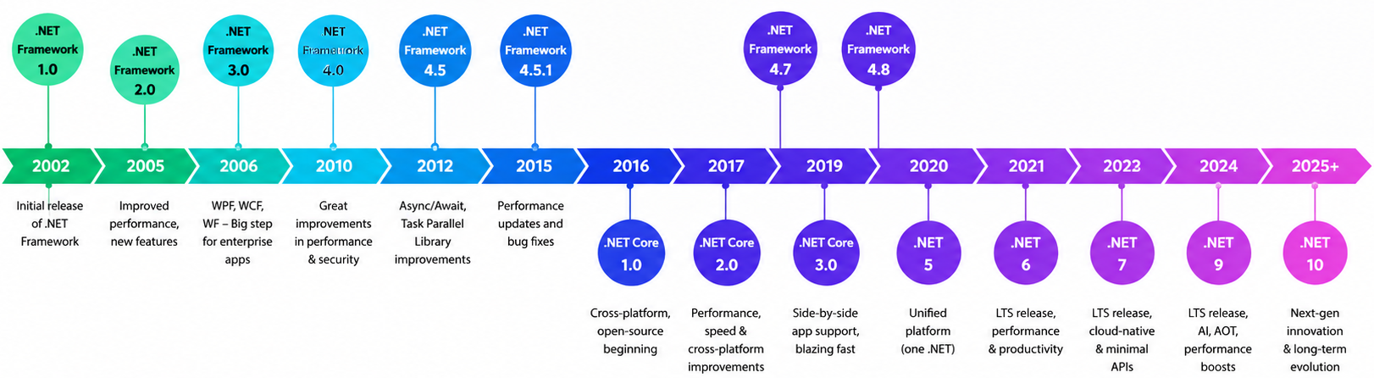
.NET History
.NET 10 was officially released on November 11, 2025. It is designated as a Long-Term Support (LTS) release, meaning it will receive support and updates for three years, until November 14, 2028.

Slide 6
C#: Overview
Section - 2

Slide 7
C#: Overview
C# is pronounced "C-Sharp".
It is an object-oriented programming language created by Microsoft that runs on the .NET Framework.
It has roots from the C family, and the language is close to other popular languages like C++ and Java.
It was developed by Anders Hejlsberg.
The first version was released in year 2002. The latest stable version of C# is C# 14, was released in November 2025 alongside .NET 10.
C# is used for: Mobile applications, Desktop applications, Web applications, Web services, Web sites, Games, VR, Database applications, And much more!

Slide 8
Namespace
Section - 3

Slide 9
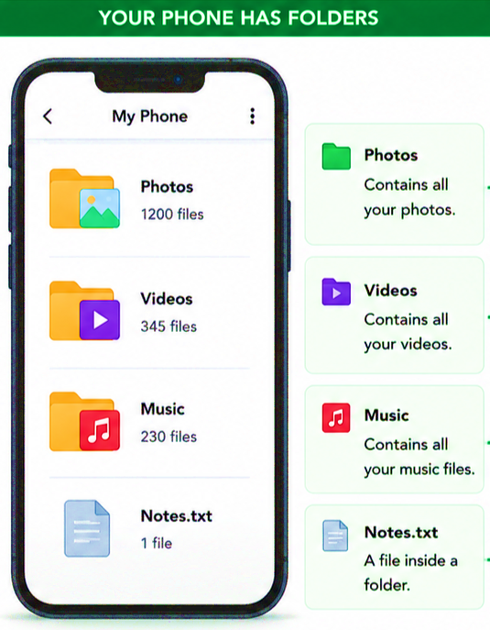
Namespace
A Namespace is a container used to organize related classes and avoid naming conflicts in a application.
Example
Your phone has folders:
Photos
Videos
Music
The folders keep files organized.
In C#:
Namespace = Folder
Class = File
💡 In C# namespace keeps classes organized.

Slide 10
Namespace Cont..
Namespaces are used in C# to keep one set of names separated from another.
This is done to organize the classes so, that they are easy to handle.
If there are two classes with the same names in different namespaces, they do not conflict with one another.
The .NET Framework uses namespaces to organize its built-in classes also.
We can say it is a container for classes and namespaces (Nested namespaces also allowed).
There are some built-in namespaces in .NET such as System, System.Linq, System.Web, etc. Each namespace contains specific related set of classes.
Namespaces are not mandatory in a C# program, but they do play an important role in writing cleaner codes and managing larger projects.
Example: Namespace
1
2
3
4
namespace namespace_name
{
// define classes here
}

Slide 11
Namespace Cont..
The following namespace contains the Student and Course classes.
Example: Namespace
1
2
3
4
5
6
7
8
9
10
11
12
namespace School
{
class Student
{
}
class Course
{
}
}

Slide 12
Namespace Cont..
The following namespace contains the Student and Course classes.
Classes under the same namespace can be referred to as namespace.classname syntax.
For example, the Student class can be accessed as School.Student.
Example: Namespace
Example: Namespace
1
2
3
4
5
6
7
8
9
10
11
12
namespace School
{
class Student
{
}
class Course
{
}
}
1
2
3
4
5
6
7
8
9
10
11
namespace DUDemo
{
class Program
{
static void Main(string[] args)
{
School.Student std = new School.Student();
School.Course cs = new School.Course();
}
}
}

Slide 13
Namespace Cont..
To use classes under a namespace without the fully qualified name, import the namespace with the using keyword at the top of C# class file.
Example: Namespace
Example: Namespace
1
2
3
4
5
6
7
8
9
10
11
12
13
using System; //built-in namespace
using School;
namespace DUDemo
{
class Program
{
static void Main(string[] args)
{
Student std = new Student();
}
}
}
1
2
3
4
5
6
7
8
9
10
11
12
namespace School
{
class Student
{
}
class Course
{
}
}

Slide 14


Namespace Cont..
Example: Class Conflicts
Example: Namespace
1
2
3
4
5
6
7
8
9
class Student
{
}
class Student
{
}
1
2
3
4
5
6
7
8
9
10
11
12
13
14
15
namespace ComputerDepartment
{
class Student
{
}
}
namespace MechanicalDepartment
{
class Student
{
}
}

Slide 15
Namespace Cont..
Nested Namespace
A Nested Namespace is simply a namespace inside another namespace.
The nested namespace and its members can also be accessed using the dot (.) operator.
Example: How to create Nested Namespace?
Example: Nested Namespace
1
2
3
4
5
6
7
8
9
10
11
namespace namespace_name
{
namespace namespace_name1
{
// code
}
namespace namespace_name2
{
// code
}
}
1
2
3
4
5
6
7
8
9
10
11
namespace Company
{
namespace HR_Department
{
// code
}
namespace IT_Department
{
// code
}
}

Slide 16
Console Class Methods
Section - 4

Slide 17
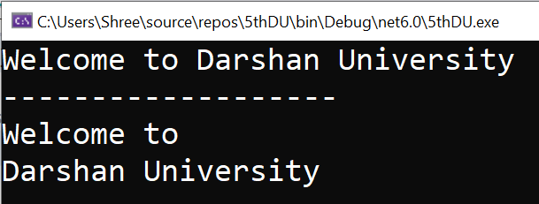
Console.WriteLine() & Console.Write()
The Console.WriteLine() and Console.Write() methods print values or texts to the console.
Console.WriteLine() method prints a new line after the text or a value.
Console.Write() method only prints the text or value without a new line.
Example
Output
1
2
3
4
5
6
7
8
9
10
11
12
13
14
15
using System;
namespace MyFirstApp
{
class Program
{
public static void Main(string[] args)
{
Console.Write("Welcome to");
Console.Write(" Darshan University");
Console.WriteLine("\n-------------------");
Console.WriteLine("Welcome to ");
Console.WriteLine("Darshan University");
}
}
}

Slide 18
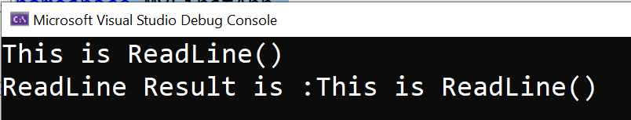
Console.ReadLine()
Console.ReadLine()
Reads the next line of characters from the standard input stream.
Simply you can say, it read all the characters from user input. (and finish when press enter).
It returns a STRING so data type should be STRING.
It means it reads all characters until the end of line.
Example
Output
1
2
3
4
5
6
7
8
9
10
11
12
using System;
namespace MyFirstApp
{
class Program
{
public static void Main(string[] args)
{
string name = Console.ReadLine();
Console.WriteLine("ReadLine Result is :"+name);
}
}
}

Slide 19
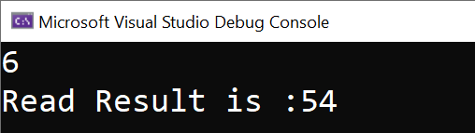
Console.Read()
Console.Read()
Reads the next character from the standard input stream.
It only accept single character from user input and return its ASCII Code.
Data type should be int, because it returns an integer value as ASCII.
E.g. As we input "6" and it return its ASCII value "54".
Example
Output
1
2
3
4
5
6
7
8
9
10
11
12
using System;
namespace MyFirstApp
{
class Program
{
public static void Main(string[] args)
{
int val = Console.Read();
Console.WriteLine("Read Result is :"+val);
}
}
}

Slide 20
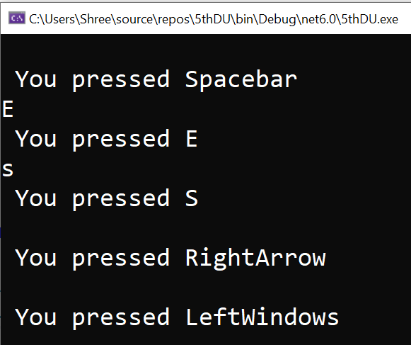
Console.ReadKey()
Console.ReadKey()
It obtains the next character or function key pressed by the user.
In simple words, it read that which key is pressed by user and return its name.
It does not require to press enter key before entering.
It is STRUCT Data type which is ConsoleKeyInfo.
Example
Output
1
2
3
4
5
6
7
8
9
10
11
12
13
14
using System;
namespace MyFirstApp
{
class Program
{
public static void Main(string[] args)
{
while (true)
{
ConsoleKeyInfo key = Console.ReadKey();
Console.WriteLine("\n You pressed " + key.Key);
}
}
}
}

Slide 21
Data Types & Variables
Section - 5

Slide 22
Data Types & Variables
Variables are containers for storing data values.
In C#, there are different types of variables (defined with different keywords), for example:
int - stores integers (whole numbers), without decimals, such as 123 or -123
double - stores floating point numbers, with decimals, such as 19.99 or -19.99
char - stores single characters, such as 'a' or 'B'. Char values are surrounded by single quotes
string - stores text, such as "Hello World". String values are surrounded by double quotes
bool - stores values with two states: true or false
Declaring (Creating) Variables
1
type variableName = value;
Example: Variables
1
2
3
4
5
int Num = 15;
double Number = 15.50;
char values = ‘B’;
string name = “Darshan University”;
bool isClosed = false;

Slide 23
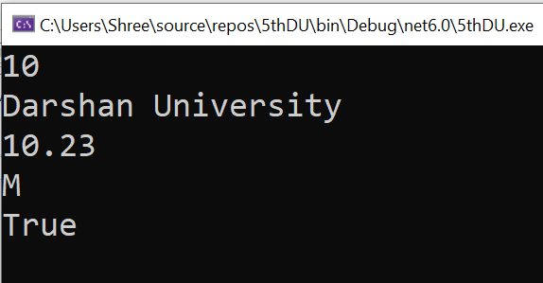
Example: Data Types & Variables
Program.cs
Output
1
2
3
4
5
6
7
8
9
10
11
12
13
14
15
16
17
18
19
20
21
22
23
using System;
namespace MyFirstApp
{
class Program
{
static void Main(string[] args)
{
int number = 10;
string name = "Darshan University";
double percentage = 10.23;
char gender = 'M';
bool isVerified = true;
Console.WriteLine(number);
Console.WriteLine(name);
Console.WriteLine(percentage);
Console.WriteLine(gender);
Console.WriteLine(isVerified);
Console.ReadLine();
}
}
}

Slide 24

Rules to Declaring a Variable in C#
Before we declare and define variables in the c# programming language, we need to follow particular rules.
You can define a variable name with a combination of alphabets, numbers, and underscore.
A variable name must always start with either alphabet or underscore but not with numbers.
While defining the variable, no white space is allowed within the variable name.
Don't use any reserved keywords such as int, float, char, etc., for a variable name.
In c#, once the variable is declared with a particular data type, it cannot be re-declared with a new type, and we shouldn’t assign a value that is not compatible with the declared type.
Valid
Invalid
1
2
3
4
5
int abc; float a2b; char _abc;
int a,b,c;
float x, y, z = 10.5;
1
2
3
4
int a b c; float 2abc; char &abc; double int;

Slide 25
Operators
Section - 6

Slide 26
Operators
Operators in C# are some special symbols that perform some action on operands.
In mathematics, the plus symbol (+) do the sum of the left and right numbers. In the same way, C# includes various operators for different types of operations.
The following example demonstrates the + operator in C#.
In the above example, + operator adds two number literals and assign the result to a variable.
It also adds the values of two int variables and assigns the result to a variable.
Some operators behave differently based on the type of the operands.
For example, + operator also concatenates two strings.
Example
1
2
3
int x = 5 + 5;
int y = 10 + x;
int z = x + y;

Slide 27
Type of Operators
Arithmetic Operators
Relational Operators
Logical Operators
Assignment Operators

Slide 28
Arithmetic Operators
A =10, B=20
Operator | Description | Example
+ | Adds two operands | A + B = 30
- | Subtracts second operand from the first | A - B = -10
* | Multiplies both operands | A * B = 200
/ | Divides numerator by de-numerator | B / A = 2
% | Modulus Operator and remainder of after an integer division | B % A = 0
++ | Increment operator increases integer value by one | A++ = 11
-- | Decrement operator decreases integer value by one | A-- = 9

Slide 29
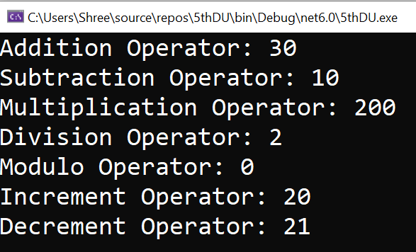
Example: Arithmetic Operators
Example
Output
1
2
3
4
5
6
7
8
9
10
11
12
13
14
15
16
17
18
19
20
21
22
23
24
25
26
27
using System;
namespace MyFirstApp
{
class Program
{
public static void Main(string[] args)
{
int ans;
int x = 20, y = 10;
ans = (x + y);
Console.WriteLine("Addition Operator: " + ans);
ans = (x - y);
Console.WriteLine("Subtraction Operator: " + ans);
ans = (x * y);
Console.WriteLine("Multiplication Operator: " + ans);
ans = (x / y);
Console.WriteLine("Division Operator: " + ans);
ans = (x % y);
Console.WriteLine("Modulo Operator: " + ans);
ans = (x++);
Console.WriteLine("Increment Operator: " + ans);
ans = (x--);
Console.WriteLine("Decrement Operator: " + ans);
Console.ReadLine();
}
}
}

Slide 30
Relational Operators
A =10, B=20
Operator | Description | Example
== | Checks if the values of two operands are equal or not, if yes then condition becomes true. | (A == B) is not true.
!= | Checks if the values of two operands are equal or not, if values are not equal then condition becomes true. | (A != B) is true.
> | Checks if the value of left operand is greater than the value of right operand, if yes then condition becomes true. | (A > B) is not true.
< | Checks if the value of left operand is less than the value of right operand, if yes then condition becomes true. | (A < B) is true.
>= | Checks if the value of left operand is greater than or equal to the value of right operand, if yes then condition becomes true. | (A >= B) is not true.
<= | Checks if the value of left operand is less than or equal to the value of right operand, if yes then condition becomes true. | (A <= B) is true.

Slide 31
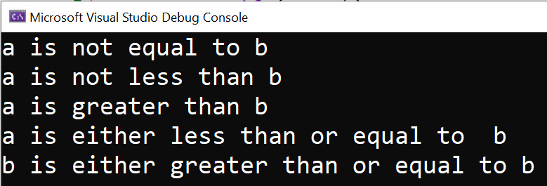
Example: Relational Operators
Example
Output
1
2
3
4
5
6
7
8
9
10
11
12
13
14
15
16
17
18
19
20
21
22
23
24
25
26
27
28
29
using System;
namespace MyFirstApp
{
class Program
{
public static void Main(string[] args)
{
int a = 21, b = 10;
if (a == b)
Console.WriteLine("a is equal to b");
else
Console.WriteLine("a is not equal to b");
if (a < b)
Console.WriteLine("a is less than b");
else
Console.WriteLine("a is not less than b");
if (a > b)
Console.WriteLine("a is greater than b");
else
Console.WriteLine("a is not greater than b");
/* Lets change value of a and b */
a = 5; b = 20;
if (a <= b)
Console.WriteLine("a is either less than or equal to b");
if (b >= a)
Console.WriteLine("b is either greater than or equal to b");
}
}
}

Slide 32
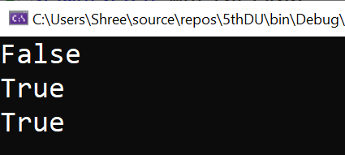
Logical Operators
Operator | Description | Example (x=5)
&& | Logical AND | Returns True if both statements are true | x < 5 && x < 10 (False)
|| | Logical OR | Returns True if one of the statements is true | x > 3 || x < 4 (True)
! | Logical NOT | Reverse the result, returns False if the result is true | !(x > 3 && x < 10) (False)
Example
Output
1
2
3
4
5
6
7
8
9
10
11
12
13
14
15
16
using System;
namespace MyFirstApp
{
class Program
{
public static void Main(string[] args)
{
bool a = true;
bool b = false;
Console.WriteLine(a && b);
Console.WriteLine(a || b);
Console.WriteLine(!(a && b));
Console.ReadLine();
}
}
}

Slide 33
Assignment Operators
Operator | Description | Example
= | Simple assignment operator, Assigns values from right side operands to left side operand | C = A + B assigns value of A + B into C
+= | Add AND assignment operator, It adds right operand to the left operand and assign the result to left operand | C += A is equivalent to C = C + A
-= | Subtract AND assignment operator, It subtracts right operand from the left operand and assign the result to left operand | C -= A is equivalent to C = C - A
*= | Multiply AND assignment operator, It multiplies right operand with the left operand and assign the result to left operand | C *= A is equivalent to C = C * A
/= | Divide AND assignment operator, It divides left operand with the right operand and assign the result to left operand | C /= A is equivalent to C = C / A

Slide 34
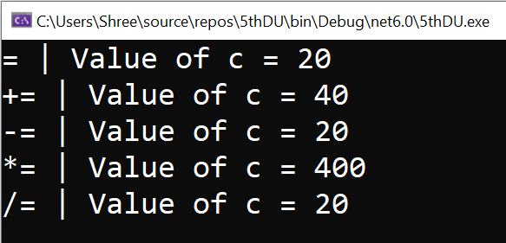
Example: Assignment Operators
Example
Output
1
2
3
4
5
6
7
8
9
10
11
12
13
14
15
16
17
18
19
20
21
22
23
using System;
namespace MyFirstApp
{
class Program
{
public static void Main(string[] args)
{
int a = 20;
int ans;
ans = a;
Console.WriteLine("= | Value of c = {0}", ans);
ans += a;
Console.WriteLine("+= | Value of c = {0}", ans);
ans -= a;
Console.WriteLine("-= | Value of c = {0}", ans);
ans *= a;
Console.WriteLine("*= | Value of c = {0}", ans);
ans /= a;
Console.WriteLine("/= | Value of c = {0}", ans);
Console.ReadLine();
}
}
}

Slide 35
Arrays
Section - 7

Slide 36
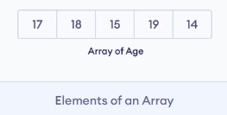
Arrays
An array is a collection of similar types of data.
It is a group of like-typed variables that are referred to by a common name.
Suppose we need to record the age of 5 students. Instead of creating 5 separate variables, we can simply create an array:
In C#, here is how we can declare an array.
Array Declaration
1
Datatype[] arrayName;

Slide 37
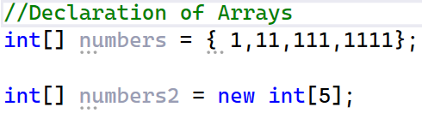
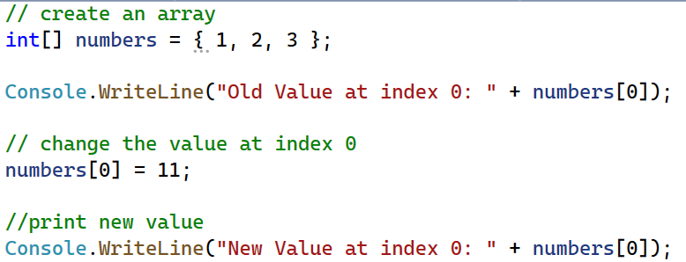
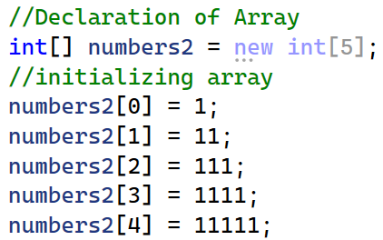
Example - Array

Slide 38
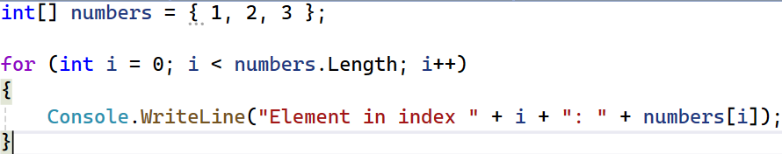
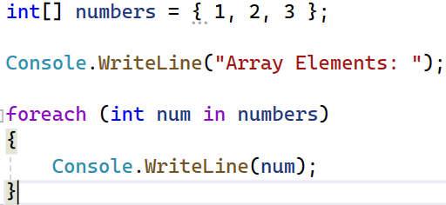
Iterating C# Array using Loops

Slide 39
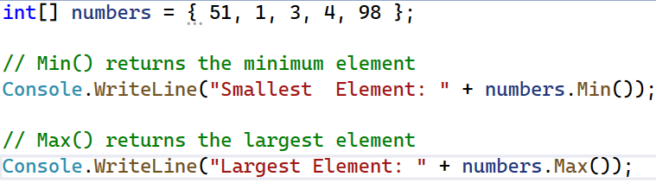
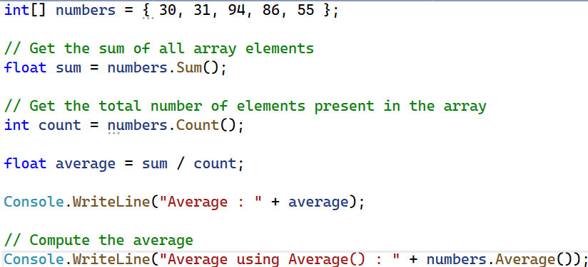
Examples - Arrays
Find Minimum and Maximum Element (using System.Linq)
Find the Average of an Array (using System.Linq)

Slide 40
Class & Objects
Section - 8

Slide 41
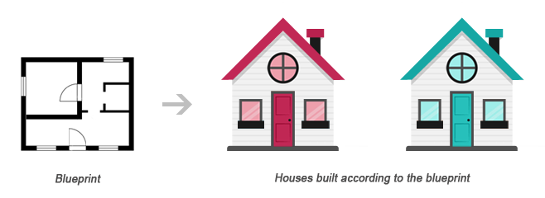
What is Class?
Class can be defined in multiple ways
A class is the building block.
A class is a blueprint for an object.
A class is a user-defined data type.
A class is a collection of objects of the similar kind.
A class is a user-defined data type which combines data and methods.
A class describes both the data and behaviors of objects.
Class contains data members (also known as field or property or data) and member functions (also known as method or action or behavior)
Classes are similar to structures in C.

Slide 42
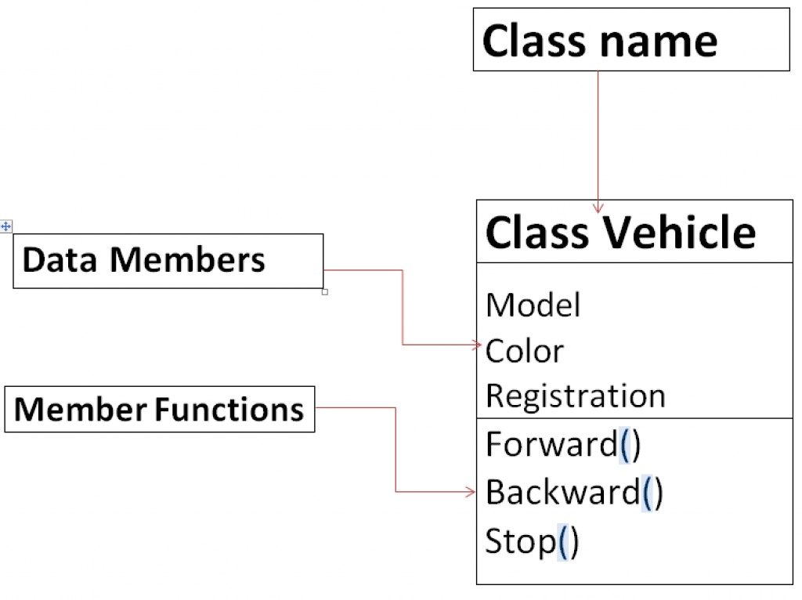
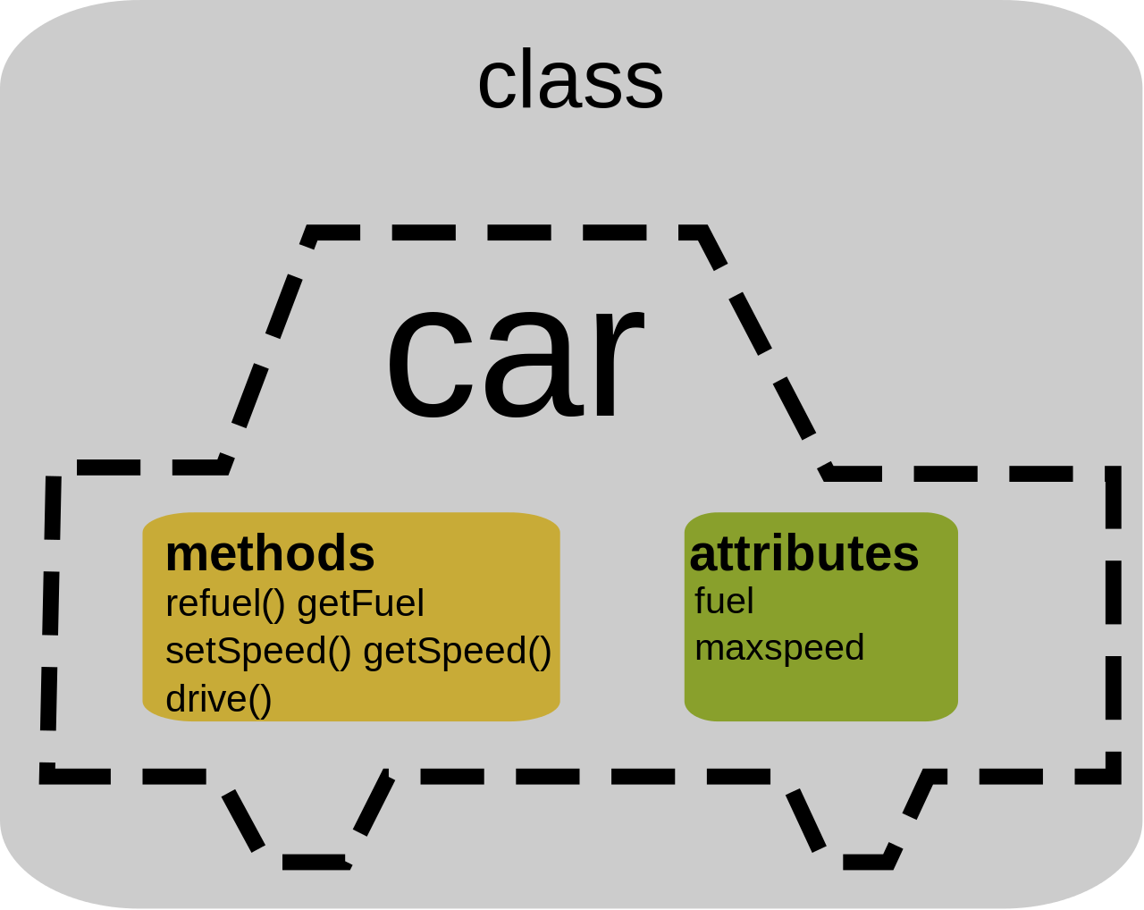
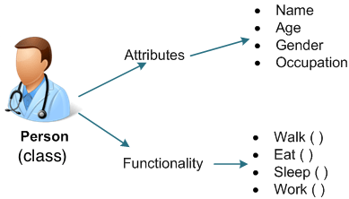
What does a Class Contain?

Slide 43
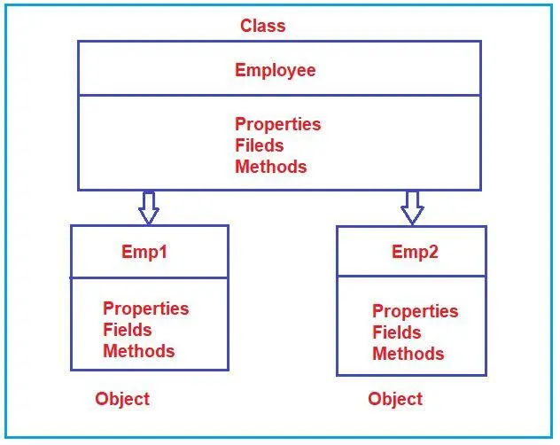
Declaring a Class in C#
Class Declaration
We defined a class “users” using class keyword with public access modifier.
Here, the public access specifier will allow the users to create objects for this class, and inside of the body class, we can create required fields, properties, methods, and events for specific usage.
1
2
3
4
public or internal class users
{
// Properties, Methods, Events, etc.
}

Slide 44
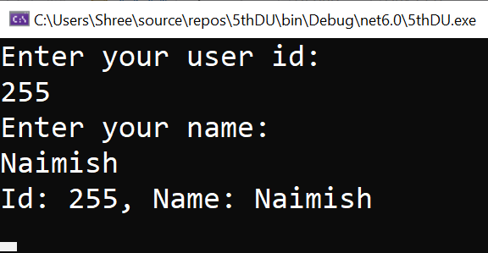
Example: Class & Object
Example
Output
1
2
3
4
5
6
7
8
9
10
11
12
13
14
15
16
17
18
19
20
21
22
23
24
25
26
27
28
using System;
namespace MyFirstApp
{
public class Users
{
public int id = 0;
public string name = string.Empty;
public void GetUserDetails()
{
Console.WriteLine("Enter your user id:");
id = Convert.ToInt32(Console.ReadLine());
Console.WriteLine("Enter your name:");
name = Console.ReadLine();
Console.WriteLine("Id: {0}, Name: {1}", id, name);
Console.ReadLine();
}
}
class Program
{
public static void Main(string[] args)
{
Users user = new Users();
user.GetUserDetails();
}
}
}

Slide 45
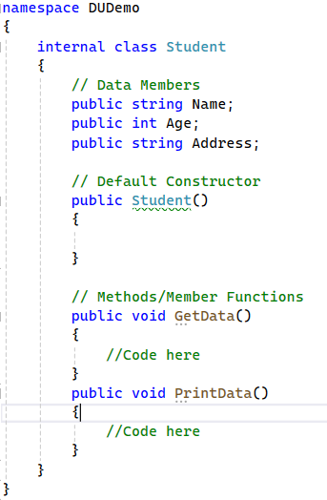
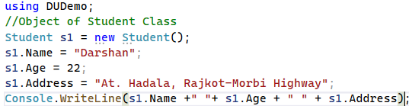

Example: Class & Object
Output

Slide 46




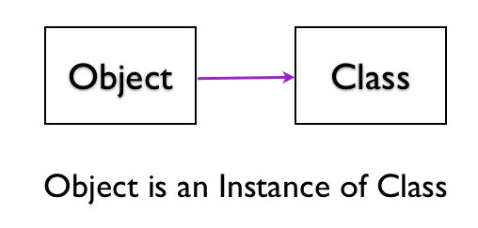
Object
Objects are real-world entities and also called as instance of a class.
An entity that has state and behavior is known as an object.
Means, they are created based on the class definition.
You can have multiple objects of the same class, each with its own unique data.
Each and every object posses
Identity
State
Behavior
OBJECT

Slide 47
Object Cont..
For example, chair, car, pen, mobile, laptop etc.
Each object can have different values of properties and field but, methods and events behaves the same.
Object Creation
Create Multiple Objects
1
Student student1 = new Student();
1
2
3
4
5
6
7
Student student1 = new Student();
student1.FirstName = "Raj";
student1.LastName = "Mehta";
Student student2 = new Student();
student2.FirstName = "Abhay";
student2.LastName = "Doshi";
Access Members of a Class
1
2
3
4
5
6
Student student1 = new Student();
student1.FirstName = "Naimish";
student1.LastName = "Patel";
student1.GetFullName();

Slide 48
Object Cont..
Class
Object1
Object2
Class is a blueprint of an object
Object is instance of class
Class describes the object

Slide 49
Class and Objects Cont..
Object 1
Person: P1
Name: Narendra Modi
Gender: Male
Age: 71 Years
Profession: Politician
Class
Person
Person: P1
Name
Gender
Age
Profession
Object 2
Person: P2
Person: P2
Name: Amitabh Bachchan
Gender: Male
Age: 79 Years
Profession: Actor

Slide 50
Class and Objects Cont..
Object 1
BankAccount: B1
Account_No: 1001123001
balance: 1,00,000
Class
BankAccount: B1
BankAccount
Object 2
Account_No
balance
BankAccount: B2
BankAccount: B2
Account_No: 1001123002
balance: 5,60,0000
BankAccount: B3
Object 3
BankAccount: B3
Account_No: 1001123003
balance: 10,000

Slide 51
Class and Objects Cont..
Object 1
Cube : C1
Name:C1
Height:20cm
Width:20cm
Depth:20cm
Class
Cube : C1
Cube
Object 2
Name
Height
Width
Depth
Cube : C2
Name: C2
Height:5cm
Width:5cm
Depth:5cm
Cube : C2
Cube : C3
Object 3
Cube : C3
Name: C3
Height:10cm
Width:10cm
Depth:10cm

Slide 52
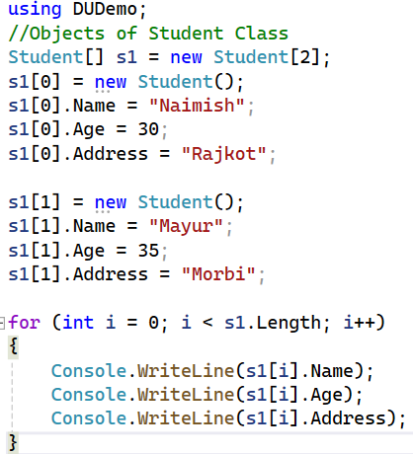
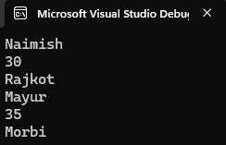
Example: Class & Object (for loop)
Output

Slide 53
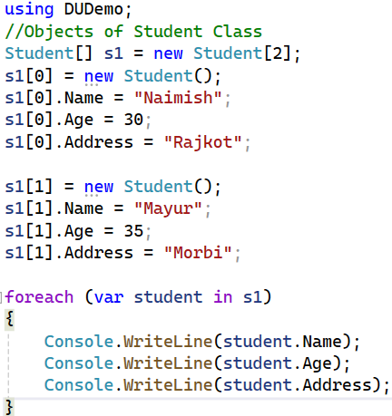
Example: Class & Object (foreach loop)
Output

Slide 54
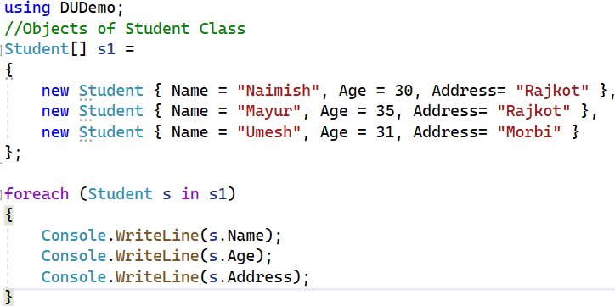
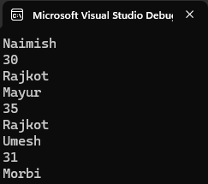
Example: Class & Object (foreach loop)
Output

Slide 55
Difference Between Class & Object
Class | Object
Class is a Blueprint or template. | Object is the instance of a class.
Class creates a logical framework that defines the relationship between its members. | When you declare an object of a class, you are creating an instance of that class.
Class is a logical construct. | An Object has physical reality. (i.e., an object occupies space in memory.)
Class is a group or collection of similar objects. e.g. Car | An Object is defined as real-world entity e.g.: Audi, Volkswagen, Tesla, Ferrari etc.
Class is declared only once. | An Object can be created as many times as required.
Class doesn’t allocate memory when it is created. | An Object allocates the memory upon creation.
Class can exist without its objects. | An Object can’t exist without a class.
Class: Profession, Mobile, Subject, Student, Color.. | Object: Doctor, Teacher, Lawyer, Politician, iPhone, Samsung, Maths, English, Science, John, Aarav, Smita, Blue, Green, Red, Yellow, Violet ..

Slide 56
Constructor
Section – 9

Slide 57
Constructor
A constructor is a special type of method which will be called automatically when you create an instance of a class.
A constructor is defined by using an access modifier and class name
<access-modifier> <class-name>(){ }.
Example
Constructor Characteristics
1
2
3
4
5
6
7
public class Student
{
public Student()
{
//constructor
}
}
A constructor name must be the same as a class name.
A constructor can be public, private, or protected.
The constructor cannot return any value so, cannot have a return type.
A class can have multiple constructors with different parameters but can only have one parameter less constructor.
If no constructor is defined, the C# compiler would create it internally.

Slide 58
Type of Constructor
Constructors can be classified as follows.
Default Constructor
By default, C# creates default constructor internally.
Parameterized Constructor
When an object is declared in a parameterized constructor, the initial values have to be passed as arguments to the constructor.
Copy Constructor
The copy constructor is a constructor which creates an object by initializing it with an object of the same class, which has been created previously.
The copy constructor is used to: Initialize one object from another of the same type.
Copy an object to pass it as an argument to a function.

Slide 59
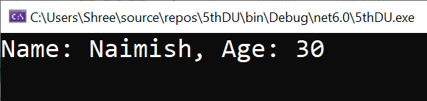
Example: Constructor
Example
Output
1
2
3
4
5
6
7
8
9
10
11
12
13
14
15
16
17
18
19
20
21
22
23
24
25
26
27
using System;
namespace MyFirstApp
{
class Program
{
public static void Main(string[] args)
{
Users user = new Users("Naimish", 30);
user.GetUserDetails();
Console.ReadLine();
}
}
public class Users
{
public string Name = string.Empty;
public int Age = 0;
public Users(string name, int age) //Parameterized Constructor
{
Name = name;
Age = age;
}
public void GetUserDetails()
{
Console.WriteLine("Name: {0}, Age: {1}", Name, Age);
}
}
}

Slide 60
Example: Copy Constructor
Example
1
2
3
4
5
6
7
8
9
10
11
12
13
14
15
16
17
18
19
20
21
22
23
24
25
using System;
namespace MyFirstApp
{
public class Users
{
public string Name = string.Empty;
public int Age = 0;
public Users(string name, int age) //Parameterized Constructor
{
Name = name;
Age = age;
}
public void GetUserDetails()
{
Console.WriteLine("Name: {0}, Age: {1}", Name, Age);
}
public Users(Users user) //Copy Constructor
{
this.Name = user.Name;
this.Age = user.Age;
}
}

Slide 61
Example: Copy Constructor
Example
Output
28
29
30
31
32
33
34
35
36
37
38
class Program
{
public static void Main(string[] args)
{
Users user1 = new Users("Naimish", 30);
Users user2 = new Users(user1);
user2.GetUserDetails();
Console.ReadLine();
}
}
}

Slide 62
Inheritance
Section - 10

Slide 63
Inheritance
In object-oriented programming, inheritance stands as a fundamental characteristic.
It provides the ability to create a child class that can reuse (inherit), extend, or alter the functionalities of a parent class.
The class whose members are inherited is called the base class.
The class that inherits the members of the base class is called the derived class.
Inheritance promotes code reuse, simplifies code maintenance, and improves code organization.
It implements the IS-A relationship between a base class and one or more derived classes.

Slide 64
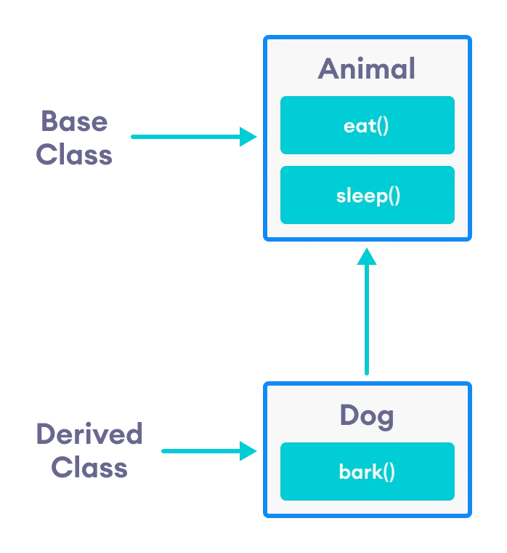
Inheritance cont..
Super Class: [Animal Class]
The class whose features are inherited is known as super class(or a base class or a parent class).
Sub Class: [Dog]
The class that inherits the other class is known as subclass(or a derived class, extended class, or child class).
The subclass can add its own fields and methods in addition to the superclass fields and methods.
Reusability:
Inheritance supports the concept of “reusability”, i.e. when we want to create a new class and there is already a class that includes some of the code that we want, we can derive our new class from the existing class.
By doing this, we are reusing the fields and methods of the existing class.

Slide 65
Inheritance Syntax
namespace Program
{
class parent
{
}
class child : parent
{
}
}
Class A (Base)
Class B (Derived)

Slide 66
Types of Inheritance
Single Inheritance
Multi-level Inheritance
Hierarchical Inheritance
Multiple Inheritance
Hybrid Inheritance

Slide 67
Single Inheritance
Single Inheritance
In single inheritance, a derived class is created from a single base class.
(There is only one parent class & one child class)
Class A (Base)
Class B (Derived)

Slide 68
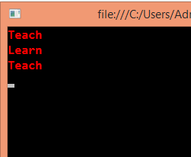
Example - Single Inheritance
//Base Class
class Teacher
{
public void Teach()
{
Console.WriteLine("Teach");
}
}
//Derived Class
class Student : Teacher
{
public void Learn()
{
Console.WriteLine("Learn");
}
}
class Program
{
static void Main(string[] args)
{
Teacher d = new Teacher();
d.Teach();
Student s = new Student();
s.Learn();
s.Teach();
Console.ReadKey();
}
}

Slide 69
Multi-level Inheritance
Multi-level Inheritance
In Multi-level inheritance, a derived class is created from another derived class.
Class A (Base)
Class B
Class C

Slide 70
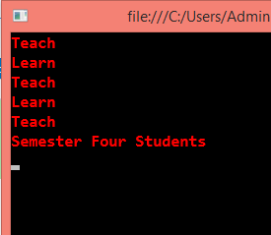
Example – Multi-Level Inheritance
//Base Class
class Teacher
{
public void Teach()
{
Console.WriteLine("Teach");
}
}
//Base,Derived Class
class Student : Teacher
{
public void Learn()
{
Console.WriteLine("Learn");
}
}
//Derived Class
class SemFour : Student
{
public void FourthSem()
{
Console.WriteLine("Semester Four Students");
}
}
class Program
{
static void Main(string[] args)
{
Teacher d = new Teacher();
d.Teach();
Student s = new Student();
s.Learn();
s.Teach();
SemFour Sem = new SemFour();
Sem.Learn();
Sem.Teach();
Sem.FourthSem();
Console.ReadKey();
}
}

Slide 71
Hierarchical Inheritance
Hierarchical Inheritace
There is one parent class that has more then one child class.
Class A
Class C
Class B
Class D
Class E
Class F
Class G

Slide 72
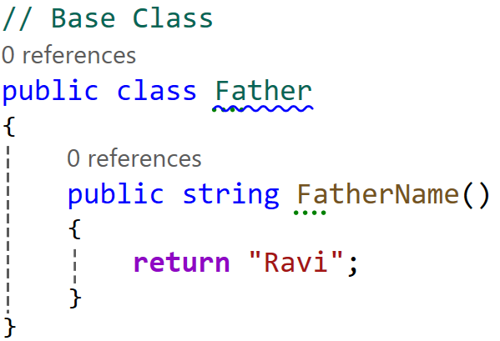
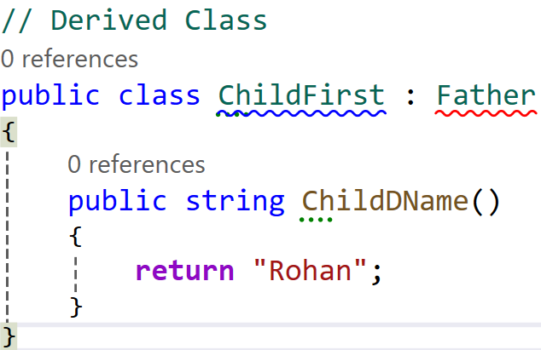
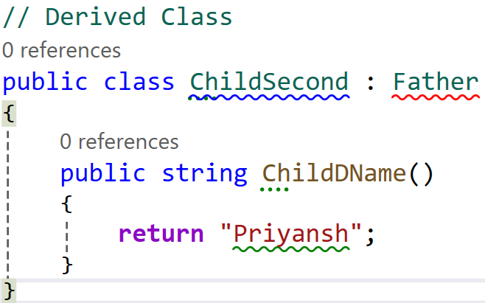
Example – Hierarchical Inheritance

Slide 73
Multiple Inheritance
Multiple Inheritance
In Multiple inheritance, child class can have more than one parent class.
This type of inheritance is not supported by .NET Languages like C#, F# etc.
Class A (Base)
Class B (Base)
Class C

Slide 74
Example – Multiple Inheritance
//Base Class
class Teacher
{
public void Teach()
{
Console.WriteLine("Teach");
}
}
//Base Class
class Student
{
public void Learn()
{
Console.WriteLine("Learn");
}
}
//Derived Class
class SemFour : Student , Teacher
{
public void FourthSem()
{
Console.WriteLine("Semester Four Students");
}
}

Slide 75
Hybrid Inheritance
Class A
Hybrid
Inheritance
It is mix of two or more of the above types of inheritance.
This type of inheritance is also not possible with classes in c#.
Class B
Class C
Class D

Slide 76
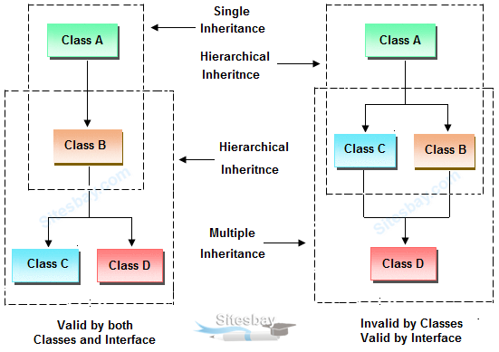
Inheritance Summary
Notes:
Reference Taken From : https://www.sitesbay.com/java/java-inheritance

Slide 77
Advantages & Disadvantages of Inheritance
Advantages
Code Reusability : Inheritance allows us to reuse existing code by inheriting properties and methods from an existing class.
Code Maintenance : Inheritance makes code maintenance easier by allowing us to modify the base class and have the changes automatically reflected in the derived classes.
Code Organization : Inheritance improves code organization by grouping related classes together in a hierarchical structure.
Disadvantages
Tight Coupling : Inheritance creates a tight coupling between the base class and the derived class, which can make the code more difficult to maintain.
Complexity : Inheritance can increase the complexity of the code by introducing additional levels of abstraction.
Fragility : Inheritance can make the code more fragile by creating dependencies between the base class and the derived class.

Slide 78
Abstraction
Section - 11

Slide 79
Abstraction
Data abstraction is the process of hiding certain details and showing only essential information to the user.
Abstraction can be achieved with either abstract classes or interfaces.
The abstract keyword is used for classes and methods:
Abstract class: is a restricted class that cannot be used to create objects (to access it, it must be inherited from another class).
Abstract method: can only be used in an abstract class, and it does not have a body. The body is provided by the derived class (inherited from).
An abstract class can have both abstract and regular methods.

Slide 80
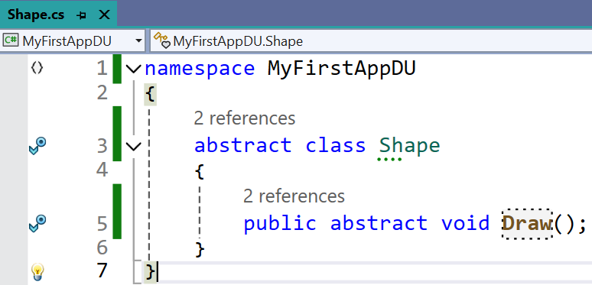
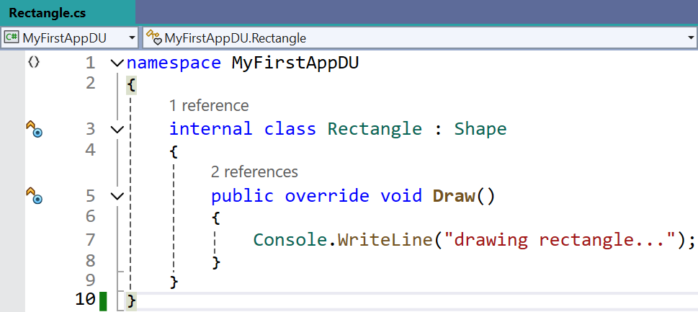
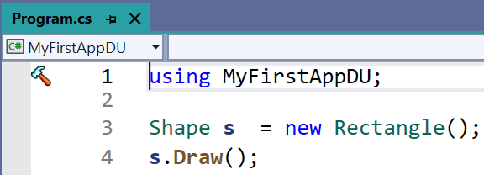
Example: Abstraction

Slide 81

Example: Abstraction
Example
1
2
3
4
5
6
7
8
9
10
11
12
13
14
15
16
17
18
19
20
21
using System;
namespace First_Prg
{
abstract class animal
{
public abstract void eat();
public void sound()
{
Console.WriteLine("dog can sound");
}
}
class dog : animal
{
public override void eat()
{
Console.WriteLine("dog can eat");
}
}
24
25
26
27
28
29
30
31
32
33
34
35
class program
{
static void Main(string[] args)
{
dog mydog = new dog();
animal thePet = mydog;
thePet.eat();
mydog.sound();
}
}
}
Output

Slide 82

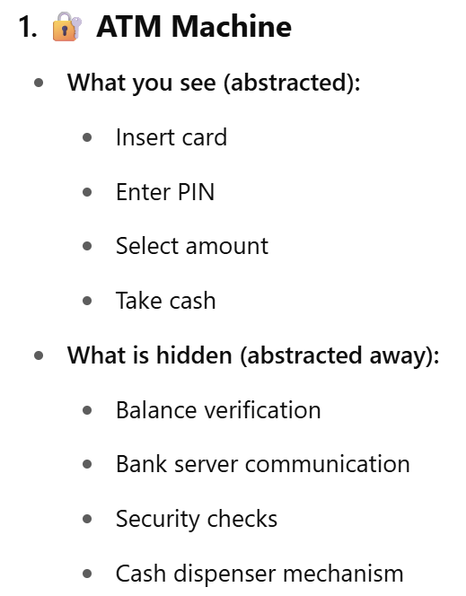




Abstraction Real World Example | Summary

Slide 83
Interface
Section - 12

Slide 84

Interface: Introduction
Interface in C# is a blueprint of a class.
It is like abstract class because all the methods which are declared inside the interface are abstract methods.
It cannot have method body and cannot be instantiated.
An interface cannot contain constructors and fields.
Interface members are by default abstract and public.
It is used to achieve multiple inheritance which can't be achieved by class.
It is used to achieve fully abstraction because it cannot have method body.
Its implementation must be provided by class.
The class which implements the interface, must provide the implementation of all the methods declared inside the interface.
A static & virtual keyword cannot be used with a method that is marked as abstract.

Slide 85

Example: Interface
Example
Output
1
2
3
4
5
6
7
8
9
10
11
12
13
14
15
16
17
18
19
20
21
22
23
24
using System;
namespace First_Prg
{
interface Calculate
{
int add(int a, int b);
}
class Program: Calculate
{
public int add(int a, int b)
{
return a + b;
}
static void Main(string[] args)
{
Program program = new Program();
int sum = program.add(10, 20);
Console.WriteLine("Sum is: {0}",sum);
}
}
}

Slide 86
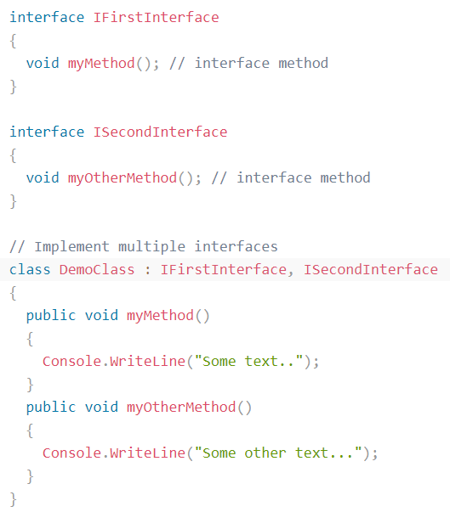
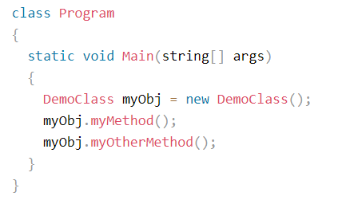
Example: Interface

Slide 87
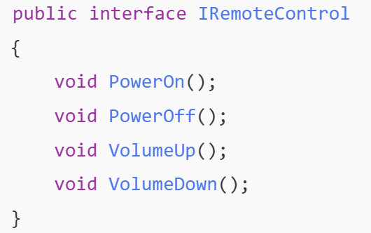
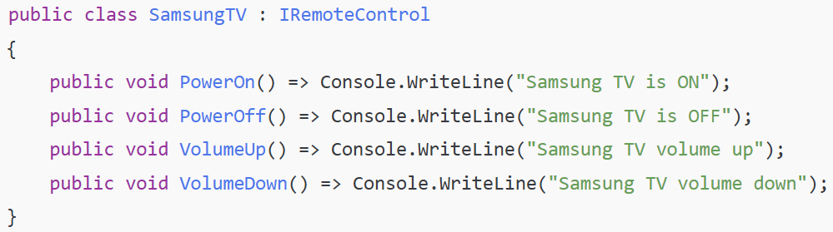
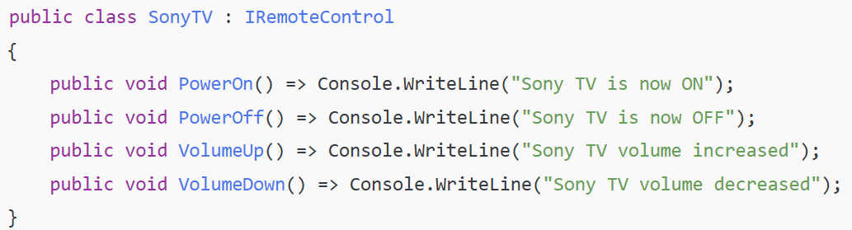

Interface Real World Example
TV Remote Control

Slide 88
Difference Between Interface & Abstraction
Feature | Interface | Abstract Class (Abstraction)
Purpose | Defines a contract with no implementation | Provides a partial implementation + abstraction
Implementation | Cannot have method body (until C# 8 with default methods) | Can have both abstract and concrete methods
Inheritance | A class can implement multiple interfaces | A class can inherit from only one abstract class
Access Modifiers | Methods are public by default | Can have any access modifier (public, protected, private)
State (Fields) | Cannot have fields (only constants) | Can have fields, properties, constructors
When to Use | When you want to enforce capabilities/behavior only | When you want to share common code + enforce behavior
Constructors | ❌ Not allowed | ✅ Allowed
Use Interface when you want to define only behavior (no code sharing).
Use Abstract Class when you want to define behavior + reusable base functionality.

Slide 89
Debugging and Error Handling
Section - 13

Slide 90
Debugging and Error Handling
Exception is a runtime error that arises because of some abnormal conditions, such as division of a number by zero and passing a string to a variable that holds an integer value.
Capturing and handling of runtime error is one of the important and crucial tasks for any programmer.
Compile time errors are those errors that occur during the compilation of a program.
It can happen due to bad coding or incorrect syntax.
We can correct these compile time errors after looking at the error message that the compiler generates.
On the other hand, runtime errors are those errors that occur during the execution of a program, and thus, they cannot be corrected at that time.
So, necessary actions need to be taken beforehand to prevent such types of errors.
To do so, you should first identify the following two aspects.
Find out those parts of a program which can cause runtime errors
How to handle those errors when they occur

Slide 91
Exception Handling
Exceptions can be handled by using the following two statements.
The try…catch…finally statement
The throw statement
try
The try block encloses the statements that might throw an exception.
catch
The catch block handles the exceptions thrown by the try block.
In a program, a try block can contain one or more catch blocks.
finally
It is an optional block and is always executed.
If no exception occurs inside the try block, the program control is transferred directly to the finally block.
try block
Code throws an exception?
Yes
catch block
No
finally block
All Errors Processed

Slide 92
Built-in Exception Classes
Class | Description
SystemException | Represents a base class for other exception classes
DivideByZeroException | Occurs if you try to divide a number by zero
IndexOutOfRangeException | Occurs if the index of an array is out of bound
FormatException | Occurs if there is an incorrect format of argument
OutOfMemoryException | Occurs if an execution stops due to lake of memory
StackOverflowException | Occurs if a stack overflows

Slide 93

Example: Exception Handling without try..catch
Output :
Unhandled exception.System.DivideByZeroException: Attempted to divide by zero in
line 3

Slide 94


Example: Exception Handling try..catch Cont..
Output :

Slide 95

Example: Exception Handling try..catch..finally Cont..
Output :
Exception caught: System.DivideByZeroException: Attempted to divide by zero. at Program.<Main>$(String[] args) in Program.cs:line 6
Result: 0

Slide 96


Example: Exception Handling try..catch..finally Cont..
Output :

Slide 97


Example: try with multiple catch blocks

Slide 98

The throw Statement
The throw statement allows us to create a custom error also.
It is used together with an exception classes.
Unhandled exception.System.DivideByZeroException: Attempted to divide by zero in line 3

Slide 99
Collection Classes
Section - 14

Slide 100
Collection Classes: Introduction
We mostly use arrays to store and manage data.
However, arrays can store a particular type of data, such as integer and characters.
To resolve this issue, the framework introduces the concept of collections for data storage and retrieval, where collection means a group of different types of data.
In arrays, you need to define the number of elements at declaration time (Dynamic Array).
But in a collection, you don't need to define the size of the collection in advance.
You can add elements or even remove elements from the collection at any point of time.

Slide 101
Collections Classes Types
The System.Collections namespace contains the non-generic collection types and System.Collections.Generic namespace includes generic collection types.
Generic Collections | Non-generic Collections
List<T> | ArrayList
Dictionary<TKey,TValue> | Bit Array
SortedList<TKey,TValue> | SortedList
Queue<T> | Queue
Stack<T> | Stack
Hashset<T> | Hashtable

Slide 102
Collection Classes (Non-generic)
The .NET Framework provides you a variety of collection classes, which are available in the System.Collections namespace.
Most useful collection classes defined are as follows.
ArrayList Class
Stack Class
Queue Class
Hashtable Class
BitArray Class

Slide 103
ArrayList Class
Similar to an array, the ArrayList class allows you to store and manage multiple elements.
Using an arrays, the main problem arises is that their size always remain fixed by the number that you specify when declaring an arrays.
In addition, you cannot add or remove items in the middle of array.
Also you can not deal with different data types.
The solution to these problems is the use of ArrayList Class, it allocated size dynamically and it gets double after elements value is filled.
With the ArrayList class, you can add and remove items from a list of array items from a specified position, and then the array items list automatically resizes itself accordingly.

Slide 104

Example – ArrayList Class
using System;
using System.Collections;
namespace MyFirstApp
{
class Program
{
static void Main(string[] args)
{
ArrayList A1 = new ArrayList();
A1.Add(10);
A1.Add("Hello");
A1.Add(true);
Console.WriteLine(A1[0]);
Console.WriteLine(A1[1]);
Console.WriteLine(A1[2]);
Console.ReadLine();
}
}
}
Output :

Slide 105

Example – ArrayList Class
using System;
using System.Collections;
namespace MyFirstApp
{
class Program
{
static void Main(string[] args)
{
ArrayList A1 = new ArrayList();
A1.Add(10); A1.Add("Hello"); A1.Add(true);
Console.WriteLine(A1.Count);
Console.WriteLine(A1.Contains(10));
Console.WriteLine("-------------------");
Console.WriteLine(A1[1]);
A1.RemoveAt(1);
Console.WriteLine(A1[1]);
Console.ReadLine();
}
}
}
Output :

Slide 106


Example – ArrayList Class

Slide 107
Stack Class
The stack class represents a last in first out (LIFO) concept.
let's take an example. Imagine a stack of books with each book kept on top of each other.
The concept of last in first out in the case of books means that only the top most book can be removed from the stack of books.
It is not possible to remove a book from between, because then that would disturb the setting of the stack.
Hence in C#, the stack also works in the same way.
Elements are added to the stack, one on the top of each other.
The process of adding an element to the stack is called a push operation.
The process of removing an element from the stack is called a pop operation.

Slide 108

Example – Stack Class (Push)
using System;
using System.Collections;
namespace MyFirstApp
{
class Program
{
public static void Main(string[] args)
{
Stack st = new Stack();
st.Push(1);
st.Push(2);
st.Push(3);
foreach (Object obj in st)
{
Console.WriteLine(obj);
}
Console.WriteLine("Total elements in the stack " + st.Count);
Console.WriteLine("Stack contain element 3? " + st.Contains(3));
Console.ReadLine();
}
}
}
Output :

Slide 109

Example – Stack Class (Pop)
using System;
using System.Collections;
namespace MyFirstApp
{
class Program
{
public static void Main(string[] args)
{
Stack st = new Stack();
st.Push(1);
st.Push(2);
st.Push(3);
st.Pop();
foreach (Object obj in st)
{
Console.WriteLine(obj);
}
Console.ReadLine();
}
}
}
Output :

Slide 110
Queue Class
The Queue class represents a first in first out (FIFO) concept.
let's take an example. Imagine a queue of people waiting for the bus.
Normally, the first person who enters the queue will be the first person to enter the bus.
Similarly, the last person to enter the queue will be the last person to enter into the bus.
The process of adding an element to the queue is the Enqueue operation.
The process of removing an element from the queue is the Dequeue operation.

Slide 111

Example – Queue Class (Enqueue)
using System;
using System.Collections;
namespace MyFirstApp
{
class Program
{
public static void Main(string[] args)
{
Queue qt = new Queue();
qt.Enqueue(1);
qt.Enqueue(2);
qt.Enqueue(3);
foreach (Object obj in qt)
{
Console.WriteLine(obj);
}
Console.WriteLine("Total elements in the queue =" + qt.Count);
Console.WriteLine("Queue contain element 3? " + qt.Contains(3));
Console.ReadLine();
}
}
}
Output :

Slide 112

Example – Queue Class (Dequeue)
using System;
using System.Collections;
namespace MyFirstApp
{
class Program
{
public static void Main(string[] args)
{
Queue qt = new Queue();
qt.Enqueue(1);
qt.Enqueue(2);
qt.Enqueue(3);
qt.Dequeue();
foreach (Object obj in qt)
{
Console.WriteLine(obj);
}
Console.ReadLine();
}
}
}
Output :

Slide 113
Hashtable Class
The Hashtable class is similar to the ArrayList class, but it allows you to access the items by a key.
Each item in a Hashtable object has a key/value pair.
So instead of storing just one value like the stack, array list and queue, the Hashtable stores 2 values that is key and value (hashcode).
The key is used to access the items in a collection and each key must be unique, whereas the value is stored in an array.
The keys are short strings or integers.
There is no direct way to display the elements of a Hashtable.
{ "1" , “Darshan" }
{ "2" , “Institute " }
{ "3" , "of Engg. & Technology" }
This is done via the ICollection interface. (This is a special data type which can be used to store the keys of a Hashtable collections)

Slide 114


Example – Hashtable Class

Slide 115

Example – Hashtable Class
using System;
using System.Collections;
namespace MyFirstApp
{
class Program
{
public static void Main(string[] args)
{
Hashtable ht = new Hashtable();
ht.Add("1", "Darshan");
ht.Add("2", "Institute");
ht.Add("3", "of Engg. & Technology");
ICollection keys = ht.Keys;
foreach (String k in keys)
{
Console.WriteLine(ht[k]);
}
Console.ReadLine();
}
}
}
Output :

Slide 116
BitArray Class
The BitArray class is used to manage an array of the binary representation using the value 1 and 0, where 1 stands for true and 0 stands for false.
A BitArray object is resizable, which is helpful in case if you do not know the number of bits in advance.
You can access items from the BitArray collection class by using an integer index.
A BitArray can be used to perform Logical AND, XOR, OR operations.

Slide 117

Example – BitArray Class
using System;
using System.Collections;
namespace MyFirstApp
{
class Program
{
public static void Main(string[] args)
{
BitArray ba = new BitArray(4);
ba[0] = true;
ba[1] = false;
ba[2] = true;
ba[3] = false;
foreach (Object obj in ba)
{
Console.WriteLine(obj);
}
Console.ReadLine();
}
}
}
Output :

Slide 118
Generics
Section - 15

Slide 119
Generics: Overview
In C#, generics allow you to write reusable, type-safe code by using placeholder type parameters (<T>).
T is a type parameter (T = Type), you can use any letter instead of T, but T is convention.
Generic code is evaluated at compile time.
Works with both reference types (classes) and value types (structs).
Instead of duplicating logic for int, string, or custom objects, you write the class or method once, and the specific data type is assigned when the code is executed.
Advantages of Generics
Write code once and reuse it for many data types.
Compile-time type checking reduces runtime errors.
Eliminates unnecessary casting.
Better performance by avoiding boxing and unboxing.
Makes code cleaner, reusable, and easier to maintain.

Slide 120
Generics Cont..
Most Common Generic - List<T>
1
2
3
4
5
6
7
8
9
List<string> names = new List<string>();
names.Add("Naimish");
names.Add("Jayesh");
// names.Add(123); // ERROR! Only strings allowed
List<int> numbers = new List<int> { 1, 2, 3, 4, 5 };
numbers.Add(1);
numbers.Add(2);
// numbers.Add("Naimish"); // ERROR! Only integers allowed

Slide 121
Generics Cont..
Generic Class
1
2
3
4
5
6
7
8
9
10
11
12
13
14
15
16
17
18
19
// Generic class
public class Box<T>
{
public T Item { get; set; }
public void Display()
{
Console.WriteLine($"Box contains: {Item}");
}
}
// Usage
Box<string> stringBox = new Box<string>();
stringBox.Item = "Books";
stringBox.Display(); // Output: Box contains: Books
Box<int> numberBox = new Box<int>();
numberBox.Item = 42;
numberBox.Display(); // Output: Box contains: 42

Slide 122
Generics Cont..
Generic Method
1
2
3
4
5
6
7
8
9
10
11
12
13
14
public class Program
{
private static T GetValue<T>(T input)
{
return input;
}
// Usage
private static void Main()
{
string text = GetValue<string>("Hello"); // Returns "Hello"
int number = GetValue<int>(100); // Returns 100
}
}

Slide 123
Building RESTful APIs with ASP.NET Core
#2401CS521
Prof. Naimish R. Vadodariya
Computer Science & Engineering Department
Naimish.vadodariya@darshan.ac.in
8866215253

