Slide 1

Unit-1 | Part - II Introduction to .NET Web API
Building RESTful APIs with
ASP.NET Core
#2401CS521
Prof. Naimish R. Vadodariya
Computer Science & Engineering Department
Naimish.vadodariya@darshan.ac.in
8866215253

Slide 2

Looping
Outline
What is Web API?
Understanding HTTP Protocol
HTTP Request and Response Components
HTTP Methods/Verbs
HTTP Status Codes
Problems Without Web APIs
Key Characteristics of Web APIs
JSON (JavaScript Object Notation)

Slide 3
What is API? (Application Programming Interface)
Section - 1

Slide 4

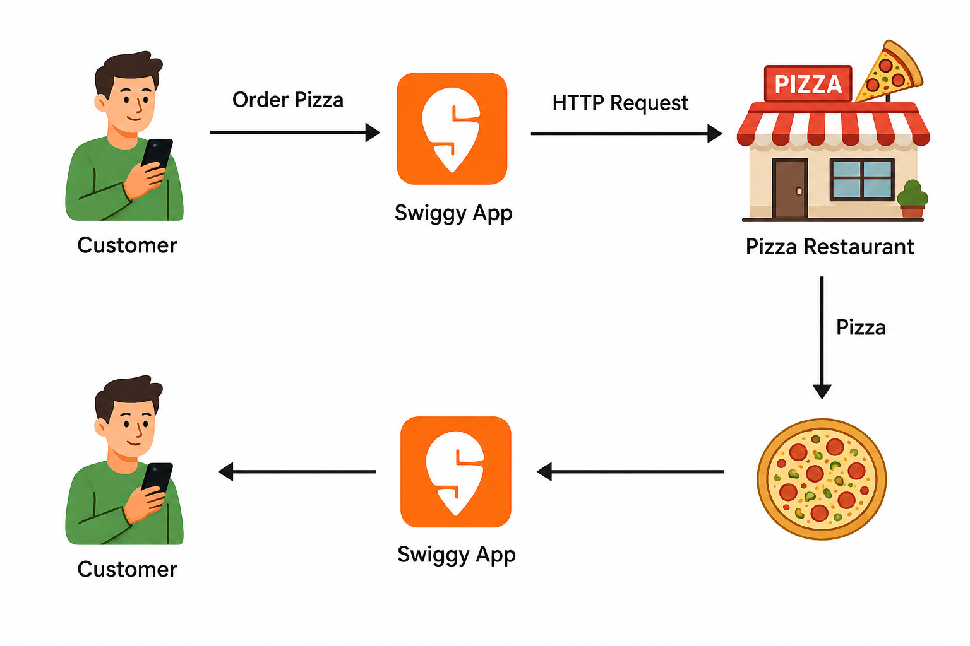
What is Web API?
A Web API (Application Programming Interface) is a software interface that allows one application to communicate with another over the internet using HTTP.
Simply, A Web API is a messenger between Client and Server.
Web API
Here Client can be Mobile Apps, Web Browsers, Smart Devices, Postman, Scalar. (For Request & Response Handling)
Client
Client

Slide 5
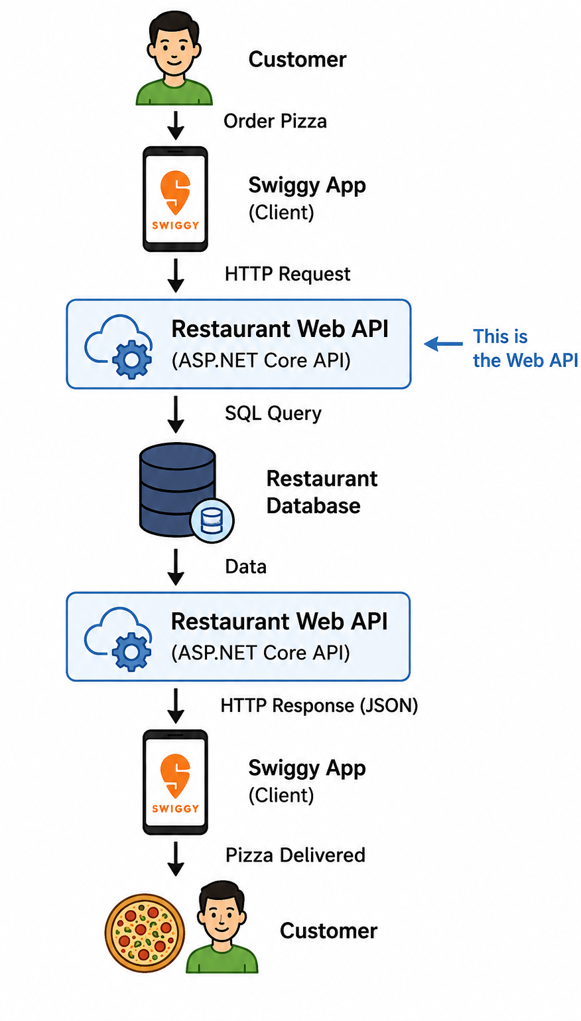
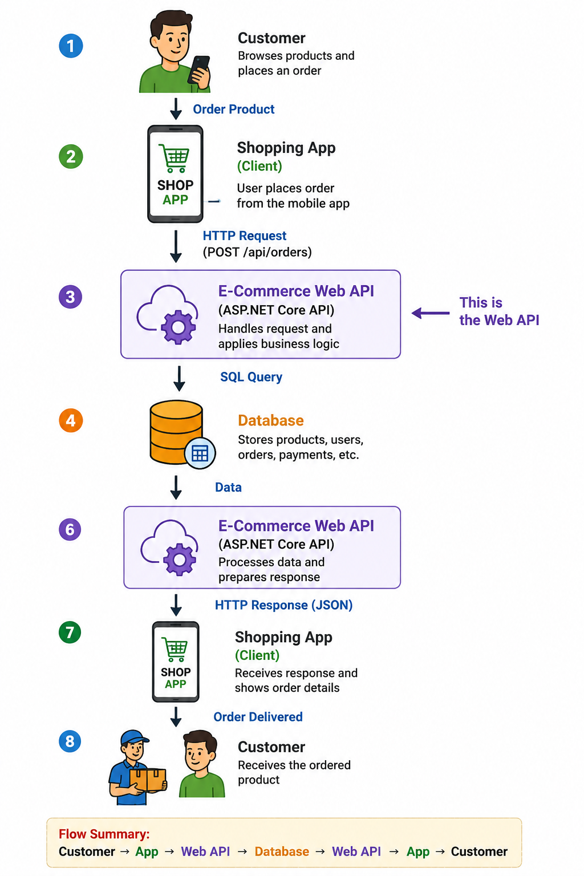
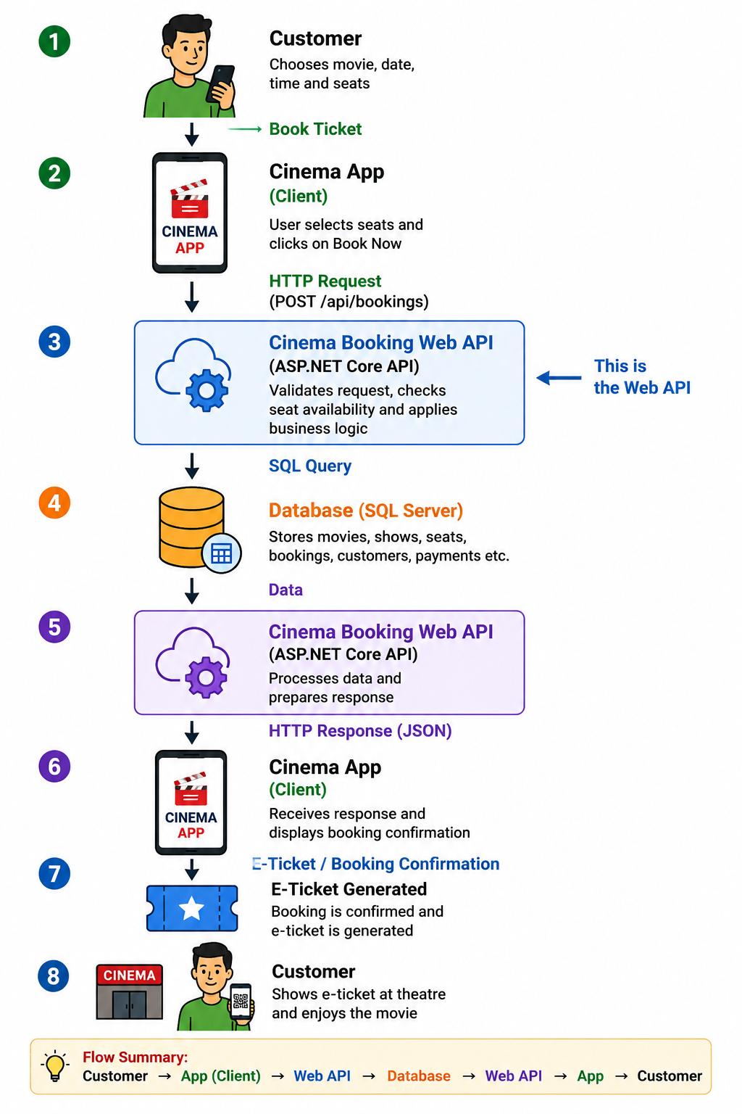
Web API Examples

Slide 6


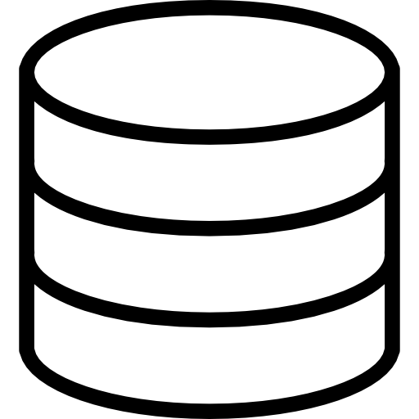



Need of API
We aim to establish communication between all these Android, iOS & web applications to the database.
So, what will we do? We will create a new separate project for all the platforms.
This individual application will interact with the database.
But this is totally wrong practice, because separate coding, separate logic & separate files.
So, what we have to do is to create an API Project and all these applications (frontend) will connect to it.
Database
Web API
Database

Slide 7
Need of API Cont..
So, these websites, Android and iOS applications, do not have direct access to the database.
They only need to communicate with the Web APIs, and it is the Web API project’s responsibility to interact with the database.
The entire business logic will be written in the Web API project only.
So, Web API acts as a mediator between the Front-End and Back-End.
Web API
Database

Slide 8
HTTP (HyperText Transport Protocol)
Section - 2

Slide 9
HTTP (HyperText Transport Protocol)
How Browser and Server Communicate with Each Other?
What is HTTP?
HTTP Request/Response Components
HTTP Verbs or HTTP Methods
HTTP Status Codes

Slide 10
1. How Browser and Server Communicate with Each Other?
Suppose, we open the web browser, type the URL in the browser and press the enter button.
As soon as you press enter, a request is going to the server (called a web server).
Whatever data you are sending from the web browser to the web server is called a Request and whatever data you are receiving from the web server is called a Response & this type of communication is only possible by using HTTP Protocol.
So, the request can be termed an HTTP Request and the response can be called HTTP Response.
For example, if you are using a mobile application, then your mobile is a client.
https://darshan.ac.in/
HTTP Request
Server
HTTP Response
Web Browser
Web Server

Slide 11
2. What is HTTP?
HTTP stands for HyperText Transfer Protocol.
It is an application-layer protocol used for communication on the World Wide Web.
It is also called as communication protocol.
It is used to send and receive web pages and files on the internet.
It serves as a foundation for exchanging information between a web server and a client, typically a web browser.
HTTP enables the retrieval of resources such as HTML documents, images, videos, and other media files, allowing users to access websites and navigate the internet.
It follows a request-response model, where a client sends an HTTP request to a server, and the server responds with an HTTP response containing the requested information.

Slide 12
3. HTTP Request Components
An HTTP request is made by the client to request a resource from the server, and the server responds with an HTTP response containing the requested resource or an error message.
When we send something from the client (browser, mobile, postman etc.) to the server (webserver) is called a Request.
The request is formed with a couple of components, are as follows.
Component | Description
URL | Each Request must have a unique URL
Verb (Method) | Each Request must have an HTTP Verb (Majorly GET, POST, PUT & DELETE)
Header(s) | Each Request can contain one or more Headers
Body | Each request can have a body. The body contains the data that we want to send to the server.
Web Browser, Mobile App, Postman, Scalar
HTTP Request
Server
Clients
Web Server
URL, Verb, Header, Body

Slide 13
3. HTTP Response Components
Whatever we get from the webserver to the clients is called HTTP Response.
The HTTP response contains the following components.
Component | Description
HTTP Status Code | It must have a Status Code
Response Headers | It can have one or more response headers
Data | Response can have data i.e. return to the client
Web Browser, Mobile App, Postman, Scalar
HTTP Response
Server
Clients
Web Server
Http Status Code, Response Header(s), Data

Slide 14
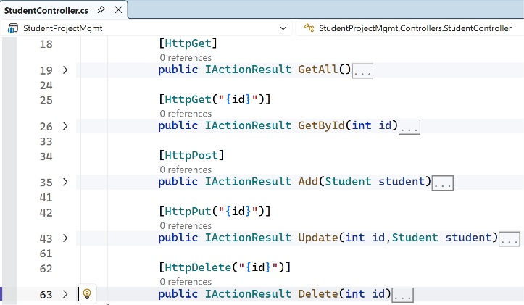
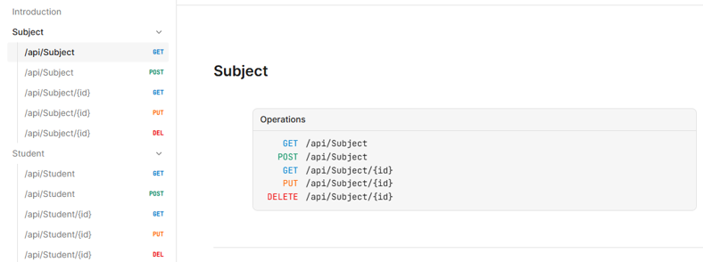
4. HTTP Verbs or HTTP Methods
HTTP verbs, also known as HTTP methods, are a set of standardized actions that can be performed on resources using the HTTP (Hypertext Transfer Protocol) protocol.
Each HTTP request typically includes a verb/method to indicate the desired action to be taken.
The primary or most-commonly-used HTTP verbs are POST, GET, PUT, and DELETE.

Slide 15
4. HTTP Verbs or Methods – Real-World Analogies
Remember
HTTP Method | Usage | Response | Idempotent
GET (Read) | Fetch data | 200 OK with data | ✅ Yes
POST (Create) | Submit new resource | 201 Created / 200 OK | ❌ No
PUT (Update) | Update full resource | 200 OK / 204 No Content | ✅ Yes
PATCH (Update[Partial]) | Update part of a resource | 200 OK / 204 No Content | ✅ Yes (ideally)
DELETE (Delete) | Remove resource | 204 No Content | ✅ Yes

Slide 16
4. HTTP Verbs or HTTP Methods (PUT v/s PATCH)
Method | Description
PUT | The PUT method is used to update all the properties of the current resource in the database. If we want to update all properties of a particular product (i.e. current resource) then we need to use PUT HTTP Request. So, whenever you want to update all the properties (column) of a resource (existing record in the database) It is idempotent.
PATCH | There are some situations where you don’t want to update all the properties of an existing resource instead you want to update a few of the properties, then you need to use the PATCH method. So, the PATCH method is similar to the PUT method, but it is used to update a few properties of the current resource in the database. For example, if you want to update a few properties (columns) of an existing product then you need to use the PATCH method. That means if your Product table contains 10 columns, and you want to update only four columns of an existing product, then you need to use the PATCH method. So, it applies partial modifications to a resource. It is used to update only specific parts of a resource, rather than replacing the entire resource.

Slide 17
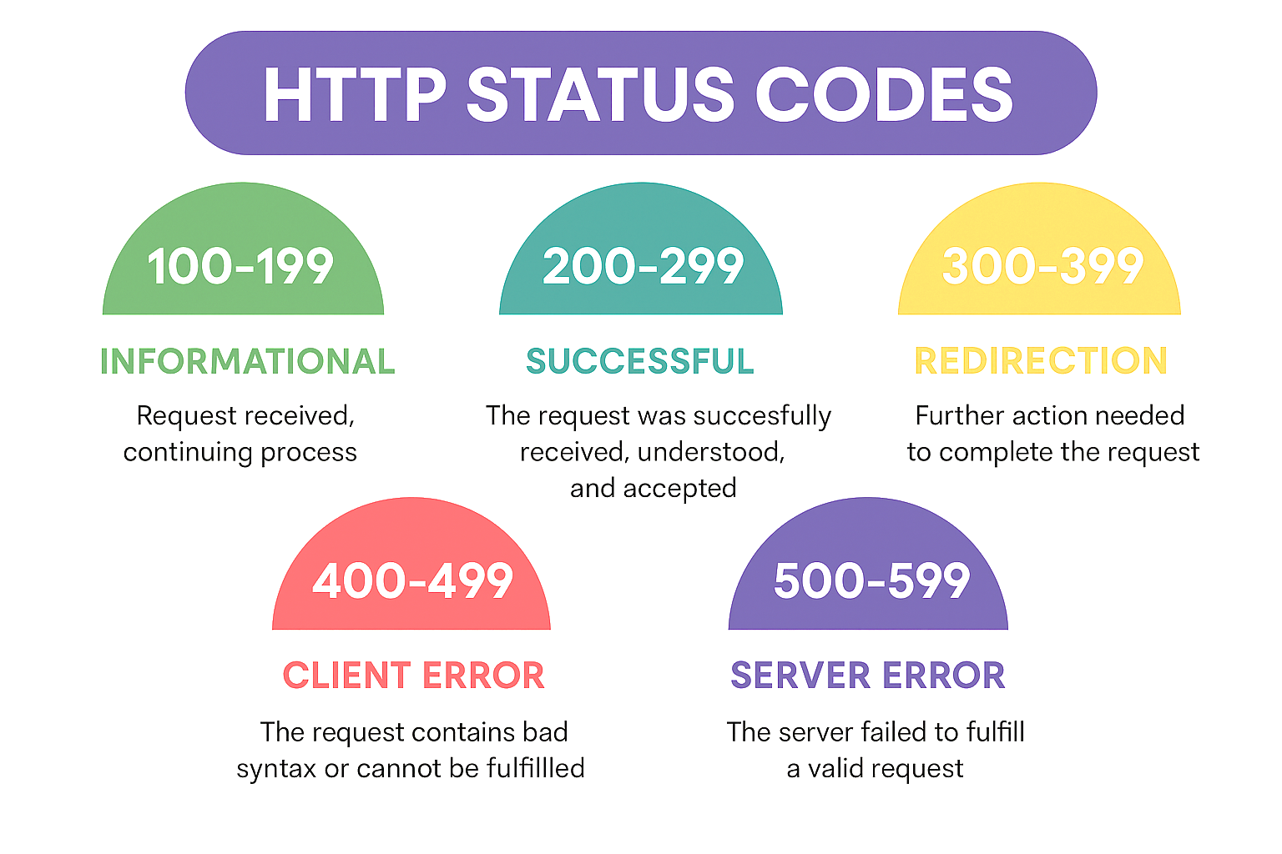
5. HTTP Status Codes

Slide 18
5. HTTP Status Codes Cont..
1XX: Informational Response (Example: 100, 101, 102, etc.)
Status codes in the 1xx range indicate that the server has received the client’s request and is continuing the process.
These codes are primarily used for informational purposes and do not typically require any action from the client.
2XX: Successful Response (Example. 200, 201, 203, 204, etc.)
Whenever you get 2XX as the response code, it means the request is successful.
Status codes in the 2xx range indicate that the client’s request was successfully received, understood, and accepted by the server.
These codes typically indicate that the requested action was successfully completed.
3XX: Redirection Response (Example. 301, 302, 304, etc.)
Whenever you get 3XX as the response code, it means it is re-directional i.e. some re-directional is happening on the server.
Status codes in the 3xx range indicate that further action is needed by the client to complete the request.
These codes are used when a resource has been moved or is temporarily unavailable, and the client needs to take additional steps to access the resource.

Slide 19
5. HTTP Status Codes Cont..
4XX: Client Error Response (Example: 400, 401, 404, 405, etc.)
Whenever you get 4XX as the response code, it means there is some problem with your request.
Status codes in the 4xx range indicate that the client’s request was not successful due to an error on the client’s side.
These codes are often associated with issues such as invalid requests, unauthorized access, or missing resources.
5XX: Server Error Response (Example: 500, 502, 503, 504, etc.)
Whenever you get 5XX as the response code, it means there is some problem in the server.
Status codes in the 5xx range indicate that the server encountered an error while processing the client’s request.
These codes are typically associated with issues on the server side, indicating that the requested action could not be completed due to server-related problems.

Slide 20
Problems Without Web APIs
Section - 2

Slide 21
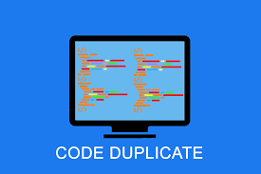

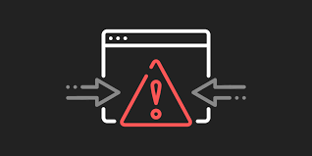

Problems Without Web APIs
1. Duplicate logic for each Application
The business should have some business logic. We will write the same logic for each application type, which means repeating the same logic for each type of application. This will duplicate our code.
3. Some Front-end frameworks cannot communicate directly with the Database
If you are developing the website (i.e., front-end) using the angular framework, then the angular framework cannot communicate with the database directly. Angular is a front-end framework.
2. Error-Prone Code
The business logic has been written in each type of application. We have to write the code in three different applications in our example. So, you might miss some code or logic in some applications. This will add more errors to your application.
4. Hard to Maintain
This type of structure is hard to maintain. This is because we have written the code in many places, and if we want to improve something in our application, we need to do the same thing in many places.

Slide 22
Key Characteristics of Web APIs
Section - 4

Slide 23
Key Characteristics of Web APIs
HTTP-based Communication:
Most Web APIs are designed to work over HTTP, the same protocol used for web browsing.
This means APIs can be accessed using standard HTTP methods like GET, POST, PUT, DELETE, etc.
The API endpoints are typically represented as URLs (Uniform Resource Locators).
Data Exchange Formats:
Web APIs use standardized data exchange formats such as JSON (JavaScript Object Notation) and XML (eXtensible Markup Language) to structure and transmit data between the client and server.
JSON has become the most popular format due to its simplicity and ease of use.
RESTful Architecture:
Many Web APIs are designed following Representational State Transfer (REST) principles.
A RESTful API is stateless, uses standard HTTP methods, and organizes resources into a hierarchy with unique URLs for each resource.
Authentication and Authorization:
Web APIs often implement security mechanisms for authentication and authorization to ensure that only authorized clients can access certain resources or perform specific actions.
Common authentication methods include API Keys, OAuth, and JWT (JSON Web Tokens).

Slide 24
JSON (JavaScript Object Notation)
Section - 5

Slide 25
What is JSON?
JSON (JavaScript Object Notation) is a lightweight data-interchange format that is easy for humans to read and write and for machines to parse and generate.
Many different programming languages use JSON which is a great way to ensure that different systems can work together and understand each other’s data.
It uses human-readable text to store and transmit data objects consisting of attribute–value pairs and arrays (or other serializable values).
JSON is a language-independent data format.
JSON is “name/value” assembly. Its structure is made up with {}, [], comma, colon and double quotation marks.
Valid data types in JSON are Object, Number, Boolean, String, Array, Null.
JSON filenames use the extension .json.
It is commonly used for transmitting data between a server and a web application as an alternative to XML, and has many business applications.

Slide 26
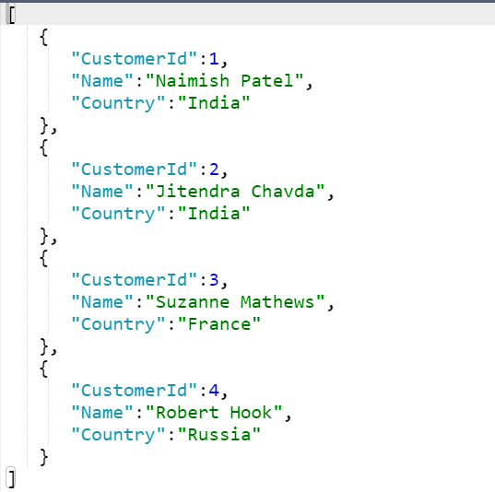
Example: JSON string returned from the API
Sample JSON
In .NET, we have two most common libraries to handle JSON:
Newtonsoft.Json
Third-party powerful library with many features, including support for complex object graphs, custom converters, and more.
System.Text.Json
High-performance JSON serialization and deserialization library introduced by Microsoft.
using System.Text.Json;
//To serialize
var jsonStr = JsonSerializer.Serialize(MyObject);
//To Deserialize
var weather = JsonSerializer.Deserialize<MyObject>(jsonStr);

Slide 27
Difference between JSON serialize and JSON deserialize?
Serialization
Serialization means to convert an object into that string. (Object → String)
Serialization is the process of converting the state of an object, that is, the values of its properties, into a form that can be stored or transmitted.
The serialized form doesn't include any information about an object's associated methods.
So, serialization converts the object into a shareable format.
Deserialization
Deserialization is its inverse operation (String → Object).
Deserialization is the process of converting the serialized stream of data into the original object state.
This ensures that the original state is not altered and is recreated when we need it.

Slide 28
JSON Serialization Example
//Student.cs
namespace SerializeDemo
{
public class Student
{
public int StudentID { get; set;} public string Name { get; set; }
public string City { get; set; }
}
}
//Program.cs
using SerializeDemo;
using Newtonsoft.Json;
Student std = new Student()
{
StudentID = 101,
Name = "Naimish",
City = "Rajkot"
};
string jsonData = JsonConvert.SerializeObject(std);
Console.WriteLine(jsonData);
Output

Slide 29
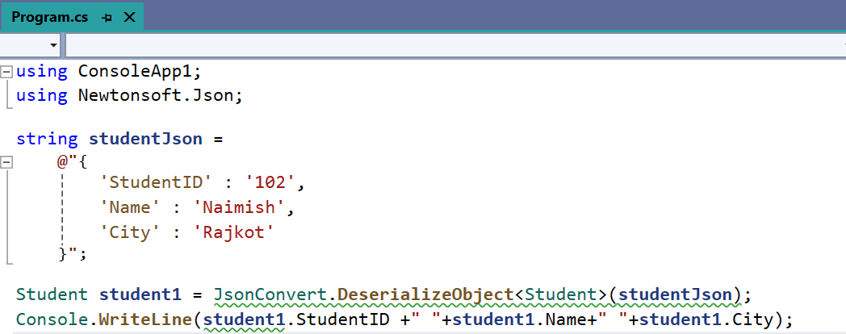
JSON Deserialization Example
Output

Slide 30
Different styles of JSON
Object
An unordered “name/value” assembly.
An object begins with “{“ and ends with “}”.
Behind each “name”, there is a colon. And comma is used to separate much “name/value”.
Array (Multiple Objects)
Value order sets, an array begins with “[“ and end with “]”.
Values are separated with commas.
String
Any quantity Unicode character assembly which is enclosed with quotation marks.
It uses a backslash to escape.

Slide 31
Building RESTful APIs with
ASP.NET Core
#2401CS521
Prof. Naimish R. Vadodariya
Computer Science & Engineering Department
Naimish.vadodariya@darshan.ac.in
8866215253

