Slide 1


DEEPFAKE DETECTION USING LSTM AND RESNET50
A HYBRID DEEP LEARNING APPROACH FOR VIDEO AUTHENTICITY VERIFICATION
Presented By
Nikhil Rajiv(CB.SC.P2AIE25014),

Slide 2
RESEARCH PROBLEM & JUSTIFICATION (WHAT & WHY)
THE DEEPFAKE CHALLENGE
  Problem Understanding:
    Deepfakes are AI-generated fake videos that manipulate facial features and expressions
    Growing threat to information integrity, privacy, and security
    Used for misinformation, fraud, and identity theft
    Traditional detection methods struggle with evolving deepfake generation techniques
  Why This Matters:
    96% of deepfakes are used maliciously (source: Sensity AI)
    Can damage reputations, manipulate elections, and enable fraud
    Need for automated, accurate detection systems
    Our Objective: Develop a hybrid deep learning model that can automatically distinguish between real and fake videos with high accuracy by analyzing both spatial and temporal features.

Slide 3
Dataset
Deepfake Detection Challenge Dataset
Dataset Characteristics:
  Total Videos Processed: 400 videos
  Real Videos: 200 samples
  Fake Videos: 200 samples (created using various deepfake algorithms)
  Frames Extracted: 5,464 face-cropped frames
  Frames per Video: 15 frames (evenly distributed)
  Image Resolution: 128×128 pixels
Preprocessing Steps:
  Face detection using Haar Cascade classifier
  Frame extraction at regular intervals
  Face cropping and resizing
  Normalization to [0, 1] range
Data Split:
  Training Set: 80% (278 sequences)
  Validation Set: 20% (70 sequences)

Slide 4
ARCHITECTURE
HYBRID CNN-LSTM ARCHITECTURE
KEY COMPONENTS:
1. Feature Extraction Layer (ResNet50)
  Pre-trained on ImageNet
  Extracts 2,048 spatial features per frame
  Identifies visual artifacts: blurring, inconsistent textures, lighting anomalies
2. Temporal Analysis Layer (LSTM)
  512 LSTM units
  Analyzes feature sequences across 15 frames
  Captures temporal inconsistencies: flickering, unstable features
  Remembers patterns over time using memory cells
3. Classification Layers
  Dense layer (128 units) with ReLU activation
  Dropout (60%) for regularization
  Output layer: 2 classes (Real/Fake) with softmax activation

Slide 5
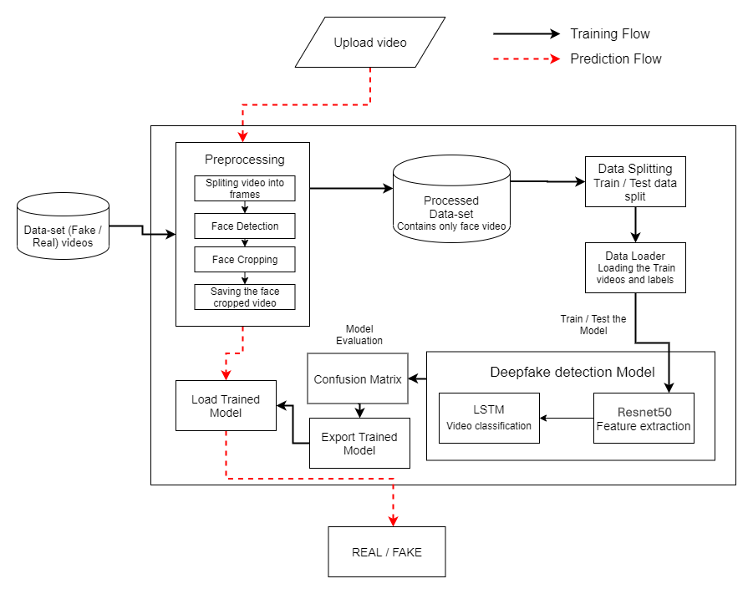
ARCHITECTURE DIAGRAM

Slide 6
AI LOGIC - HOW IT WORKS
Spatial Feature Analysis (ResNet50):
  What it detects: Visual inconsistencies in individual frames
    Examples: Unnatural skin textures
          Blurred boundaries around faces
          Lighting inconsistencies
          Color artifacts
          Abnormal facial geometry
Temporal Pattern Recognition (LSTM):
  What it detects: Inconsistencies across time
    Examples: Flickering facial features
          Unstable eye movements
          Inconsistent lighting changes
          Unnatural head movements
          Frame-to-frame discontinuities
Why This Combination Works:
  Real videos: Smooth spatial AND temporal consistency
  Fake videos: May look good in single frames but show temporal artifacts
  LSTM remembers patterns → Detects subtle inconsistencies humans might miss

Slide 7
METHODOLOGY - TRAINING STRATEGY
Optimization Strategy:
  Optimizer: Adam (learning rate: 5×10⁻⁶)
  Loss Function: Binary Cross-Entropy
  Batch Size: 4 sequences
  Epochs: 50 (with early stopping)
  Class Weights: Real (1.15), Fake (1.05) - balanced for better real detection
Data Augmentation:
  Horizontal flipping, Rotation (±10 degrees), Zoom (10% range)
  Preprocessing: ResNet50 normalization
Regularization Techniques:
  Dropout: 60% (prevents overfitting)
  Early Stopping: Patience of 10 epochs

Slide 8
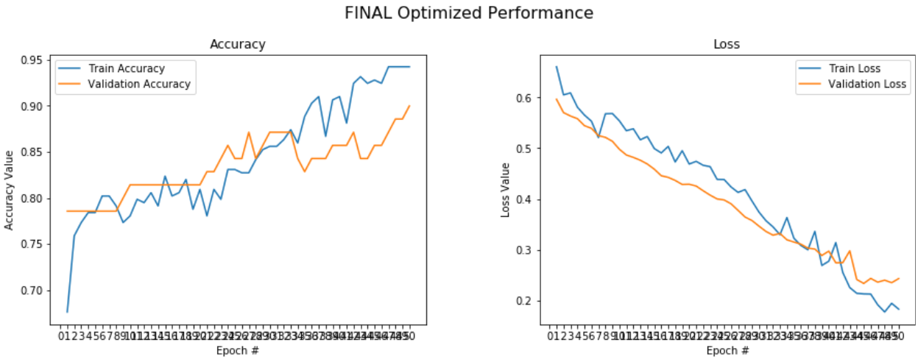
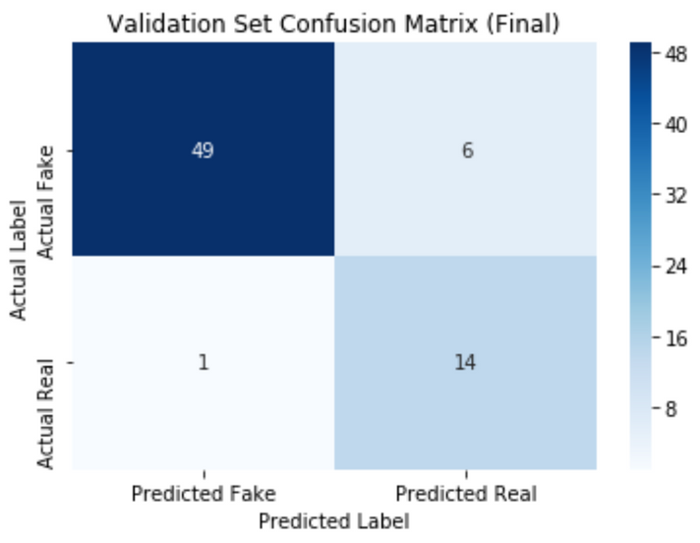
RESULT
Accuracy Curve:
  Started at 67.6%, reached 94.2% on training
  Validation accuracy: 78.6% → 90.0%
  Steady improvement with minimal fluctuation
  Good generalization (small train-val gap)
Loss Curve:
  Training loss: 0.662 → 0.182
  Validation loss: 0.596 → 0.232
  Consistent decrease indicates proper learning
  No significant overfitting observed
Training Characteristics:
  Model converged smoothly without early stopping
  Learning rate scheduling helped optimization
  Class weighting improved real video detection
  Data augmentation prevented overfitting
TRUE NEGATIVES (FAKE→FAKE): 49 ✓
TRUE POSITIVES (REAL→REAL): 14 ✓
FALSE POSITIVES (FAKE→REAL): 6 ✗
FALSE NEGATIVES (REAL→FAKE): 1 ✗

Slide 9
CONCLUSION
Achieved 90% validation accuracy on challenging dataset
Demonstrated effective combination of spatial and temporal analysis
Created end-to-end pipeline: preprocessing → training → evaluation
Technical Contributions:
  Implemented transfer learning with fine-tuned ResNet50
  Applied LSTM for temporal consistency verification
  Optimized training with regularization and data augmentation
  Achieved production-ready performance metrics
Impact:
  Provides automated tool for video authenticity verification
  Contributes to combating misinformation
  Foundation for more advanced detection systems

Slide 10
THANK
YOU

