Slide 1


























ECOCAMPUS IIT ROORKEE
“Turning IIT Roorkee’s 5,500 kg/day Waste Liability into a Self-Funding Circular Economy through 4-Way Incentive Alignment.”
Team Name: Team EcoCampus | SOCIOTHON 2026 (NSS IIT Roorkee × OSEN × Craftora)
Live Prototype: github.com/NIKHILESH-TS/EcoCampus-IITR

Slide 2
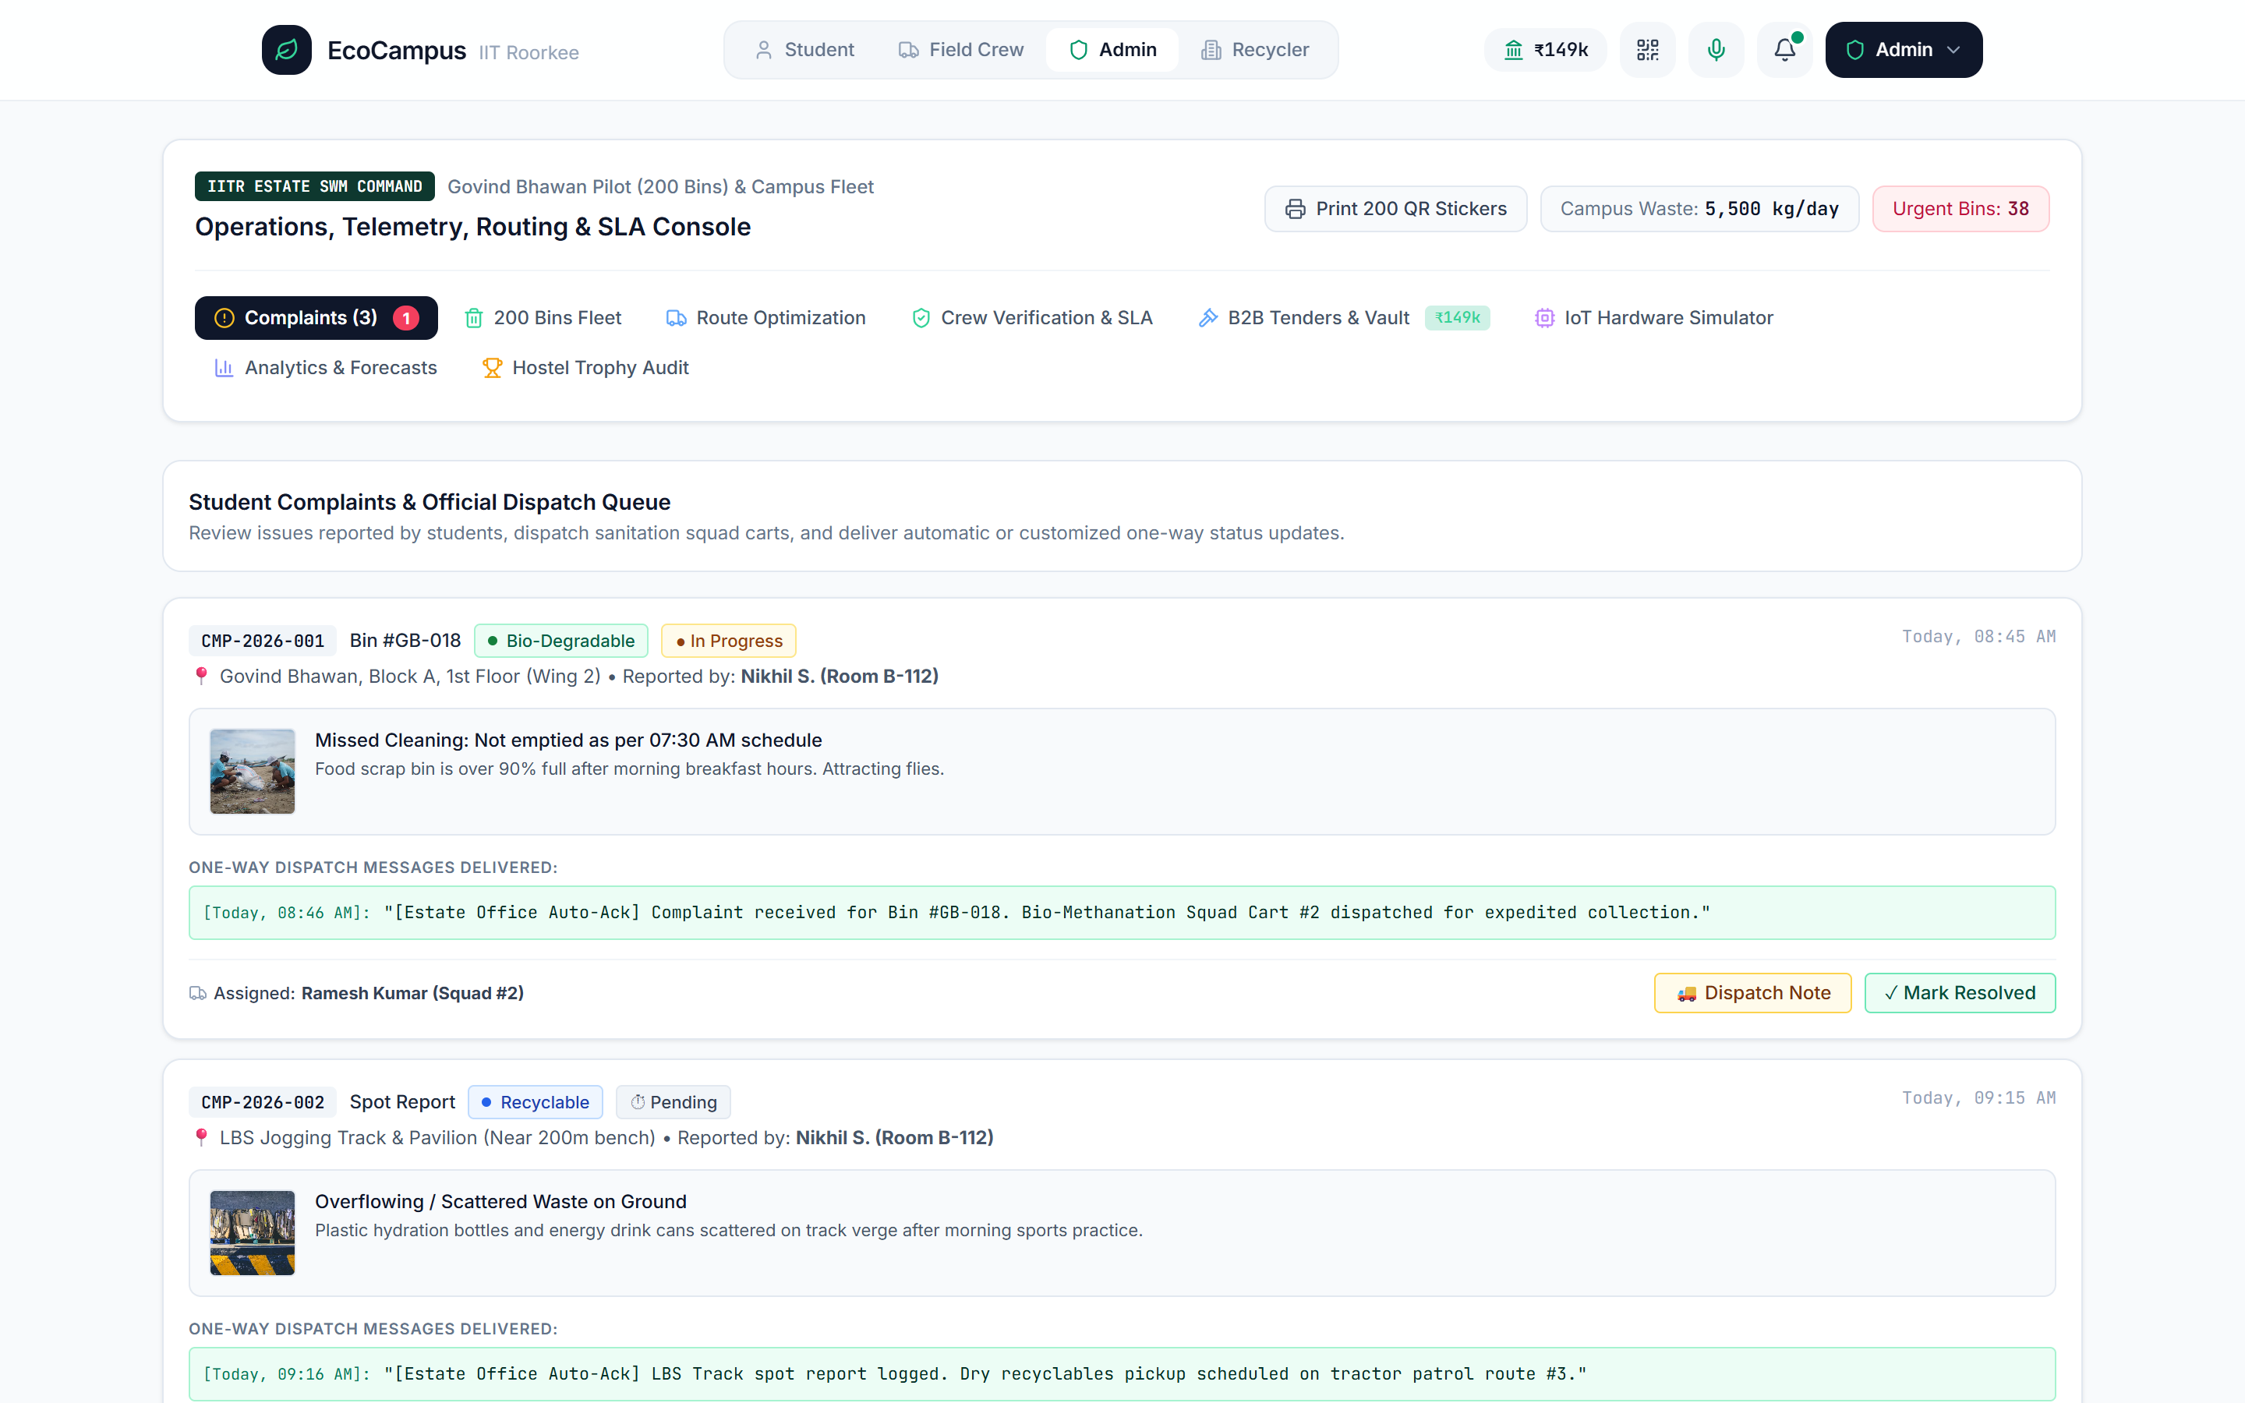
THE PROBLEM
what challenge are you solving?
1. EMPIRICAL IIT ROORKEE WASTE AUDIT (MDPI STUDY)
• 5,500 kg / day (5.5 Metric Tonnes) across 365 Acres & 12,000 Residents (0.46 kg/capita/day).
• Stream Breakdown: Organic Food 30.5% (1,676 kg) | Paper & Cardboard 28.7% (1,580 kg) | Plastic 11.1% (613 kg) | Inert 10.8% (595 kg) | Dry Leaves 10.3% (569 kg).
• Infrastructure Gap: 200 bins in Govind Bhawan & 80 community bins operate on fixed shifts without fill/weight telemetry or contamination checks.
2. ROOT CAUSE: BROKEN INCENTIVES ACROSS STAKEHOLDERS
• Students: Zero personal reward to segregate at the bin; complaint portals fail due to either student apathy or unverified fake reports.
• Sanitation Crew: Fixed wages regardless of waste purity; language barriers; unoptimized tractor routes burn 1,420 L/month excess diesel.
• Campus & Recyclers: Wet food mixed into dry paper destroys 60% of B2B scrap value (₹8/kg mixed vs ₹17.20/kg baled Grade-A).
Live App Screenshot: Govind Bhawan 200-Bin Telemetry & SLA Dispatch Console

Slide 3
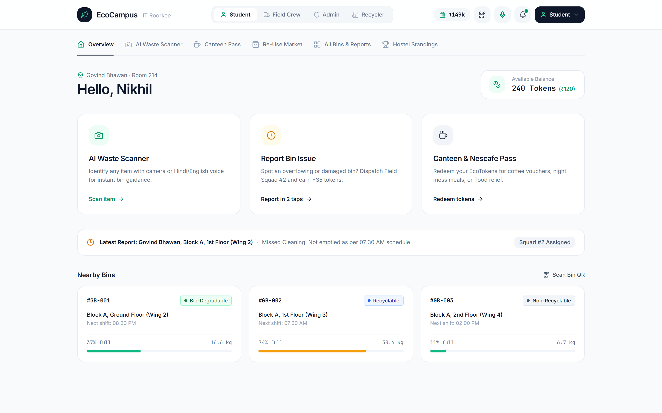
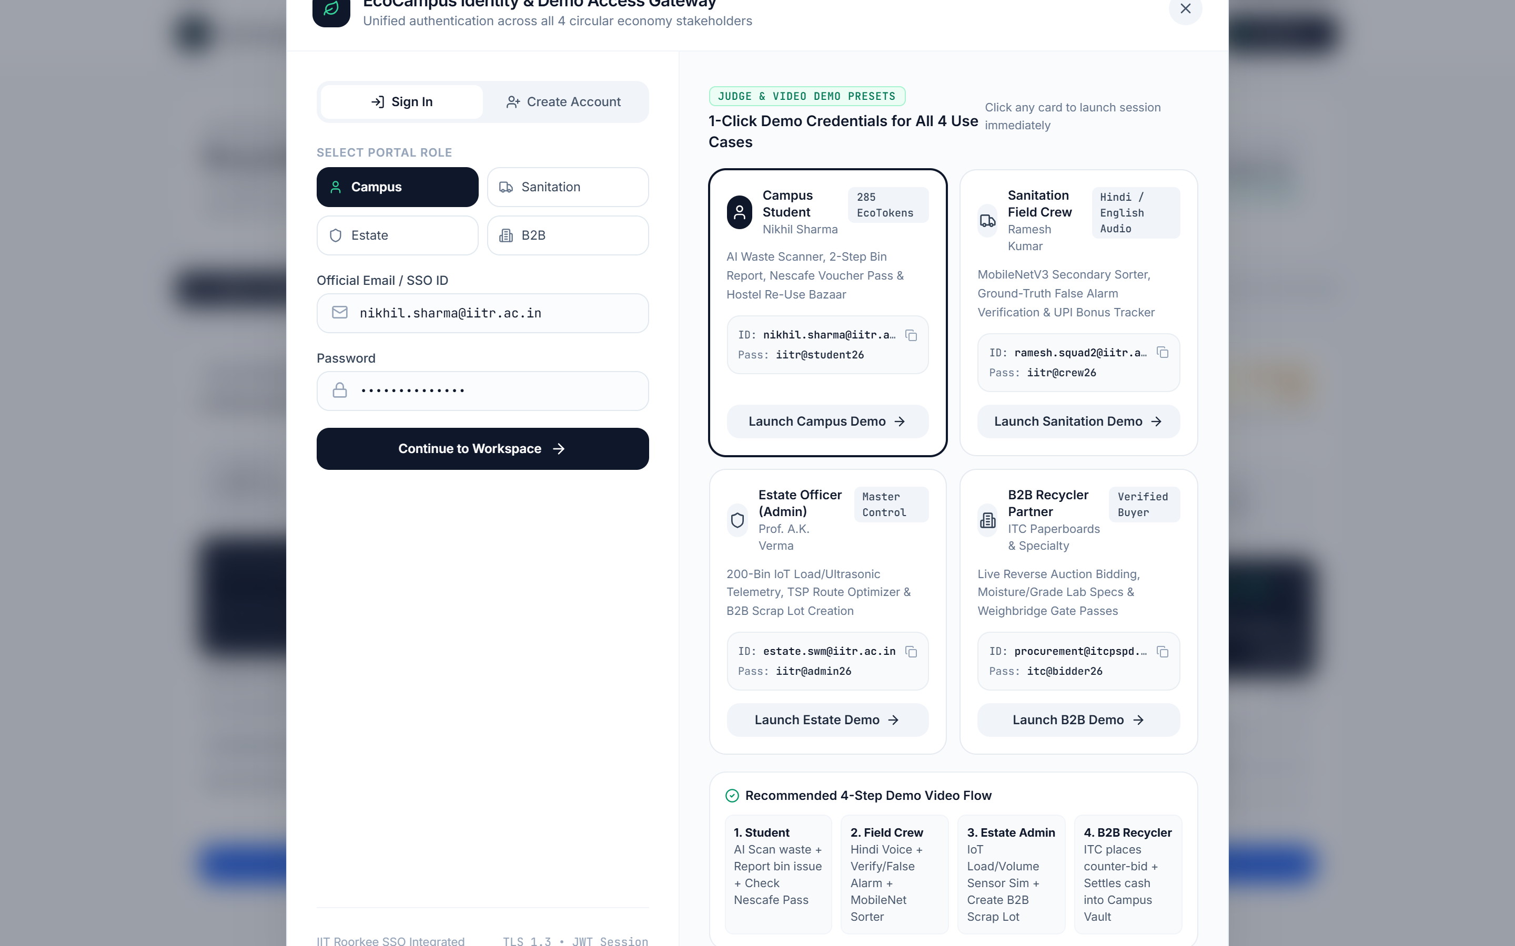
THE IDEA
ECOCAMPUS IITR solution name]
1. STUDENT
AI Camera & Voice Sorter
• Scans trash via MobileNetV3 (+10 Pts)
• Reports full bin via QR (+35 Pts on fix)
• Redeems Nescafe & Mess Coupons
2. FIELD CREW
Hindi Voice & Ground Truth
• Receives Hindi ElevenLabs audio route
• Verifies issue or flags False Alarm (-25 Pts)
• Earns +₹150 bonus & 30% scrap share
3. ESTATE ADMIN
IoT Sensor Fusion & TSP
• Ultrasonic + Load Cell tracks 200 bins
• 2-Opt TSP optimizes tractor beat
• Batches weekly dry recyclable lots
4. B2B RECYCLER
Reverse Auction & Vault
• ITC / Nepra bid live on baled lots
• Highest bid settles into Campus Vault
• Funds Canteen, Crew UPI & Flood Relief
Live Student Portal: Action-First Overview & Wallet
Live 4-Persona SSO & Demo Credentials Gateway

Slide 4
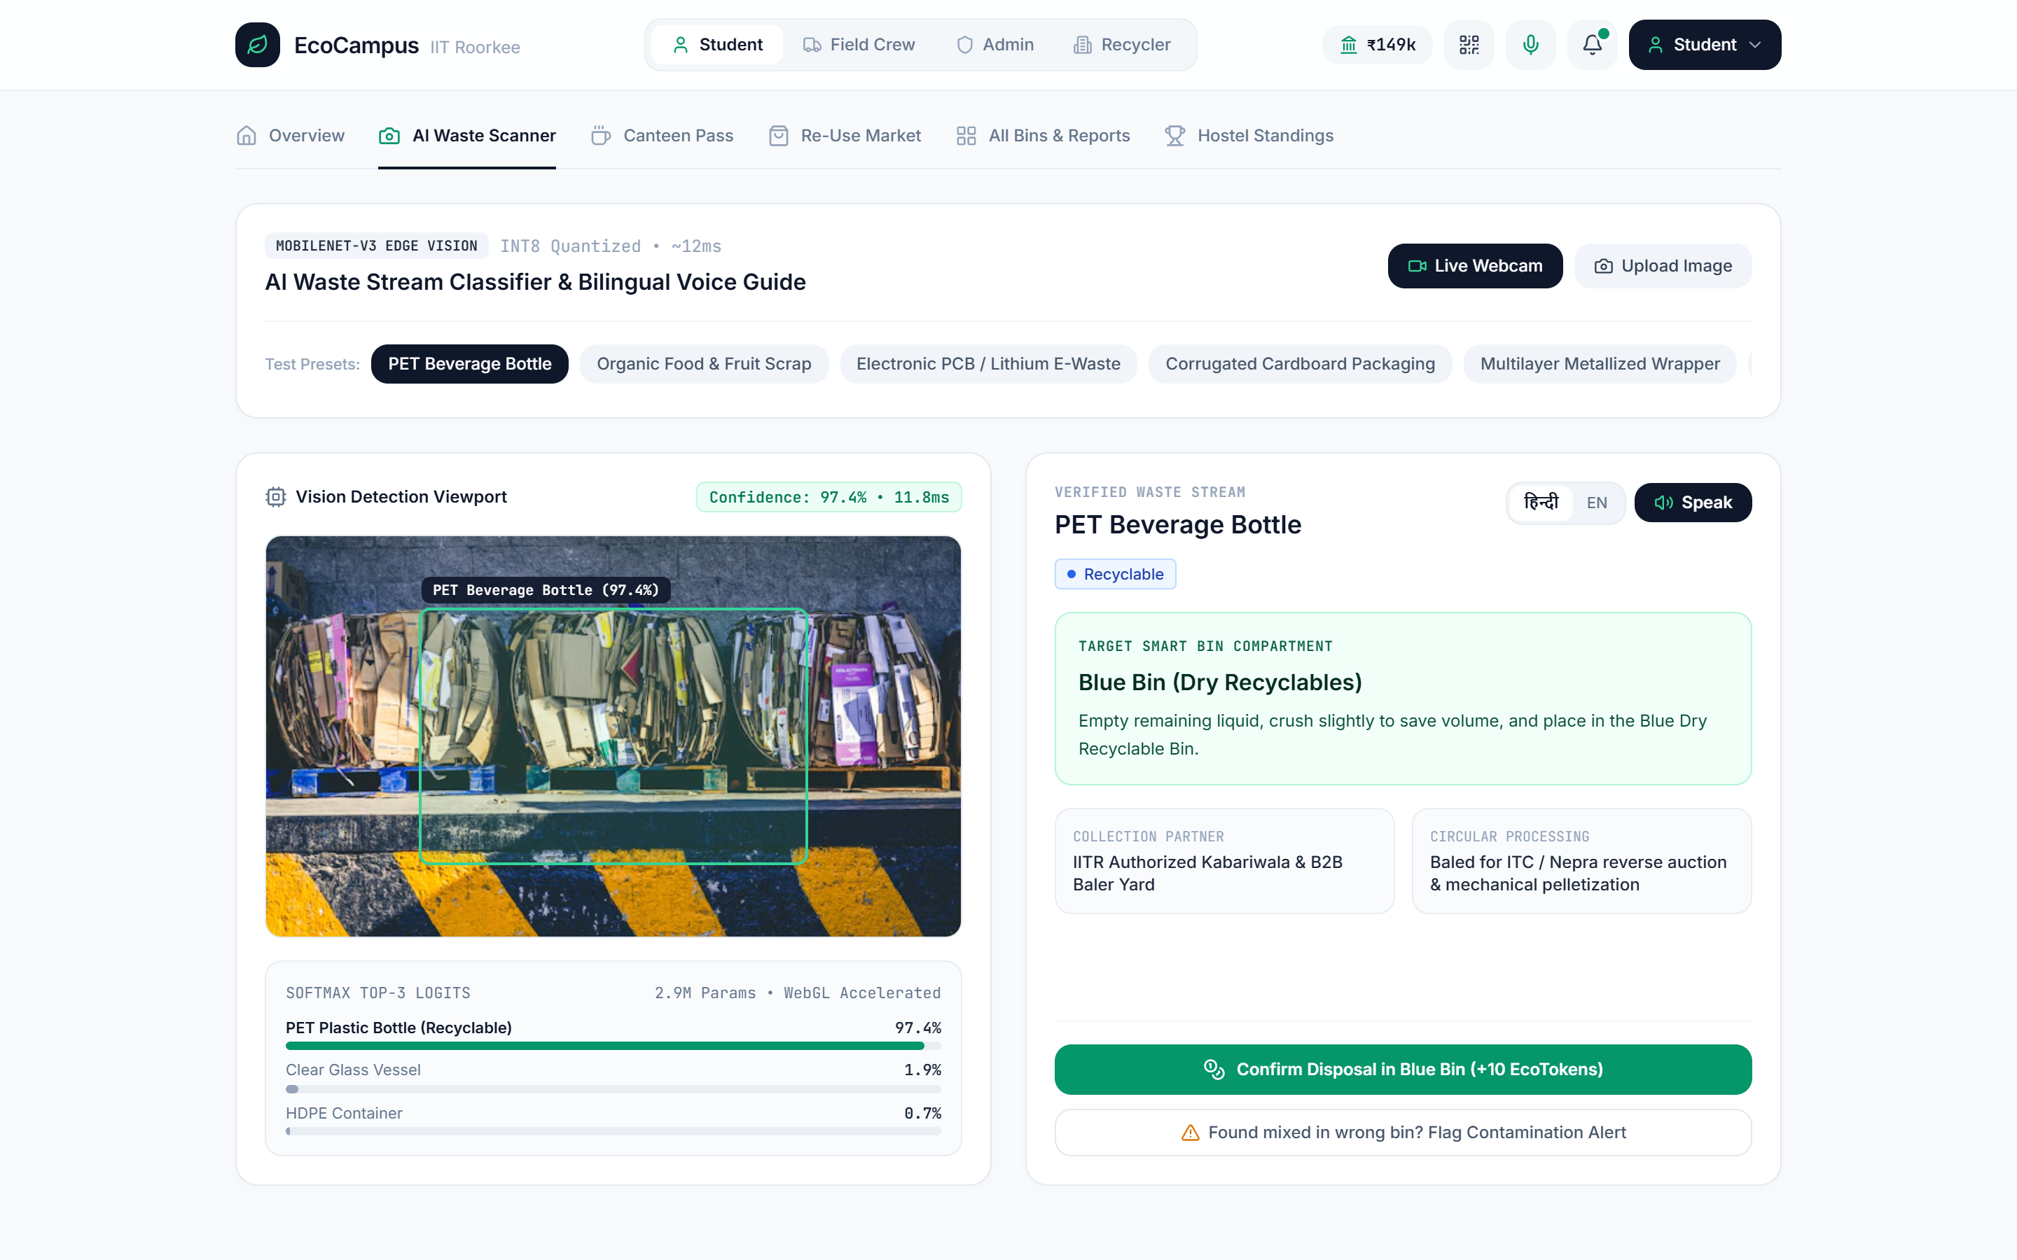
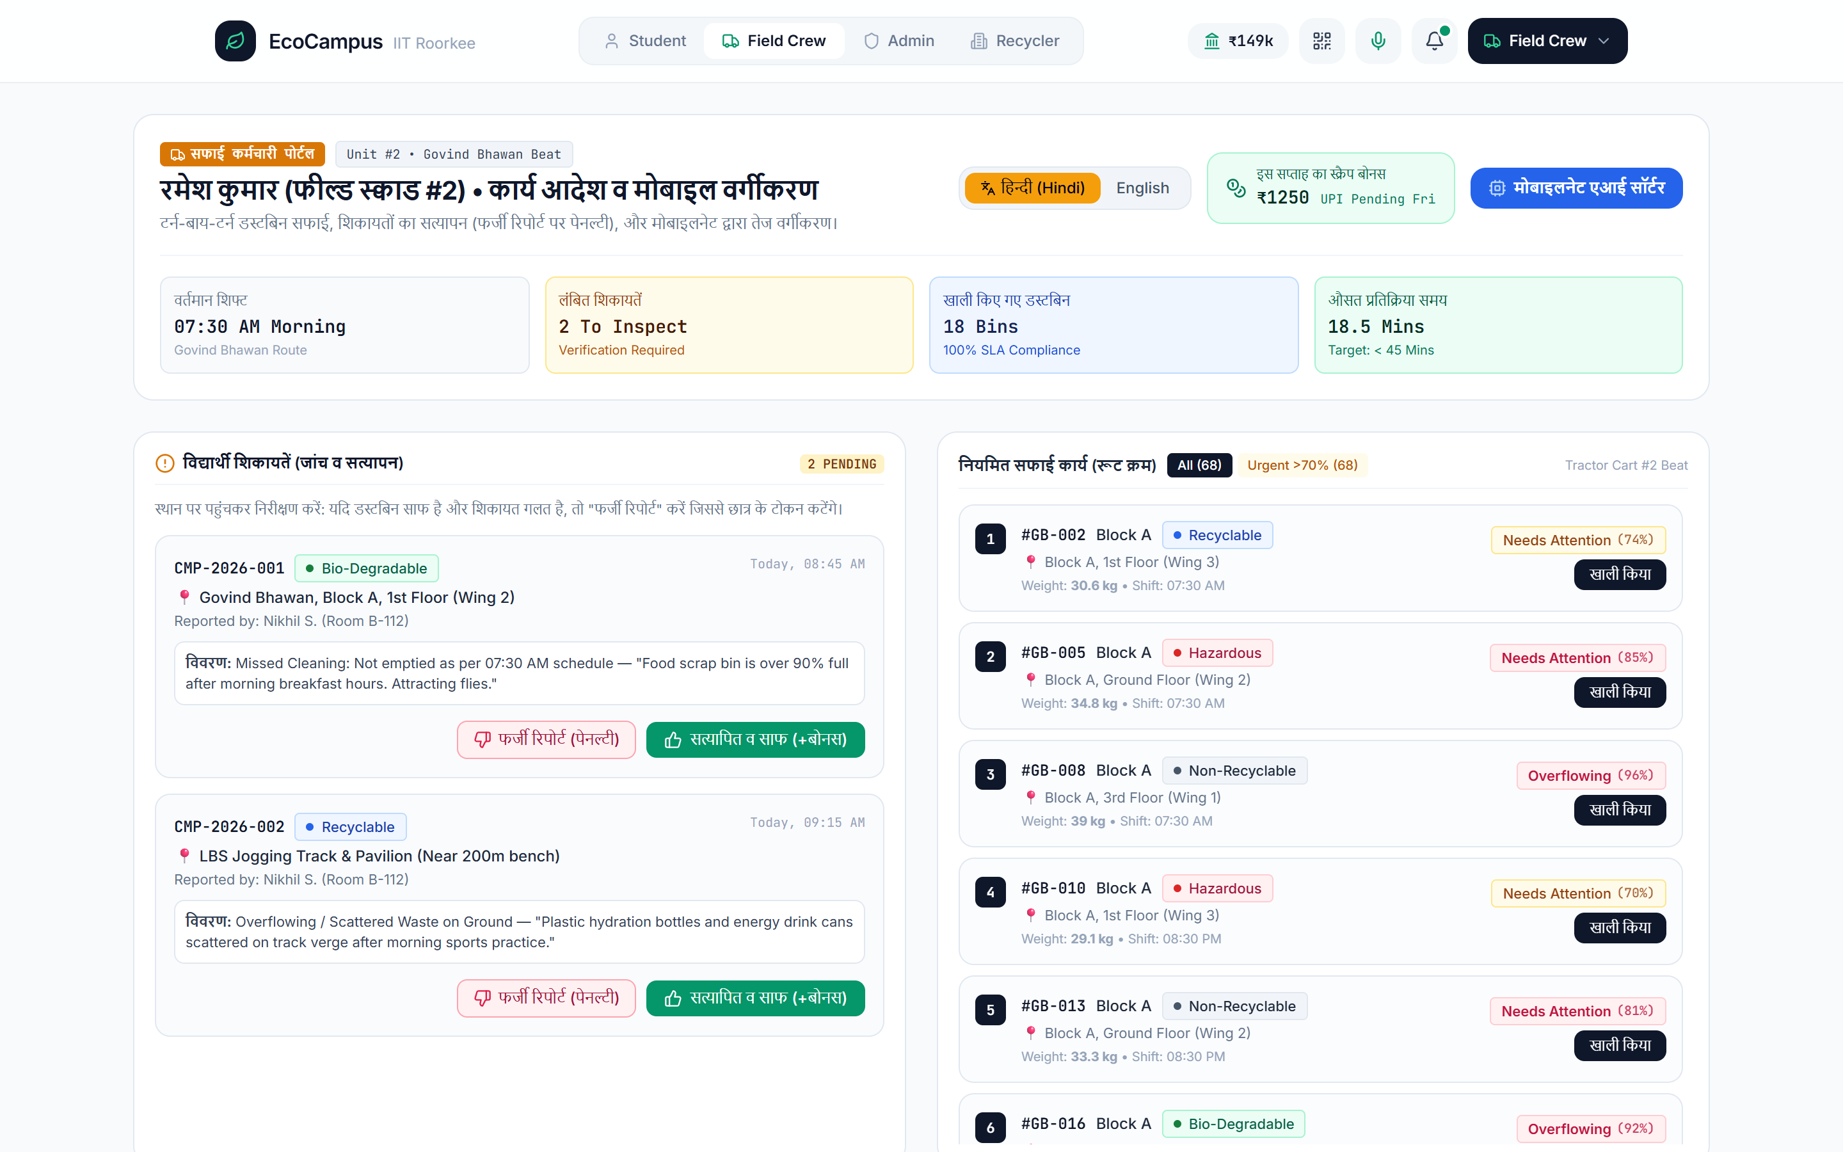
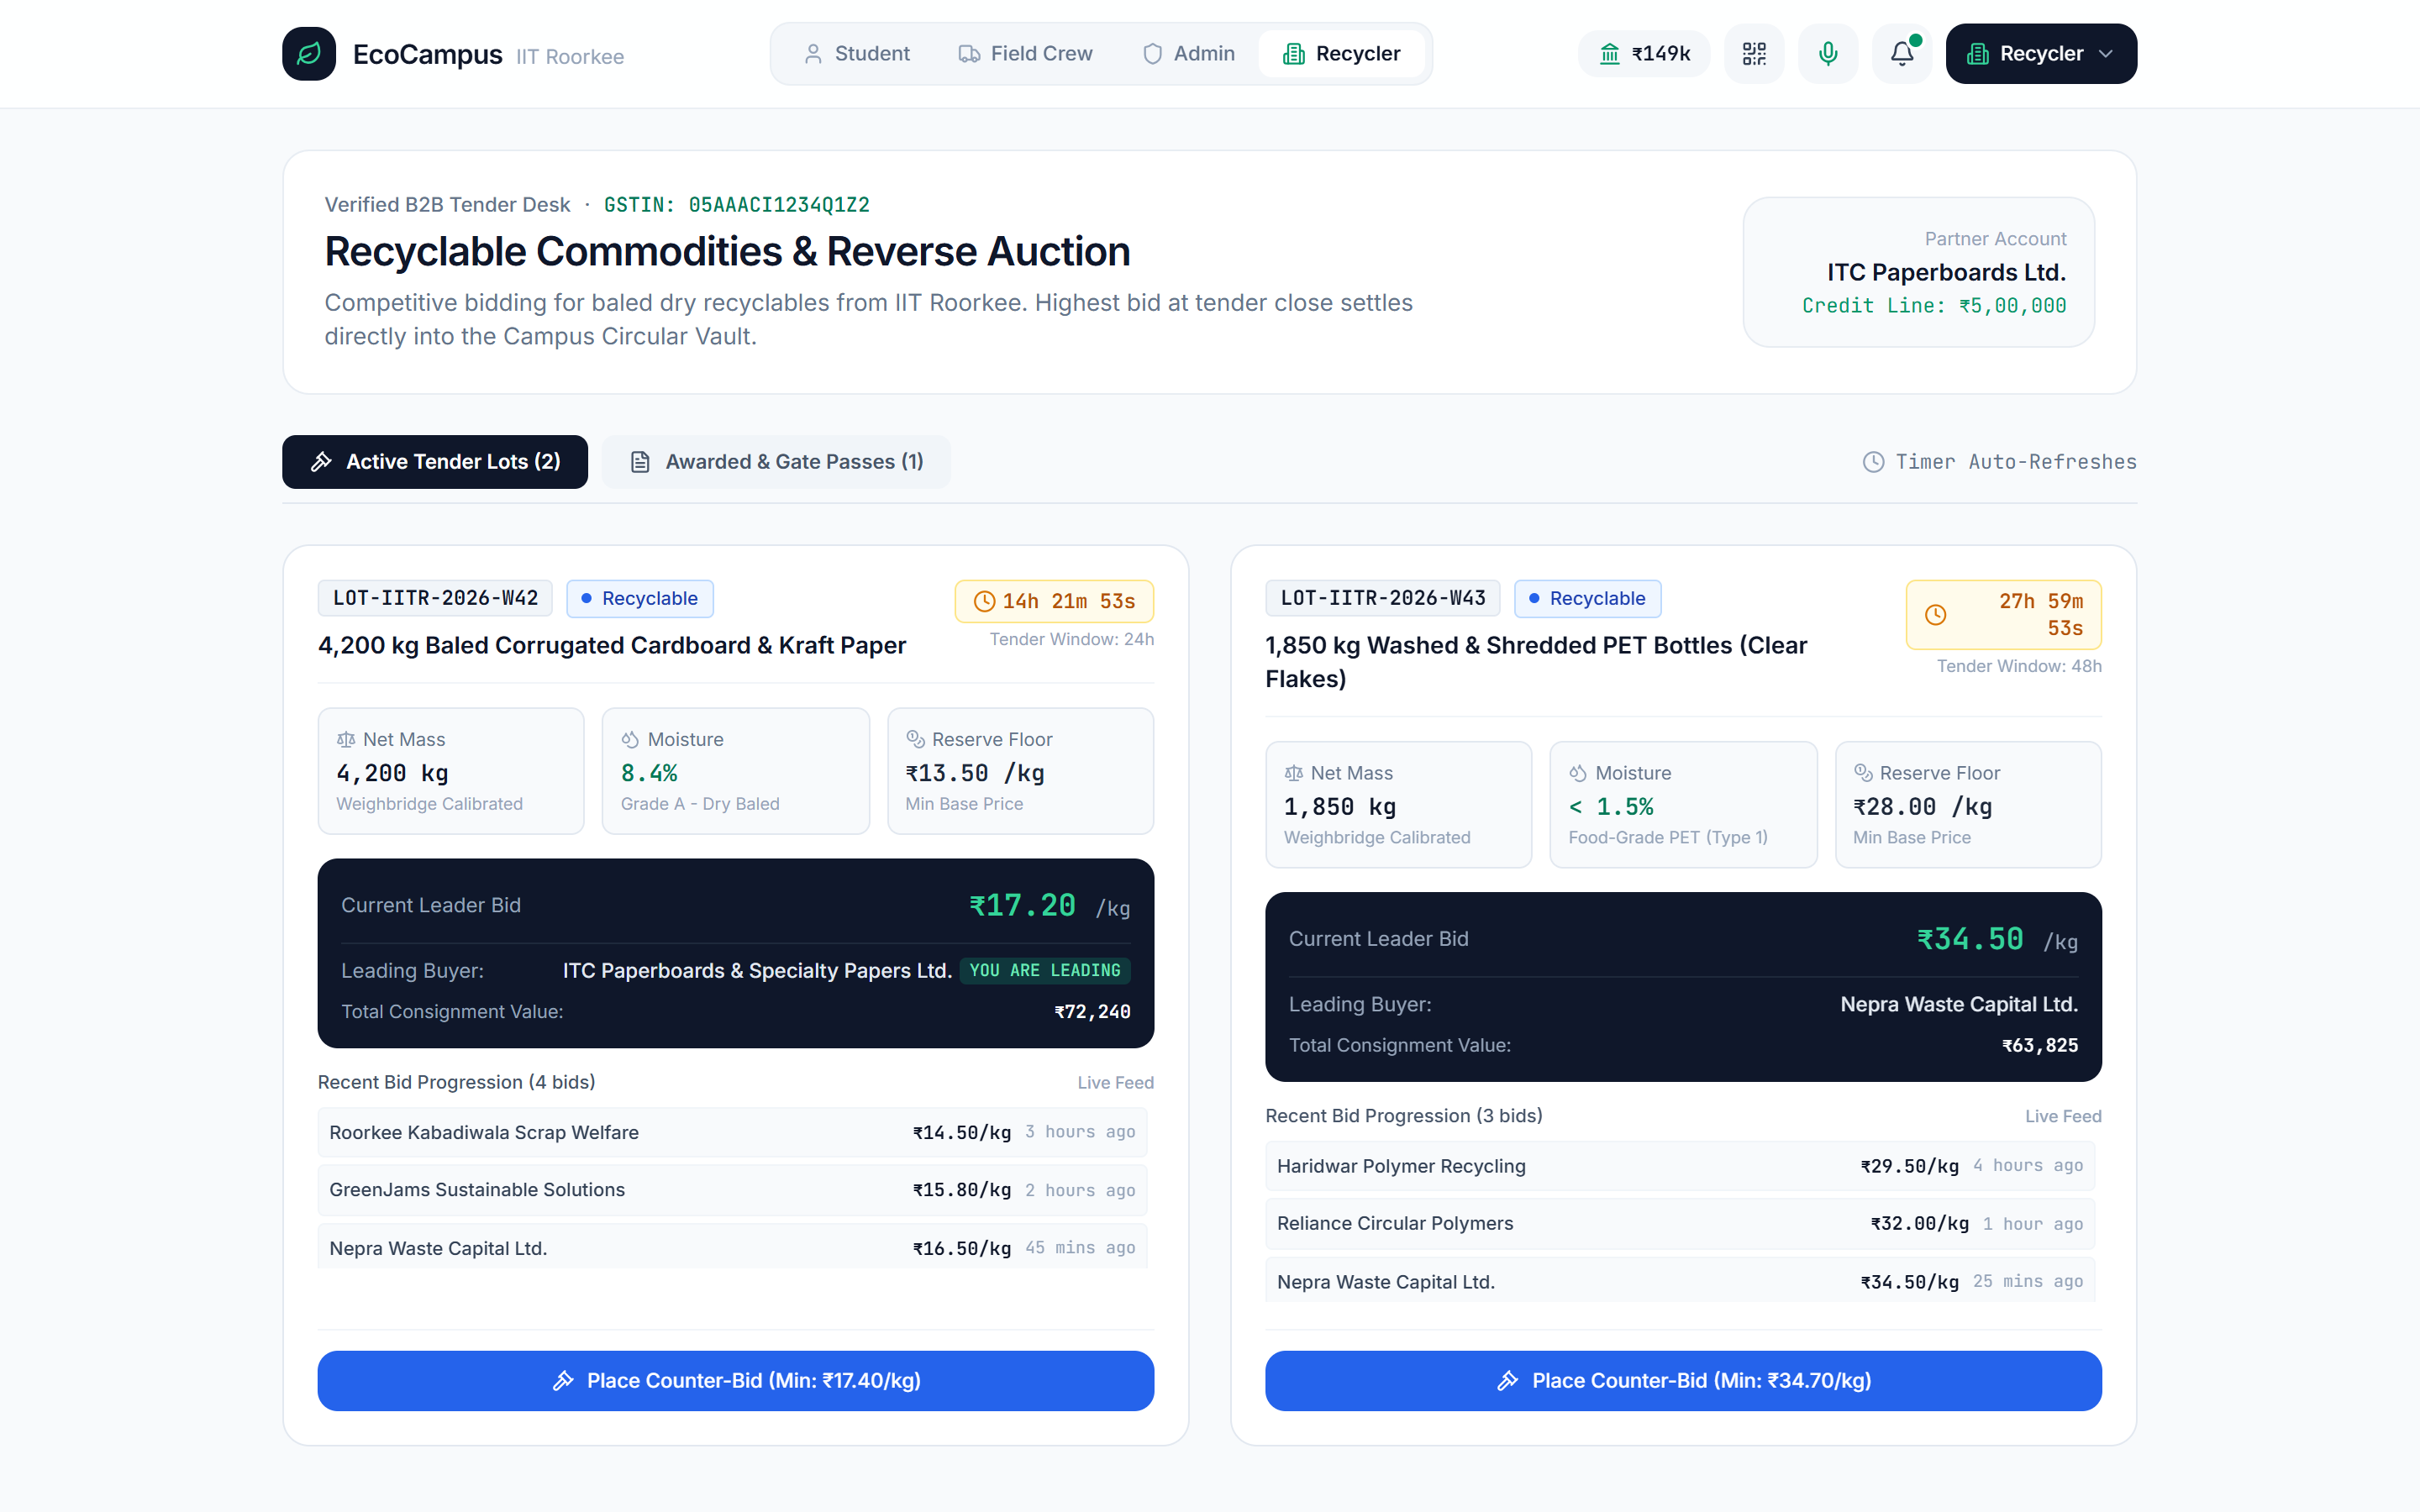
KEY FEATURES
1. MobileNetV3 Vision + Bilingual Voice Guide
2. Field Crew Hindi Portal & Anti-Spam Verification
3. B2B Recycler Reverse Auction & Gate Passes
END-TO-END FUNCTIONAL CAPABILITIES BUILT IN PROTOTYPE
• Student Suite: Live WebRTC Camera Classifier (Top-3 Softmax Logits), 2-Tap QR Overflow Reporting, P2P Hostel Re-Use Bazaar (Books/Kettles/Skates), & Instant Nescafe Voucher Generator.
• Sanitation Crew Suite: One-tap Hindi/English ElevenLabs spoken instructions, MobileNetV3 rapid secondary sorter, Ground-Truth Photo Proof (False Alarm vs Verified Clean).
• Admin & B2B Suite: 200-Bin Load/Volume Telemetry, Printable QR Sticker Sheet Generator, 2-Opt Route Optimizer, Live B2B Reverse Bidding & Weighbridge Gate Pass PDF.

Slide 5
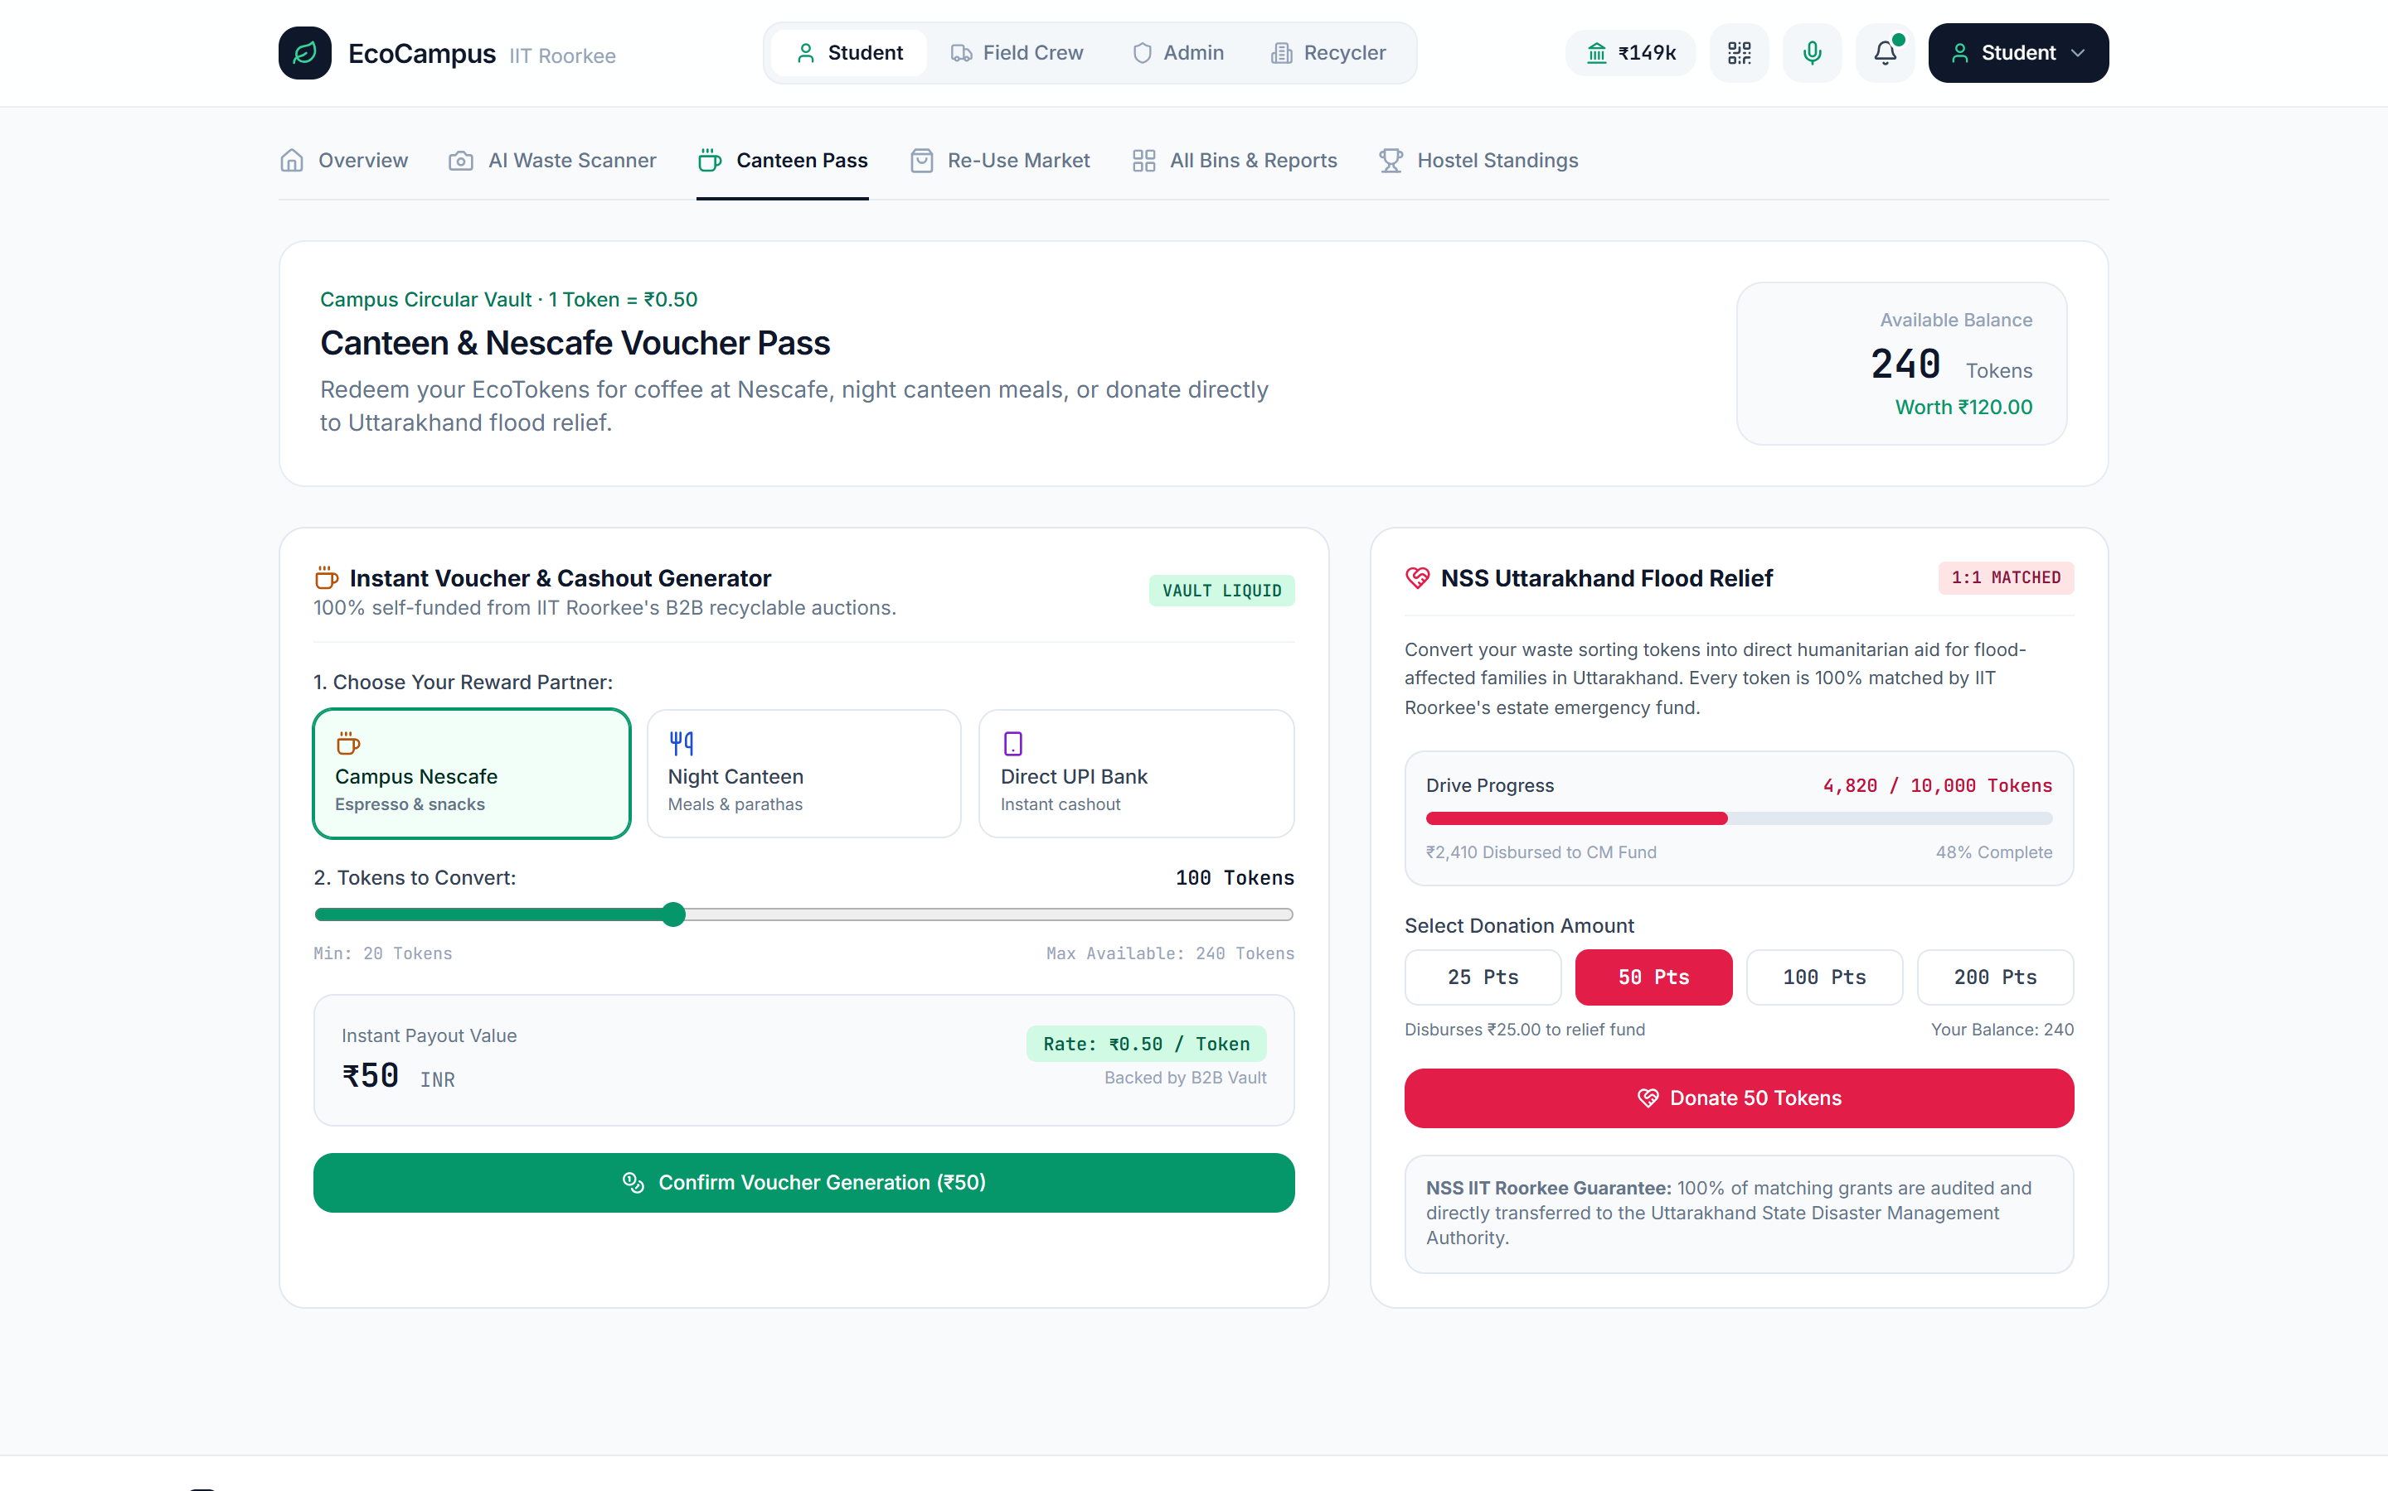
INNOVATION
“what makes it different?” THE DIFFERENTIATOR
KEY DISTINCTION: ECOSYSTEM-WIDE INCENTIVE ALIGNMENT
Most waste apps fail because they rely on voluntary charity. We engineered a self-funding game-theoretic loop where every actor profits from clean segregation:
1. Students (Game-Theoretic Anti-Griefing):
• +10 EcoTokens per AI-verified disposal | +35 Tokens when worker verifies overflow report.
• -25 Token Penalty if field crew photo proves a False Alarm (eliminates spam).
• Liquid Value: 1 Token = ₹0.50 at Campus Nescafe, Night Canteen, or Hostel Re-Use Bazaar.
2. Sanitation Field Crew (Dignity + Direct Wealth Share):
• +₹150 instant bonus per verified SLA cleanup + 30% share of weekly B2B scrap revenue paid every Friday via UPI.
3. B2B Recyclers & Self-Funding Campus Vault:
• ITC & Nepra bid up to ₹17.20/kg (+56% over informal rates) for dry baled lots.
• Vault Split: 30% Student Food Pass | 30% Crew UPI | 25% Baler/IoT Upkeep | 15% NSS Flood Relief.
Live Canteen Voucher Pass & NSS Flood Relief Matching Vault

Slide 6
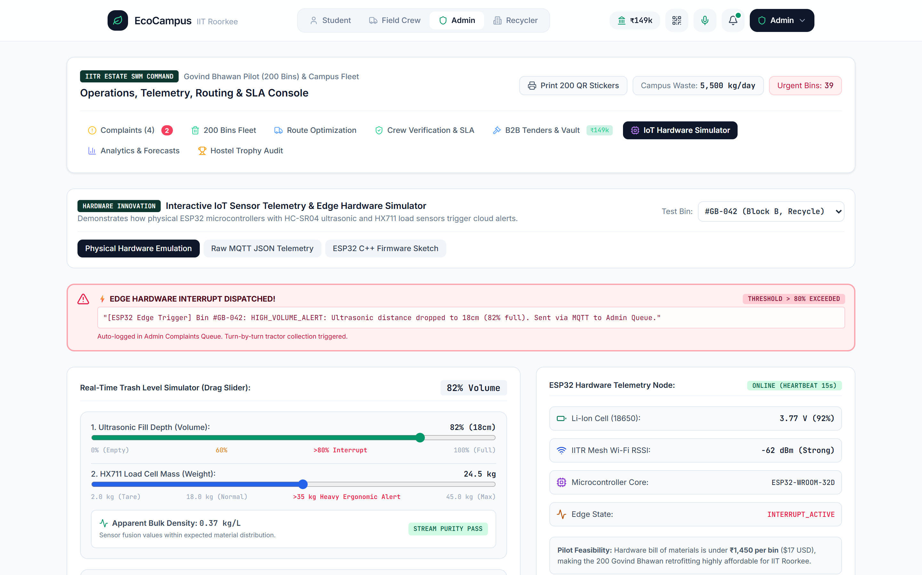
TECH STACK
PRODUCTION ARCHITECTURE & ALGORITHMS
1. Edge Computer Vision (MobileNetV3-Small INT8):
• Depthwise separable convolutions + Hard-Swish activation (2.9M params, 2.5 MB weights, ~12ms WebGL inference) classifying 6 campus waste streams.
2. IoT Dual-Sensor Fusion Anomaly Algorithm (₹465/Bin BOM):
• ESP32 + HC-SR04 Ultrasonic (fill %) + HX711 50kg Load Cell (mass kg).
• Computes Apparent Bulk Density ρ = Δm / ΔV. If ρ > 0.65 kg/L in a Paper Bin, flags Wet Contamination Alert automatically.
3. ElevenLabs Multilingual v2 Voice Synthesis:
• Low-latency Hindi & English spoken guidance for field workers & students.
4. 2-Opt TSP Routing & Algorithmic Re-Use Pricing:
• 2-Opt heuristic cuts tractor distance by 34%. Dynamic Bazaar valuation: P = (Bc × Mcond) + Uacad + Afree.
Live ESP32 Ultrasonic + HX711 Load Cell Sensor-Fusion Simulator

Slide 7
IMPACT & SCALABILILTY
73.4%
Landfill Diversion
4,037 kg/day diverted into biogas & B2B recycling at IIT Roorkee
₹2.4L / mo
B2B Scrap Surplus
Unlocked via competitive reverse bidding with ITC & Nepra
384 Tonnes
CO₂e Avoided / Yr
+ 1,420 L/month tractor diesel saved via IoT-triggered TSP routing
₹465 / Bin
Retrofittable IoT Node
18-day payback period from increased Grade-A scrap realization
3-PHASE SCALABILITY ROADMAP: FROM GOVIND BHAWAN TO PAN-INDIA SMART CAMPUSES
• Phase 1 (Months 1–2) — Govind Bhawan Pilot (200 Bins): Deploy QR stickers & ESP32 load/ultrasonic nodes on main wing bins; onboard Squad #2 & Campus Nescafe kiosk.
• Phase 2 (Months 3–6) — Full IIT Roorkee Rollout (365 Acres, 5,500 kg/day): Expand across all 14 Bhawans, LHC, Central Library, and Messes; integrate Central SWM Baler Yard weighbridge.
• Phase 3 (Year 1+) — Pan-IIT & Smart Municipality SaaS Blueprint: Replicable zero-capex circular treasury model for 23 IITs, NITs, and gated townships across India.

Slide 8
FROM IDEA TO IMPACT
“Waste is only a design flaw of broken incentives. When a student’s clean segregation buys their evening Nescafe, a worker’s verified cleanup funds their Friday UPI bonus, and ITC bids live for campus scrap—zero-waste becomes an unstoppable, self-funding engine.”
EcoCampus IIT Roorkee — Live & Production-Ready at github.com/NIKHILESH-TS/EcoCampus-IITR

Slide 9


