Slide 1

Student Details
Name:kUmari Nikita
AICTE Internship Registration ID) : STU64638bd5a86901684245461
COLLEGE NAME:Institute of Technical Education and Research, Siksha O Anusandhan-Bhubaneswar
SkillsBuild Email ID :2041014084.kumarinikita@gmail.com

Slide 2
A NETFLIX CLONE
In this project, I proudly present a Netflix clone web that is designed to replicate the key features of the renowned streaming platform. It help to explore the world of trending movies, browse various genres, Let's dive into the details of how I built this remarkable project using HTML, CSS, JavaScript, and external APIs.

Slide 3
AGENDA
Netflix is one of the world's leading entertainment services with over 238 million paid memberships in over 190 countries enjoying TV series, films and games across a wide variety of genres and languages.
In this project, I have created a Netflix clone application using HTML, CSS, and JavaScript. The purpose of this project is to replicate the key features of the popular streaming platform, Netflix, and provide users with a similar movie-watching experience. By building this clone, I aimed to showcase my front-end development skills and demonstrate the ability to integrate external APIs to fetch movie data and trailers.
Key Objectives:
Replicate Key Features: My aim of this project is to replicate essential features of the Netflix platform, such as the dynamic banner, categorized movie sections, and movie trailers.
API Integration: I integrated external APIs, specifically The Movie Database (TMDb) API and YouTube API, to fetch movie data and trailers for a diverse movie catalog.
Responsive Design: Ensuring the application's compatibility across various devices and screen sizes was crucial to enhance user accessibility.
User Experience: I prioritized creating a seamless and intuitive user experience, allowing users to navigate through the app with ease.
Showcasing Skills: Through this project, I demonstrate my ability to work with APIs, manage data, and apply modern web development principles.

Slide 4
PROJECT OVERVIEW
Netflixclone is an ambitious web application project aimed at emulating the key features and user experience of the popular streaming platform, Netflix. My goal was to create a captivating and user-friendly movie streaming platform, allowing users to explore trending movies, view comprehensive movie details, and watch official trailers, all within a dynamic and visually appealing interface.
Key Features:
Trending Movies: NetflixClone showcases the latest trending movies from various genres, allowing users to stay up-to-date with the most popular titles in the industry.
Movie Sections: The application is thoughtfully organized into distinct movie sections, making it easy for users to explore movies based on their interests and preferences.
Captivating Banner: FlixClone features a dynamic banner section that displays captivating backdrop images and essential movie details, capturing users' attention from the moment they land on the platform.
Clone's frontend development heavily relied on HTML, CSS, and JavaScript. HTML provided the foundation for structuring the application's content, while CSS was employed for designing and styling the user interface, ensuring a visually cohesive and appealing design. JavaScript played a crucial role in implementing dynamic functionalities, such as fetching movie data and handling user interactions, to create an engaging and interactive user experience.

Slide 5
WHO ARE THE END USERS of this project?
The end users of the netflix-clone project are individuals who enjoy streaming and watching movies online. The application targets movie enthusiasts and users seeking a platform to discover trending movies, explore various genres, and watch movie trailers. It caters to anyone looking for an immersive and user-friendly movie-watching experience, similar to what is offered by popular streaming platforms like Netflix.
The project aims to provide a diverse range of movie options, making it suitable for users with different tastes and preferences in movies. Whether users enjoy action, romance, comedy, sci-fi, or any other genre, FlixClone offers a collection of movies to cater to their interests.
As the project is designed to be responsive and optimized for various devices, it appeals to users accessing the platform through desktops, laptops, tablets, and mobile phones. FlixClone's intuitive user interface and engaging movie discovery features aim to provide a seamless experience to users of all ages and technological backgrounds.
In summary, the end users of the FlixClone project are movie enthusiasts and anyone seeking a convenient and enjoyable way to browse, explore, and watch movies online within a visually appealing and dynamic platform.

Slide 6
YOUR SOLUTION AND ITS VALUE PROPOSITION
NetflixClone is a web application that replicates the key features and user experience of the popular streaming platform, Netflix. It offers a visually engaging and user-friendly platform for movie enthusiasts to explore, discover, and watch movies online. The project encompasses a range of functionalities, including showcasing trending movies, organizing movies into categorized sections, and providing comprehensive movie details and official trailers.
Key Features:
Trending Movies:NetflixClone keeps users up-to-date with the latest trending movies across various genres, ensuring they never miss out on popular titles.
Categorized Movie Sections: With intelligently organized movie sections, users can effortlessly explore movies based on their interests and preferences.
Captivating Banner: The dynamic banner section presents captivating backdrop images and movie details, creating an immersive movie-watching experience.
Intuitive Movie Cards: Each movie is presented as an attractive card, displaying the movie poster and essential details in an intuitive layout.
Interactive User Experience: FlixClone incorporates smooth animations and interactive elements to provide a seamless and enjoyable user experience.
In summary, NetlixClone offers a unique value proposition by providing an enticing movie streaming platform that replicates the best aspects of Netflix. With its user-friendly interface, diverse movie collection, and dynamic features, FlixClone aims to provide an unparalleled movie-watching experience for all users.

Slide 7
How did you customize the project and make it your own
Custom Styling: To create a unique visual theme for the application. I changed the color scheme, font styles, button designs, and overall layout to give the project a fresh and distinct look.
Interactive UI Elements: Implemented interactive UI elements such as animated buttons, hover effects, and transitions to enhance the user experience and make the application more engaging.
Responsive Design: I Ensure that the application is fully responsive and works well on various devices, including desktops, tablets, and smartphones. This will improve accessibility and user satisfaction.

Slide 8
MODELLING
add movies to netflix clone with html and css full design with TMDB api
Header Building
Load All Movies Categories
Fetch All Movies for a category and show all movies in the section
Fetch Trending Now Movies List and build its section
Build Banner Section
Find trailer of a movies using Youtube Search API

Slide 9
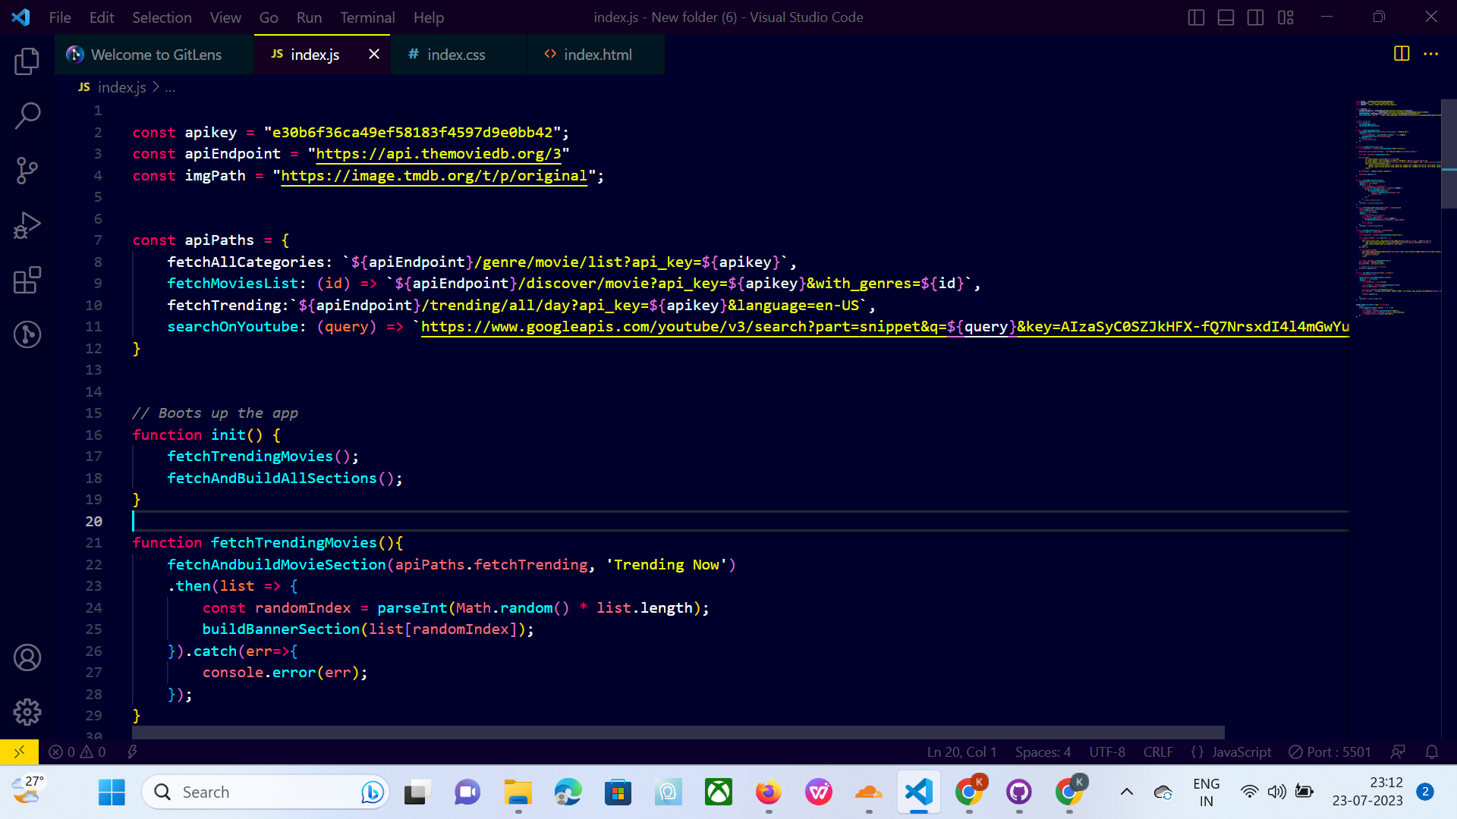
SCREEN-SHOT

Slide 10
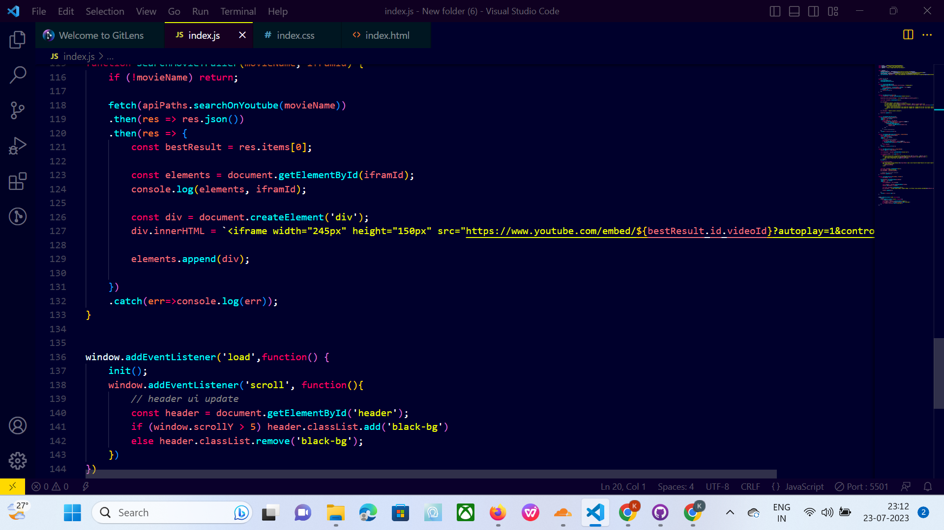
SCREEN-SHORT

Slide 11
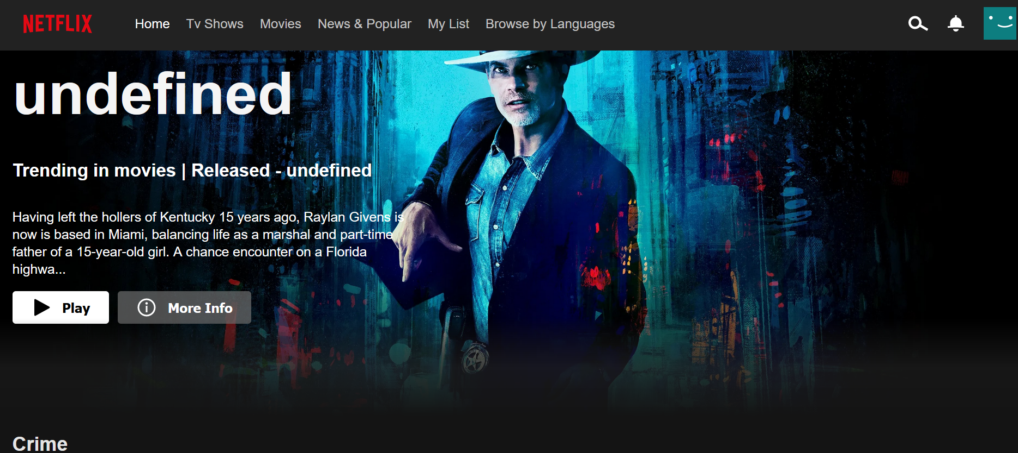
FINAL RESULT-CLONE

Slide 12
Results
Successful Project Implementation:The Netflix clone project was successfully implemented using HTML, CSS, and JavaScript.
The project achieved its objectives of replicating key features of the Netflix platform.
Seamless Content Browsing:The project provides a user-friendly interface for content browsing and searching.
Users can effortlessly explore a wide range of movies and TV shows.
Movie Sections:Movies are effectively categorized into different sections based on genres.
The project fetches and displays movies for each category, providing a well-organized content library.
Challenges and Solutions:Some challenges were encountered during the development process, such as API integration and responsive design.
Innovative solutions were implemented to overcome these challenges and deliver a polished application.
github-link: https://nikita22288.github.io/NetflixClone.github.io/

Slide 13
links
The Movie Database (TMDb):https://www.themoviedb.org/
Javscript documentation:https://www.w3schools.com/jsrEF/default.asp
Youtube open source:https://youtu.be/P7t13SGytRk

