Slide 1


Department of Computer Science and Engineering
AI-Driven Aircraft Maintenance System for Real-
Time Crack Detection and Predictive Maintenance.
1. NIKITHA B V - 211421104177
2. JYOTHIKA G - 211421104116
3. KAVIPRIYA S - 211421104122
Dr. SATHYA PREIYA V
ASSOCIATE PROFESSOR
Dr. KAVITHA SUBRAMANI
PROFESSOR

Slide 2
ABSTRACT
The AI-driven aircraft maintenance system leverages machine learning to enhance predictive maintenance. YOLOv5 enables real-time detection of structural cracks, ensuring quick identification and response to potential damage. Machine learning models estimate battery life by analyzing charge/discharge cycles and environmental factors, improving battery management. Predictive models assess jet engine sensor data to forecast remaining useful life (RUL), allowing timely interventions. By providing real-time insights and personalized predictions, the system empowers maintenance teams to address potential failures before they occur, optimizing maintenance schedules and improving operational reliability. This proactive, data-driven approach minimizes unexpected breakdowns, reduces downtime, enhances safety, and lowers operational costs. By transforming traditional reactive maintenance into an AI-powered predictive framework, the system significantly advances efficiency and cost-effectiveness in the aviation industry.

Slide 3
INTRODUCTION
Current aircraft maintenance relies on scheduled inspections and reactive repairs, leading to unnecessary downtime, higher costs, and safety risks.
Manual visual inspections for structural cracks are time-consuming, labor-intensive, and prone to human error, increasing the risk of undetected damage.
Battery replacements are based on manufacturer guidelines, ignoring real-world factors like environmental conditions and usage patterns, causing premature failures.
Life cycle estimations rely on historical averages rather than real-time sensor data, leading to unexpected breakdowns and costly repairs.
The absence of predictive monitoring highlights the urgency for a data-driven maintenance system to improve safety, reduce costs, and enhance operational efficiency.

Slide 4
OBJECTIVE OF THE PROJECT
Develop a real-time crack detection module for accurate and efficient identification of structural damage.
Create a battery life prediction model using real-world data for precise estimations.
Design predictive maintenance algorithms for jet engines based on time-series sensor data to forecast remaining useful life.
Integrate all modules into a centralized platform that provides actionable insights and recommendations.
Optimize maintenance schedules, reduce downtime, enhance safety, and lower operational costs to modernize aircraft maintenance practices.

Slide 5
LITERATURE SURVEY
S.NO | YEAR | TITLE AUTHOR NAME | JOURNAL DETAIL | METHODOLOGY | OUTCOME
1. | 2024 | Title: Aircraft Skin Damage Detection and Assessment From UAV Images Using GLCM and Cloud Model. Author: Lei Shao. | IEEE Transaction On Intelligent Transportation System. VOL. 25.NO. 3. | Uses Gray-Level Co-occurrence Matrix (GLCM) and Unmanned Aerial Vehicles (UAVs) images with Cloud Model | Improves automation but faces challenges like weather dependency, high computational costs, noise sensitivity, and the need for extensive data for accurate classification.
2. | 2024 | Title: Leveraging AI and Industry 4.0 in Aircraft Maintenance: Addressing Challenges and Improving Efficiency Author: TIMJERDINE Mohammed | Journal of Artificial Intelligence General Science (JAIGS) . Vol.1, Issue2, May 2024 | Industry 4.0 technologies (AR, additive manufacturing, machine learning) in aircraft maintenance. | Most technologies are in pre-production; requires high investment, regulatory adaptation, and industry collaboration.
3. | 2022 | Title: AI-Based Predictive Maintenance in Manufacturing Industries Author: Kaledio Potter | IEEE Transaction On Intelligent Transportation System. VOL. 29.NO. 6 | AI-driven Predictive Maintenance (PdM) using Machine Learning (ML) and Deep Learning (DL) models. | Data quality issues, high implementation costs, lack of model interpretability, and challenges in broader adoption.

Slide 6
S.NO | YEAR | TITLE AUTHOR NAME | JOURNAL DETAIL | METHODOLOGY | OUTCOME
4. | 2024 | Title: Predictive Maintenance in Aviation using Artificial Intelligence Author: Mr. Kondala Rao Patibandla | IEEE Transactions on Vehicular Technology VOL. 15 .NO. 10 | AI, IoT, and data analytics for predictive maintenance in aviation. | Integration challenges, dependency on high-quality sensor data, and cybersecurity risks.
5. | 2024 | Title: Evaluating YOLO Models for Efficient Crack Detection in Concrete Structures Using Transfer Learning Author: Sohaib | International Journal of Prognostics and Health Management | Digital image processing and strain data analysis for crack detection. | Potential interference in detection, computational complexity, and limitations in real-world applications.
6. | 2022 | Title: Artificial Intelligence Application on Aircraft Maintenance: A Systematic Literature Review Author: Erna Shevilia Agustian | Journal of The International Council on System Engineering. | AI-based aircraft engine maintenance using LSTM and C-MAPSS dataset. | Dataset limitations, lack of focus on specific components, and need for industry-relevant real-time data.
7. | 2023 | Title: Real-time crack detection in aircraft structures using YOLO. Author: Smith | IEEE Transactions on Aerospace, 57(3), 145-152 | YOLO (You Only Look Once) for crack detection in aircraft structures. | Similarity in Texture Features. Challenges with Early-Stage Damage Detection.

Slide 7
S.NO | YEAR | TITLE AUTHOR NAME | JOURNAL DETAIL | METHODOLOGY | OUTCOME
8. | 2024 | Title: Predictive maintenance of aircraft engines using machine learning. Author: Johnson | Journal of Aerospace Engineering, 34(4), 1223-1231. | Recurrent Neural Networks (RNN) and Long Short-Term Memory (LSTM) for time-series sensor data analysis | High data processing requirements, potential inaccuracies due to sensor anomalies, and limited adaptability to new engine models.
9. | 2022 | Title: Battery life estimation for aircraft systems using deep learning Author: Zhang | International Journal of Electrical Engineering, 48(2), 875-883. | Convolutional Neural Networks (CNN) and Recurrent Neural Networks (RNN) for charge cycle pattern recognition Long Short-Term Memory (LSTM) for time-series prediction | Limited Focus on Specific Components. Challenges in Full Automation
10. | 2023 | Title: Integrated approach for aircraft maintenance: Combining computer vision and predictive analytics Author: Lee | Aerospace Science and Technology, 92(6), 1302-1311. | LSTM and Gated Recurrent Units (GRU) for time-series prediction of failures Bayesian Networks for probabilistic failure prediction and risk assessment | Computationally intensive, potential sensor failures affecting predictions, and need for robust infrastructure for real-time processing

Slide 8
PROBLEM STATEMENT
Scheduled inspections and reactive repairs cause unnecessary downtime, high costs, and safety risks.
Manual visual inspections are labor-intensive, time-consuming, and prone to human error, increasing the risk of undetected structural damage.
Relying on manufacturer guidelines leads to inaccurate predictions, premature replacements, and unexpected failures, affecting reliability.
Historical averages fail to consider real-time sensor data and individual usage patterns, resulting in unexpected breakdowns and expensive repairs.
The lack of real-time monitoring and predictive maintenance increases inefficiencies, emphasizing the importance of an AI-powered, data-driven framework for proactive failure detection.

Slide 9
PROPOSED SYSTEM
The system integrates AI-driven models for crack detection, battery life estimation, and jet engine predictive maintenance into a centralized platform.
YOLO is used for real-time crack detection, fine-tuned with transfer learning for aircraft-specific structural analysis.
Battery life estimation utilizes Random Forest, Gradient Boosting, and Neural Networks, with hyperparameter tuning for improved accuracy.
LSTM networks analyze time-series sensor data to predict the remaining useful life (RUL) of jet engines, with ARIMA models used for benchmarking.
The architecture consists of a data layer for collection and preprocessing, a model layer for AI-driven predictions, and an application layer with a Streamlit-based interface.

Slide 10
SOFTWARE USED
Python (ML, AI, and backend)
PyTorch, Scikit-Learn, OpenCV, YOLO (Image processing and defect detection)
Pandas, NumPy, Matplotlib (Data handling and visualization)
Streamlit (User interface)
Roboflow API (Defect annotation and detection)

Slide 11
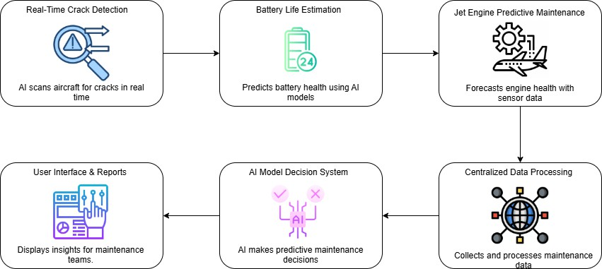
ARCHITECTURE DIAGRAM

Slide 12
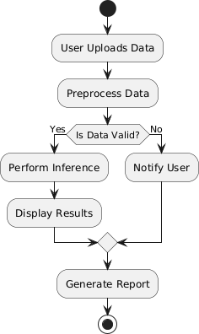
FLOW CHART

Slide 13
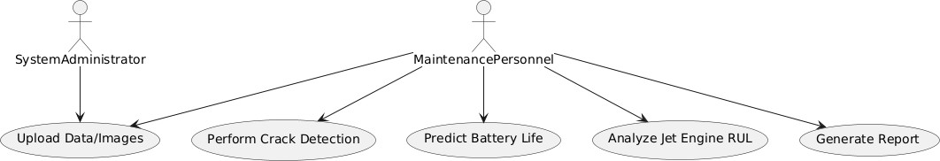
USECASE DIAGRAM

Slide 14
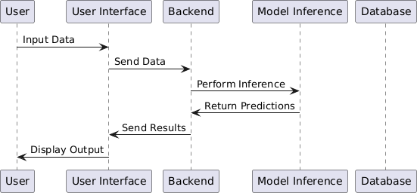
COLLABORATION DIAGRAM

Slide 15
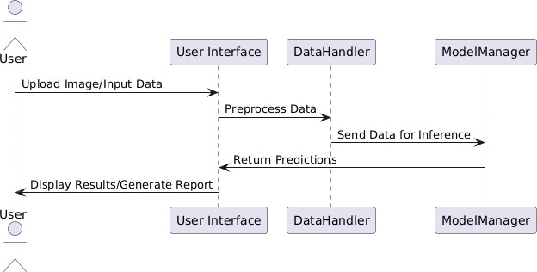
SEQUENCE DIAGRAM

Slide 16
CRACK DETECTION MODULE
Functionality: Detects and highlights cracks in aircraft structures using image processing and object detection techniques.
Technologies Used: YOLO (You Only Look Once) object detection model, OpenCV for image handling, and Streamlit for UI.
Process:
Users upload high-resolution images of aircraft parts.
The YOLO model identifies cracks and annotates them with bounding boxes.
The processed image with detected cracks is displayed in the UI.

Slide 17
BATTERY LIFE ESTIMATION MODULE
Functionality: Predicts the remaining useful life of aircraft batteries based on time-series sensor data.
Technologies Used: Random Forest Regressor, Scikit-learn, Joblib for model loading, and Streamlit for UI.
Process:
Users input battery performance parameters such as charge-discharge cycles, voltage levels, and charging time.
The trained model predicts the remaining battery life in cycles.
Results are displayed, helping users make informed maintenance decisions.

Slide 18
JET CYCLE PREDICTION MODULE
Functionality: Estimates the remaining useful life (RUL) of jet engines using time-series sensor data.
Technologies Used: LSTM (Long Short-Term Memory) networks for time-series prediction, Streamlit for UI.
Process:
Users provide key sensor readings such as temperature, pressure, and fuel flow.
The trained model predicts the remaining operational cycles before maintenance is needed.
Results help in proactive maintenance planning to prevent failures.

Slide 19
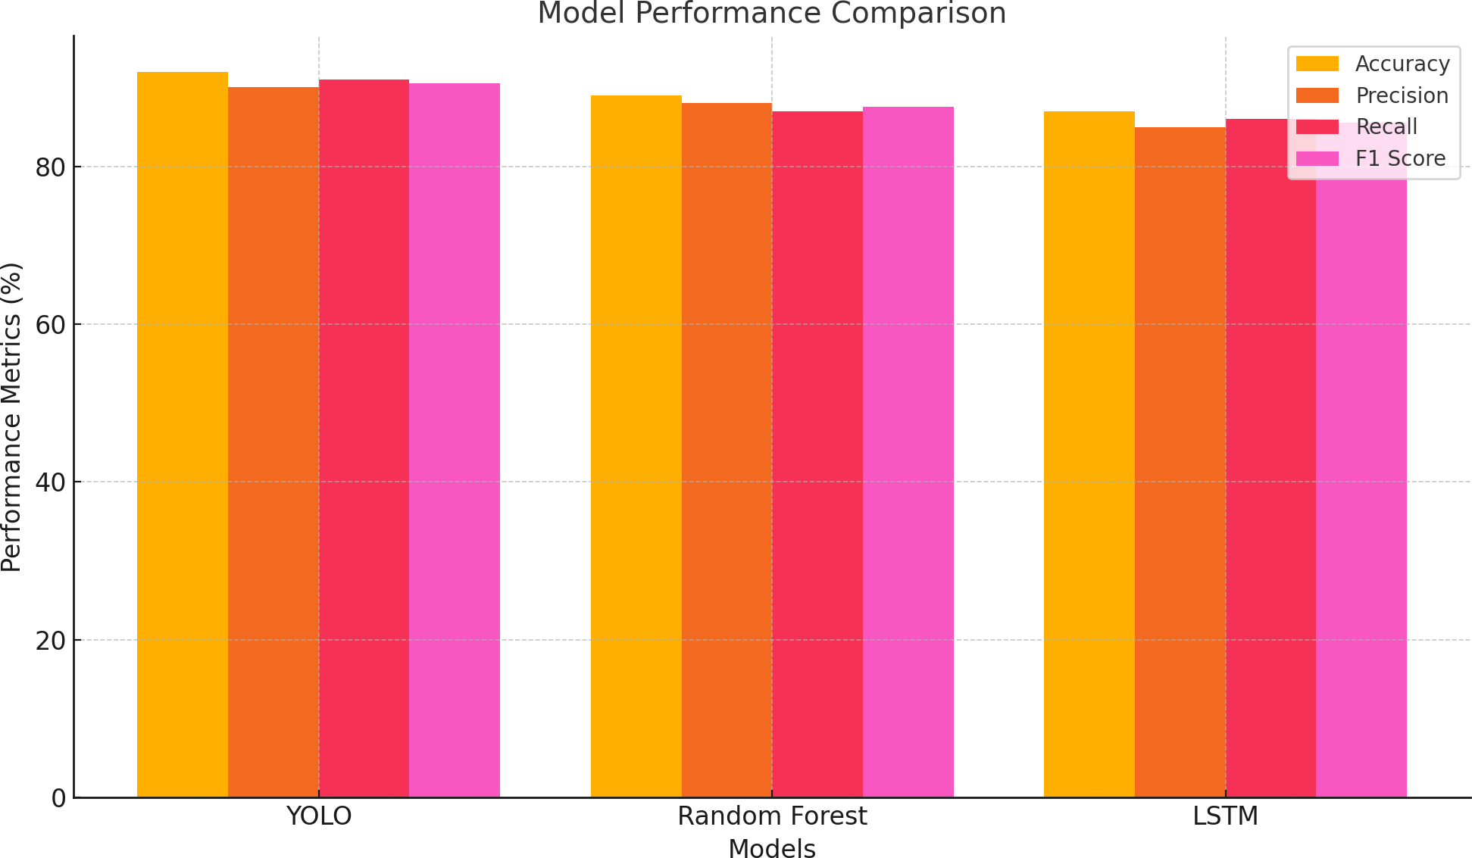
PERFORMANCE EVALUATION

Slide 20
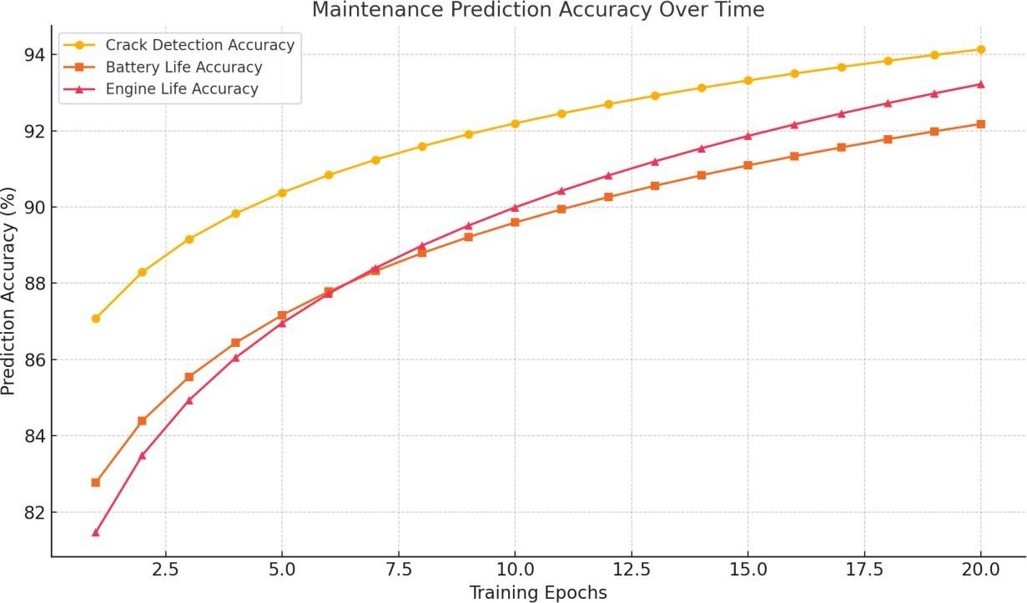
PERFORMANCE ACCURACY

Slide 21
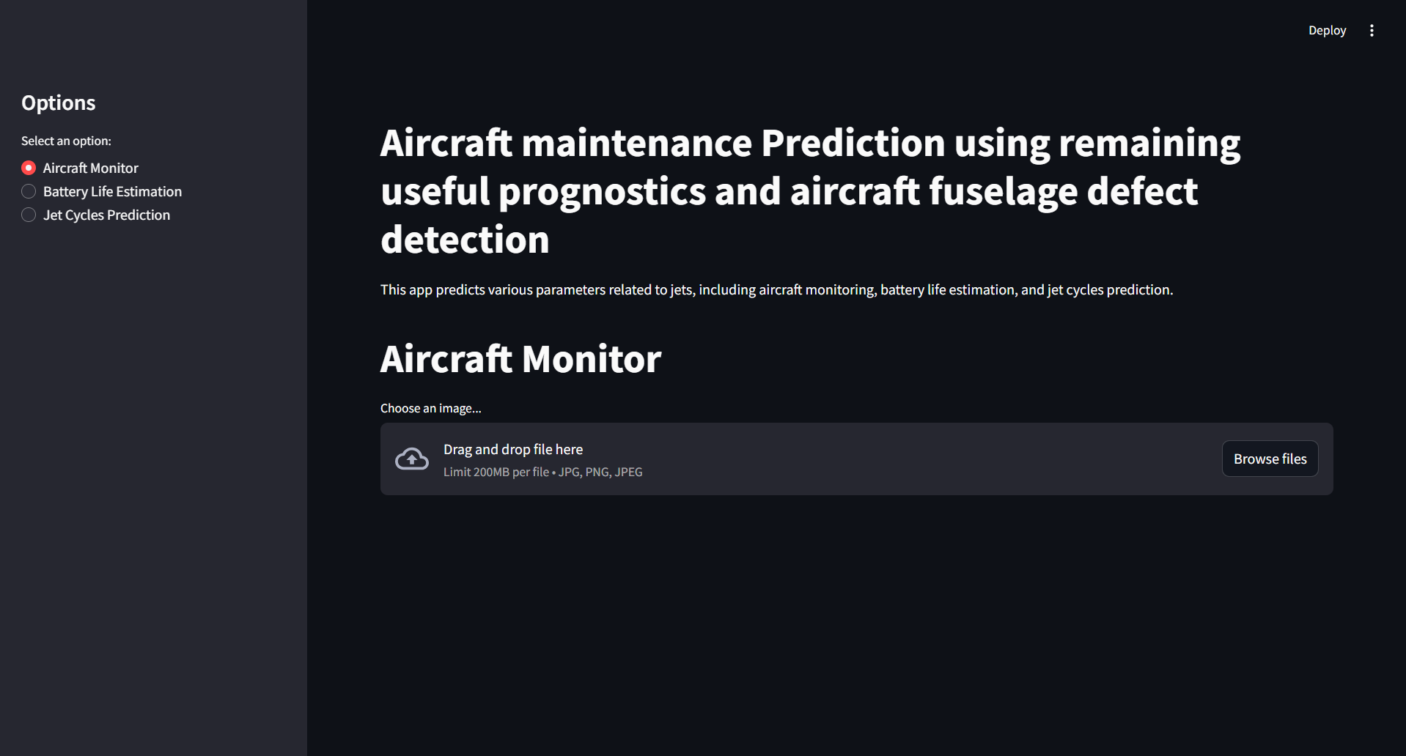
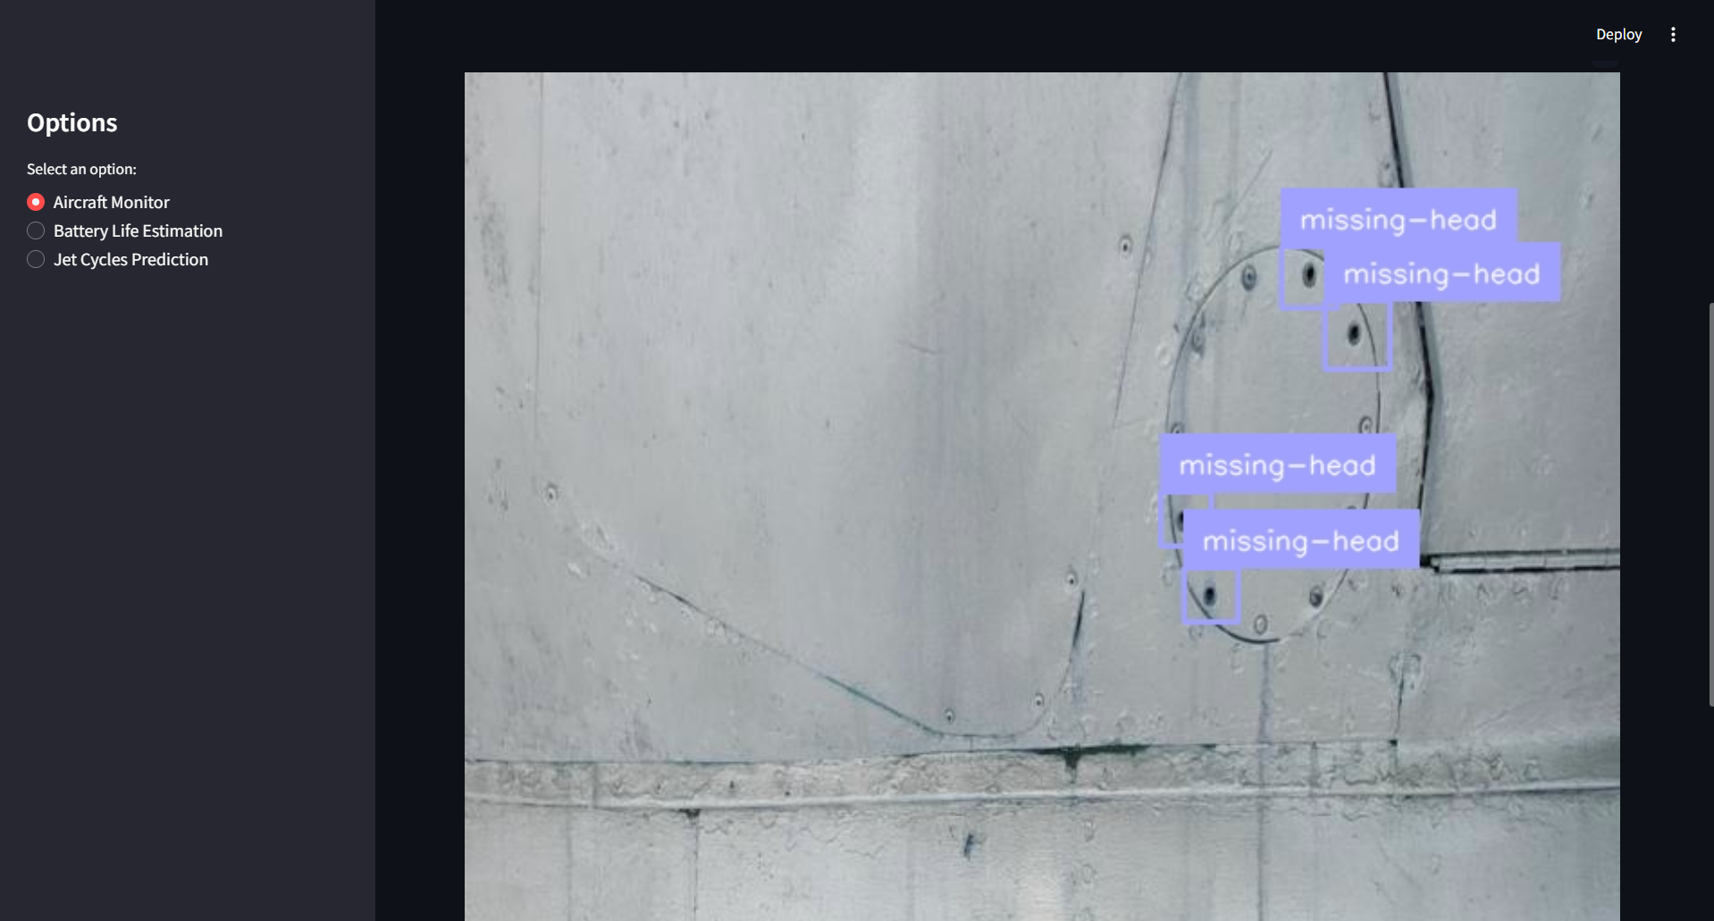
CRACK DETECTION OUTPUT

Slide 22
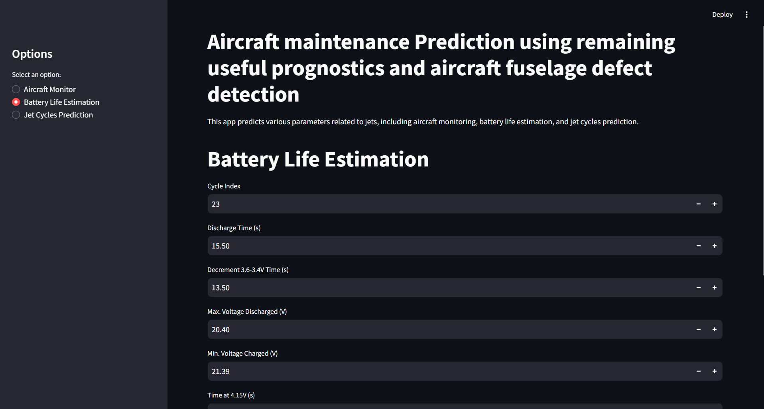
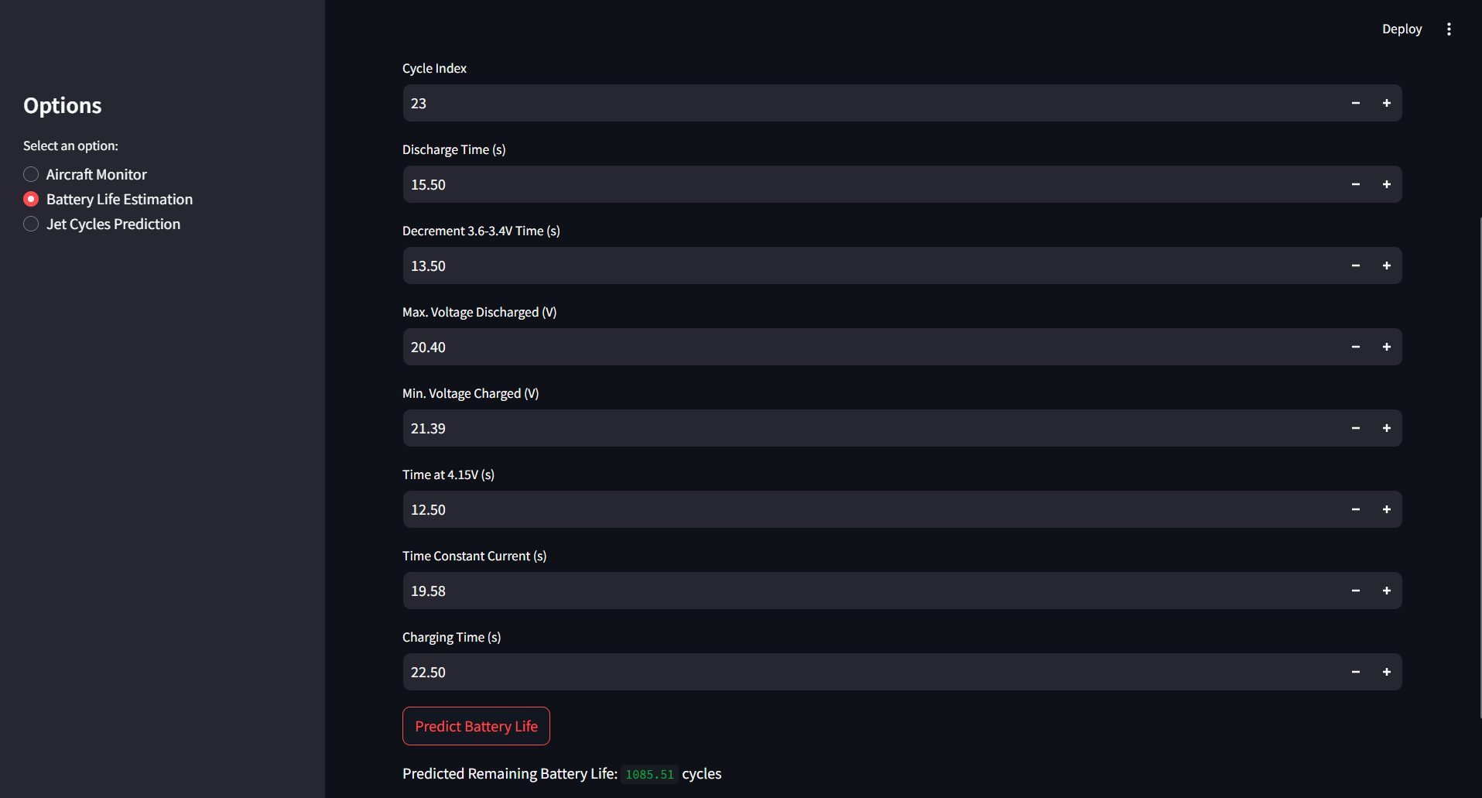
BATTERY LIFE ESTIMATION OUTPUT

Slide 23
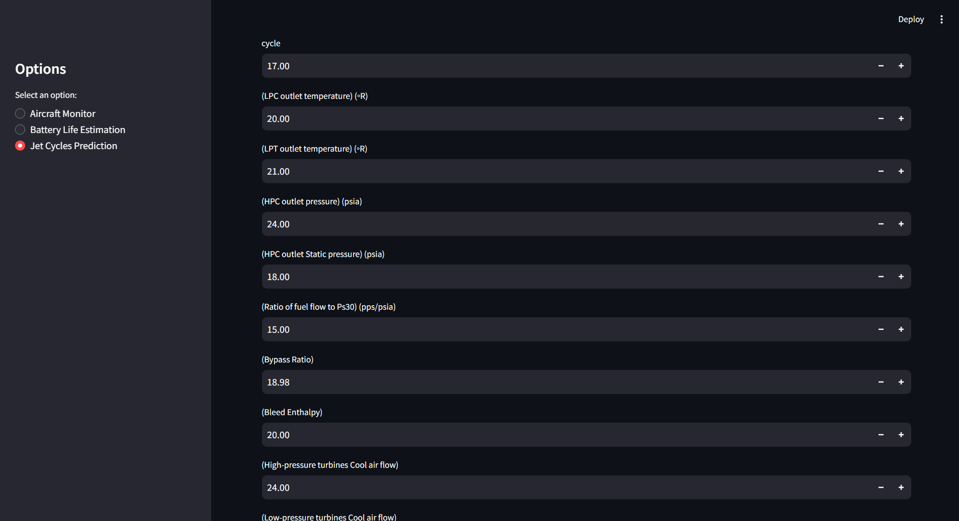
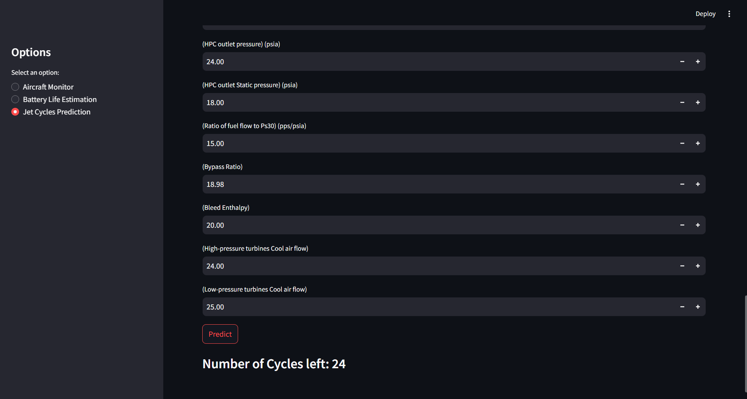
JET ENGINE PREDICTION OUTPUT

Slide 24
FEATURE ENHANCEMENT
Implement a system that processes live video feeds to detect cracks instantly, improving inspection efficiency.
Develop an AI-powered alert system that notifies engineers before potential failures occur, enabling proactive maintenance.
Connect smart sensors to aircraft components to collect real-time performance data for better predictive analysis.
Utilize cloud computing to store, manage, and analyze large datasets efficiently, ensuring easy access and scalability.
Create a mobile application that allows users to track aircraft maintenance status and receive alerts from anywhere.

Slide 25
CONCLUSION
The AI-driven system enhances aircraft safety, minimizes downtime, and reduces maintenance costs through real-time crack detection, battery life estimation, and predictive maintenance.
Real-time monitoring allows early fault detection, helping airlines optimize maintenance schedules and prevent failures.
The modular design enables customization for different aircraft by integrating additional sensors and data sources.
Future advancements should focus on lightweight AI models and transfer learning for better accessibility in resource-limited environments.
Addressing data privacy, transparency, and regulatory compliance is essential for industry-wide adoption and trust.

Slide 26
REFERENCE
Lei Shao, Jiawei He, Xia Lu, Bo Hei, Jiahao Qu, and Weihua Liu. (2024) Aircraft Skin Damage Detection and Assessment From UAV Images Using GLCM and Cloud Model, VOL. 25, NO. 3.
Kaledio Potter, Peter Broklyn, (2024). AI-BASED PREDICTIVE MAINTENANCE IN MANUFACTURING INDUSTRIES AI-Based Predictive Maintenance in Manufacturing Industries, 10.13140.
TIMJERDINE Mohammed, TAIBI Saoudi, MOUBACHIR Younes, (2024). Leveraging AI and Industry 4.0 in Aircraft Maintenance: Addressing Challenges and Improving Efficiency, 979-8-3503-7159-8/24.
Mr. Kondala Rao Patibandla, (2024). Predictive Maintenance in Aviation using Artificial Intelligence, 3006-4023.
Sohaib, M.; Arif, M.; Kim, J.-M. (2024) Evaluating YOLO Models for Efficient Crack Detection in Concrete Structures Using Transfer Learning. 14, 3928.

Slide 27
REFERENCE
Erna Shevilia Agustian, Zastra Alfarezi Pratama, (2024) Artificial Intelligence Application on Aircraft Maintenance: A Systematic Literature Review, 10.4108.
Smith, A., Johnson, T., & Lee, H. (2021). Real-time crack detection in aircraft structures using YOLO. IEEE Transactions on Aerospace, 57(3), 145-152.
Johnson, M., Kim, S., & Wang, X. (2022). Predictive maintenance of aircraft engines using machine learning. Journal of Aerospace Engineering, 34(4), 1223-1231.
Zhang, Y., & Liu, P. (2022). Battery life estimation for aircraft systems using deep learning. International Journal of Electrical Engineering, 48(2), 875-883.
Lee, B., Kumar, S., & Patel, D. (2023). Integrated approach for aircraft maintenance: Combining computer vision and predictive analytics. Aerospace Science and Technology, 92(6), 1302-1311.

