Slide 1


B V RAJU INSTITUTE OF TECHNOLOGY (UGC Autonomous) Vishnupur, Narsapur, Medak District
Department of CSE (Artificial Intelligence and Machine Learning)
Mini Project
Title : Utilizing GANs to solve Sequence Labelling Tasks
By:
MEDIPALLI NIKITHA
SAGILI NITHESH KUMAR REDDY
SHEELAPAKA YATHENDRA KUMAR
SUJITH GANESHUNI
: 22211A6667
: 22211A66A0
: 22211A66A5
: 22211A66B1
Supervisior:
Ms. Srilakshmi V
Co-Supervisior:
Mrs. B Lavanya

Slide 2
Outline
Introduction
Abstract
Problem Statement
Review of Literature
Methodology Adopted
Architecture Used
Implementation Details
Results and Discussions
Conclusion
References
© BVRIT CSE(AIML)

Slide 3
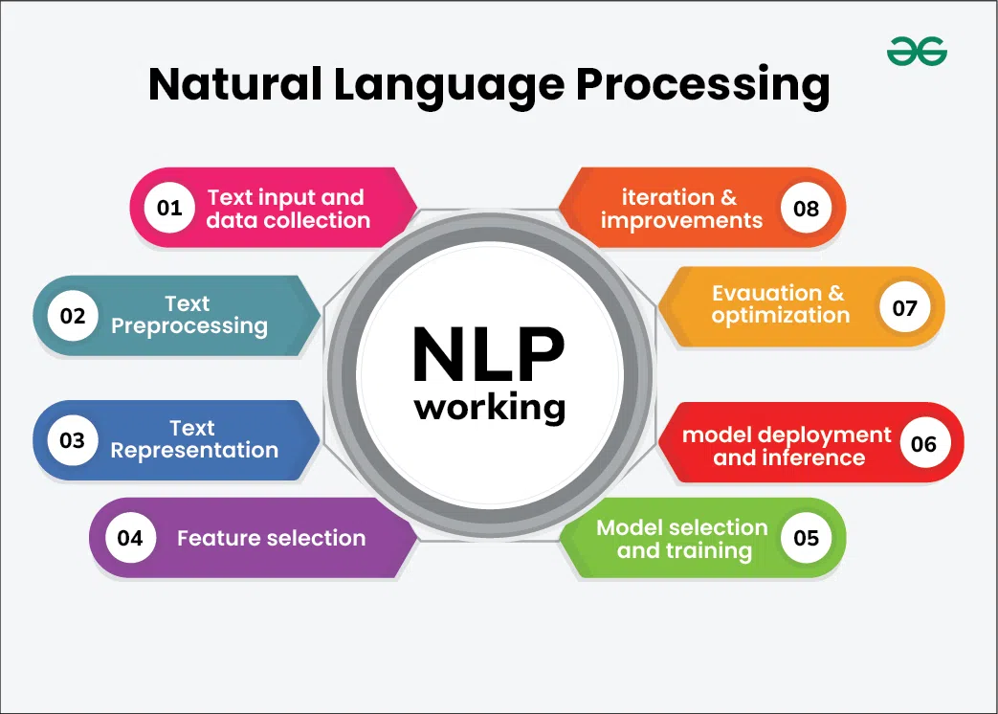
Introduction
Natural Language Processing (NLP) is a subfield of AI that enables machines to interpret, generate, and interact using human language.
Sequence Labeling is a foundational NLP task that involves assigning a categorical label to each token in a text sequence (e.g., a word or character).
It is essential for tasks like Named Entity Recognition (NER), Part-of-Speech (PoS) Tagging, Chunking, Semantic Role Labeling (SRL), and Grammatical Error Detection (GED).
Accurate sequence labeling is critical in real-world applications such as chatbots, information extraction, voice assistants, and grammar checking tools.
© BVRIT CSE(AIML)

Slide 4
Abstract
Despite its central role, sequence labeling faces persistent challenges. Traditional models, which often rely on supervised learning with pre-trained language models followed by sequence taggers such as Conditional Random Fields (CRFs), are highly dependent on the quality and domain coverage of annotated training data. This reliance leads to performance degradation in the presence of domain shifts
Our Goal in this project is to create a GAN based that is capable of handling domain shifts and enhances sequence labelling tasks.
© BVRIT CSE(AIML)

Slide 5
Problem Statement:
Difficulty in Sequence Labeling: Traditional models often struggle with tasks like NER and PoS tagging due to the challenges of handling unseen words and out-of-domain data.
Need for Robust Models: Current models are limited by their dependency on labeled data, making them vulnerable to performance degradation when faced with domain shifts or new words.
Lack of Adaptability: Many traditional models lack flexibility across multiple tasks and languages.
Need for Lightweight Models: We’ve seen various BERT based approaches to this problem but they’re computationally expensive and take up valuable time in Real time scenarios.
© BVRIT CSE(AIML)

Slide 6
Literature Survey
Year | Author Name | Title | Journal Name | Research Design | Conceptual/ Theoretical framework | Major theme in paper
2024 | Yu Tong, Ge Chen, Guokai, Zheng, Rui Li, Jiang Dazhi | When Generative Adversarial Networks Meet Sequence Labeling Challenges | ACL Anthology (EMNLP) | Develops SLGAN: a GAN-based framework for sequence labeling tasks with tag-level discriminator. | Redefines GANs for sequence labeling, with discriminator focusing on tag accuracy rather than real/fake judgment. | Versatile, cross-lingual sequence tagging using adversarial learning.
2021 | Wei Liu, Xiyan Fu, Yue Zhang, Wenming Xiao | Lexicon Enhanced Chinese Sequence Labeling Using BERT Adapter | ACL IJCNLP | Implements Lexicon Adapter within BERT to deeply integrate lexicon knowledge during training. | Deep fusion of lexicon data in early BERT layers improves contextual understanding in Chinese NER.. | Better Chinese sequence labeling via low-level lexicon integration in pre-trained models.
© BVRIT CSE(AIML)

Slide 7
Literature Survey
Year | Author Name | Title | Journal Name | Research Design | Conceptual/ Theoretical framework | Major theme in paper
2024 | Zhang,Y., Wang J., Chen X. & Li Y. | Recent Advances in NER: A Comprehensive Survey and Comparative Study | arXiv | Comprehensive literature review and performance benchmarking of recent NER models (Transformer-based, LLMs, etc.) across multilingual datasets. | Framework covers Transformer, LLM, RL, and graph-based NER models. Emphasizes comparative analysis across datasets and model architectures. | Comparative study of NER model performance across languages and methods.
2024 | Li H., Zhou T., & Zhang M. | Embedded Named Entity Recognition using Probing Classifiers | ACL Anthology (EMNLP) | Introduces probing classifier mechanism to extract entity labels from language models without full retraining. | Uses internal language model representations for lightweight and efficient NER without structural overhaul. | Efficient NER with minimal model modifications. High performance on biomedical and general datasets.
© BVRIT CSE(AIML)

Slide 8
Methodology Adopted :
Data Collection:
Using publicly available datasets like CoNLL-2003, CoNLL-2000, Brown Corpus
Data Preprocessing:
Mapping text labels into numeric IDs.
Converting all Input labels to PyTorch tensors.
Data Loader creates batches of data from these tensors
Model Development:
A Generator that generates Embedding using TinyBERT.
A Discriminator that classifies how correct a tag is by using Multi-head attention mechanism to focus on different parts of the Input sequence.
Loss Evaluation to backpropagate and finetune the parameters.
Evaluation:
F1-Score, Recall, Precision and accuracy are calculated to know the performance of the Methodology
© BVRIT CSE(AI & ML)

Slide 9
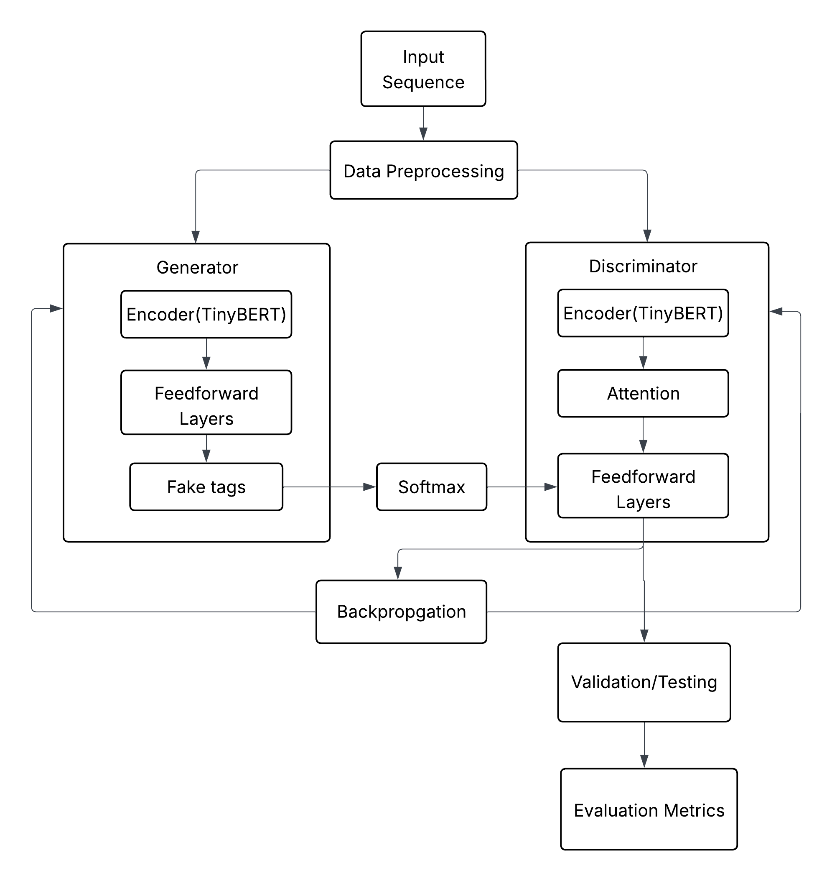
Architecture Used
© BVRIT CSE(AIML)

Slide 10
Implementation Details
Datasets: English datasets like CoNLL 2003(for NER), CoNLL 2000(for Chunking) and Brown Corpus(for PoS tagging) are used.
Hyperparameters: The model is trained with a batch size of 32, 128 sequence length, and an Adam optimizer with a learning rate of 2e-5​.
Evaluation Metrics: The performance is evaluated using metrics like F1 score, Recall, Precision focusing on the generalization ability of the model​.
Cross-Domain Evaluation: It is tested across various domains to find out how well it generalizes to other sequence labelling tasks.
© BVRIT CSE(AIML)

Slide 11
Results and Discussions
This GAN based framework achieves consistent performance across multiple sequence labelling tasks.
The Framework Generalizes well across different tasks and Provides results that rivals BERT+CRF model while taking nearly half the time to execute.
Task | F1-Score | Precision | Recall | Accuracy
NER | 95% | 95% | 94% | 95%
PoS Tagging | 94% | 95% | 95% | 94%
Chunking | 90% | 89% | 91% | 91%
© BVRIT CSE(AIML)

Slide 12
Conclusion
This GAN framework provides a powerful solution for sequence labeling tasks, improving accuracy, cross-domain scenarios all the while taking less resources to execute.
This framework also achieves similar results when compared to State-of-The-Art Models.
Future Works for this includes Exploring other sequence labeling tasks, such as dependency parsing or coreference resolution, using this GAN framework.
© BVRIT CSE(AIML)

Slide 13
References :
Zhang, Y., Wang, J., Chen, X., & Li, Y. (2024). Recent advances in named entity recognition: A comprehensive survey and comparative study. arXiV
Li, H., Zhou, T., & Zhang, M. (2024). Embedded named entity recognition using probing classifiers. Association for Computational Linguistics.
Tong, Y., Chen, G., Zheng, G., Li, R., & Dazhi, J. (2024). When generative adversarial networks meet sequence labeling challenges. Association for Computational Linguistics.
Liu, W., Fu, X., Zhang, Y., & Xiao, W. (2021). Lexicon enhanced Chinese sequence labeling using BERT adapter. Association for Computational Linguistics.
Singh, P., & Verma, R. (2024). Deep learning for named entity recognition: A survey. Soft Computing.
© BVRIT CSE(AIML)

Slide 14
Thank You
© BVRIT CSE(AIML)

