Slide 1
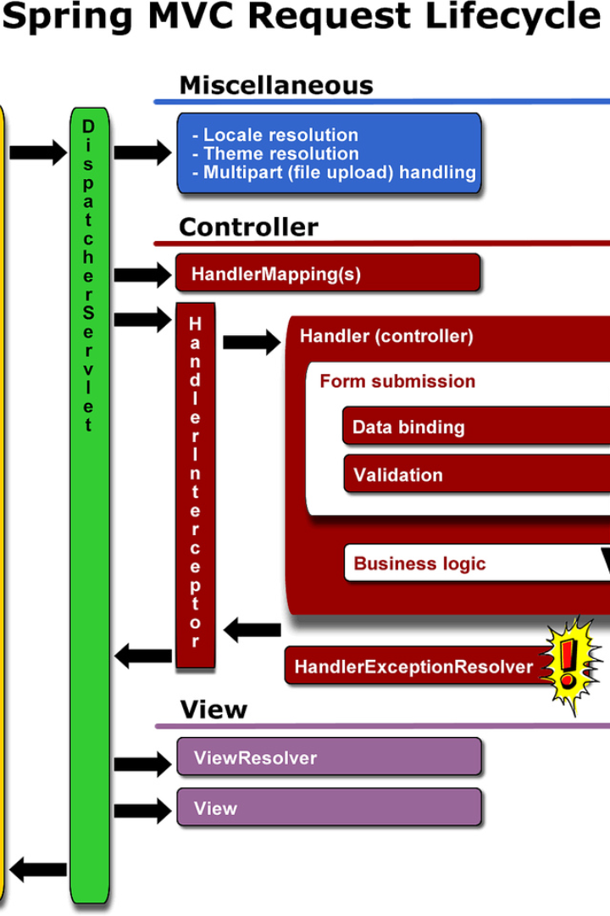
Let's Learn About Spring Framework
Spring Framework is an essential part of Java development. In this presentation, we will explore the benefits of using Spring and how it can make your programming life easier.

Slide 2
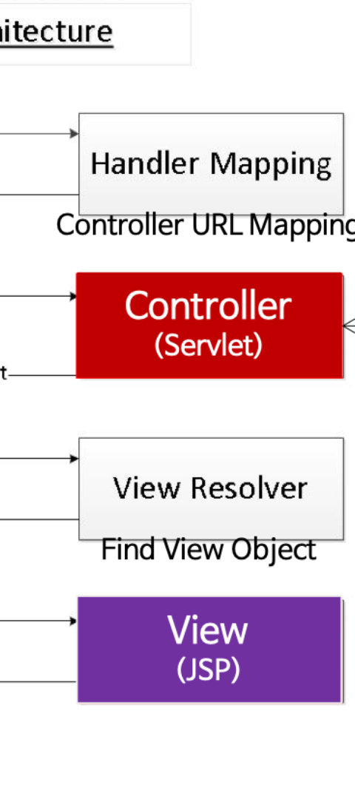
Why Use Spring Framework?
Modular Structure
Include only the modules you need, avoiding dependencies.
Ease of Development
Handle many tasks for you. Just a few lines of configuration and a couple of classes.
High Demand
Exciting job opportunities. Many positions require knowledge or familiarity with Spring.

Slide 3

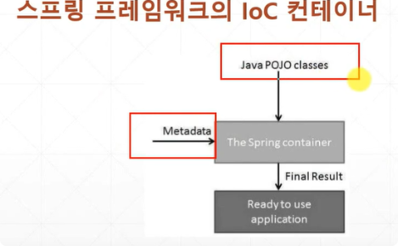
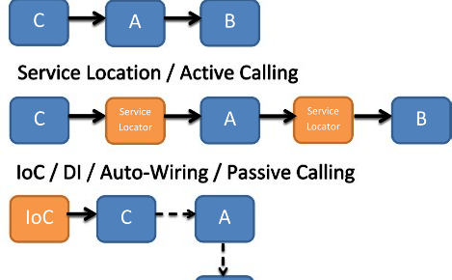
Beans and Inversion of Control
Beans
Inversion of Control (IoC)
Are simply objects of a certain class.
Taking control of the execution flow, calling your code at the appropriate times.
Dependency Injection (DI)
The framework provides the necessary dependencies instead of your classes depending on them.
Let's focus on DI and how we can store beans in the application context to access them when needed.

Slide 4
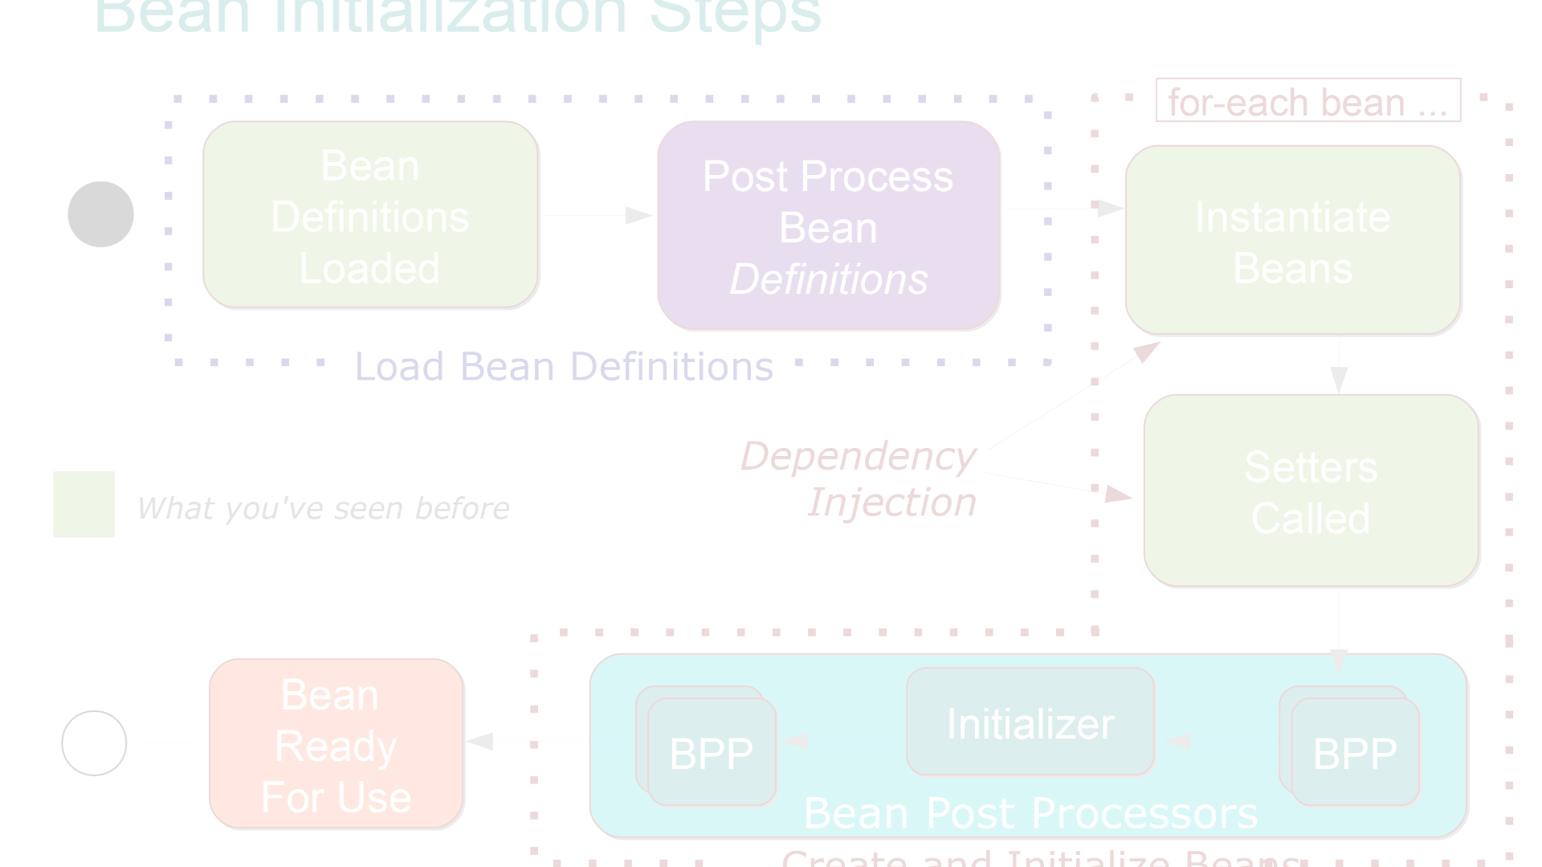
The Power of Application Context
1
Step 1: Storing Beans
Store all beans in an application context as a map.
Step 2: Retrieving Beans
2
Retrieve beans when needed by name or type.
3
Step 3: Passing Beans
The framework hands over the control to the beans you need.
Using Spring, we don't need to pass beans around everywhere. Instead, we can use the shared application context to store and retrieve them.

Slide 5
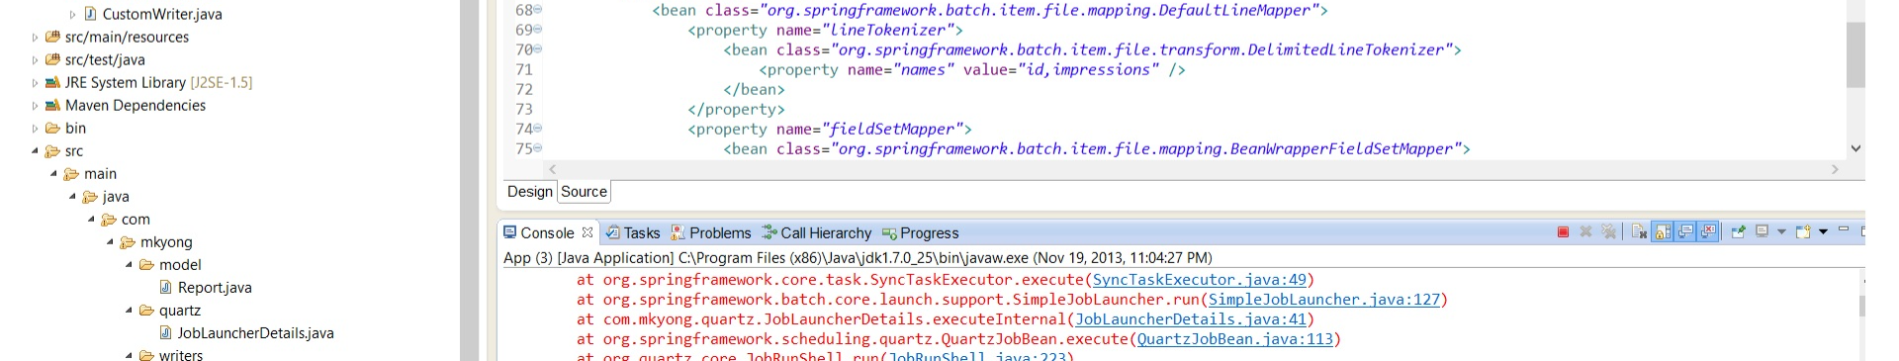
Configuring the Application
1
XML configuration
2
Java configurations
3
Automatic Configuration
Traditional way to configure the application in XML files.
Becoming more popular to configure the application in Java.
Spring takes care of the configuration.
Spring provides different configuration options and suggests which one to use. Let's focus on the automatic and Java configurations.

Slide 6
Automatic Configuration in Spring
Pros
Cons
Quickly creates a working project
Harder to understand the inner workings
No configuration is needed
Can't fine-tune specific settings
Easily customizable
Can't handle advanced configurations
Automatic configuration comes with high-level defaults and is suitable for most projects. It's the fastest and simplest way of using Spring.

Slide 7
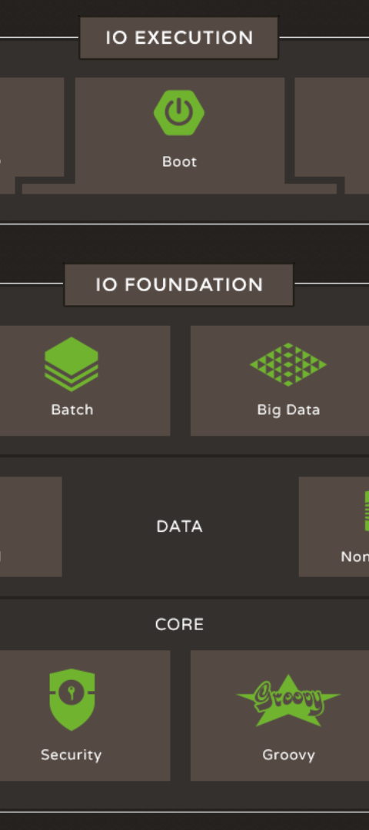
Java Configuration in Spring
1
Step 1: Create Configuration Class
Create a class with methods to define beans.
2
Step 2: Annotate Configuration
Annotate the configuration class with @Configuration.
3
Step 3: Retrieve Beans
Retrieve beans from the context when needed.
Java Configuration provides a more readable way of configuring Spring. It's ideal for large projects that require special settings.

Slide 8
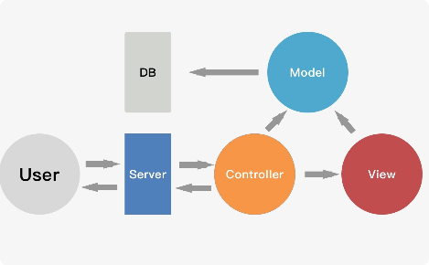


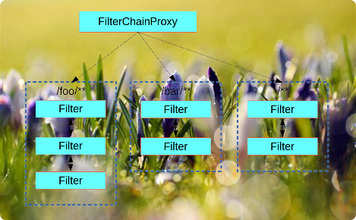
Spring Modules
Data Access
Web
Helps with data management
Provides web features for building RESTful applications
Core
Security
The foundation of the framework
Secures applications
Spring Framework is not a single framework but rather a collection of smaller frameworks, each serving a specific purpose. The modular structure of Spring helps you to avoid unnecessary dependencies.

Slide 9
Spring Boot: Another Level of Abstraction
Abstracts away boilerplate code
Automatically configures the application
Built-in features
Includes many useful features and libraries.
Write less code than ever before. Most configurations are automated.
Focus on your code and let Spring Boot handle the rest.
Spring Boot is another level of abstraction above the Spring Framework. It's an opinionated framework that minimizes boilerplate code and offers many built-in features.

Slide 10
Conclusion
Benefits
What We Learned
Simplifies development process
What Spring Framework is
Modular and flexible structure
How to use beans and application context
Many job opportunities
How to configure the application using Java and automatic configurations
Spring Framework is a popular framework that helps developers to write less code and focus on their business logic. Understanding the core concepts of Spring allows you to master modern Java web development.

