Slide 1



Smarter Commerce: Data-Driven Insights & Predictive Modeling
Amazon | Meesho| Flipkart

Slide 2
PROBLEM STATEMENT:
Why eCommerce Needs Data Intelligence ?
1. Data Overload, Insights Deficit Modern eCommerce platforms generate massive volumes of data (sales, traffic, reviews, returns), but most of it goes unanalyzed—leading to missed business opportunities.
2. Dynamic Customer Behavior Customers switch preferences fast. Without data intelligence, brands struggle to keep up with trending products, pricing sensitivity, and seasonal shifts.
3. Fierce Competition With multiple platforms (Amazon, Meesho, Flipkart) vying for market share, businesses need data-driven strategies to stand out.
4. Forecasting Challenges Inaccurate demand forecasting can lead to overstocking, understocking, or poor resource allocation—directly impacting profitability.
5. Lack of Platform Comparability Without integrated analysis across platforms, businesses can’t identify which marketplace yields the best ROI, product category performance, or pricing advantage.

Slide 3
PROJECT GOALS
Our Objectives:
1. Build an Interactive Analytics Dashboard To visualize key metrics like sales trends, product performance, customer ratings, and platform comparisons in real-time.
2. Compare Performance Across Platforms To analyze and contrast Amazon, Meesho, and Flipkart on pricing, ratings, categories, and customer behavior.
3. Develop Predictive Models To forecast future sales and customer demand using machine learning techniques (e.g., XGBoost, ARIMA).
4. Uncover Actionable Insights To identify trends, opportunities, and anomalies that can inform business strategy and drive growth.
5. Enhance Decision-Making with Data To enable data-backed decisions for inventory planning, marketing, and platform optimization.

Slide 4
Datasets Overview
Amazon Dataset
Source: Kaggle
Contents:
Product listings (name, category, subcategory)
Prices and discounts
Customer ratings and reviews
Availability and delivery information
Meesho Dataset
Source: Kaggle
Contents:
Product titles and descriptions
Price and discounted price
Rating distribution
Product categories (fashion, home, electronics)
Flipkart Dataset
Source: Kaggle
Contents:
Product names and brand info
Original vs. discounted prices
Customer ratings and review counts
Category and subcategory classification

Slide 5
Data Transformation Pipeline
1. Missing Value Handling
Imputed missing prices, ratings, and review counts using mean, median, or nearest-neighbor techniques
Removed entries with critical missing identifiers (e.g., product name)
2. Data Normalization & Standardization
Scaled numeric fields (prices, ratings) to a common range
Converted currencies and formatted text fields uniformly
3. Duplicate & Irrelevant Data Removal
Identified and removed duplicate products based on title and SKU
Filtered out irrelevant or non-eCommerce entries (ads, placeholders)
4. Category & Text Cleaning
Standardized category names across platforms for comparison
Removed HTML tags, emojis, and special characters from text fields
5. Feature Engineering
Extracted new features:
Price gap = Original Price - Discounted Price
Review score bins = Low, Medium, High
Platform tag = Amazon / Meesho / Flipkart

Slide 6
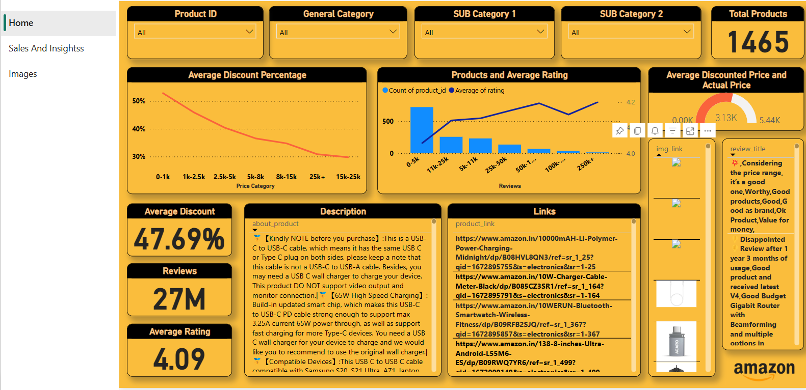
Interactive Dashboard Highlights
Our custom-built dashboard empowers users to explore and compare key eCommerce metrics across Amazon, Meesho, and Flipkart through dynamic visualizations.

Slide 7
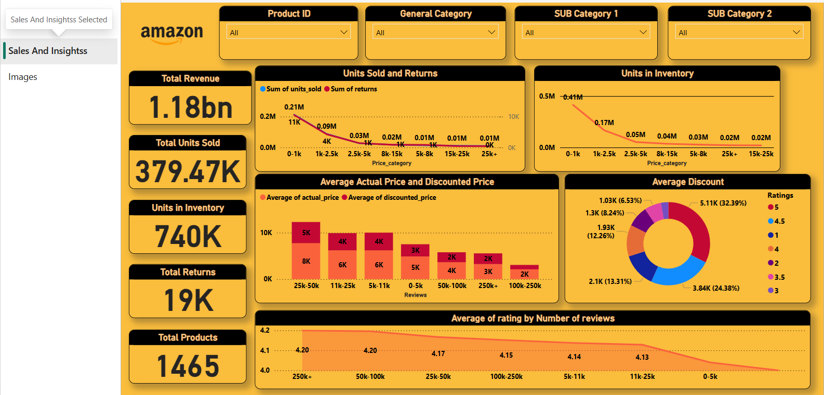

Slide 8
Predictive Modeling
Models Used
XGBoost Regressor For high-performance price and sales volume prediction using structured features.
ARIMA (AutoRegressive Integrated Moving Average) For time series forecasting of daily/weekly sales trends.
Random Forest & Decision Trees For feature importance analysis and interpretable predictions.
Feature Inputs
Product price & discount
Category & subcategory
Rating, review count, and sentiment
Platform identifier (Amazon, Meesho, Flipkart)
Historical sales data (where available)
Evaluation Metrics
MAE (Mean Absolute Error)
RMSE (Root Mean Square Error)
R² Score Used to evaluate the accuracy and robustness of our predictive models.
Key Findings
Pricing and ratings are strong predictors of sales
Meesho categories show higher price elasticity
Seasonal patterns significantly influence demand across all platforms

Slide 9
What We Discovered
Our analysis uncovered critical insights that highlight platform-specific strengths, consumer trends, and growth opportunities:
Platform Performance
Amazon leads in customer satisfaction, with the highest average rating and review volume.
Meesho excels in budget-friendly categories, especially fashion and home essentials.
Flipkart offers the most aggressive discounts in electronics and accessories.
Category Trends
Fashion and Electronics consistently rank as top-selling categories across all platforms.
Products in the Home & Kitchen category show higher average customer ratings.
Customer Behavior
Products with ratings above 4.0 and more than 100 reviews are significantly more likely to convert.
Visual-heavy listings (e.g., better images, clearer descriptions) correlate with higher engagement
Price vs. Sales Correlation
Lower-priced items with high ratings perform best on Meesho.
On Amazon, moderately priced items with premium branding perform better.
Predictive Modeling Impact
Forecasts suggest an uptick in seasonal demand for fashion and mobile accessories during sale periods.
Our model predicts a 15–25% sales increase for high-rated, discounted items over the next quarter.

Slide 10
Hurdles We Faced
During our project, we encountered several technical and analytical challenges that shaped how we handled the data and built our models:
Inconsistent Data Formats
Each dataset had different structures, naming conventions, and units.
Required significant standardization for cross-platform comparison.
Missing & Noisy Data
Many records lacked key information like ratings, reviews, or prices.
Text fields had inconsistent formatting, spelling errors, and unnecessary symbols.
Unaligned Product Categories
Categories varied widely between Amazon, Meesho, and Flipkart (e.g., "Mobile Accessories" vs. "Smartphone Gadgets").
Required manual and programmatic mapping for uniform analysis.
Lack of Real-Time Sales Data
Static datasets limited our ability to validate trends over time.
Hindered temporal forecasting beyond a certain point.
Model Generalization Issues
Models performed differently across platforms due to varied data volume and quality.
Required fine-tuning for each platform to avoid overfitting.

Slide 11
PROJECT OUTCOMES AND FUTURE
Project Outcomes
Built an interactive dashboard to compare Amazon, Meesho, and Flipkart
Developed accurate sales forecasting models using real-world eCommerce data
Uncovered platform-specific insights to guide pricing and category strategy
Future Work
1. Expand Platform Coverage
Integrate more marketplaces like Myntra, Nykaa, and JioMart
Enable broader industry comparisons
2. Real-Time Data Integration
Shift from static Kaggle datasets to live API feeds for dynamic analysis and forecasting
3. Advanced Customer Segmentation
Use clustering and deep learning to group users based on behavior and preferences
4. Recommendation Engine Integration
Suggest products based on rating, price sensitivity, and previous purchases using collaborative filtering
5. Deploy Dashboard as a SaaS Tool
Make the dashboard accessible to small businesses for self-service eCommerce analytics

Slide 12
References
Kaggle Datasets
Amazon Product Data: https://www.kaggle.com/datasets
Meesho Product Listings: https://www.kaggle.com/datasets
Flipkart Product Data: https://www.kaggle.com/datasets
Libraries & Tools Used
Python, Pandas, NumPy, Scikit-learn, Matplotlib, Seaborn
XGBoost, ARIMA (from statsmodels), Streamlit / Power BI (for dashboard)
Inspiration & Documentation
Scikit-learn Documentation: [https://scikit-learn.org/stable/]
Streamlit Docs (if used): [https://docs.streamlit.io]
ARIMA Tutorial – StatsModels: [https://www.statsmodels.org]

