Slide 1
PUBLIC TRANSPORT OPTIMIZATION

Slide 2
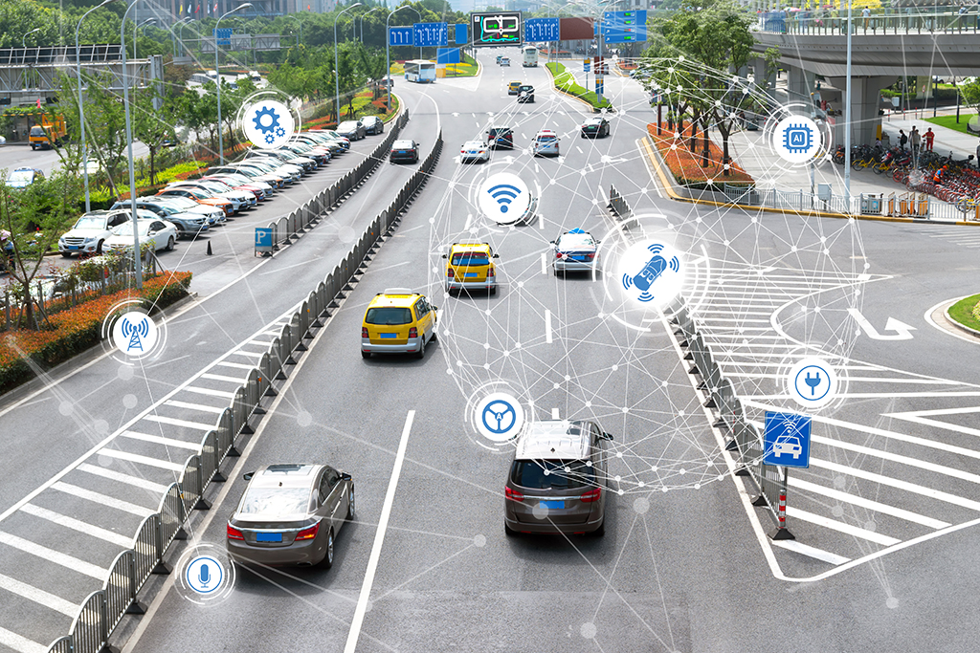
PROJECT DEFINITION :
The project involves integrating IoT sensors into public transportation vehicles to monitor ridership, track locations, and predict arrival times. The goal is to provide real-time transit information to the public through a public platform, enhancing the efficiency and quality of public transportation services. This project includes defining objectives, designing the IoT sensor system, developing the real-time transit information platform, and integrating them using IoT technology and Python

Slide 3
CONTENTS OF THIS TEMPLATE
Project objectives
Deployment Plan for IoT Sensors in Public Transportation Vehicles
Design of a Web-Based Real-Time Transit Information Platform
To enable IoT sensors on public transportation vehicles to send data to the real-time transit information platform, a communication architecture needs to be established. Here's a highlevel overview of how this data transmission can be ach

Slide 4
PROJECT OBJECTIVES:
Certainly, let's define the objectives for the project, including realtime transit information, arrival time prediction, ridership monitoring, and enhanced public transportation services:
1. Real-Time Transit Information:
Objective:
To provide passengers with accurate and up-to-date information about the status and location of public transportation vehicles in real-time.
Rationale:
Real-time transit information ensures that passengers can make informed decisions about when and where to catch a vehicle, reducing wait times and increasing overall satisfaction.
2. Arrival Time Prediction:
Objective:
To predict and display estimated arrival times of public transportation vehicles at different stops along their routes.

Slide 5
Rationale:
Arrival time prediction helps passengers plan their journeys more efficiently, reducing uncertainty and making public transportation a more attractive option.
3. Ridership Monitoring:
Objective:
To track the number of passengers on board each public transportation vehicle at any given time.
Rationale:
Ridership monitoring allows transportation authorities to optimize routes and schedules, ensuring that vehicles are appropriately sized to meet demand and improve service quality.

Slide 6
4. Enhanced Public Transportation Services:
Objective:
To improve the overall quality and convenience of public transportation services for passengers.
Rationale:
By offering real-time information, optimizing routes, and enhancing the overall passenger experience, the project aims to make public transportation a more attractive and reliable option for the public, thereby increasing ridership and reducing traffic congestion
These objectives form the foundation of the project and serve as guiding principles to create a system that benefits both transportation authorities and passengers alike.

Slide 7
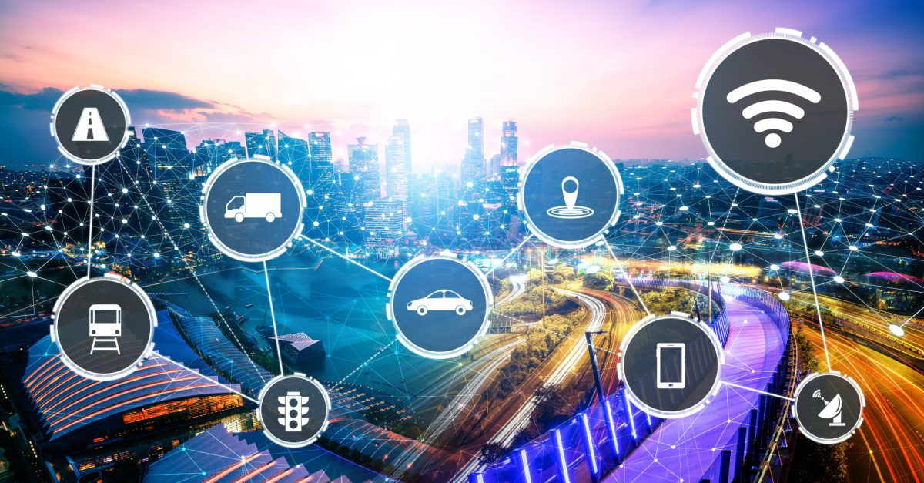
Deployment Plan for IoT Sensors in Public Transportation Vehicles :
To effectively monitor ridership, track vehicle locations, and predict arrival times, we need a well-planned deployment of IoT sensors in public transportation vehicles. Here's a step-by-step plan for deploying these sensors:
1. Sensor Selection:
a. GPS Sensors:
Select high-accuracy GPS sensors capable of realtime tracking and location data transmission.
b. Passenger Counters:
Choose reliable passenger counting sensors that accurately record the number of passengers entering and exiting the vehicle

Slide 8
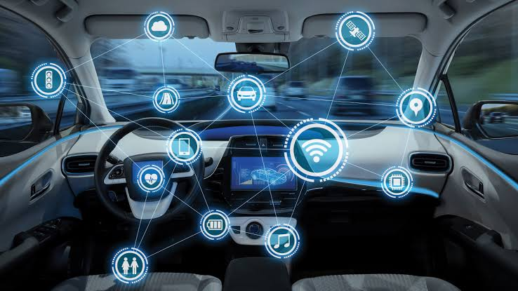
2. Vehicle Assessment:
a. Identify Vehicle Types:
Determine the types of public transportation vehicles to be equipped with sensors (e.g., buses, trams, trains). b. Sensor Place
b. Sensor Placement:
For each vehicle type, identify optimal sensor placement locations. For GPS sensors, they should have a clear line of sight to the sky for accurate positioning. Passenger counters should be strategically placed near entry/exit points

Slide 9
Design of a Web-Based Real-Time Transit Information Platform :
Creating an effective web-based platform to provide real-time transit information to passengers requires careful planning and consideration of user needs. Here's a design framework for such a platform :
1. User-Friendly Interface:
• Clean and Intuitive Design:
The platform should have a userfriendly and intuitive design with a clear layout, easy navigation, and well-organized informat
• Responsive Design:
Ensure that the platform is responsive, adapting seamlessly to various screen sizes and devices, including smartphones, tablets, and desktops.

Slide 10
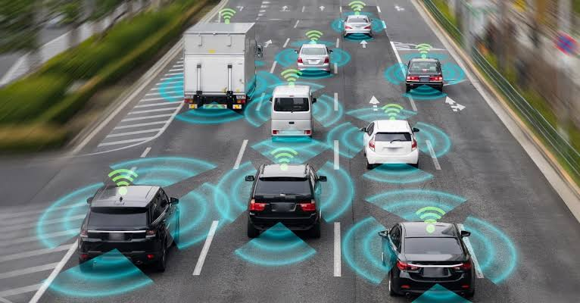
2. Real-Time Map:
• Live Vehicle Tracking:
Display a map that shows the real-time locations of all public transportation vehicles. Icons or markers representing vehicles should move in sync with their actual positions.
• Interactive Features:
Allow users to click on vehicle icons for additional information, such as vehicle number, route, and estimated arrival time at their location.

Slide 11
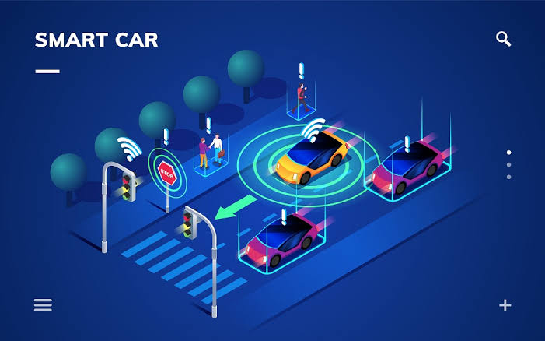
3. Arrival Time Predictions:
• Destination Input:
Provide a search bar or input field where users can enter their destination or select it from a list of predefined stops.
• Estimated Arrival Times:
Once a destination is selected, display estimated arrival times for public transportation vehicles at the chosen stop or destination.

Slide 12
4. Ridership Information:
• Crowd Density Indicators:
Include indicators or color-coded icons to represent the crowd density on each vehicle (e.g., green for light, yellow for moderate, red for crowded).
• Capacity Alerts:
Alert users when a vehicle is nearing full capacity and suggest alternatives if available.
5. Service Alerts:
• Notifications:
Display service alerts, such as delays, diversions, or other relevant information prominently on the platform.
• Push Notifications:
Allow users to subscribe to push notifications for real-time updates about their selected routes or stops.

Slide 13
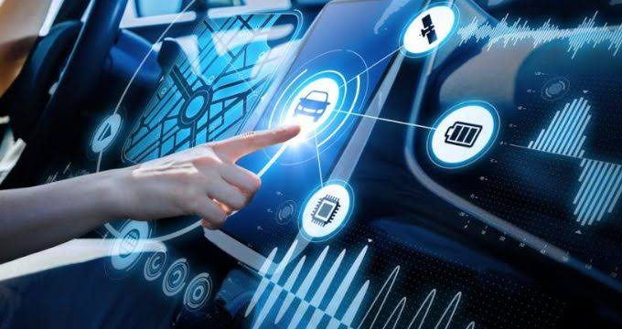
6. Accessibility:
• Accessibility Features:
Ensure the platform is accessible to users with disabilities by providing features like screen reader compatibility, alt text for images, and keyboard navigation.
• Multilingual Support:
Offer support for multiple languages to accommodate a diverse user base.

Slide 14
7. User Account and Personalization:
• User Profiles:
Allow users to create accounts to save their favorite routes and receive personalized transit alerts.
• History and Favorites:
Provide a history of recent searches and the ability to mark favorite routes or stops for quick access.
8. Feedback and Support:
• Feedback Mechanism:
Include a feedback button or form for users to report issues or provide suggestions.
• Customer Support:
Offer contact information for customer support or transit authorities for users with specific inquiries or concerns.

Slide 15
To enable IoT sensors on public transportation vehicles to send data to the real-time transit information platform, a communication architecture needs to be established. Here's a highlevel overview of how this data transmission can be achieved:
1. Sensor Data Collection:
• IoT sensors, including GPS sensors and passenger counters, continuously collect relevant data while the public transportation vehicles are in operation. GPS sensors capture location data, while passenger counters record passenger entries and exits.
2. Data Processing on Vehicles:
• Implement onboard data processing capabilities on the vehicles to prepare the collected data for transmission. This may include data aggregation, formatting, and basic validation.

Slide 16
3. Local Data Storage:
• Implement onboard data processing capabilities on the vehicles to prepare the collected data for transmission. This may include data aggregation, formatting, and basic validation.
4. Communication Protocols:
• Select appropriate communication protocols for data transmission, taking into account the connectivity options available. Common options include:
• Cellular Networks:
Use 4G/5G or other cellular data connections for real-time data transmission. This is a reliable option for urban areas.
• Wi-Fi:
If the vehicles have onboard Wi-Fi, it can be used for data transmission, especially within depots or transit hubs.

Slide 17
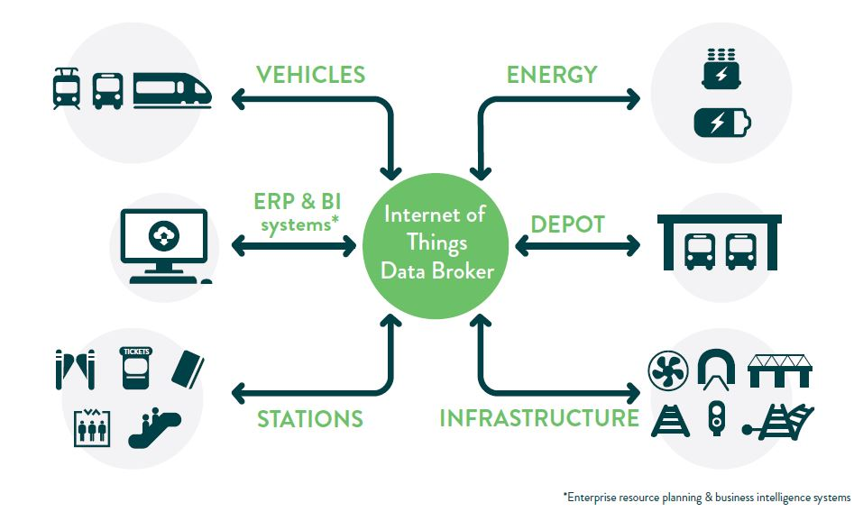
5. Data Encryption and Security:
• Encrypt sensor data during transmission to ensure data privacy and security. Utilize secure communication protocols (e.g., HTTPS) and encryption methods to safeguard the data from unauthorized access.

Slide 18
THANK YOU
These are the topics of (phase-1) PUBLIC TRANSPORT OPTIMIZATION
Presented by :
NILAASRI M
422621104030
University College of Engineering
Panruti.

