Slide 1
Introduction to
Step1- “class”
for JAVA Project
{
< Here is where our Presentation begins >
}
...

Slide 2
Table of contents
01
02
03
Output Of Step1 class
Contains the output image of the step1 class
UML image of Step1
Contains the UML image of the step1 class
Conclusion
Conclusion of this class

Slide 3

A picture is worth a thousand words

Slide 4

A picture always reinforces
the concept
Images reveal large amounts of data, so remember: use an image instead of a long text. Your audience will appreciate it
*

Slide 5
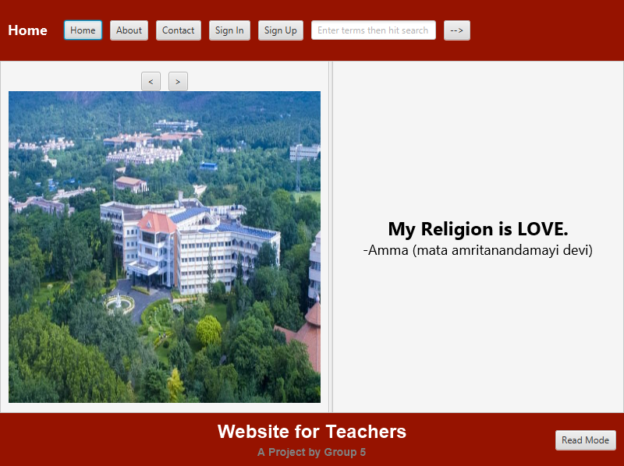
Output GUI Home-Page
{
This is the home page of our java-project, this home page is for the teacher’s side. Like any website, this has an image and quotes only of amrita college.
}
...

Slide 6
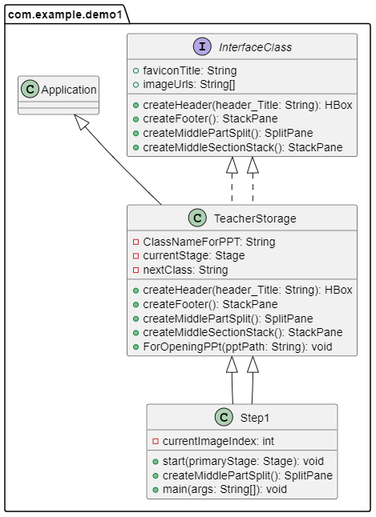
UML Image
{
UML image of the “Step1” class, the header and footer is inherited from the abstract class-“TeacherStorage” and all other classes, variables, etc are also inherited from interface “InterfaceClass”
}

Slide 7

Conclusion
{
This is just a class which is is similar to home-page of any website
}
...

Slide 8
Thanks!

