Slide 1
Introduction to Step2- “class” for JAVA Project
{
< Here is where your presentation begins >
}
...

Slide 2
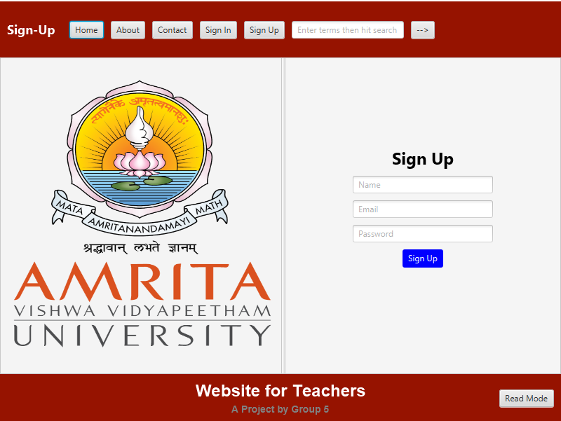
Output GUI Sign up-Page
{
This is the Sign-up page of our java-project after the verification process is done the teacher enters this sign-up page, and enters his/her personal email ID and password.
}
...

Slide 3
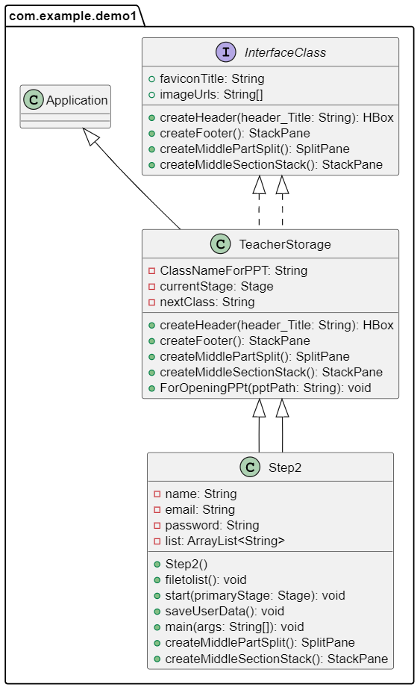
UML Image
{
UML image of the “Step2” class, the header and footer is inherited from the abstract class-“TeacherStorage” and all other classes, variables, etc are also inherited from interface “InterfaceClass”
}

Slide 4

Phone mockup
{
You can replace the image on the screen with your own work. Just right-click on it and select “Replace image”
}
...

Slide 5
A timeline always works well
{
*
Venus is the second planet from the Sun
Despite being red, Mars is a very cold place
Mercury is the closest planet to the Sun
Jupiter is the biggest planet of them all
}

Slide 6
Initially-2 in the user_data.txt
{
name | Collegeid | password1 | email | password2
Nilavarasan | 825746 | nilanila123 | nila012@gamil.com | nilanila321
Manimaran | 830644 | manimani321 | mani@gmail.com | maninila
Priya | 757712 | 123456pri | Priya@gmail.com | nilapriya
}

Slide 7
Thanks!

