Slide 1
Introduction to Step4- “class” for JAVA Project
{
< Here is where your presentation begins >
}
...

Slide 2
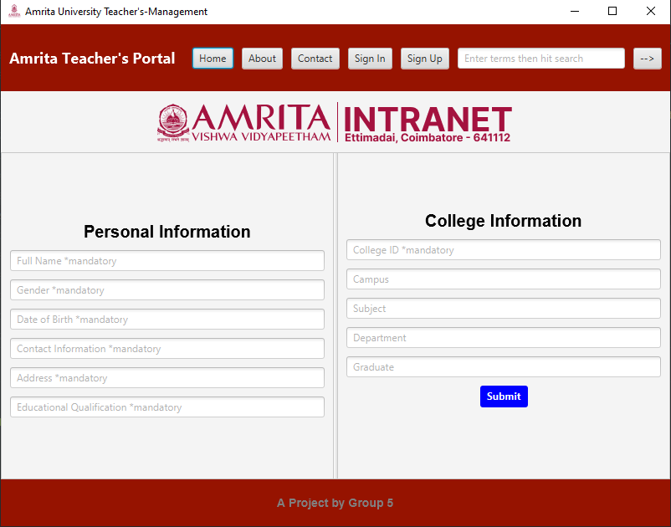
Output GUI info-Page
{
This is the info page of our java-project after the Sign-Up process is done the teacher enters this info page, and enters his/her personal info.
}
...

Slide 3
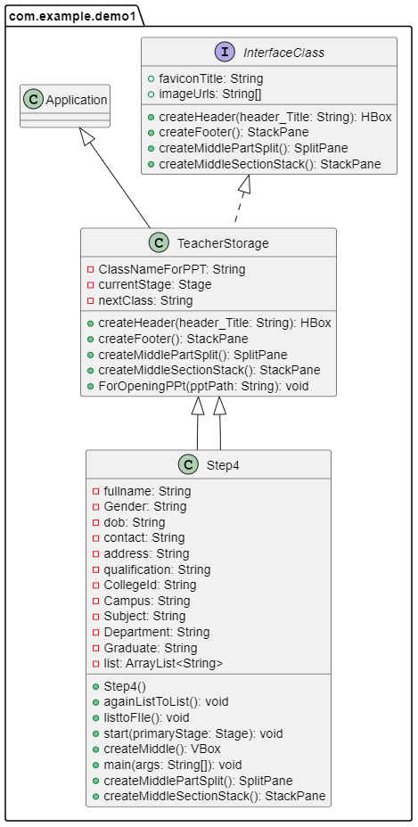
UML Image
{
UML image of the “Step4” class, the header and footer is inherited from the abstract class-“TeacherStorage” and all other classes, variables, etc are also inherited from interface “InterfaceClass”
}

Slide 4

Phone mockup
{
You can replace the image on the screen with your own work. Just right-click on it and select “Replace image”
}
...

Slide 5
A timeline always works well
{
*
Venus is the second planet from the Sun
Despite being red, Mars is a very cold place
Mercury is the closest planet to the Sun
Jupiter is the biggest planet of them all
}

Slide 6
Initially-3 in the user_data.txt
{
name | Collegeid | password1 | email | password2 | Fullname | Gender | DOB | Contact | Address | ..
Nilavarasan | 825746 | nilanila123 | nila012@gamil.com | nilanila321 | a | a | a | a | a | ..
Manimaran | 830644 | manimani321 | mani@gmail.com | maninila | b | b | b | b | b | ..
Priya | 757712 | 123456pri | Priya@gmail.com | nilapriya | c | c | c | c | c | ..
}

Slide 7
Thanks!

