Slide 1
JAVA DEVELOPMENT KIT
The Java Development Kit (JDK) is a cross-platformed software development environment that offers a collection of tools and libraries necessary for developing Java-based software applications and applets. It is a core package used in Java, along with the JVM (Java Virtual Machine) and the JRE (Java Runtime Environment).

Slide 2
CONTENETS OF JDK
The JDK has a private Java Virtual Machine (JVM) and a few other resources necessary for the development of a Java Application.
JDK contains:
Java Runtime Environment (JRE),
An interpreter/loader (Java),
A compiler (javac),
An archiver (jar) and many more.
The Java Runtime Environment in JDK is usually called Private Runtime because it is separated from the regular JRE and has extra content. The Private Runtime in JDK contains a JVM and all the class libraries present in the production environment, as well as additional libraries useful to developers, e.g, internationalization libraries and the IDL libraries.

Slide 3
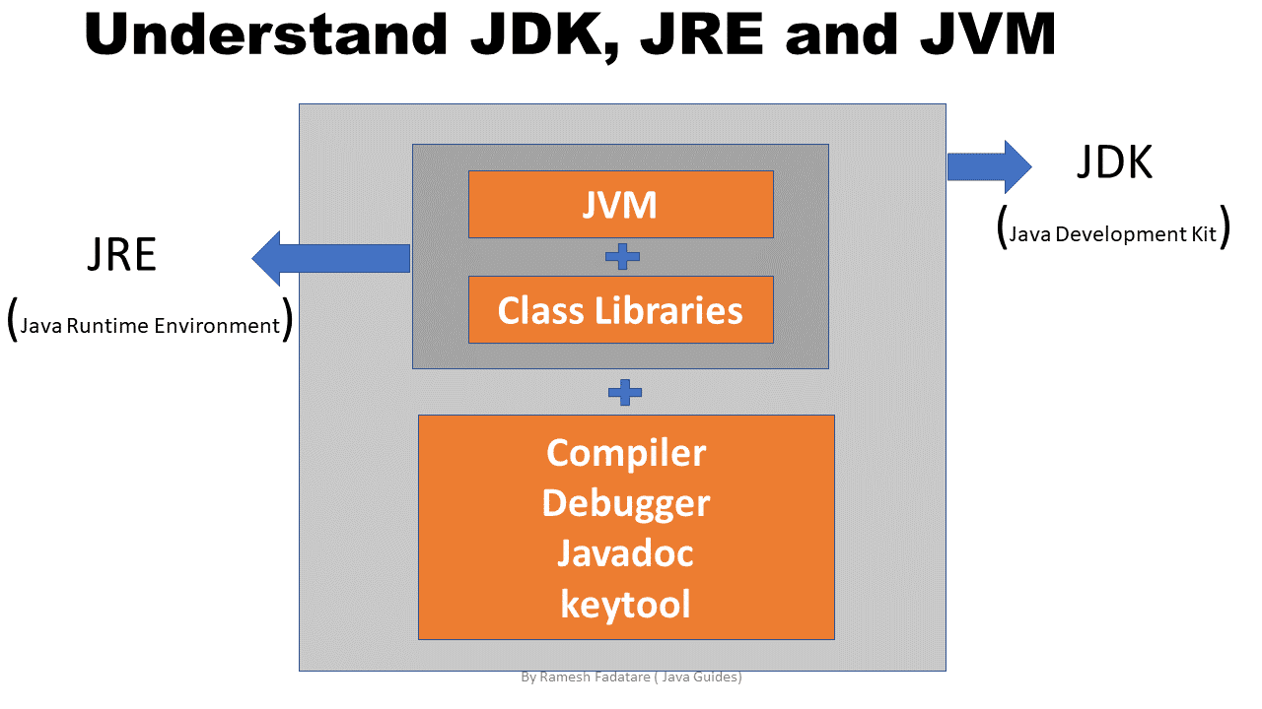
JDK=JRE+Development Tools

