Slide 1
Good Tech Scholars Program Gov-Seva Digitisation to ease access to social services
By
Josmi K Jose
Nimisha Varghese
Pranav Unni
Saintgits College of Engineering, Kottayam
May,2022

Slide 2
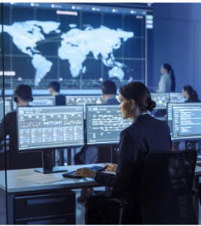


Table of Contents
Problem Statement and its relevance
Solution Approach
Demo
Q&A

Slide 3
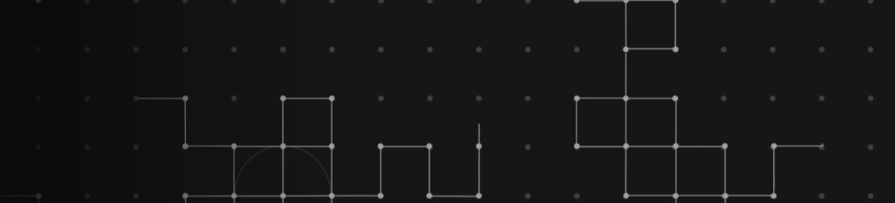

Problem statement and relevance
Context
Problem Summary
Outcomes
Impact
Submitting an application in govt office.
Visiting a govt office for document verification or application.
In many cases it will take more than a week for an application to be proccessed.
In most of the cases public need to wait and visit the govt office multiple times to avail any particular document or application
Sometimes the applicant won’t get it as and when it is required.
Unnecessary trouble for the public
Officials do not have responsibility in their work
Some officials may misuse their position for personal revenge.
Notes:
Revision 1 (20/09/21:09:30AM): <ANBU>
1. Hands-on experience lets them develop industry/pro skills. And opportunity is already mentioned in the sub-title – hence removed.
2. Additional Info to be used as talking points: The UN had the following Sustainable Development Goals to achieve by 2030 – we can mention a few if required: (1) No Poverty, (2) Zero Hunger, (3) Good Health and Well-being, (4) Quality Education, (5) Gender Equality, (6) Clean Water and Sanitation, (7) Affordable and Clean Energy, (8) Decent Work and Economic Growth, (9) Industry, Innovation and Infrastructure, (10) Reducing Inequality, (11) Sustainable Cities and Communities, (12) Responsible Consumption and Production, (13) Climate Action, (14) Life Below Water, (15) Life On Land, (16) Peace, Justice, and Strong Institutions, (17) Partnerships for the Goals.
</ANBU>

Slide 4
Future Scope
Trace the location and based on that the user will be instruted where to visit for which service
The user will be able to select their local language for communication in the chatbot as well as the apllication
A mobile version of the same
Telephonic application and data collection for the elderly
Express way application for the fast delivery of applications
Revaluation of the applications in case of accidental rejection
Updations and status review through SMS especially for the elderly
Proirity services based on the age and state.

Slide 5
Solution description
We have created a platform which would be helpful for the public to get their works fastly done in the government offices and track their applications : this would provide the users with a tracking of there file updates
In case if the govt.officials do not complete the task in time, it will automatically be forwarded to their higher officials and will be given a warning period of 3 days. Even then if the work is kept pending without any valid reasons, actions will be taken againt the person resulting in, :
*salary cuts
*termination
*Black mark in their service, etc

Slide 6
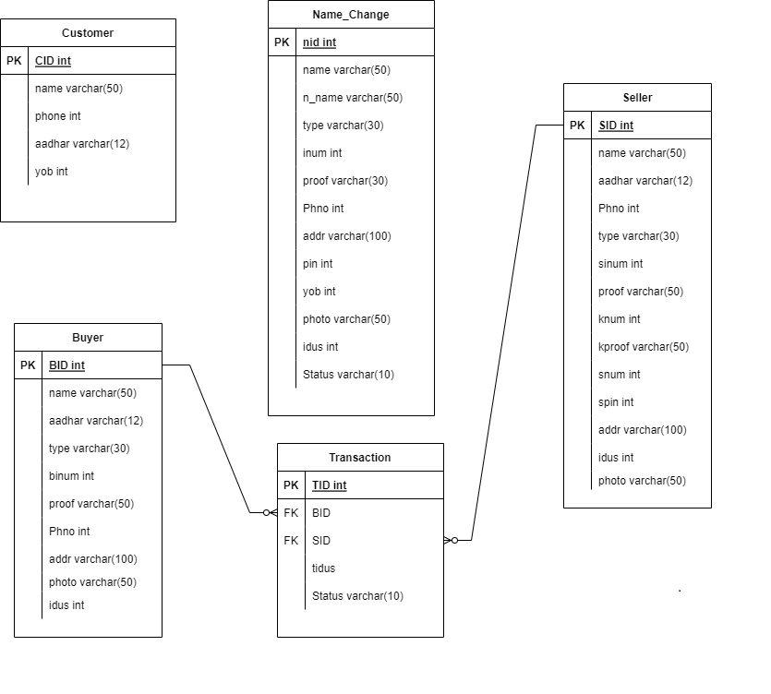
ER Diagram

Slide 7
Working
User entering details for verifying the approval of file he needs
This request passes to the corresponding official with a time bound
If task not done within the time or is rejected with no valid reasons the document will be passed to the higher official.
Senior officer verifies the request and provide the officer with a warning period of 3 days.
Each officer will be rated according to the timely delivery of applications
In case of physical verification the user would be provided with a schedule to appear in the office with the valid docuements which will also have a timebound.
User can also request for date change
Here the software itself randomly picks up from the incharge sets of officers to whom the file should be moved on and in this manner all the staffs will have a balanced file distribution

Slide 8
Impacts on government officials
If an officer does not do the job at the right time it would provide a black mark in his service records. Say that if the initial score is (100) and if it goes below a score a certain percent, say 30, his/her salary would be cut and would be given punishments.
The black mark score limit go higher with the increase in rank and the percentage of salary cuts and impact of punishments also increase.

Slide 9
General Impacts
The govt officials become more responsible providing more dedication to their work.
Public will get their applicaions done on time.
The system can have dedicated officials in higher ratings.
It helps in eradicating forced bribery.
The salary cut of the irresponsible officials will be traced back to the tressury.
There won’t be any individual denied from justice.

Slide 10
Demo
https://github.com/NIMISHAVARGHESE/2022_IBM_Coding_Challenge_Gov_Seva

Slide 11
Q&A

