Slide 1






SPOTIFY
Exploring Insights using SQL
By Nimish Shukla

Slide 2

Project Overview
Exploring insights using SQL and extracting useful insights.
Analyzing key performing metrics using dataset.
The analyzing are determined into three categories of understanding as Beginner , Intermediate and Advance level.
Throughout this project we would gain insight and determine current trends , popularity and various other metrics.
By gaining these insights we would determine the key performing or most popular tracks , album, stream , likes , danceability , etc .

Slide 3
Project Objective
Beginner
Retrieve all columns for tracks by the artist "Gorillaz."
List the distinct album types available in the dataset.
Find the total number of tracks in the dataset.
Retrieve the top 5 tracks with the highest number of views.
Find the number of tracks with a "TRUE" value for official_video.
Intermediate
Calculate the average danceability score of all tracks.
Retrieve the album and track name of the longest track (by Duration_min).
Find the artist with the most tracks in the dataset.
Get the top 3 most liked songs along with their artists.
List the top 5 albums with the highest total number of streams.

Slide 4
Project Objective
Advanced
Use a with clause to calculate difference between the highest and the lowest energy value for each tracks in each albums.
Retrieve the top 5 artists whose tracks have the highest average Valence (happiness).
Rank all tracks based on their Views, using the RANK() function.
Identify the platform (most_playedon) with the highest total number of streams.
Create a query to categorize songs into "Low," "Medium," and "High" popularity based on the number of streams (e.g., Low: <10M, Medium: 10M-100M, High: >100M).
Would you like me to provide SQL queries for these questions? get sloution

Slide 5
Tools And Techniques
Microsoft Excel:
. Data cleaning and formatting.
. Removing duplicate values and null values.
. Arranging cleaned and ordered data.
MySQL:
. Transforming data from excel into MySQL and make required changes .
. Gaining insights and data exploration .
. Using various aggregations , filters , basic queries and complex queries .

Slide 6

Data Exploration and Insight
Beginner
Retrieve all columns for track by the artist ‘Gorillaz’.
2. List the distinct album types available in dataset.
3. Find the total number of tracks in dataset.

Slide 7
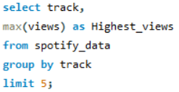
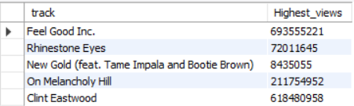


Retrieve the top 5 tracks with highest number of views.
5. Find the number of tracks with a “TRUE” value for official_video.

Slide 8
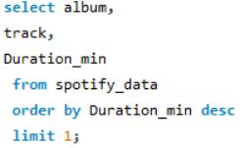
Intermediate
Calculate the average danceability score of all tracks.
Retrieve the album and the track name for the longest track (by Duration_min).

Slide 9
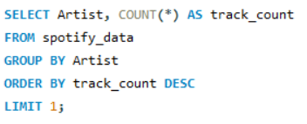
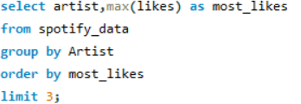

Find the artist with the most tracks in the dataset.
Get the top 3 most liked along with their artists.

Slide 10
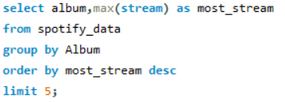

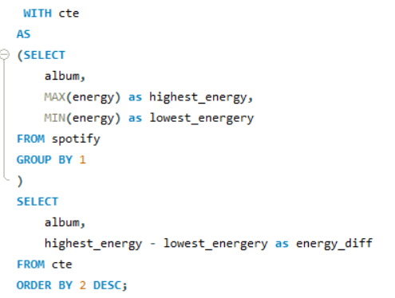
Advance
List the top 5 albums with the highest total number of streams.
Use with clause to calculate the difference between the highest and the lowest energy value for each tracks in each albums.

Slide 11
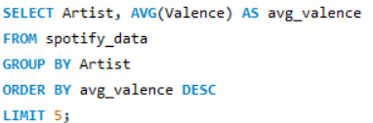
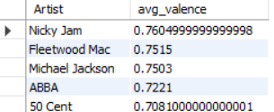

Retrieve the top 5 artists whose tracks have the highest average valence (happiness).
Rank all the tracks based on their Views, using the Rank()function.

Slide 12
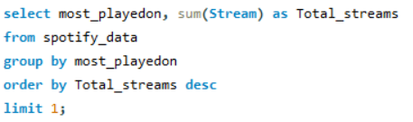

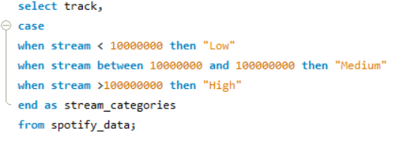
14. Identify the platform (most_playedon) with highest total number of streams.
15. Create a query to categorize songs into “Low”, ”Medium” and “High” popularity based on the number of streams. (e.g., Low : <10M , Medium: 10M-100M , High: >100M )

Slide 13
Conclusion
. There are 231 distinct album with total 54 tracks.
. The Feel Good Inc. the track with highest number of views.
. The Average Danceability for all tracks is 0.645 approx.
. Longest track by duration minute is master of puppets(Remastered) with 8.58 minute.
. The artist with most tracks is Gorillaz with 10 tracks and artist with most likes is Beyonca.
. The most streamed songs are lovely , memories , The Eminem Show , etc.
. The track with most views is X and the artist is Nicky Jam.
. The most loved and played platform is Spotify,

Slide 14
Thank You

