Slide 1






SPOTIFY
Exploring Insights using SQL
By Nimish Shukla

Slide 2

Project Overview
Exploring insights using SQL and extracting useful insights.
Analyzing key performing metrics using dataset.
The analyzing are determined into three categories of understanding as Beginner , Intermediate and Advance level.
Throughout this project we would gain insight and determine current trends , popularity and various other metrics.
By gaining these insights we would determine the key performing or most popular tracks , album, stream , likes , danceability , etc .

Slide 3
Project Objective
Beginner
Retrieve all columns for tracks by the artist "Gorillaz."
List the distinct album types available in the dataset.
Find the total number of tracks in the dataset.
Retrieve the top 5 tracks with the highest number of views.
Find the number of tracks with a "TRUE" value for official_video.
Intermediate
Calculate the average danceability score of all tracks.
Retrieve the album and track name of the longest track (by Duration_min).
Find the artist with the most tracks in the dataset.
Get the top 3 most liked songs along with their artists.
List the top 5 albums with the highest total number of streams.

Slide 4
Project Objective
Advanced
Use a with clause to calculate difference between the highest and the lowest energy value for each tracks in each albums.
Retrieve the top 5 artists whose tracks have the highest average Valence (happiness).
Rank all tracks based on their Views, using the RANK() function.
Identify the platform (most_playedon) with the highest total number of streams.
Create a query to categorize songs into "Low," "Medium," and "High" popularity based on the number of streams (e.g., Low: <10M, Medium: 10M-100M, High: >100M).
Would you like me to provide SQL queries for these questions? get sloution

Slide 5
Tools And Techniques
Microsoft Excel:
Data cleaning
Handling missing/duplicate values
Formatting and structuring data
MySQL:
Importing dataset from Excel
Writing SQL queries (basic to advanced)
Data analysis and insights extraction

Slide 6

Data Exploration and Insight
Beginner
Retrieve all columns for track by the artist ‘Gorillaz’.
2. List the distinct album types available in dataset.
3. Find the total number of tracks in dataset.

Slide 7
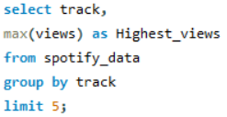
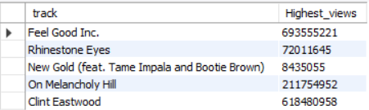


Retrieve the top 5 tracks with highest number of views.
5. Find the number of tracks with a “TRUE” value for official_video.

Slide 8
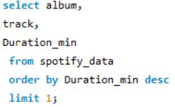
Intermediate
Calculate the average danceability score of all tracks.
Retrieve the album and the track name for the longest track (by Duration_min).

Slide 9
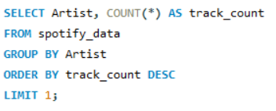
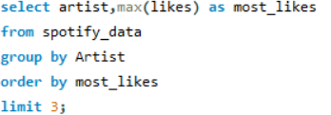

Find the artist with the most tracks in the dataset.
Get the top 3 most liked along with their artists.

Slide 10
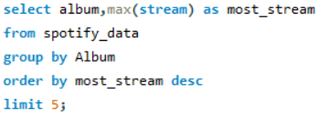

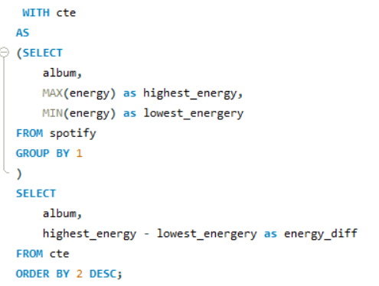
Advance
List the top 5 albums with the highest total number of streams.
Use with clause to calculate the difference between the highest and the lowest energy value for each tracks in each albums.

Slide 11
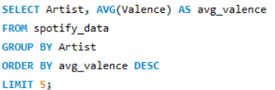
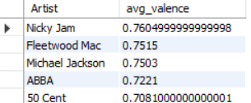

Retrieve the top 5 artists whose tracks have the highest average valence (happiness).
Rank all the tracks based on their Views, using the Rank()function.

Slide 12
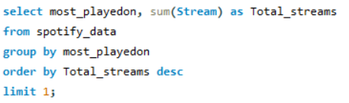

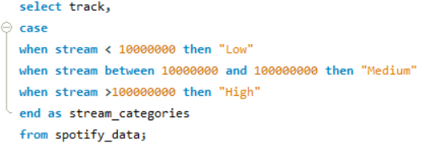
14. Identify the platform (most_playedon) with highest total number of streams.
15. Create a query to categorize songs into “Low”, ”Medium” and “High” popularity based on the number of streams. (e.g., Low : <10M , Medium: 10M-100M , High: >100M )

Slide 13
Conclusion
Total of 231 albums and 54 tracks analyzed
"Feel Good Inc." holds the highest number of views
Average danceability: ~0.645
Longest track: "Master of Puppets (Remastered)" - 8.58 minutes
Artist with most tracks: Gorillaz (10 tracks)
Most liked artist: Beyoncé
Most streamed songs include: Lovely, Memories, The Eminem Show, etc.
Most viewed track: "X" by Nicky Jam
Most popular platform: Spotify

Slide 14
Thank You

