Slide 1
Google Play Store App’s Analysis
NIMISHA ANTONY

Slide 2

DATA SET
Collected the set of data’s of apps in Google play store
13 unique variables
10841 unique apps

Slide 3
DATA DICTIONARY
COLUMN NAME | DESCRIPTION
1. App | Name of the app
2. Category | Category in which the app belongs to
3. Rating | Rating of the applications
4. Reviews | Number of reviews by the user
5. Size | Size of the app
6. Installs | Number of downloads for the app
7. Type | Type of the app(free or paid)
8. Price | Price of the app
9. Content Rating | Number of different Categories
10. Genres | Gives the Genre of the app
11.Last Updated | Last update date of the app
12.Current Version | Gives current version
13.Android Version | Give the no of Android version

Slide 4
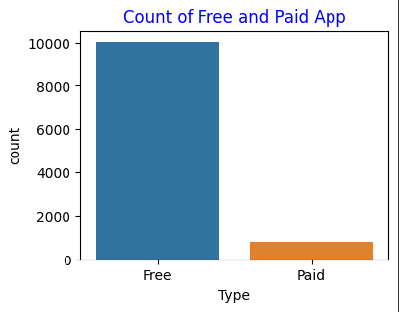
Data Set Analysis
# There are two type of apps in our data set
#Paid and free
#More than 92% of apps in our Google play store are free

Slide 5
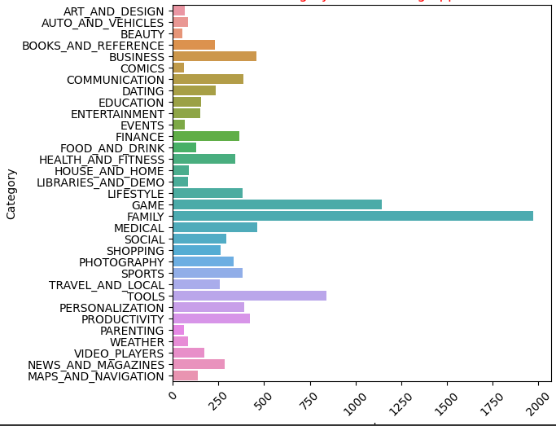
Category Of Most Using App
number
# THE FAMILY CATEGORY IS THE TOP OF MOST USING APPS.

Slide 6
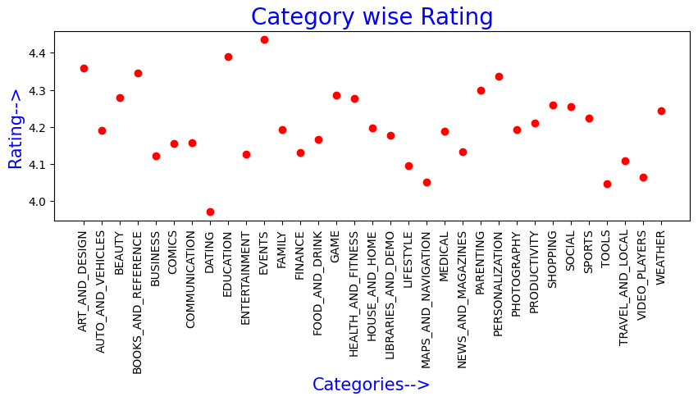
# The average rating of app's category are 4.1.compare to all other categories the rating of dating category is least. The rating of events category is highest.
Notes:
Dd

Slide 7
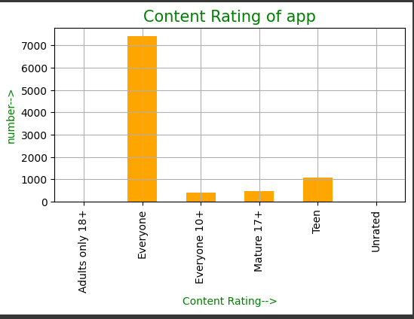
***More than 80 Percentage of Apps having content rating as everyone

Slide 8
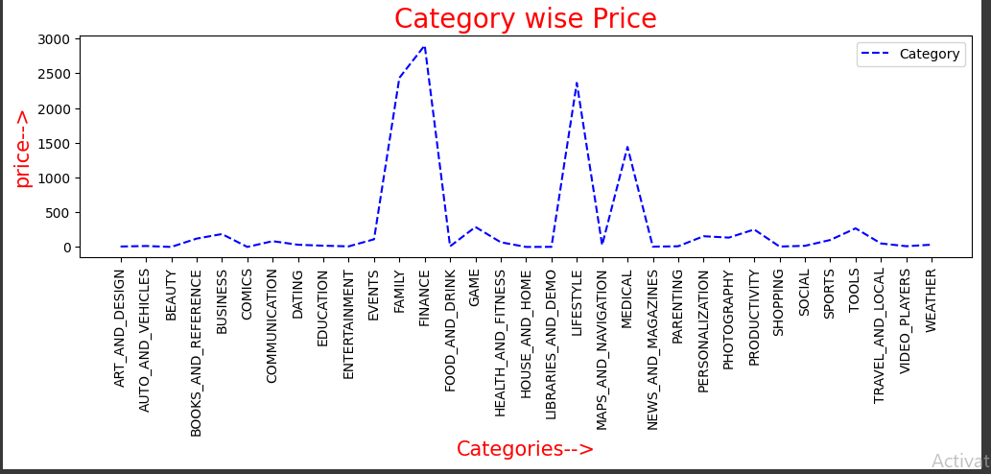
# THE FAMILY,FINANCE,LIFESTYLE CATEGORIES HAVE THE APPS WITH THE HIGHEST COST

Slide 9
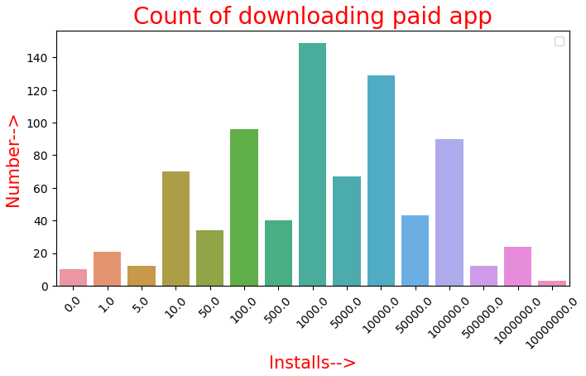
# Out of 800 paid app's more than 140 app's those downloading count is 1000

Slide 10
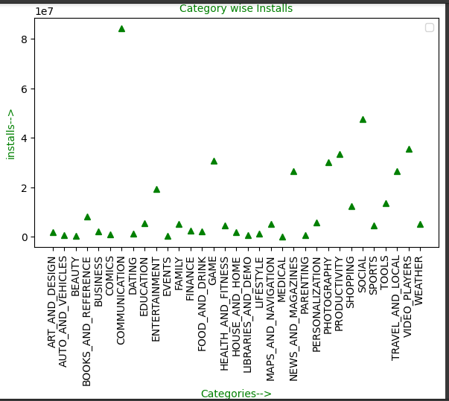
#THE COMMINICATION CATEGORY IS MOST INSTALLED APP IN OUR DATA SET.

Slide 11
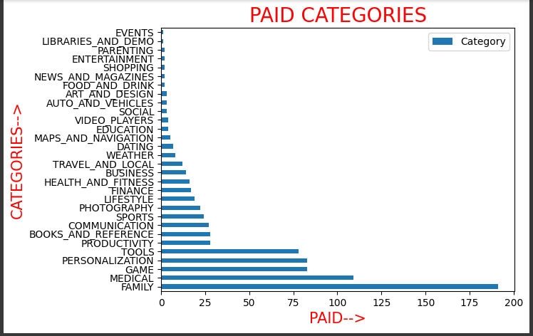
# Family category is the most paid type. The tope five paid categories are family , medical ,game , tools and personalization. Where events are least one.

Slide 12
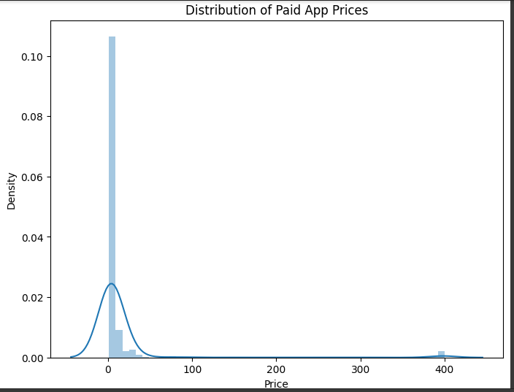
more than 85% apps in the play store have a price tag of 10$ or less.some apps have price greater than 350$

Slide 13
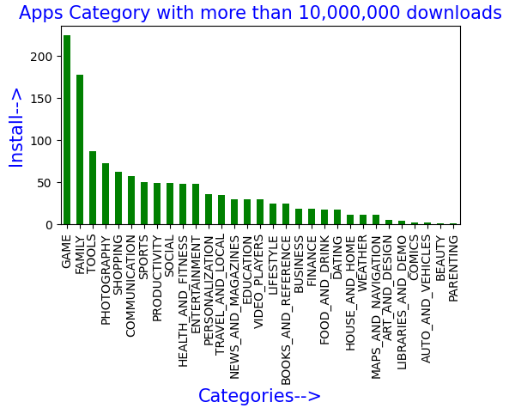
THE GAME CATEGORY CONTAINS MORE APPPS WITH DOWNLOADS MORE THAN 10,000,000. where parenting category is least one

Slide 14
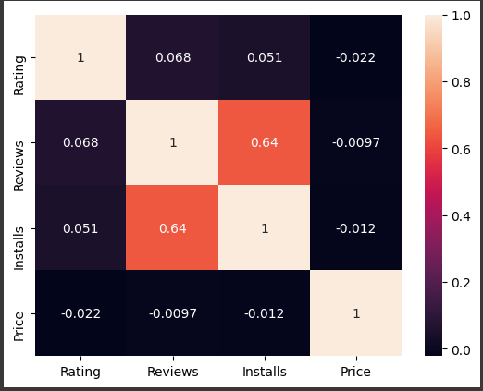
There are 4 numerical columns in our dataset. The Reviews and Installs are highly correlated. The relation between Price and all other numerical data are negative That is, There is less correlation occurred

Slide 15
conclusions
# From the above analysis I got the following informations
Out of 10841 unique apps in our data set more than 92% are freely available in our play store.
Buyers are more willing to pay since there are less resources available
Both family and game category plays a vital role in our life. These two are the most number in category. Both rating above 4.1 and installation above 10,000,000.

Slide 16
The most downloaded paid app’s category is game. By the analysis we can concluded that it will increases in future.
There are only 53 beauty apps in our sample over 10841 applications , but the thing is its rating is above the average rating. Yet it is the category with the fewest app
The analysis helps to predict which kind of apps rating high in future.
The analysis helps to identify the people interest in each category.

Slide 17


