Slide 1

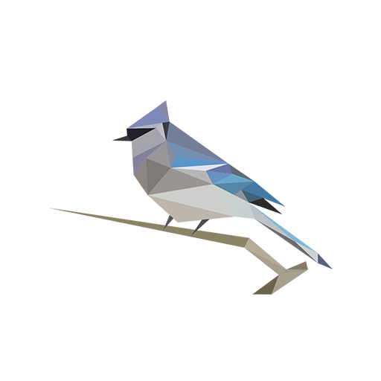

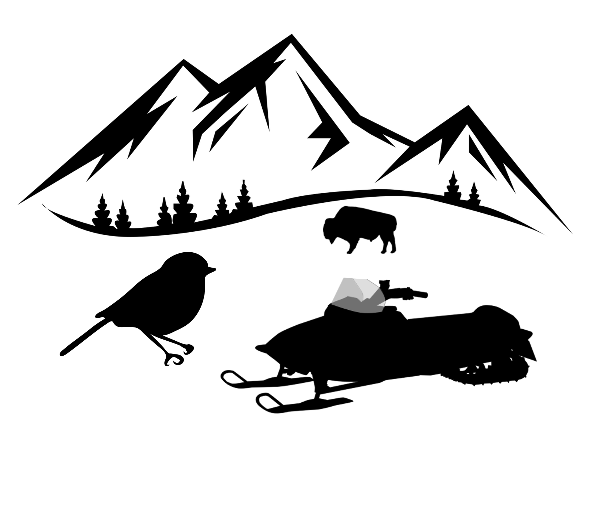



1)
Compile three snowmobile sounds dataset
Train & Validate snowmobile model
Create a test dataset from a subset of Yellowstone dataset
Test 4 different filtering on the test dataset:
  MC>0.95+
  MC>0.95+; HNR>0.1+
  MC>0.95+; HNR>0.1+;DL6+
  MC>0.99+; HNR>0.1+;DL6+
Run BirdNET and snowmobile model
Filter snowmobile detections using filtering 4)
Extract meteorological variables and aggregate number of calls in 15s buckets
Analyse the dataset using statistical methods
2)
4)
5)
3)
6)
7)
8)
MC: Model confidence
HNR: Harmonic noise ratio
DL: Segment duration length

