Slide 1

四川大学课题报告
汇报人：XXX
日期：XX年XX月

Slide 2
CONTENT
Part One
Part Two
Part Three
Part Four
Use, by you or one client, in a single end product which end users are not charged for.
Use, by you or one client, in a single end product which end users are not charged for.
Use, by you or one client, in a single end product which end users are not charged for.
Use, by you or one client, in a single end product which end users are not charged for.

Slide 3
CONTENT
Part One
Part Two
Part Three
Part Four
Use, by you or one client, in a single end product which end users are not charged for.
Use, by you or one client, in a single end product which end users are not charged for.
Use, by you or one client, in a single end product which end users are not charged for.
Use, by you or one client, in a single end product which end users are not charged for.

Slide 4
1
ADD THE TITLE HERE
Use, by you or one client, in a single end product which
01
Main Keyword
No matter how bad your heart has been broken, the world doesn’t stop for your grief. The sun comes right back up the next day. No matter how bad your heart has
02
Main Keyword
No matter how bad your heart has been broken, the world doesn’t stop for your grief. The sun comes right back up the next day. No matter how bad your heart has
03
Main Keyword
No matter how bad your heart has been broken, the world doesn’t stop for your grief. The sun comes right back up the next day. No matter how bad your heart has

Slide 5
1
ADD THE TITLE HERE
Use, by you or one client, in a single end product which
Main Keyword
Main Keyword
Main Keyword
No matter how bad your heart has been broken, the world doesn’t stop for your grief. The sun comes right back up the next day. No matter how bad your heart has
No matter how bad your heart has been broken, the world doesn’t stop for your grief. The sun comes right back up the next day. No matter how bad your heart has
No matter how bad your heart has been broken, the world doesn’t stop for your grief. The sun comes right back up the next day. No matter how bad your heart has

Slide 6
1
ADD THE TITLE HERE
Use, by you or one client, in a single end product which
1
2
Main keyword
Main keyword
No matter how bad your heart has been broken, the world doesn’t stop for your grief. The sun comes right back up the next day. No matter how bad your heart has
No matter how bad your heart has been broken, the world doesn’t stop for your grief. The sun comes right back up the next day. No matter how bad your heart has
4
3
Main keyword
Main keyword
No matter how bad your heart has been broken, the world doesn’t stop for your grief. The sun comes right back up the next day. No matter how bad your heart has
No matter how bad your heart has been broken, the world doesn’t stop for your grief. The sun comes right back up the next day. No matter how bad your heart has

Slide 7
CONTENT
Part One
Part Two
Part Three
Part Four
Use, by you or one client, in a single end product which end users are not charged for.
Use, by you or one client, in a single end product which end users are not charged for.
Use, by you or one client, in a single end product which end users are not charged for.
Use, by you or one client, in a single end product which end users are not charged for.

Slide 8
2
ADD THE TITLE HERE
Use, by you or one client, in a single end product which
Main keyword
Main keyword
Main keyword
Main keyword
No matter how bad your heart has been broken, the world doesn’t stop for your grief. The sun comes right back up the next day. No matter how bad your heart has been broken, the world doesn’t stop for your grief. The sun comes right back up the next day.

Slide 9

2
ADD THE TITLE HERE
Use, by you or one client, in a single end product which
Text here to add title
No matter how bad your heart has been broken, the world doesn’t stop for your grief. The sun comes right back up the next day. No matter how bad your heart has
Text here to add title
No matter how bad your heart has been broken, the world doesn’t stop for your grief. The sun comes right back up the next day. No matter how bad your heart has
Text here to add title
No matter how bad your heart has been broken, the world doesn’t stop for your grief. The sun comes right back up the next day. No matter how bad your heart has
Text here to add title
No matter how bad your heart has been broken, the world doesn’t stop for your grief. The sun comes right back up the next day. No matter how bad your heart has

Slide 10
2
ADD THE TITLE HERE
Use, by you or one client, in a single end product which
10%
25%
45%
title
title
title
No matter how bad your heart has been broken, the world doesn’t stop for your grief. The sun comes right back up the next day. No matter how bad your heart has been broken, the world doesn’t stop for your grief. The sun comes right back up the next day. No matter how bad your heart has been broken, the world doesn’t stop for your grief. The sun comes right back up the next day. No matter how bad your heart has been broken, the world doesn’t stop for your grief. The sun comes right back up the next day.

Slide 11
2
ADD THE TITLE HERE
Use, by you or one client, in a single end product which
Main keyword
Main keyword
No matter how bad your heart has been broken, the world doesn’t stop for your grief. The sun comes right back up the next day. No matter how bad your heart has.
No matter how bad your heart has been broken, the world doesn’t stop for your grief. The sun comes right back up the next day. No matter how bad your heart has.
Main keyword
Main keyword
No matter how bad your heart has been broken, the world doesn’t stop for your grief. The sun comes right back up the next day. No matter how bad your heart has.
No matter how bad your heart has been broken, the world doesn’t stop for your grief. The sun comes right back up the next day. No matter how bad your heart has.

Slide 12
2
ADD THE TITLE HERE
Use, by you or one client, in a single end product which
Main keyword
No matter how bad your heart has been broken, the world doesn’t stop for your grief. The sun comes right back up the next day. No matter how bad your heart hasNo matter how bad your heart has been broken, the world doesn’t stop for your grief. The sun comes right back up the next day.
No matter how bad your heart hasNo matter how bad your heart has been broken, the world doesn’t stop for your grief. The sun comes right back up the next day. No matter how bad your heart hasNo matter how bad your heart has been broken, the world doesn’t stop for your grief. The sun comes right back up the next day. No matter how bad your heart has
Main keyword
Main keyword

Slide 13
CONTENT
Part One
Part Two
Part Three
Part Four
Use, by you or one client, in a single end product which end users are not charged for.
Use, by you or one client, in a single end product which end users are not charged for.
Use, by you or one client, in a single end product which end users are not charged for.
Use, by you or one client, in a single end product which end users are not charged for.

Slide 14

3
ADD THE TITLE HERE
Use, by you or one client, in a single end product which
No matter how bad your heart has been broken, the world doesn’t stop for your grief. The sun comes right back up
No matter how bad your heart has been broken, the world doesn’t stop for your grief. The sun comes right back up
No matter how bad your heart has been broken, the world doesn’t stop for your grief. The sun comes right back up
No matter how bad your heart has been broken, the world doesn’t stop for your grief. has been broken, the world grief. The sun comes right

Slide 15
3
ADD THE TITLE HERE
Use, by you or one client, in a single end product which
80%
60%
70%
Main keyword
Main keyword
Main keyword
No matter how bad your heart has been broken, the world doesn’t stop for your grief. The sun comes right back up the next
No matter how bad your heart has been broken, the world doesn’t stop for your grief. The sun comes right back up the next
No matter how bad your heart has been broken, the world doesn’t stop for your grief. The sun comes right back up the next

Slide 16


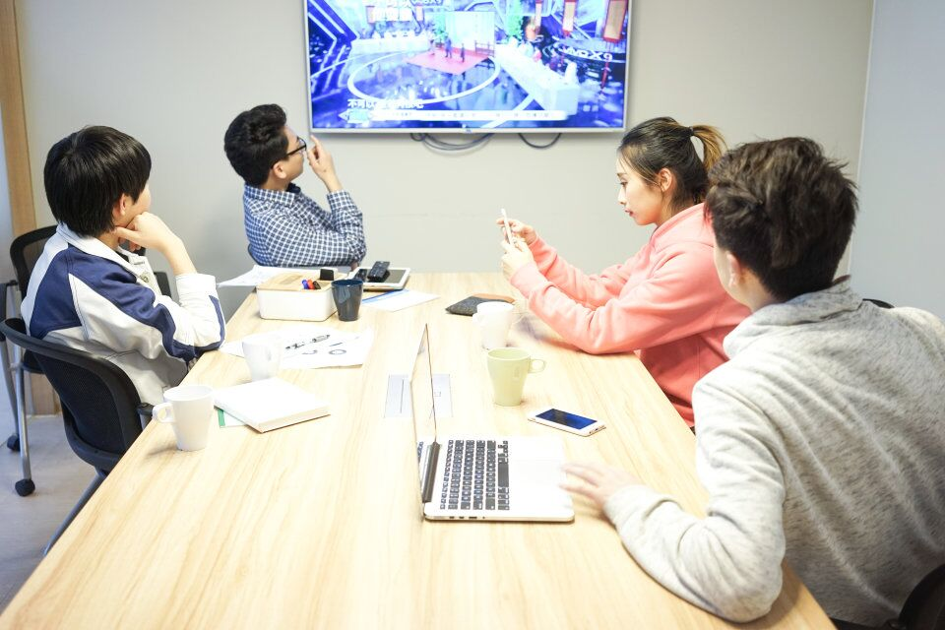
3
ADD THE TITLE HERE
Use, by you or one client, in a single end product which
Main keyword
Main keyword
Main keyword
No matter how bad your heart has been broken, the world doesn’t stop for your grief. The sun comes right back up the next day. No matter how bad your heart has
No matter how bad your heart has been broken, the world doesn’t stop for your grief. The sun comes right back up the next day. No matter how bad your heart has
No matter how bad your heart has been broken, the world doesn’t stop for your grief. The sun comes right back up the next day. No matter how bad your heart has

Slide 17
CONTENT
Part One
Part Two
Part Three
Part Four
Use, by you or one client, in a single end product which end users are not charged for.
Use, by you or one client, in a single end product which end users are not charged for.
Use, by you or one client, in a single end product which end users are not charged for.
Use, by you or one client, in a single end product which end users are not charged for.

Slide 18

ADD THE TITLE HERE
Use, by you or one client, in a single end product which
1
No matter how bad your heart has been broken, the world doesn’t stop for your grief. The sun comes right
2
No matter how bad your heart has been broken, the world doesn’t stop for your grief. The sun comes right
3
No matter how bad your heart has been broken, the world doesn’t stop for your grief. The sun comes right

Slide 19
4
ADD THE TITLE HERE
Use, by you or one client, in a single end product which
No matter how bad your heart has been broken, the world doesn’t stop for your grief. The sun comes right back up the next day. No matter how bad your heart hasNo matter how bad your heart has been broken, the world doesn’t stop for your grief.
keyword
No matter how bad your heart has been broken, the world doesn’t stop for your grief. The sun comes right back up the next day. No matter how bad your heart hasNo matter how bad your heart has been broken, the world doesn’t stop for your grief.
keyword
No matter how bad your heart has been broken, the world doesn’t stop for your grief. The sun comes right back up the next day. No matter how bad your heart hasNo matter how bad your heart has been broken, the world doesn’t stop for your grief.
keyword

Slide 20
1
ADD THE TITLE HERE
Use, by you or one client, in a single end product which
Text here to add title
Main keyword
No matter how bad your heart has been broken, the world doesn’t stop for your grief. The sun comes right back up the next day. No matter how bad your heart hasNo matter how bad your heart has been broken, the world doesn’t stop for your grief. The sun comes right back up the next day.
No matter how bad your heart hasNo matter how bad your heart has been broken, the world doesn’t stop for your grief. The sun comes right back up the next day. No matter how bad your heart hasNo matter how bad your heart has been broken, the world doesn’t stop for your grief. The sun comes right back up the next day. No matter how bad your heart has
Main keyword
Main keyword

Slide 21
Thank you for watching

